Slide 1

The React Framework For Production
Eng/Ryhab Farouq

Slide 2
Agenda
Server side rendering ‘SSR’
Client side rendering ‘CSR’
Stale while revalidate ‘SWR’
API routes feature & how to create basic API
Handle GET requests
Handle POST requests
Dynamic API routes
Handle DELETE requests
Catch all API routes

Slide 3
Server Side Rendering ‘SSR’
Next.js allows you to pre-render a page not at build time but at request time , the html is generated for every incoming request
SSR is required when you need to fetch data per request and also when you need to fetch personalized data keeping in mind SEO
We use getServerSideProps function to fetch data

Slide 4
Client Side Data Fetching
Sometimes you might not always need to pre-render the data
Like : user dashboard page .
As it’s private , that’s behind a login page screen , highly user specific and SEO is not relevant , so no need to pre-render the data you can rely on client side data fetching .

Slide 5
SWR for client side data fetching
The name ‘SWR’ is derived from ‘Stale-While-Revalidate’
Is a strategy to first return the data from cache (stale), then send the fetch request (revalidate) and finally come with the up-to-date data
Npm I swr

Slide 6
Revision
CSR: Rendering happens on the browser, so users may see a loading spinner while the application is being rendered. The performance (initial load) depends on the size of the application and how much JS is shipped to the browser
SSR: Rendering happens on the server before the result is sent to the browser. There may be latency (depending on the server's location) because the request has to go to the server and back
SSG: Rendering happens at a built time on the server, the result is cached in CDNs closer to users. This helps improve performance because rendering happens once and the result is stored closer to users (solving latency issues)
ISR: Rendering happens at time intervals and is cached, so it's still performant but using ISR ensures data doesn't become stale

Slide 7
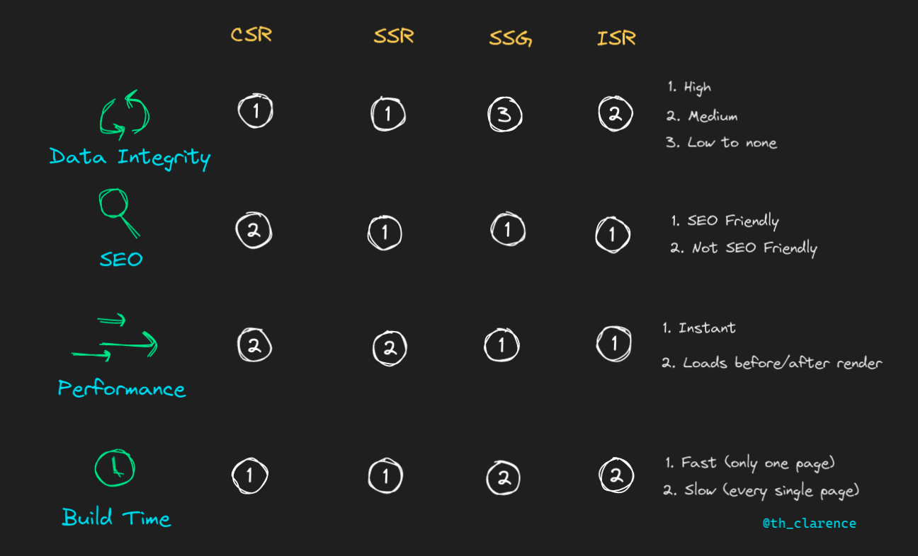

Slide 8
Agenda
Authentication and Authorization
Client Side Authentication
Securing Pages Client Side
Server Side Authentication
Securing Pages Server Side
Securing API Routes

Slide 9
Intro
API routes allow you to create restful endpoints as part of your next.js application folder structure
Within the page folder , you need to create a folder called ‘api’
Within ‘api’ folder you can define all the APIs for your application
You can add business logic without needing to write any additional custom server code and without having to configure any API routes
Next.js gives everything you need to write full-stack react + node application

Slide 10
API routing mechanism is similar to page based routing mechanism , APIs are associated with a route based on their file name
Every API routes exports a default function typically named as handler function
We shouldn’t call our own API routes for pre-rendering content “cause delay”

