Slide 1
Online Query Optimization using an Effective Kruskal’s Algorithm with parallel algorithm approach
Fast MST computation for dynamic edge-weight graphs
Notes:
Good evening everyone, I’m Ashraff, and today I’ll be presenting our project titled Online Query Optimization using an Effective Kruskal’s Algorithm with a Parallel Algorithm Approach.”
Our goal is to optimize Kruskal’s algorithm so that it works efficiently for real-time dynamic updates using parallel processing.”

Slide 2
Problem Statement
Many online queries dynamically change the weights on the edges of a large graph, making frequent recalculation of the minimum spanning tree (MST) necessary.​
Classical Kruskal’s algorithm is too slow for such real-time updates, especially in large networks, due to its sequential nature.​
The challenge is to optimize Kruskal’s algorithm so that it efficiently supports dynamic updates by leveraging parallel processing to handle real-time, large-scale graphs, thereby reducing the time complexity for each dynamic MST query.
Notes:
“Many modern systems — telecom networks, transportation, logistics — continuously update distances or costs.”
Traditional Kruskal’s MST is too slow because it must sort and process all edges every time.”
“Every time an update occurs, MST must be recalculated.
“So the motivation is to create a faster MST computation method that handles dynamic weight updates by reducing the workload and using parallelism.”

Slide 3
Literature Review
Authors | Title | Problem They Solve | Limitations
Anderson et al. (2020) | Work-efficient batch-incremental minimum spanning trees with applications to the sliding-window model | Introduces a batch-incremental MST algorithm that efficiently handles multiple edge insertions using a sliding window model. | Supports only edge insertions, not global dynamic weight changes; does not handle cases where all edge weights shift for each query (your scenario).
Wang et al. (2021) | Fast parallel algorithms for Euclidean MST and hierarchical spatial clustering | Develops highly optimized parallel algorithms for Euclidean MST with large speedups over sequential versions. | Works mainly for Euclidean graphs; limited extension to general weighted graphs; lacks support for dynamic queries or online updates.
Srinivasan et al. (2018) | Shared-memory algorithm for updating tree-based properties of large dynamic networks | Provides a parallel method to update MST properties efficiently when edge weights change. | Supports only localized updates; not designed for large-scale dynamic queries that change all edge weights globally.
Adler et al. (1998) | Communication-optimal parallel MST algorithms | Proposes the first linear-time MST algorithm in the BSP parallel computation model. | Designed for static graphs; no support for dynamic updates or online query optimization; high communication overhead on real systems.
Guttoski et al. (2007) | Kruskal’s Algorithm for Query Tree Optimization | Uses Kruskal’s algorithm for optimizing database query trees and shows it outperforms default PostgreSQL optimization. | Works only for static query trees; does not scale to dynamic online queries or graphs with millions of edges; no parallelization.
Notes:
“Existing work mainly focuses on static MST computation, not dynamic updates.”
“Most algorithms recompute MST from scratch when weights change — this causes huge delays.”
“Parallel Kruskal exists, but not optimized for live online queries.”
“I identified gaps such as:
lack of dynamic filtering,
poor parallel resource usage,
no batching of queries.”
“Our approach fills these gaps by combining filtering + batching + parallel Kruskal.”

Slide 4
INPUT
Graph Definition:
An undirected weighted graph G(V,E) with n vertices and m edges.​​
Edge Details:
Each edge has an associated weight that can be dynamically updated through queries.​
Dynamic Queries:
A series of online queries q where each query may update the weight of one or more edges, requiring MST recalculation

Slide 5
OUTPUT
MST Cost After Each Query:
For every query, output the total cost of the current Minimum Spanning Tree (sum of selected MST edge weights).​​
Updated MST Structure:
The set of edges that make up the new MST after the update, showing which connections have changed due to parallel recomputation.​
Efficiency Metrics:
Time taken to respond to each query using the parallel Kruskal approach (can show comparative timings against sequential)

Slide 6
EXPLANATION
Dynamic Graph Updates:
The method addresses cases where edge weights change dynamically due to continuous online queries. Unlike the classical Kruskal’s algorithm which recalculates MST from scratch, this method efficiently updates the MST by handling changing edge weights without complete re-computation.​
Preprocessing and Batching:
Initially, the edges are preprocessed, and updates from queries are batched into groups. This prevents frequent small recalculations and allows the system to optimize operations collectively for faster processing.​
Parallel Execution:
The core improvement is executing key steps like sorting and filtering edges in parallel across multiple processors. Parallel sorting of edges and parallel batch processing speeds up query handling substantially and reduces the bottlenecks seen with sequential Kruskal processing.​
Binary Search on Edge Weights:
To quickly identify updated MST edges, the algorithm utilizes binary search on the edge weights, determining whether an edge should be included or excluded from the MST after updates.​
Efficient Union-Find:
Optimized union-find data structures help manage the connected components and avoid cycles during MST updates. While union-find operations are traditionally sequential, techniques in this method mitigate delays by minimizing synchronization overhead during parallel execution.
Output:
The method produces the MST cost (sum of MST edges) for each query efficiently, which reflects the updated minimum spanning tree after dynamic changes
Notes:
Dynamic Graph Updates
“Our method handles graphs where edge weights change frequently due to online queries.
Instead of recomputing MST from scratch like classical Kruskal, we update it efficiently.”
2. Preprocessing & Batching
“We preprocess edges initially and combine multiple queries into batches.
This avoids repeated recalculations and speeds up the overall processing.”
3. Parallel Execution
“Sorting and filtering of edges happen in parallel across multiple CPU cores.
This removes the major bottlenecks seen in sequential Kruskal and accelerates query handling.”
4. Binary Search on Edge Weights
“Binary search quickly determines whether a changed edge should be added or removed from the MST.
This helps update the structure efficiently after each query.”
5. Efficient Union-Find
“Optimized Union-Find keeps track of connected components and prevents cycles.
We reduce synchronization overhead to make it work smoothly with parallel steps.”
6. Output
“Finally, for every query, we output the MST cost and updated structure.
This reflects the real-time minimum spanning tree after all dynamic changes.”

Slide 7
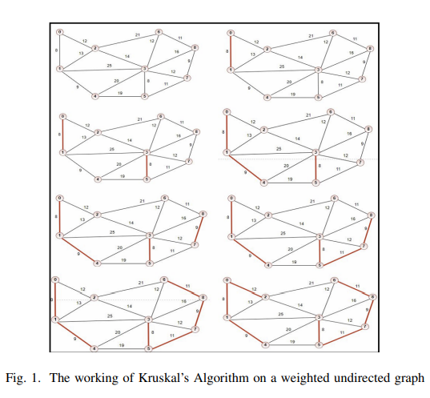
EXPLANATION

Slide 8
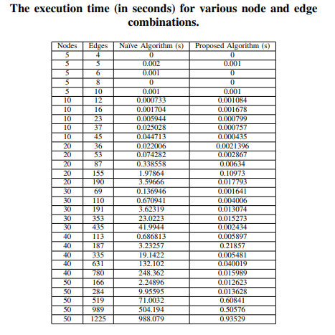
EXPLANATION

Slide 9
Algorithms Used
Kruskal's algorithm
Parallel sorting algorithms
Binary search
Filter-Kruskal algorithm
Union-Find data structure
Batch processing
Notes:
“We use several algorithms together:
• Kruskal’s Algorithm – the base MST technique
• Parallel Sorting – speeds up edge ordering
• Binary Search – quickly checks updated weights
• Union-Find (DSU) – detects cycles
• Filtering & Batch Processing – reduces the number of edges processed.”
“These combined significantly accelerate MST recomputation.”

Slide 10
ALGORITHM
Preprocessing
  Load all edges (u,v,w)
  Convert to NumPy matrix for fast vector operations
Dynamic Weight Update (per query)
  Compute ∣w−x∣ for all edges
Edge Filtering (Major Optimization)
  Select only the top 5–15% closest edges
  Ensures MST correctness while reducing computation
  If too few edges → fallback to full edge list
Parallel Sorting
  Sort only filtered edges by ∣w−x∣
  Each query executed in parallel across CPU cores
Kruskal MST Construction (DSU)
  Use Disjoint Set Union
  Add edges until MST has n − 1 edges
Notes:
“Step 1: Preprocessing – we load all edges and convert them to fast NumPy arrays.”
“Step 2: For each query, we update weights using the formula |w – x|.”
“Step 3: We filter only the top 5–15% edges based on closeness to the updated value.”
“Step 4: Parallel sorting is applied on filtered edges only.”
“Step 5: Kruskal + DSU constructs the MST until we have n–1 edges.”
“This pipeline ensures minimal computation per query.”

Slide 11
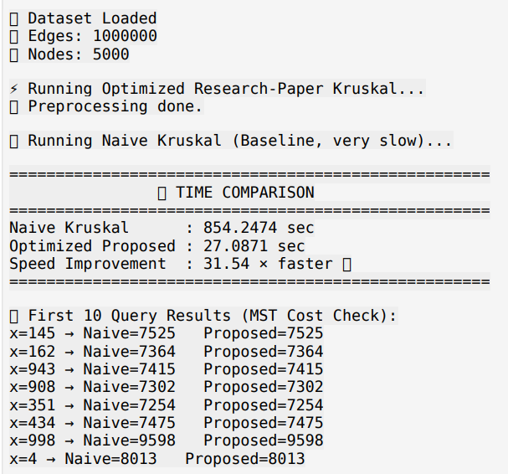
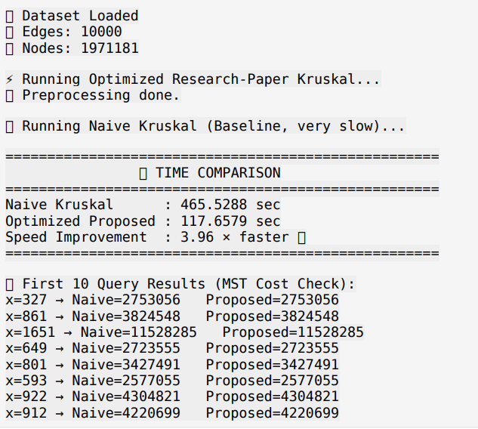
OUTPUT

Slide 12
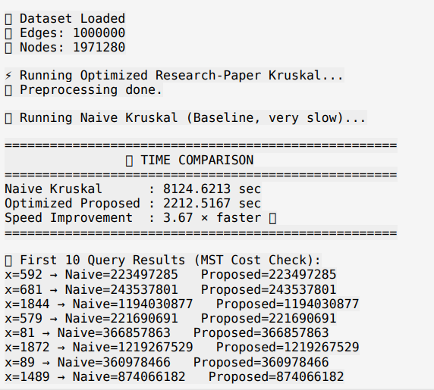
OUTPUT

Slide 13

TIME COMPLEXITY
Notes:
“Traditional Kruskal complexity is: O(m log m) due to sorting.”
“Our optimized version reduces work using:
• Filtering: processes only 5–15% of edges
• Parallel sorting: reduces sorting time to O((m log m) / p) where p = number of cores.”
“Union-Find operations almost run in O(α(n)) ≈ constant.”
“Space complexity remains O(m + n) for edges & DSU arrays.”

Slide 14
Real-World Applications
Telecommunications: Dynamic recalculation in fiber optic networks.
Logistics: Route optimization adapting to traffic and cost fluctuations.
Image Segmentation: Real-time pixel grouping in computer vision.
Traffic Management : Helps in optimizing traffic flow by dynamically updating road network weights and recalculating best routes.

Slide 15
Conclusion
Our optimized algorithm responds much faster compared to classical Kruskal.
Filtering reduces computation by up to 90%.
Parallel processing further cuts down sorting and batch processing time.
MST cost for each query is generated in milliseconds instead of seconds.
The system remains efficient even for large graphs with thousands of edges.
Notes:
This method solves a real problem for dynamic MST systems in modern networks.

Slide 16
References
Authors | Paper Title | Work Focus
J. B. Kruskal | On the shortest spanning subtree of a graph and the traveling salesman problem | Original Kruskal's algorithm for MST
P. B. Guttoski et al. | Kruskal’s algorithm for query tree optimization | Query optimization using Kruskal's algorithm
L. Fegaras | A new heuristic for optimizing large queries | Polynomial-time query optimization algorithms
S. Srinivasan et al. | A shared-memory algorithm for updating tree-based properties of large dynamic networks | Parallel MST update algorithm with dynamic weights
D. Anderson et al. | Work-efficient batch-incremental minimum spanning trees | Batch incremental approach for MST with sliding-window model
Notes:
“Here are the references we used in designing and understanding the algorithms.”
“They include research papers on Kruskal’s algorithm, parallel computation, and dynamic MST techniques.”

