Slide 1
Evaluating the impact of Weight Averaging Strategies in Federated Learning
By Ashraful Alam Nirob, Tahmidul Karim Takee, Shifath Jahan Prity, Shadik Ul Haque

Slide 2
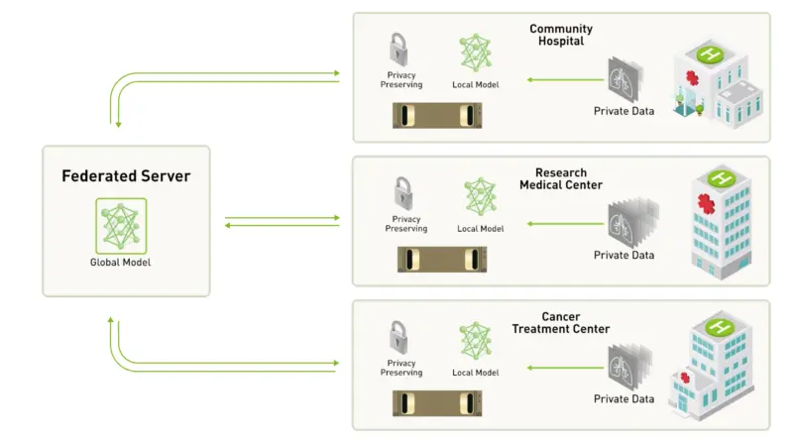
Federated Learning

Slide 3
What is Federated Learning and Why it’s important
Definition: Federated Learning is a machine learning approach that trains an algorithm across multiple decentralized devices or servers holding local data samples, without exchanging them.
Privacy Preservation: It’s a way to learn from data that you don’t actually have, which is a good thing from a privacy perspective.
Efficiency: Federated Learning allows for model training on the edge device itself (like a smartphone), reducing the need for data communication with the server.
Real-time Updates: It enables the model to learn and improve in real-time on the edge device, enhancing the user experience.
Collaborative Learning: It uses a collaborative approach to train models, where the model learns from multiple edge devices and updates itself.
Importance: Federated Learning is important because it addresses critical issues like data privacy, data security, data access, and data analysis efficiency.

Slide 4
Federated Averaging
FedProx
Weighted Averaging For Federated LEarning (WAFFLE)
Precision-weighted Federated Learning
FedNova
FedSGD

Slide 5
FedProx
Uses a proximal term in the loss function to constrain model updates towards the global model
Mitigates weight divergence between clients
Developed by Google researchers

Slide 6
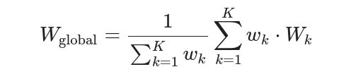
Weighted Averaging For Federated LEarning (WAFFLE)
Uses a weighted average to aggregate client updates instead of a simple average
Weights clients based on factors like reliability, hardware, data quality etc.

Slide 7
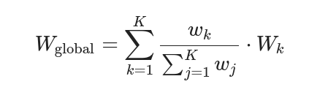
FedNova
Gives higher weight to client updates with lower gradient variance
Variance estimated using multiple local updates on client data
Handles heterogeneity in client precisions

Slide 8
FedSGD
Uses normalized weights to aggregate updates to improve robustness
Weight normalization handles arbitrary client contributions
Dynamically adjusts to non-IID data

Slide 9
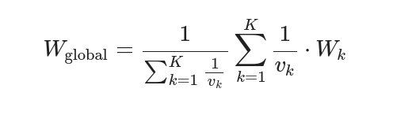
Precision-weighted Federated Learning
Applies SGD to the global model using client updates
Handles non-IID data via mini-batch style learning
Computationally lighter than FedAvg

Slide 10
Potential Challenges
Learning Resource Limitation
Environment Setup
Handling unbalanced and non-IID data
Lack of clear benchmarks
Communication efficiency

Slide 11
Plan of Action
Research on the federated averaging techniques
Create an n number of client environment
Creating synthetic and non synthetic dataset
Creating framework to benchmark

Slide 12
Related Research Topics
1.FedSDG-FS:Efficient and Secure Feature Selection fo rVertical Federated Learning
arxiv.org/pdf/2302.10417.pdf
2.WAFFLE: Watermarking in Federated Learning
https://ieeexplore.ieee.org/abstract/document/9603498
3.On the Convergence of FedAvg on Non-IID Data
https://arxiv.org/abs/1907.02189?fbclid=IwAR2T2bHu8xZp4k8Lr6UXTgKF6W-jh8%20gaEZ25jWY5Zquyw5d6hFY_xzE8wQs

Slide 13
Related Research Topics (Contd.)
4.Precision-Weighted Federated Learning
https://www.researchgate.net/publication/353354180_Precision-Weighted_Federated_Learning
5.Tackling the Objective Inconsistency Problem in Heterogeneous Federated Optimization
https://proceedings.neurips.cc/paper_files/paper/2020/file/564127c03caab942e503ee6f810f54fd-Paper.pdf

Slide 14
Conclusion
In conclusion it might be a challenging task but also a optimistic one. This research can elaborately discuss the potential of different averaging methodes.

