Slide 1
HGraph: Parallel and Distributed Tool for Large-Scale Graph Processing
Presentation by Ashraful Alam Nirob

Slide 2
Hypothesis/Problem Statement
Challenge in processing real-world graphs due to size and complexity.
Existing systems lack efficiency in handling large-scale graphs.
Graphs are crucial in diverse fields like social networks and biological networks.

Slide 3
Proposed Solution
Introduction of HGraph, a parallel and distributed tool.
Built on Hadoop and Spark frameworks.
Offers high scalability and adaptability for graph problem algorithms.

Slide 4
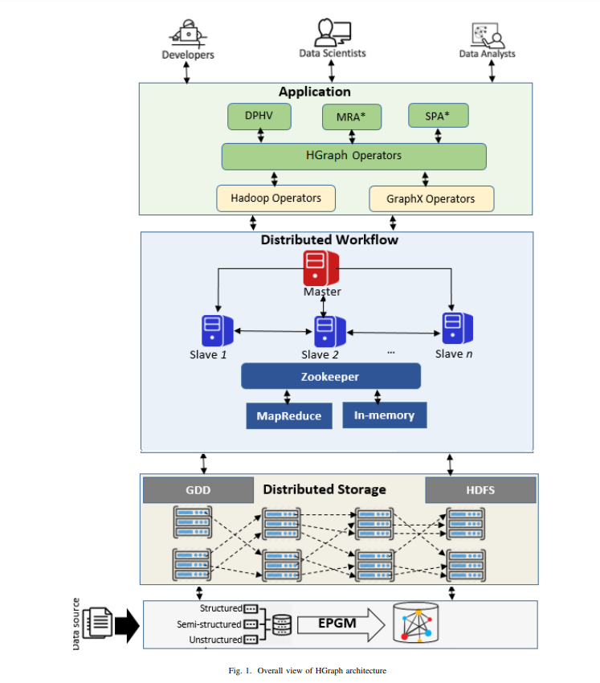
Methodology
Combination of Hadoop and Spark components.
EPGM data model for structured data as graphs.
Optimal use of hardware resources for high-performance computing.

Slide 5
Results
Performance tests on MRA* and SPA* algorithms.
Significant time reduction in computing coverage paths.
Quasi-optimal solutions achieved in reduced computation time.

Slide 6
Conclusion
HGraph as a promising tool for large-scale graph processing.
Successful implementation of basic graph operators and algorithms.
Ongoing development and need for further improvements.

