Slide 1
Evaluating the impact of Weight Averaging Strategies in Federated Learning
Task-6
Team 20:
Ashraful Alam Nirob
Shifath Jahan Prity
Tahmidul karim Takee
Shadik ul Haque
CSE 449:PARALLEL, DISTRIBUTED, AND HIGH-PERFORMANCE COMPUTING (HPC)
Instructor: Annajiat Alim Rasel
RA:
ST: Eshanur Rahman Rythm

Slide 2
Introduction
Weight averaging:
A fundamental technique for combining model updates from participating devices.
Different averaging strategies exist, each with its own advantages and disadvantages.
Evaluation technique: IID datasets were used in evaluating the models.
Approach: Comparison of the models through the results achieved

Slide 3
Federated Learning
1. What is it?
Collaborative learning: Imagine devices training a model like students in a group, but each keeps their own notes private.
2. Why use it?
Privacy first: Data stays on devices, protecting user information.
Local smarts: Models adapt to individual data for potentially better performance.
No data transfer: Devices train on their own data, reducing communication costs.
3. How does it work?
Local training: Each device trains on its own data, like studying their own notes.
Model updates: Devices share their learnings (updated model weights) with the group.
Improved model: The group combines everyone's learnings to create a better model.
Repeat and improve: The cycle continues, with the model getting better each time.

Slide 4
Why Weight Averaging Strategies is used in Federated Learning
Privacy: Aggregates model updates (weights) instead of sharing raw data.
Collaboration: Devices learn together like students sharing study notes.
Non-IID Data: Adapts the aggregation based on data relevance and uncertainty.
Resource Efficiency: Reduces communication by sending only weight updates.
Multiple Strategies: Different approaches for specific training needs and data situations.

Slide 5
Dataset
Dataset used was and IID format dataset.
Independent: does not have any dependence on other data points. In simpler terms, each data point is a unique sample and carries no information about any other point.
Identically Distributed: Follows the same probability distribution as all other data points. Homogeneous: They usually contain data from a single source or population, often with similar features and characteristics.
Easier to model: Due to their consistent statistical properties, IID datasets are generally easier to train machine learning models on. Simple learning algorithms like linear regression often perform well with IID data

Slide 6
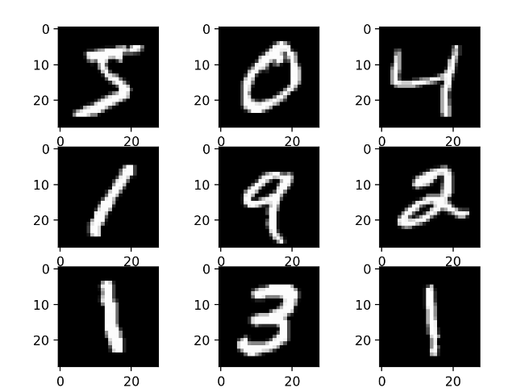
Dataset
The database contains 60,000 training images and 10,000 testing images.
The images from the database were normalized to fit into a 28x28 pixel bounding box and anti-aliased, which introduced grayscale levels.

Slide 7
Methodology
Federated Learning enables decentralized model training while preserving data privacy.
Methods Explored:
FedProx: Standard averaging for IID data.
WAFFLE: Weighted averaging for varying data distribution.
FedSGD: Variant of SGD for large device numbers.
Precision-weighted: Tailored approach for varying data quality.
FedNova: Proximal term for non-IID data, encouraging local solutions.
Used MNIST and CIFAR-10 datasets, ensuring representative samples for IID and non-IID scenarios to prepare the data.

Slide 8
Result Overview
Considering the specific use case and priorities for optimal model selection, each method presents trade-offs in accuracy, precision, and recall.
Benchmark Model: Exceptional overall performance, setting a high standard.
FedProx & Waffle: Competitive with a slight trade-off in accuracy.
FedNova: Lower accuracy but shows adaptability in precision and recall.
Precision Weighted & FedSGD: Encounter significant performance challenges, indicating areas for improvement.

Slide 9
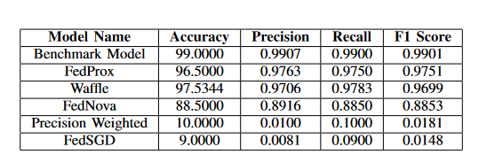
Result Analysis On MNIST Dataset

Slide 10
Limitations
Unfair data: Real-world data is messy (non-IID), making it hard to tell if the strategy or the data itself is behind the results.
Data limitations: Sensitive data often lacks large, diverse datasets needed for solid evaluation.
Device diversity: Different devices and networks add noise, making it hard to isolate the strategy's impact.
Evolving world: Data and user behavior change, making long-term evaluation and generalizability difficult.
Privacy paradox: Evaluating often involves accessing model updates, raising privacy concerns that need careful management.

Slide 11
Future Works
Develop standardized datasets and open-source frameworks for research collaboration.
Focus on explainable AI techniques to understand how averaging strategies work.
Target specific application domains with well-defined tasks and metrics.
Continuously research and develop new, robust, and privacy-preserving weight averaging strategies.

Slide 12
Thank You

