Slide 1


QuickPlot
SWE 4404: Software Project Lab II
Group 09
Tiran Abdullah
230042105
Md. Ashraful Abedin
230042111
Arafat Hosen
230042151
1

Slide 2
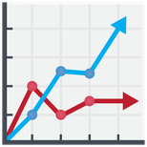
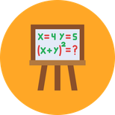


QuickPlot is a web-based graphing platform that renders mathematical equations interactively.
Creates opportunity to plot multiple equations simultaneously, adjust parameter sliders in real time, and switch between Cartesian and polar coordinate systems both in 2D & 3D.
Introduction
Workspaces can be saved and shared, making it easy to revisit or distribute a set of equations with a specific view.
QuickPlot
The platform targets students, educators, and developers who need instant, zero-setup visual feedback for mathematical functions.
1

Slide 3
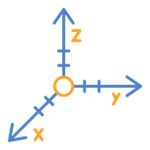
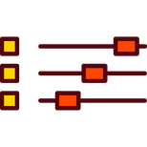

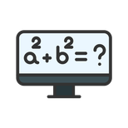


Features
CORE
Equation Grapher
Parameter Sliders
Zoom & Pan
    Type any expression (i.e. polynomials, trigonometry, logarithm) — and render the curve instantly.
  Add sliders for arbitrary constants (e.g. a, b, c) and animate equations live.
  Zoom and pan on the canvas with snap-to-axis grid lines and automatic axis rescaling.
    Supports multiple simultaneous equations with color coding.
Implicit Equations
Polar Graphing
Save & Share
  Support for implicit curves using a marching-squares interpolation approach.
  Switch to polar mode and plot equations with automatic angle range sampling and interpolation.
  Export the current workspace (equations & axis settings) as a JSON file. Reload or share the exact view using link or data.
2

Slide 4








Tools & Technology
Backend
Supabase
Vercel
Firebase
Database
PostgreSQL
Supabase
Extension
Manifest V3
Chrome MV3
Service worker
DevOps
Git
GitHub
VSCode
3

Slide 5







Tools & Technology
Core Language
TypeScript
JavaScript
Frontend
React
Tailwind CSS
Rendering Engine
HTML Canvas
Three.js
D3-scale
4

Slide 6
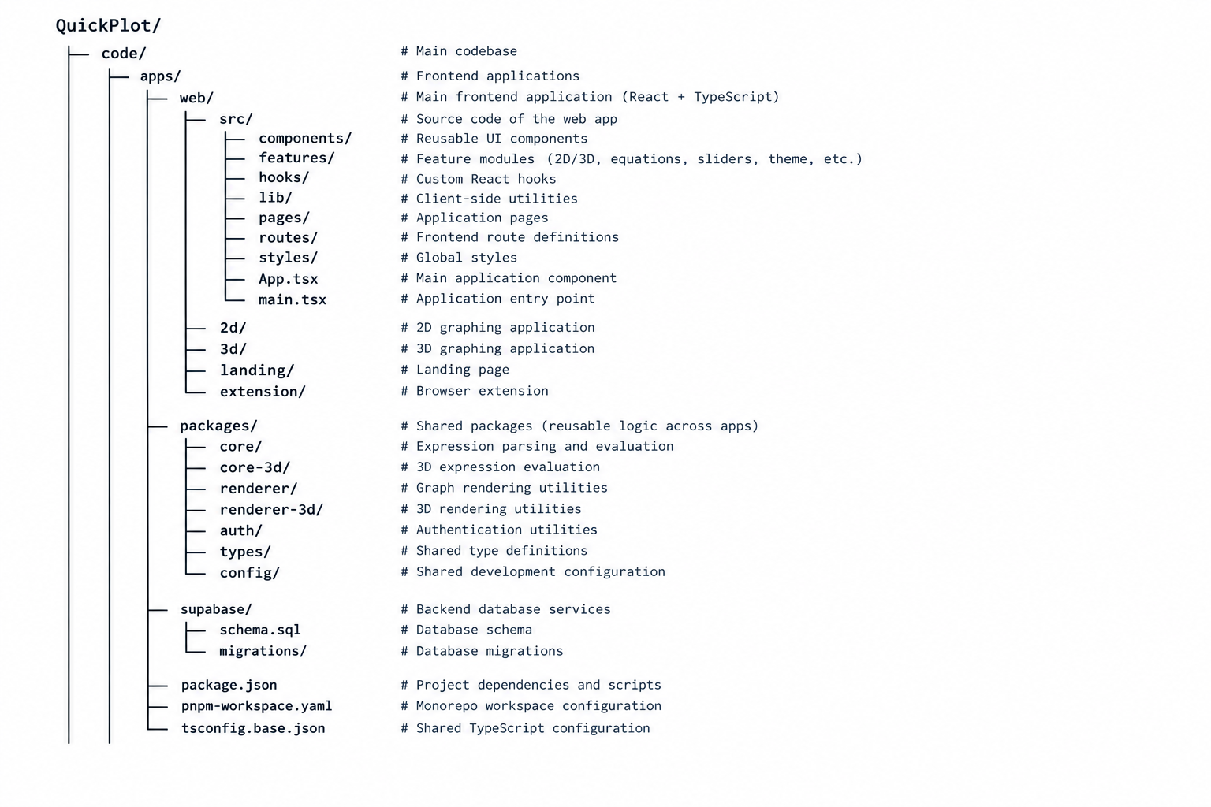
Project
Structure
5

Slide 7
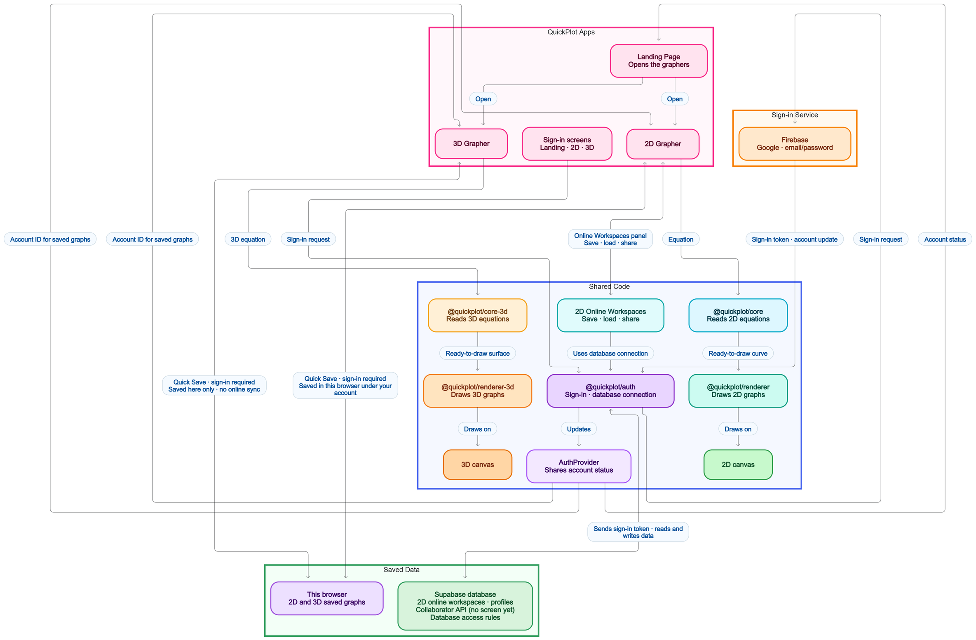
Communication between Components
6

Slide 8
DEMONSTRATION

Slide 9
Thank You
Any Feedbacks?
7
Notes:
7

