Slide 1
Java LOOPING

Slide 2



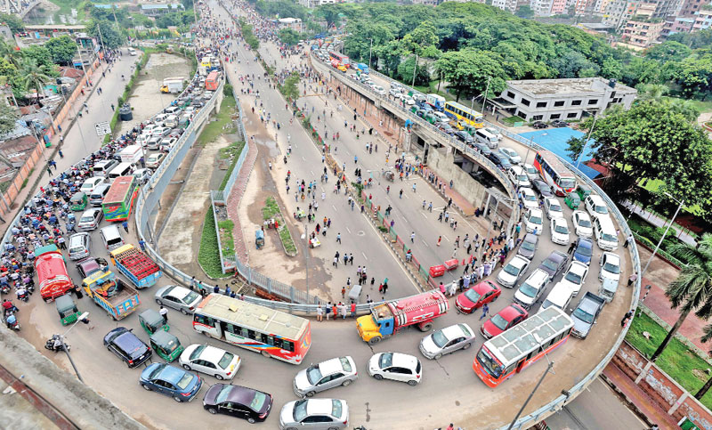

Slide 3
Looping
Looping is used in programming to execute a statement or a block of statement repeatedly.
Looping in programming languages is a feature which facilitates the execution of a set of instructions/functions repeatedly while some condition evaluates to true.
A loop is a structure that allows repeated execution of a block of statements. Within a looping structure, a Boolean expression is evaluated. If it is true, a block of statements called the loop body executes and the Boolean expression is evaluated again. The loop body can be a single statement, or a block of statements between curly braces. As long as the expression is true, the statements in the loop body continue to execute

Slide 4
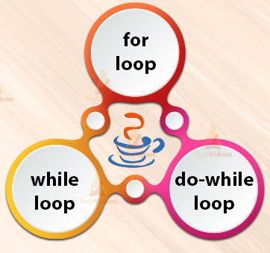
Different Types of loops
while loop
for loop
do while loop

Slide 5
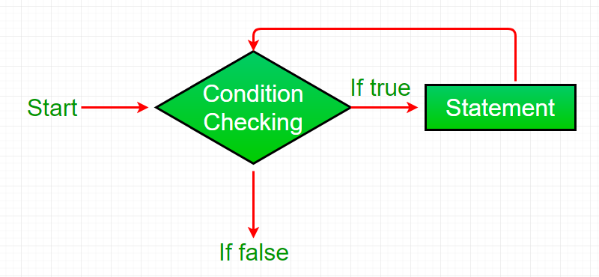
While loop
While loop is used when certain statements need to be executed repeatedly until a condition is fulfilled. In while loops, condition is checked first before execution of statements.
Syntax:
Initialization;
While (condition){
statement(s)
increment/decrement}
While loop will keep on executing until it becomes false

Slide 6
While loop
Syntax:
Initialization;
While (condition){
statement(s)
increment/decrement}
A while loop statement in Java programming language repeatedly executes a target statement as long as a given condition is true.
Example (1)
int i=1;
while (i<=10) {
System.out.println(i);
i++;
}
Example (3)
public class WhileLoop {
public static void main(String[] args) {
int x = 1, sum = 0;
while (x <= 10) {
sum = sum + x;
x++;
}
System.out.println("Summation: " + sum);
}
}
Output: 1 2 3 4 5 6 7 8 9 10
Example (2)
int i=1;
while (i<=4) {
System.out.println("Hello World");
i++;
}
Output: 55
Output:
Hello World
Hello World
Hello World
Hello World

Slide 7
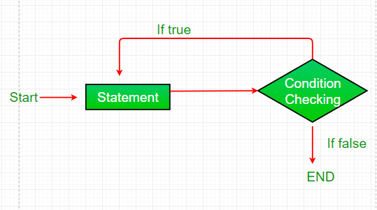
do while loop
do while loop is same as while loop with only difference that condition is checked after execution of block of statements. Hence in case of do while loop, statements are executed at least once.
Syntax:
Initialization;
do{ statement(s)
increment/decrement}
While (condition)
This loop will execute the code block once, before checking if the condition is true, then it will repeat the loop as long as the condition is true.

Slide 8
do while loop
Syntax:
Initialization;
do{ statement(s)
increment/decrement}
While (condition)
do-while loop is called an exit control loop
Example (1)
int i=1;
do {
System.out.println(i);
i++;
} while (i<=10);
Example (3)
public class WhileLoop {
public static void main(String[] args) {
int x = 1, sum = 0;
do {
sum = sum + x;
x++;
} while (x <= 10);
System.out.println("Summation: " + sum);
}
}
Output: 1 2 3 4 5 6 7 8 9 10
Example (2)
int i=1;
do {
System.out.println("Hello World");
i++;
} while (i<=4);
Output: 55
Output:
Hello World
Hello World
Hello World
Hello World

Slide 9
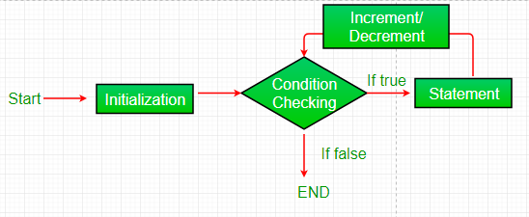
for loop
For loop are used in java to execute statements repeatedly for a given number of times. Initializing the loop control variable, Testing the loop control variable, Updating the loop control variable
Syntax:
for (initialization; condition; increment/decrement){
statement(s)
}
Initialization is executed (one time) before the execution of the code block.
Condition defines the condition for executing the code block.
Increment/Decrement is executed (every time) after the code block has been executed.

Slide 10
for loop
Syntax:
for (initialization; condition; increment/decrement){
statement(s)
}
When you know exactly how many times you want to loop through a block of code, use the for loop instead of a while loop.
Example (1)
for (int i=0;i<6; i++){
System.out.println(i);
}
public class Namta {
public static void main(String[] args) {
Scanner input = new Scanner (System.in);
System.out.println("Enter a Number, anything you want :");
int num;
num = input.nextInt();
int nu;
for(int i=1;i<=10;i++) {
nu = num*i;
System.out.println(num+ "X" +i +"=" +nu);
}}}
Output: 0 1 2 3 4 5
Example (2)
for (int i=0;i<=3; i++){ System.out.println("Hello World");
}
Output:
Hello World
Hello World
Hello World
Hello World
Output: ??
int a[]={6,8,7,9,4};
Arrays.sort(a);
for(int i=0;i<a.length;i++){ // Ascending order, < less than
System.out.println(a[i]);}
for(int i=a.length-1;i>=0;i--){ // Descending order, greater than equals
System.out.println(a[i]);}
Output: Ascending 4 6 7 8 9
Decending 9 8 7 6 4
Example (3)
for (int i=10;i>=5; i--){
System.out.println(i);
}
Output: 10 9 8 7 6 5

Slide 11
While loop
do while loop
for loop
Syntax:
Initialization;
While (condition){
statement(s)
increment/decrement}
Syntax:
Initialization;
do{ statement(s)
increment/decrement}
While (condition)
Syntax:
for (initialization; condition; increment/decrement){
statement(s)
}
Example
int i=1;
while (i<=10) {
System.out.println(i);
i++;
}
Example
int i=1;
do {
System.out.println(i);
i++;
} while (i<=10);
Example
for (int i=0;i<=5; i++){
System.out.println(i);
}
Output: 0 1 2 3 4 5
Output: 1 2 3 4 5 6 7 8 9 10
Output: 1 2 3 4 5 6 7 8 9 10

Slide 12
for each loop / Enhanced loop
Syntax:
for (data_type variable : array | collection){
statement(s)
}
When we do not know the size / length (condition) then we should use For Each loop. Declaring an array, traversing the array with for-each loop.
Example (1)
int a[]={ 4, 7, 8, 9, 12, 15};
for (int x:a){
System.out.println(x);
}
public class EnhancedForLoop {
public static void main(String[] args) {
String array[] = { "New York", "Texas", "Georgia" };
for (String x : array) {
System.out.println(x);}
}}
Output: 4 7 8 9 12 15
Output: ??
Example (1)
int a[]={ 5, 8, 12, 15};
Int total=0;
for (int x:a){
total = total + x;
}
System.out.println(total);
public class ForLoop {
public static void main(String[] args) {
String array[] = { "New York", "Texas", "Georgia" };
for (int i = 0; i < array.length; i++){
System.out.println(array[i]);}
}}
Output: 40
Output: ??

Slide 13
The End

