Slide 1
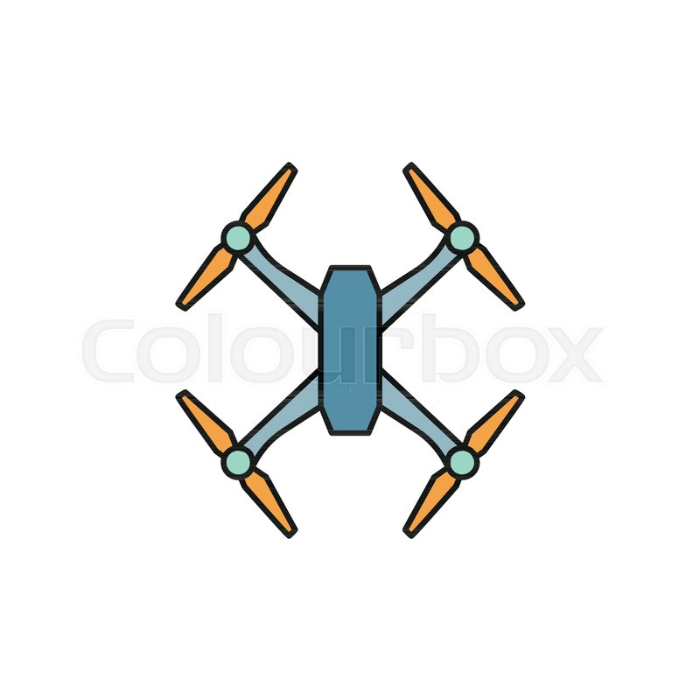
MINE-DETECTION DRONE

Slide 2
Project Charter Elements

Slide 3
1-Project sponsor
Amir Mustafa Ibrahim
2-Project manager
Islam Abdelhady Hassanein
3-Purpose of the project
-Detecting and extracting mines at the lowest cost and less harmful than the usual and recognized methods.

Slide 4
4-Business case for the project
-The most places in Egypt where there are mines.
-What new will the project add?
5-Basic timeline of when the project milestones will be reached.
6-High level assumptions and constraints
-Not allowing the purchase of some internal components of the device.
-Predetermined budgets, deadlines, resources, preferred vendors, and required technology.

Slide 5
Project scope statement

Slide 6
1-Product Scope Description
-The project will work in the desert and lands where there is a large amount of mines.
2-Product Acceptance Criteria
- Easy to use.
- High efficiency.
- Detects mines on a large scale.
3-Project Constraints

Slide 7
Work Breakdown Structure

Slide 8
The project generally consists of:
• 701.1 Hardware
• 701.2 Software
• 701.3 Electrical circuit

Slide 9
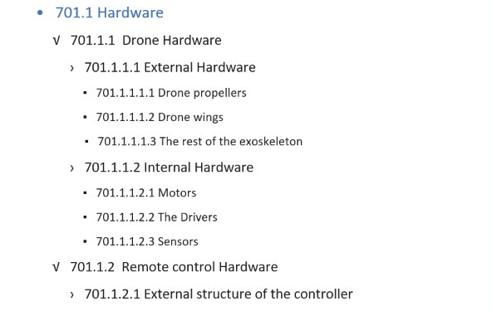
701.1 Hardware

Slide 10
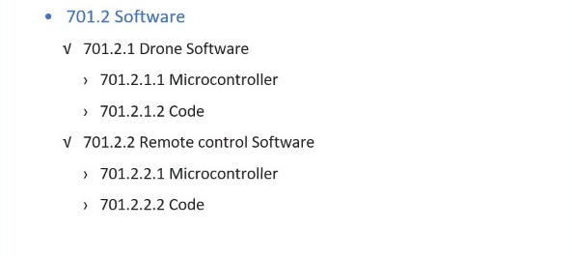
701.2 Software

Slide 11
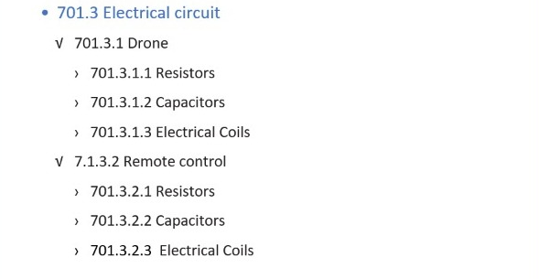
701.3 Electrical circuit

Slide 12
WBS Dictionary

Slide 13
1-Description of the WBS element
WBS elements are divided into three main parts:
1-Hardware
2-Software
3-Electrical circuit

Slide 14
2-Resources required to create the WBS element (resources are people, materials, and facilities)
1- People: -
Mechanical Engineers | To create the mechanical design of the Drone.
Electrical Engineers | Drone circuit design.
Software Engineers | Drone programming.
Application Developer | Create the application.

Slide 15
2- Materials: -
Mechanical Part | Materials for the outer structure such as aluminum or plastic.
Electrical Part | Electronic parts such as resistors, capacitors, controller and driver and motors.

Slide 16
3- Facilities: -
labs | Electrical and mechanical laboratories.
Machines | CNC machine and 3D Printer.

Slide 17
Responsibilities matrix

Slide 18
The legend for this matrix:
A = Approves
R = Reviews
P = Participant
C = Creator
Mine Expert | Application Developer | Software Engineer | Electrical Engineer | Mechanical Engineer | Project Manager
R | P | P | P | C | A | Drone Structure Industry
P | P | P | C | P | A | Electrical Circuit Design
R | P | C | C | C | P | Controller Industry
R | R | C | C | P | A | Drone Programming
P | C | P | P |  |  | Create the Application
P | C | P | P | P | A | Test the Application

Slide 19
Project Network

Slide 20
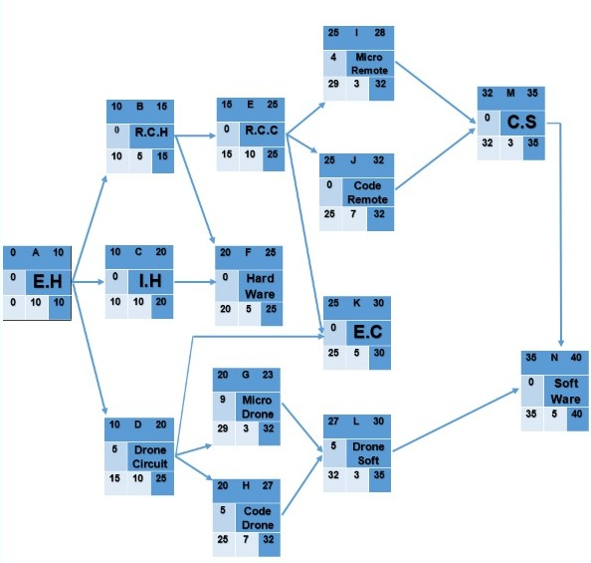
Network

Slide 21
Resource Constrained

Slide 22
Budget Baseline

Slide 23
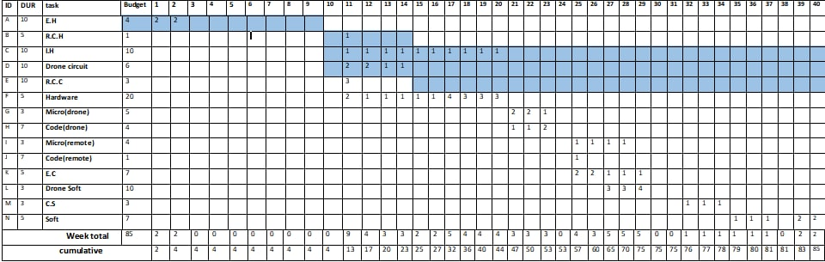
Budget Baseline

Slide 24
Risk Management

Slide 25
1-The risks that can face our project
- Incompatibility of the electronic chip used with the circuit.
- Delayed sensor response.
- The code is not compatible with the chip.
2-Dealing with these risks
- Experimenting with electronic chips with the circuit more than once.
- Try to use high quality sensors.
- Test the code more than once with the electronic chip

Slide 26
3-Project Monitoring
- Holding permanent meetings with the work team to monitor the latest developments.
- Overseeing everything on the project.
- Each member of the team must submit a detailed report on what he has achieved and his mission.

