Slide 1

Nutrition Tracking and Diet Managment
Presented by
Dumpa Revanth(1BG22CS043)
Venkateshwar Reddy(1BG22CS178)
Ashray V B(1BG23CS401)

Slide 2
Contents
1
Project Abstract
2
Problem Statement
3
Project Objectives
4
Literature Survey
5
Tools and Technologies
6
System Architecture
7
Methodology
8
Execution Flow
9
Conclusion and Future Scope

Slide 3
Project Abstract
Features
Technology Stack
Meal logging with detailed nutrition breakdown
Frontend: React.js, Tailwind CSS
Analysis of calories, proteins, fats, and carbs
Backend: Node.js, Express.js, MongoDB
Personalised nutrition goals
DevOps tools: GitHub, Docker, Netlify

Slide 4
Problem Statement
Lack of Awareness
Inadequate Tools
Scalability Issues
Users struggle to track dietary habits accurately.
Existing apps are complex or lack personalisation.
Limited DevOps integration hinders growth and stability.

Slide 5
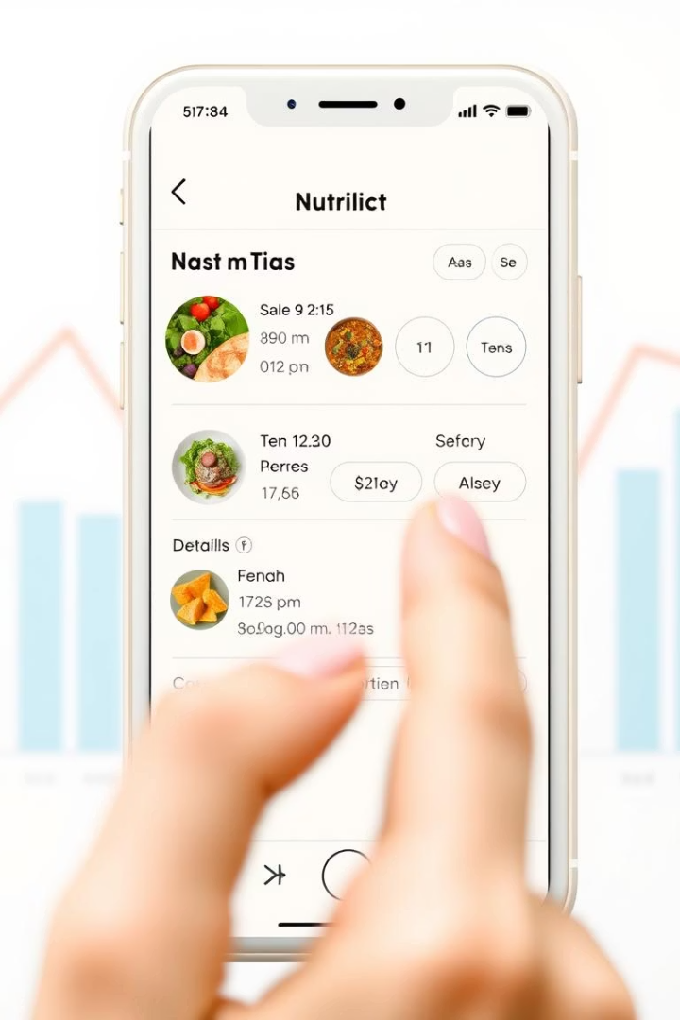
Project Objectives
Meal Logging
Enable accurate breakdowns of food intake.
Personal Goals
Allow users to set and track nutrition targets.
Progress Tracking
Visual progress through interactive charts.
DevOps Practices
Implement Git for version control and Docker for containerization.

Slide 6
Literature Survey
DevOps Insights
CI/CD Principles
Nutrition Apps UX
Derived from The Phoenix Project on best practices.
Adopted from Martin Fowler’s strategies for deployment automation.
Research by Rahim et al. highlights UI/UX importance.
Git Strategies
Behavioural Impact
Guidance from Pro Git for efficient version controlling.
Samoggia & Riedel emphasize positive effects of nutrition apps.

Slide 7
Tools and Technologies
Frontend
Backend
Database & Auth
DevOps
React.js, Tailwind CSS for responsive design and UI.
Node.js with Express.js for API handling.
MongoDB storage with JWT for secure user authentication.
Git & GitHub for version control; Docker for containerization.

Slide 8
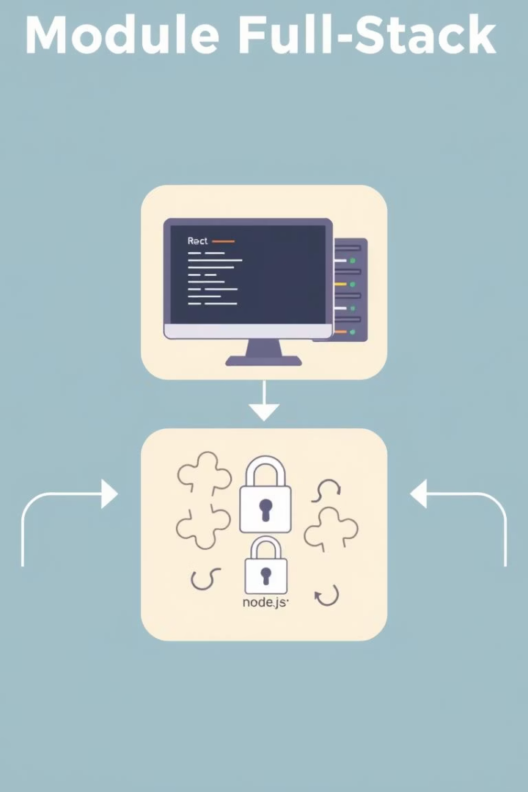
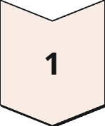
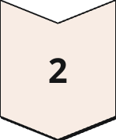
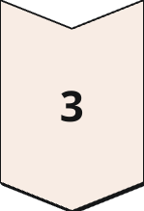
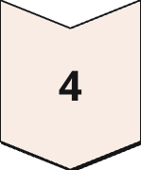
System Architecture
Frontend
User interface built with React.
Backend
Containerized Node.js Express app using Docker.
API Integration
Connects to external nutrition databases for data retrieval.
Authentication
JWT ensures secure user sessions and data privacy.

Slide 9

Methodology
1
Requirement Analysis
Understanding user needs and system specifications.
2
Frontend Development
Implementing user interface with React and Tailwind.
3
Backend Development
Building using Node and Express.
4
DevOps Implementation
Setting up Git, Docker, and CI/CD workflows.

Slide 10

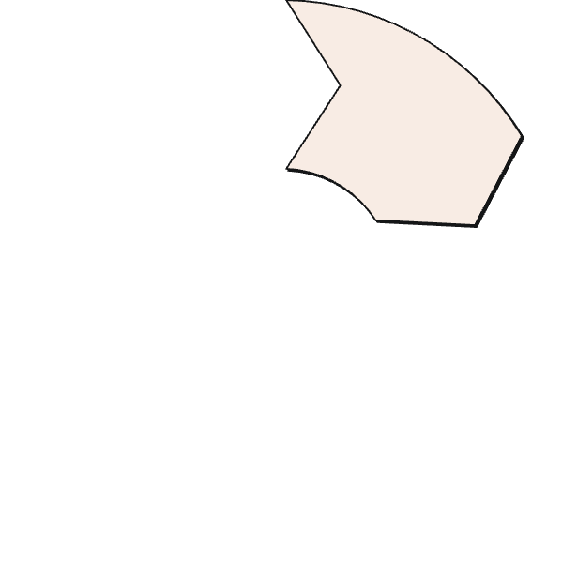




Execution Flow
User Authentication
Setting the Goal
Secure user login with robust session management to protect data integrity.
Users define personalized nutrition targets and preferences.
1
2
Logout
Meal Logging
6
Users end their session safely ensuring their application state remains secure.
Users record meals with comprehensive nutritional details for accurate tracking.
3
Progress Visualization
5
Data Persistence
4
Interactive charts display nutrition trends to monitor user progress effectively.
All user data and computed nutrition metrics are securely stored in MongoDB.

Slide 11
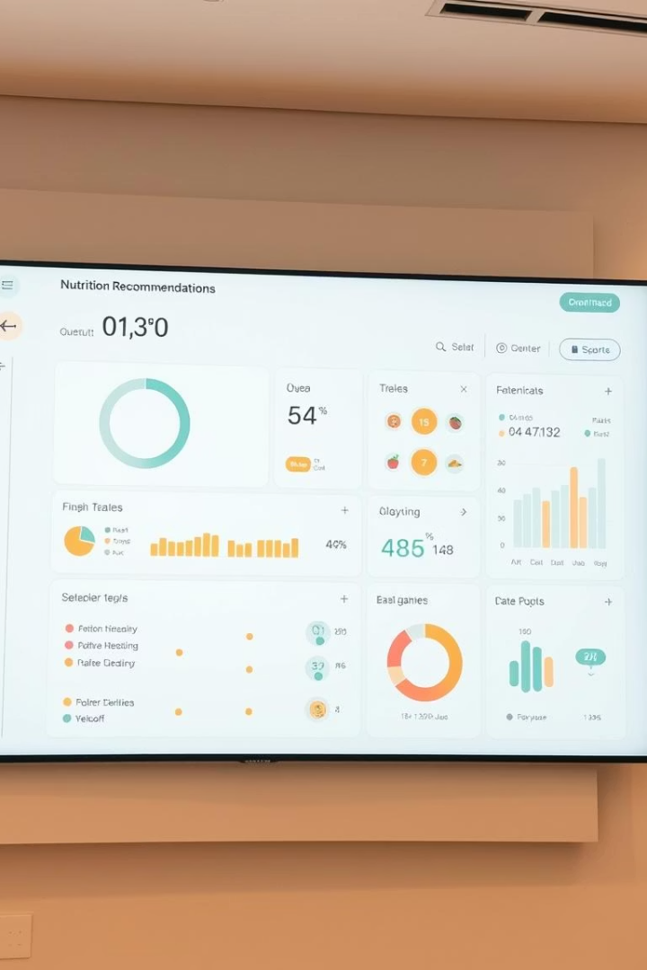
Conclusion and Future Scope
Current Achievements
Scalable DevOps-enabled nutrition tracking system.
Future Enhancements
Implement full CI/CD pipelines
Develop mobile apps using React Native
Integrate AI-based nutrition recommendations
Introduce modules for dietitian collaboration

Slide 12
Thank You!
"Tracking your nutrition is the first step towards a healthier life — small choices lead to big changes."

