Slide 1

Predicting Healthcare Insurance costs and Risk Categories Using Machine Learning
- Shreeyukta Aryal

Slide 2
Introduction, Purpose & Aim
Introduction
Purpose
Aim
Health insurance costs vary significantly based on demographics, lifestyle choices, and underlying health risks. Machine learning enables data-driven prediction and classification to improve risk assessment and pricing strategies.
Analyze factors influencing insurance charges through regression modeling for cost prediction and classification for risk tier assignment. Compare performance of multiple ML models.
Identify the most accurate and reliable model while evaluating the impact of feature engineering, data transformation, and advanced ensemble methods for better insurance analytics decision-making.

Slide 3
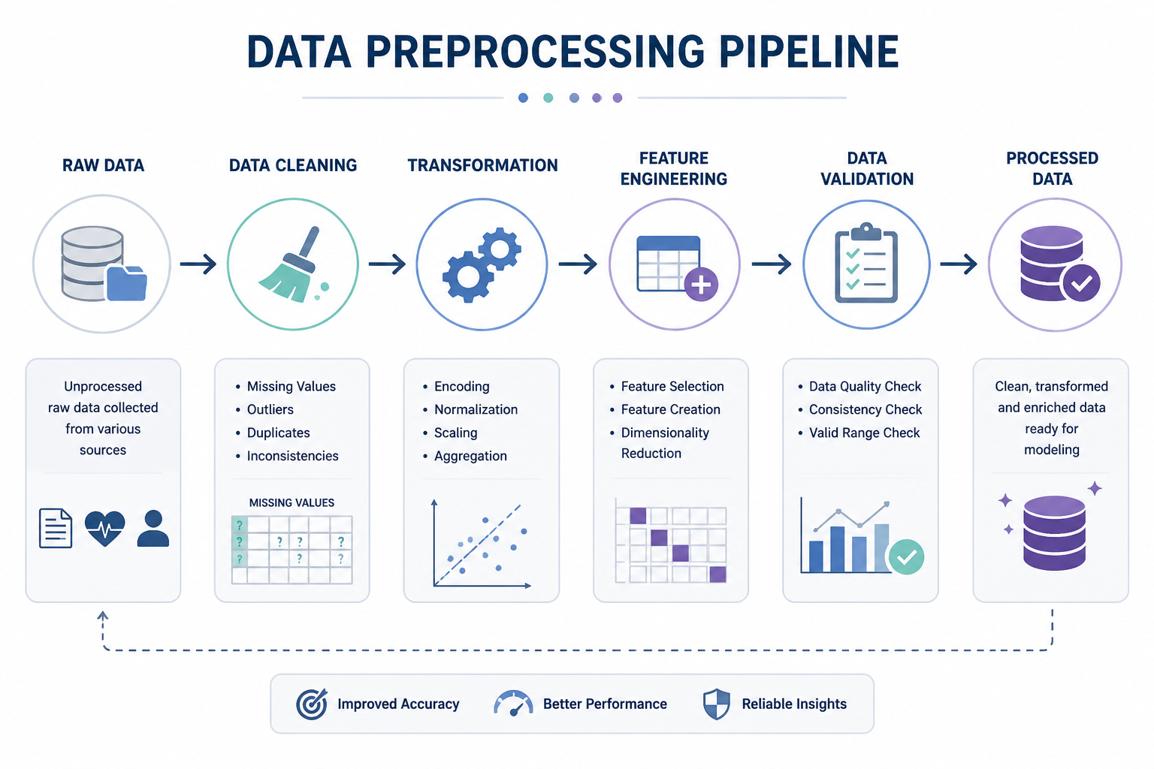
Data Preparation & Initial Inspection
Data Overview
Dataset loaded from CSV with 1,338 initial records cleaned to 1,335 observations. Contains 12 variables covering demographics, health metrics, and insurance charges.
Data Inspection
Verified data types and structure, identified missing
values in age, BMI, and children variables. Removed incomplete rows using dropna(), resulting in 1,335 clean observations.

Slide 4
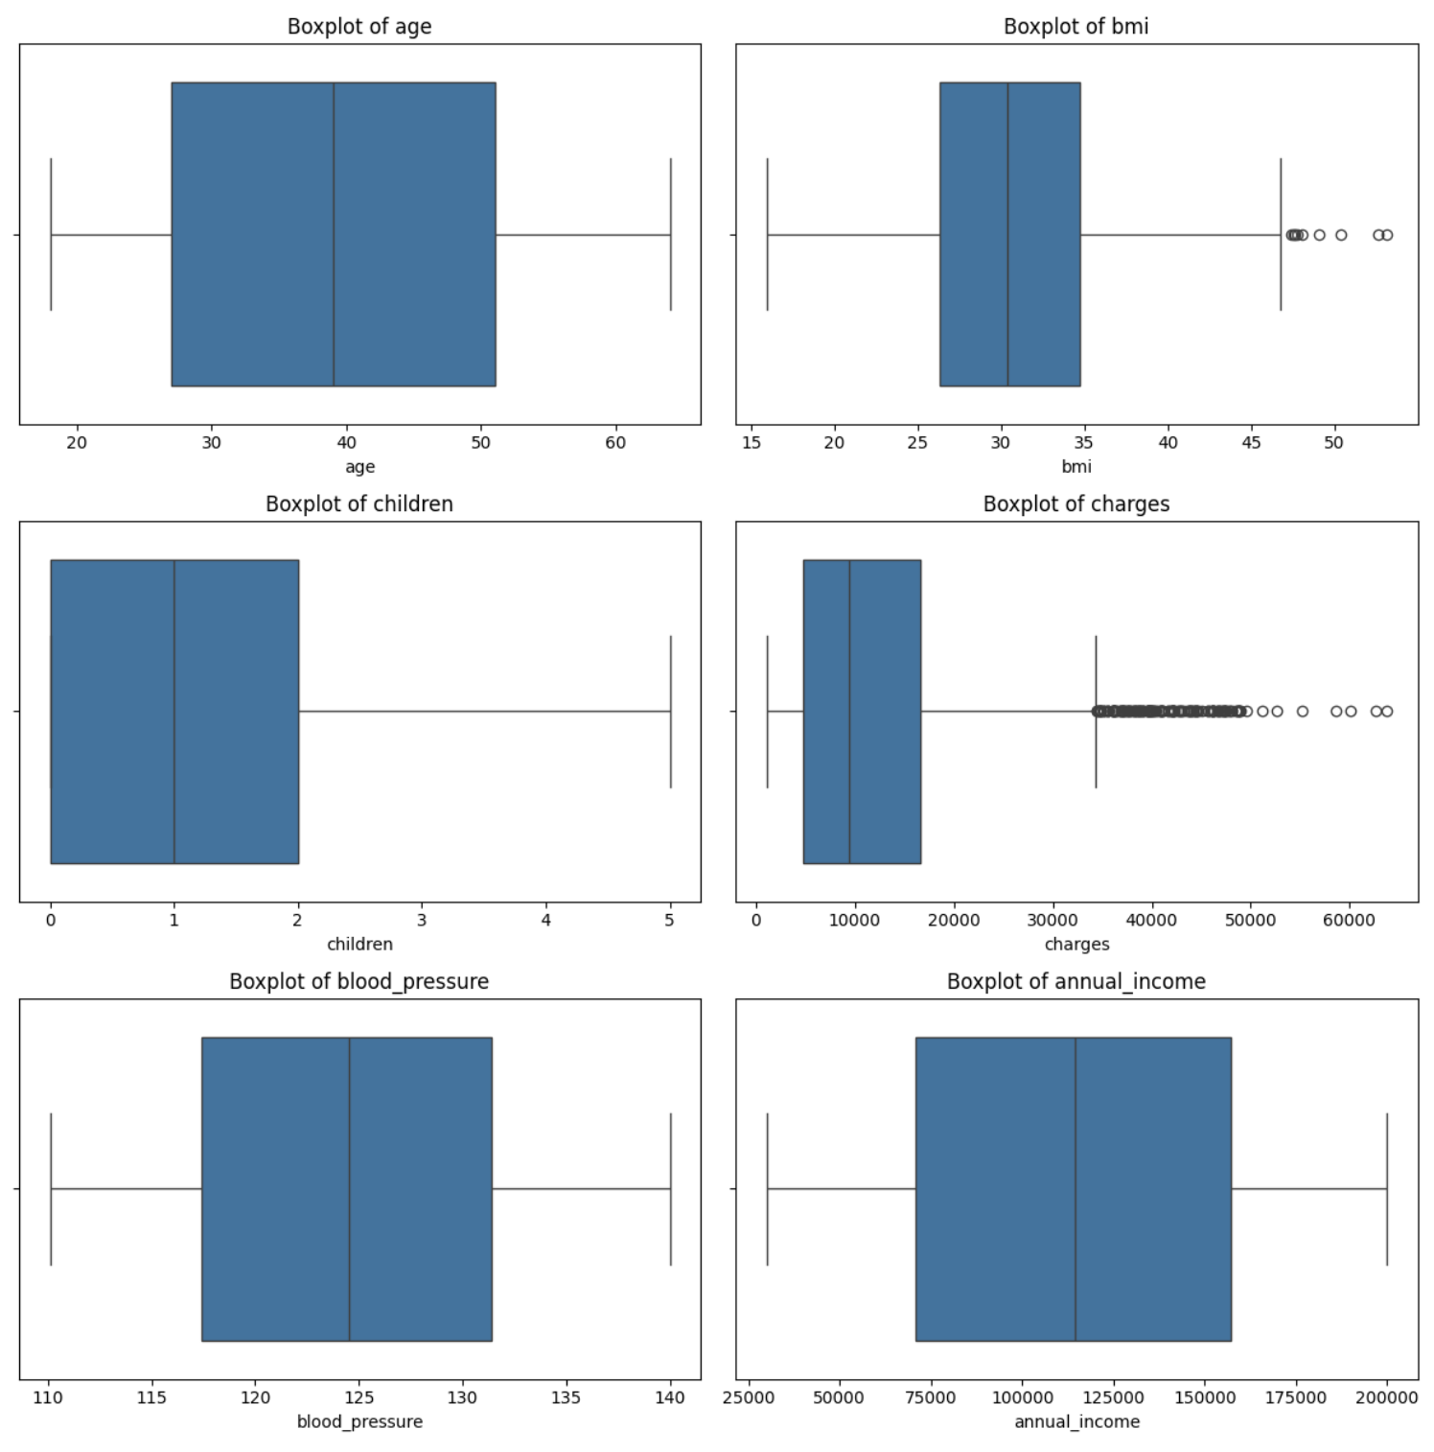
Exploratory Data Analysis (EDA)
Main Findings
Average age: 39 years; average BMI: 30.7
Insurance charges are highly variable, ranging up to about $63K
Most individuals are non-smokers
Most common region: Southeast
Most common occupation risk: Moderate
Visual Insights
Histograms show that charges is strongly right-skewed.
Boxplots confirm outliers in charges and BMI-related variables.
Other variables such as age, blood pressure, and income are more stable
Key Takeaway
EDA shows that insurance charges contain skewness and outliers, which supports using log transformation and robust preprocessing before modeling.

Slide 5
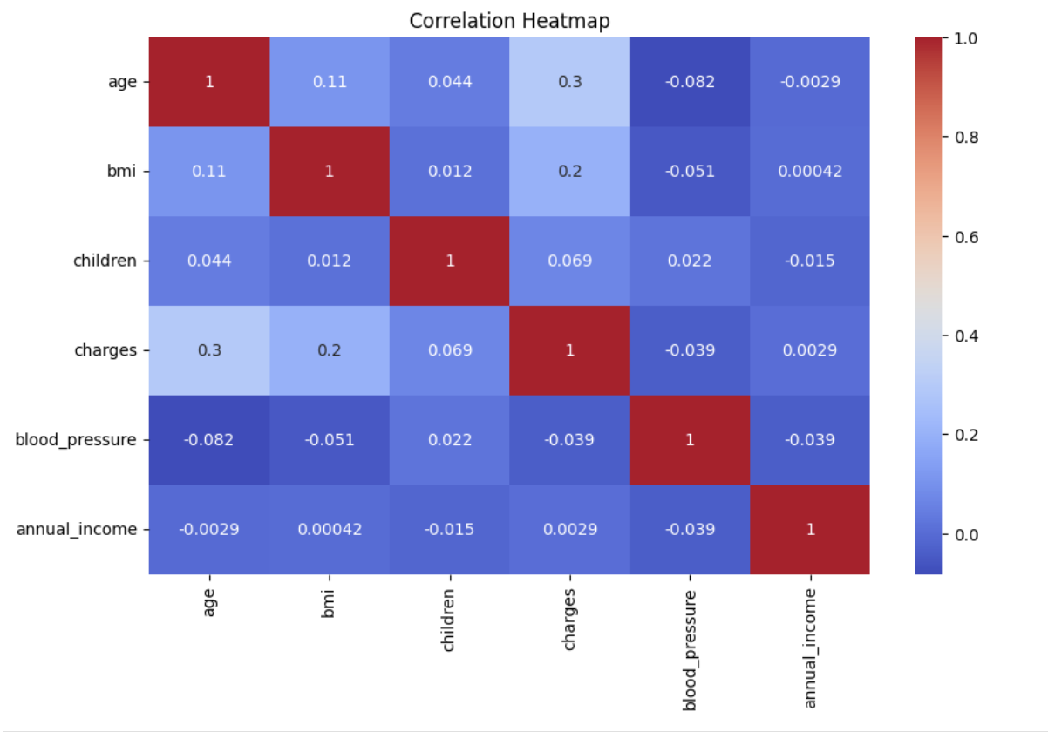
Feature Relationships
Key Findings
charges vs log_charges: 0.89 → log transformation preserves pattern
smoker_binary & bmi_smoker_interaction: strong positive relationship with charges
age vs age_bp_risk: 0.98 → confirms engineered feature design
annual_income vs charges: ~0.00 → negligible impact
blood_pressure vs charges: -0.04 → weak relationship
Key Takeaway
Insurance costs are primarily driven by smoking behavior and age-related risk, not income

Slide 6
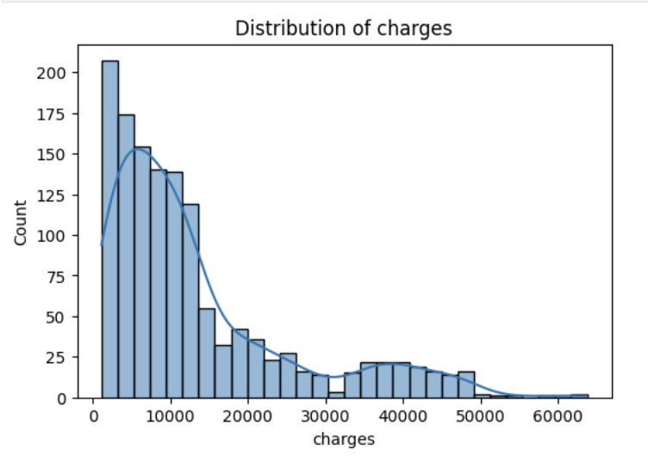
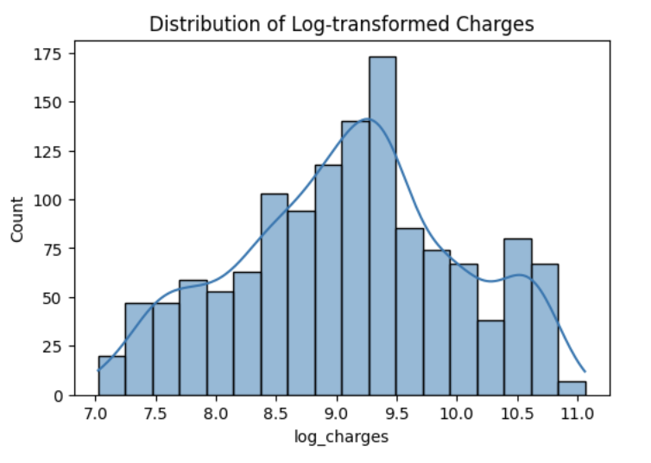
Handling Skewness: Log Transformation
Before Transformation
Charges range: $1,121 → $63,770
Highly right-skewed distribution
Mean: 13,255 vs Median: 9,378 → strong skew
Presence of extreme high-cost outliers
After Transformation
Log range: 7.0 → 11.0
Distribution becomes approximately normal
Reduced impact of extreme values
Improved stability for regression models
Key Takeaway
Log transformation reduces skewness and helps models learn better patterns without being dominated by outliers

Slide 7
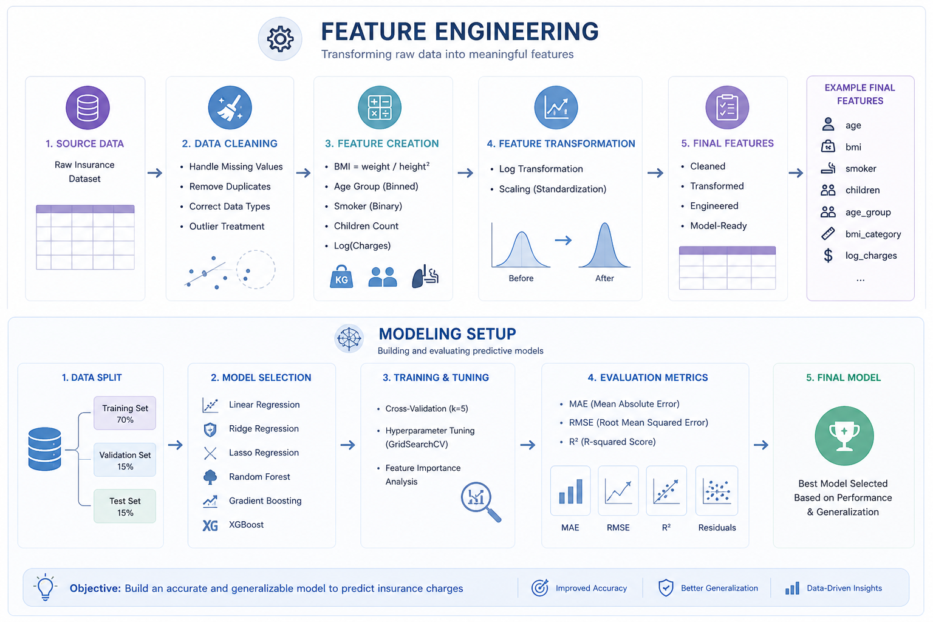
Feature Engineering & Modeling Setup
Risk Tier Creation
Quantile-based classification of charges
Balanced dataset: Low: 445, Medium: 445 , High: 445
Model Setup
Regression target: log_charges
Classification target: risk_tier
Split: 70% train / 15% validation / 15% test
Preprocessing:
Numeric: median imputation + scaling
Categorical: most frequent imputation + one-hot encoding
Key Takeaway
Balanced, feature-enhanced dataset optimized for modeling.

Slide 8
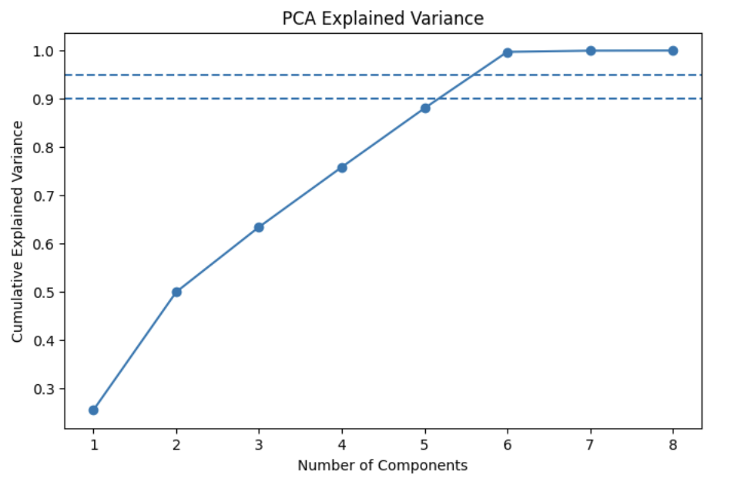
Principal Component Analysis (PCA) Dimensionality Reduction
Key Findings
First 5 components ~88% of variance.
Around 6 components ~95%+ of variance.
PCA reduced model dimensions from 25 → 14
PCA vs Original
Original features achieve R² = 0.855 while PCA features achieve R² = 0.841
Key Takeaway
PCA reduces complexity with minimal performance loss, but original features perform slightly

Slide 9
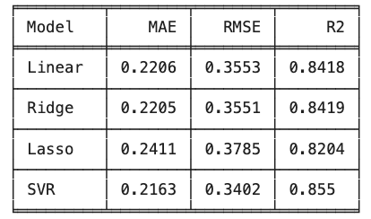
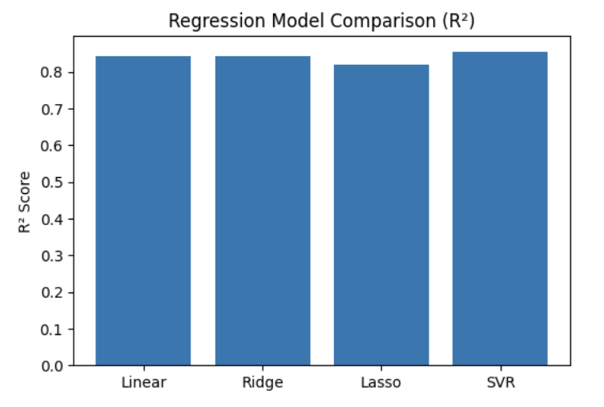
Regression Model Performance
Models Tested
Linear Regression, Ridge, Lasso, SVR ( Support Vector Regression)
Target variable: log_charges
Evaluation metrics: MAE, RMSE, R², 5-fold CV R²
Cross-Validation Insight
Linear/Ridge have the highest mean CV R²: ~0.770
SVR has the best test R²: 0.855
Lasso performs weakest overall
Key Takeaway
SVR captures non-linear relationships best on the test set, while Ridge/Linear show strong stability in cross-validation

Slide 10
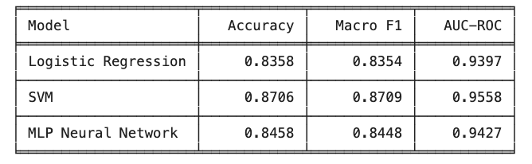
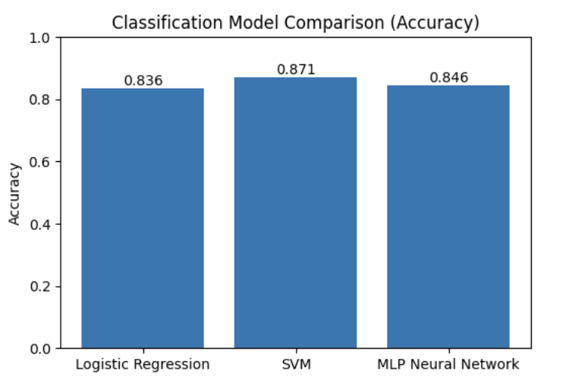
Classification Model Performance
Models Tested
Logistic Regression
SVM (Support Vector Machine) with RBF kernel
MLP (Multi-Layer Perception Neural Network)
Learning Curve Insight
MLP training accuracy increases to about 93%
Validation accuracy stabilizes around 86 - 87%
Small gap suggests mild overfitting, but not severe
Key Takeaway
SVM performs best overall, while MLP shows strong learning behavior but slightly lower validation/test performance.

Slide 11
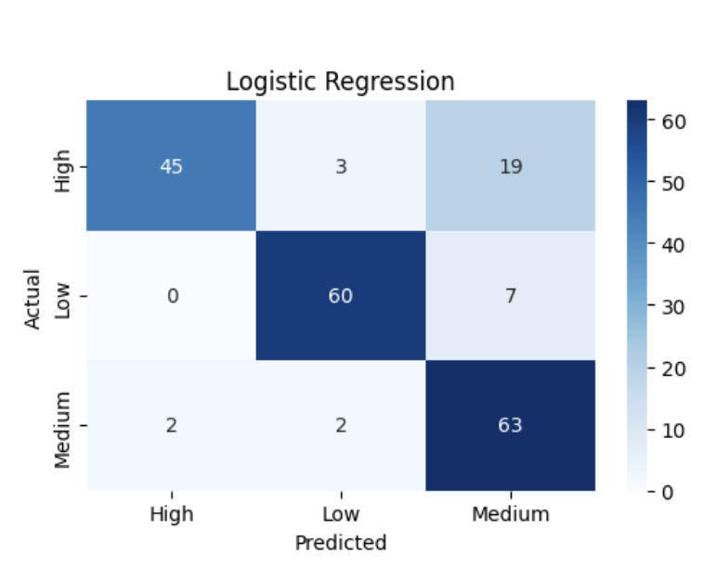
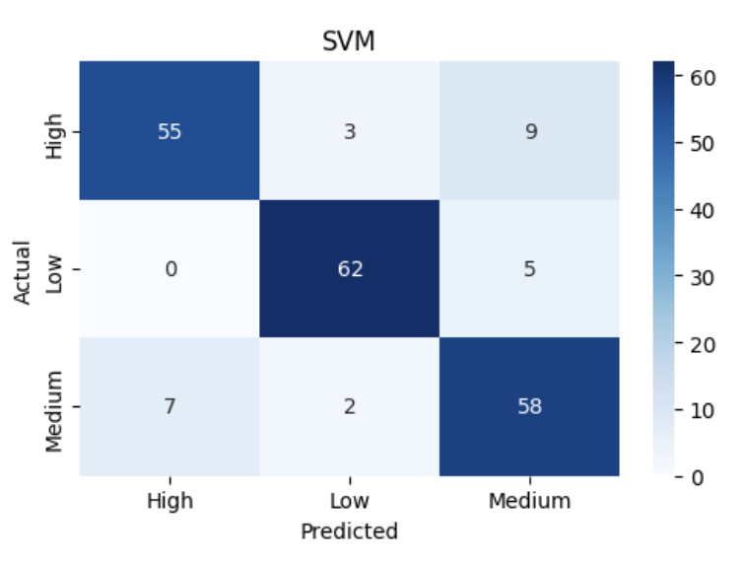
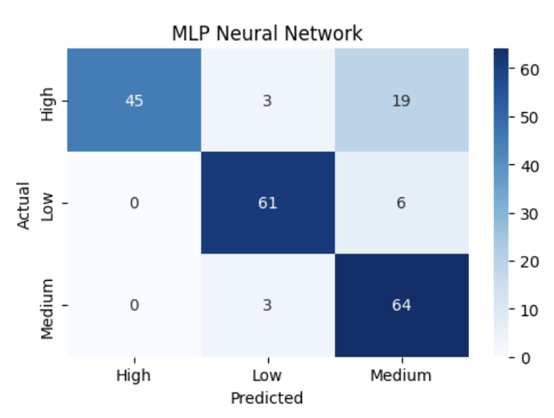
Model Performance – Confusion Matrix Analysis
Compared class-wise prediction :
Logistic Regression , SVM , MLP Neural Network
Key Observations
SVM performs best overall : High: 55 correct , Low: 62 correct , Medium: 58 correct
Logistic Regression : Strong for Low (60 correct), Misclassifies High → Medium (19 cases)
MLP Neural Network : Strong for Medium (64 correct), Similar confusion: High → Medium (19 cases)
Common Error Pattern
High-risk individuals often predicted as Medium risk
Indicates overlap between High vs Medium features
Key Takeaway
SVM achieves the most reliable and balanced classification, while all models struggle slightly to distinguish high-risk from medium-risk individuals.

Slide 12
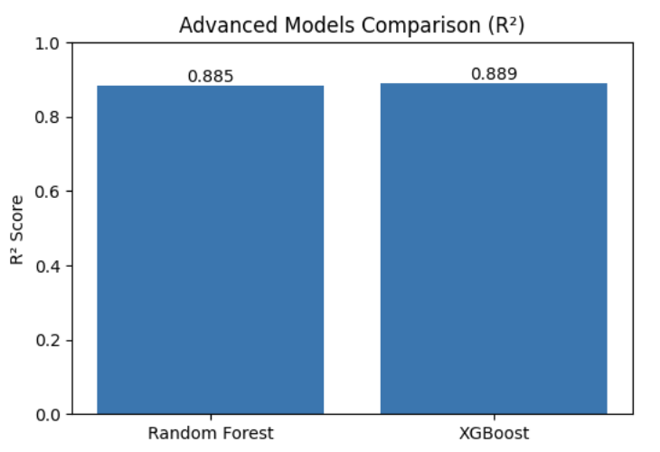
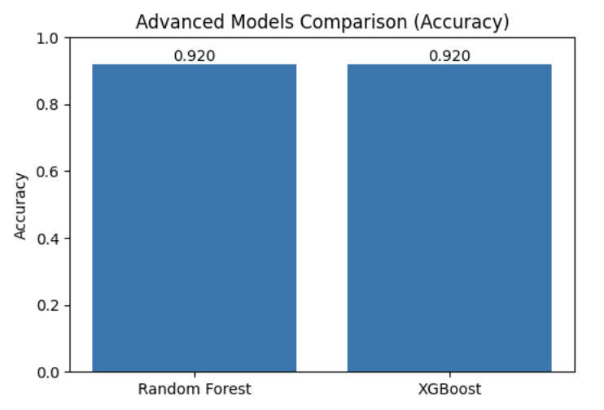
Advanced Model Comparison: Random Forest vs XGBoost
Compare ensemble models for regression & classification
Regression Performance
XGBoost performs best
R²: 0.889 vs 0.885
MAE: 0.159 vs 0.165
High accuracy (~92%)
Nearly Classification Performance
Both models achieve very identical Macro F1 → balanced predictions across classes
Key Takeaway
XGBoost is the best overall model for regression tasks
For classification, both models are equally strong and stable
Ensemble methods significantly outperform traditional models

Slide 13
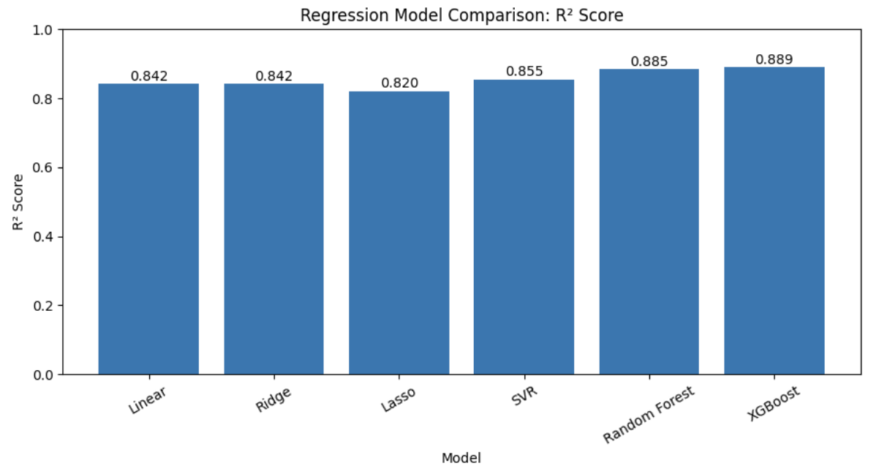
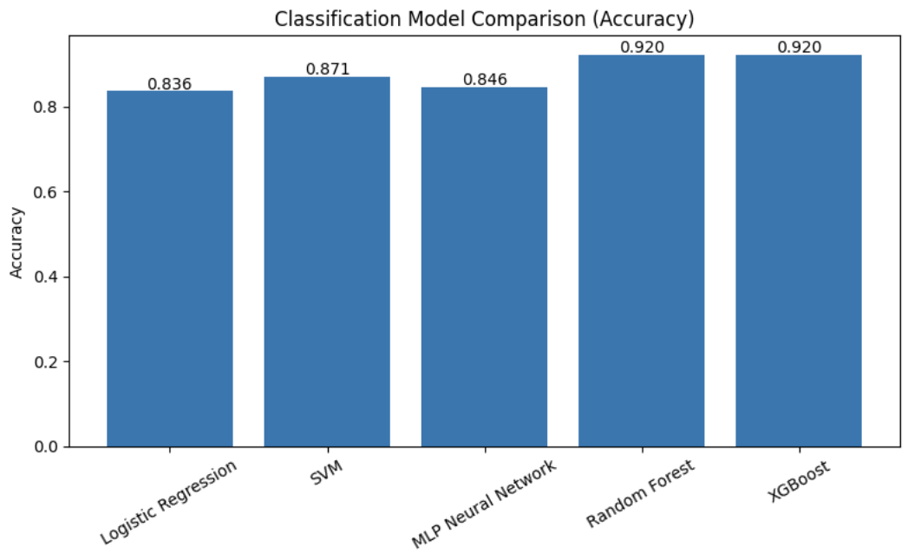
Final Model Comparison & Selection
Objective Identify the best-performing models for:
Regression (insurance cost prediction)
Classification (risk tier prediction)
Regression Performance (R²)
XGBoost: 0.889 (Best) , Random Forest: 0.885 , SVR: 0.855, Linear / Ridge: ~0.842, Lasso: 0.820 (Lowest)
Classification Performance (Accuracy)
Random Forest & XGBoost: ~0.920 (Best), SVM: 0.871, MLP:0.846, Logistic Regression: 0.836
Key Takeaway
Ensemble models outperform all others, with XGBoost leading regression and Random Forest/XGBoost dominating classification. Overall, models deliver high accuracy with strong and stable performance across tasks.

Slide 14
Conclusion
Key Findings
Feature engineering significantly improved model performance
Log transformation reduced skewness and stabilized predictions
Ensemble models captured complex patterns better than linear models
Model Performance
XGBoost achieved highest regression performance (R² = 0.889)
Random Forest & XGBoost achieved highest classification accuracy (~92%)
Traditional models performed well but were outperformed by ensemble methods
Insights
Smoking-related and risk-based features are strong predictors
Some overlap exists between High vs Medium risk categories
PCA reduced dimensionality but slightly reduced accuracy

