Slide 1
STORYBOARD
TEAM 08

Slide 2
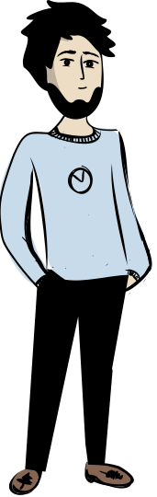
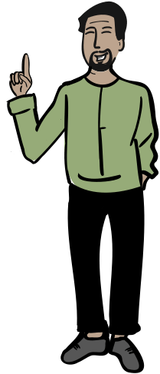
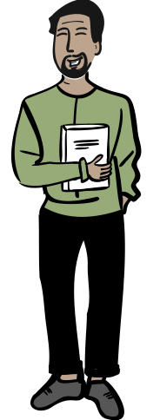
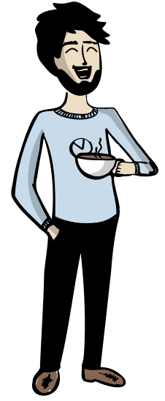

Backstory
So the new term registration has started, have you registered for the courses yet?
Oh yes!! I have registered for Python and Stats. What about you?
Wow! I have also registered for the same courses
Hey Sam!
Hey Ash!

Slide 3
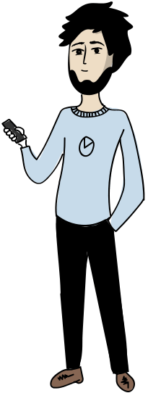
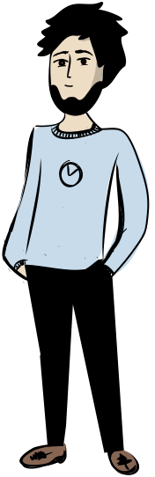




Problem
Hey Nikita! You seem a little worried, have you registered for the courses yet?
Not yet, I am so confused which courses to take! I have asked so many people for suggestions but still can’t decide
Don’t you know about the course recommendation site? It can help you to figure out the courses.
Let me show you
Oh! I have never heard of that.

Slide 4


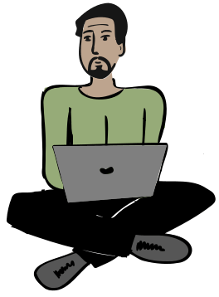

Solution
Recommendation 1
Course 1
Course 2
Course 3
Recommendation 2
Course 1
Course 2
Recommendation 3
Course 1
Course 2
Course 3
Course 4
Now you need to fill out the basic details to get personalised recommendations. As I am already a user, you can see my recommendations here
COURSE RECOMMENDATION APP
Here you can explore the options and get any information related to registration and subjects
This is great! I’ll create my account right away.
EXPLORE

Slide 5
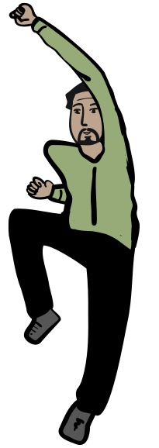
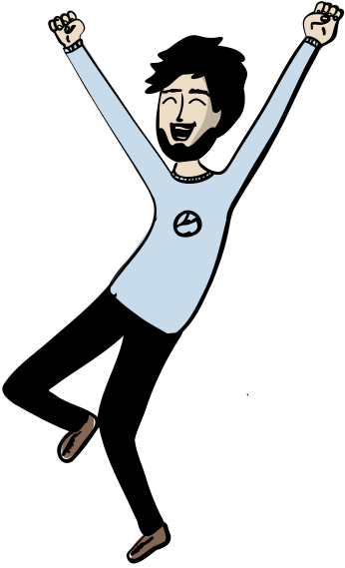

Result
YAYYY!!
Registration Completed!!

