Slide 1



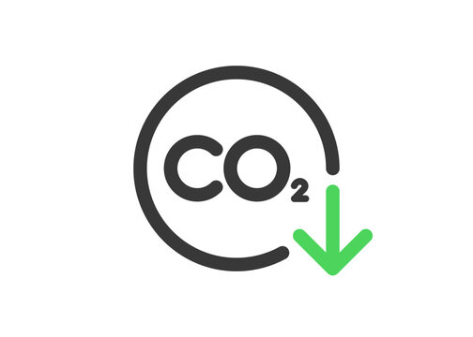
Greenovation Challenge 2025
Problem Statement - Decarbonising Power and Steel Sector
Team Name – DecarbonX
Theme - Decarbonisation

Slide 2

ECO-BHARAT
SOLUTION:
Electric Arc Furnace + Scrap Recycling → Replaces coal-heavy blast furnaces; uses scrap steel to reduce mining & coal usage.
AI-Driven Digital Plant Manager → Real-time CO₂ optimization, furnace load scheduling, and energy efficiency.
Carbon-Aware Scrap Sourcing → AI selects suppliers based on CO₂ footprint, distance, and market carbon pricing.
Dynamic Scrap Composition → AI predicts optimal scrap mix daily for higher yield and lower cost.
UNIQUE VALUE PROPOSITION :
Reduces CO₂ emissions by up to 60%(Based on global benchmarks (World Steel Association, McKinsey, 2023).
Improves energy efficiency & cost optimization
Integrates AI + sustainability + smart steel production in a single system

Slide 3
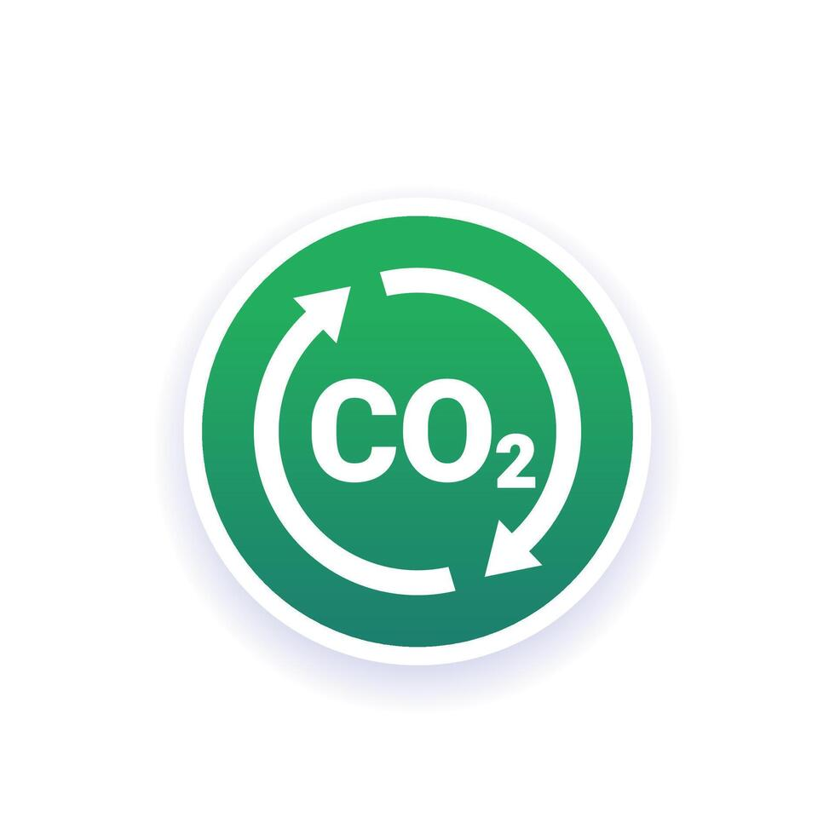
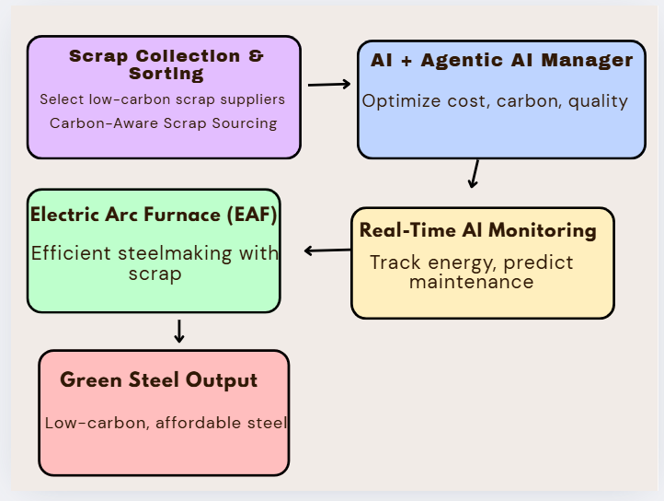

Slide 4

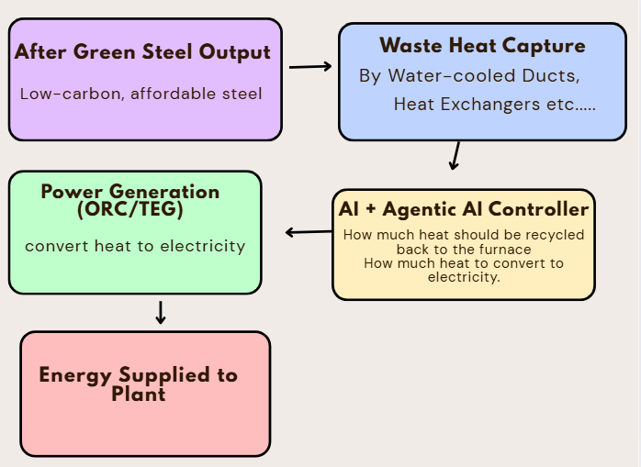
MAXIMIZING IMPACT : STEEL WASTE AS POWER SOURCE

Slide 5

FEASIBILITY:
Uses proven steelmaking and heat recovery tech with AI models for real-time control, making implementation technically achievable and adaptable to existing plants.
VIABILITY:
Delivers strong economic savings, meets stringent CO₂ emission regulations, and scales across steel plants using scrap and EAF, ensuring market acceptance and growth potential.
IMPACT:
Reduces carbon emissions significantly by shifting from coal-based blast furnaces to AI-optimized scrap-fed Electric Arc Furnace steelmaking.{First mainly focusing on pilot}

Slide 6
GLOBAL PERSPECTIVE:
Steel industry contributes 7–8% of global CO₂ emissions .
Rising global pressure for net-zero steel by 2050 .
INDIA’S URGENCY:
India IS 2nd largest steel producer .
Steel sector accounts for 12% of India’s CO₂ emissions.
Growing demand: India’s steel demand expected to double by 2030.
Government push: National Green Hydrogen Mission + Carbon neutrality by 2070.

Slide 7
COST SAVINGS :
Scrap-fed Electric Arc Furnace (EAF): 20–30% cheaper than coal-heavy blast furnace.
AI-driven optimization: Saves 10–15% energy costs.
Reduced dependency on imported coking coal , billions saved annually.
MARKET OPPURTUNITY:
Global Green Steel market projected to reach $500B+ by 2035.
Indian steel exports can gain a green premium in EU/US markets (Carbon Border Adjustment Mechanism).
Rising investor & policy support for low-carbon steel projects.

