Slide 1
Analysis of British Airways Reviews
Task 1

Slide 2
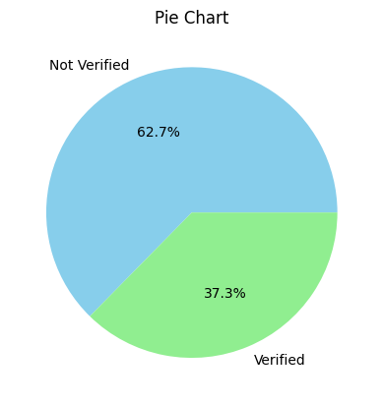
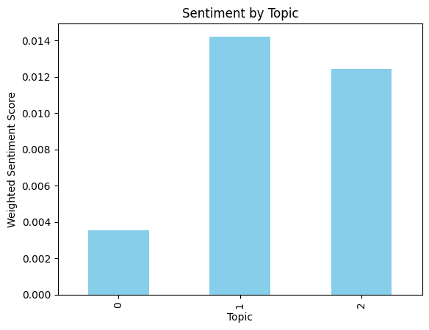
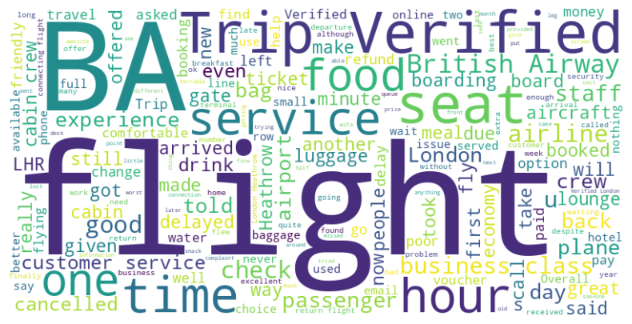
More than half of the people are Not Verified
As shown in the Sentiment by Topic bar chart, all the values are positive which suggests positive sentiment
Since the values are close to zero, this shows mild positivity. This could indicate that the customers were satisfied but not extremely happy with the service provided.

