Slide 1
Nutrition agent
IBM HACKATHON PROJECT
Presented By: Ashritha S
Student name : Ashritha S
College Name : City Engineering College
Department : CSE

Slide 2
OUTLINE
Problem Statement
Technology used
Wow factor
End users
Result
Conclusion
Git-hub Link
Future scope
IBM Certifications

Slide 3
Problem Statement
Today, more people want to eat healthy — but most nutrition apps just give one-size-fits-all meal plans. They don’t adapt to each person’s unique health needs, allergies, cultural food habits, or changing goals. For dieticians too, it’s hard to scale personalized guidance for every client in real-time.

Slide 4
Problem Statement
We created a Nutrition AI Agent — a smart virtual assistant that acts like your personal diet coach. It: ✔️ Designs daily and weekly meal plans just for you ✔️ Suggests recipes that fit your taste, culture, and health goals ✔️ Tracks what you eat and adjusts plans automatically ✔️ Answers nutrition questions anytime — like a 24/7 dietitian

Slide 5
Technology used
We built the agent using the various technology provided by IBM Cloud Service with the Lite version.
IBM Watsonx AI Studio — to develop and train the AI
Natural Language Processing (NLP) — so it understands your queries naturally
Retrieval-Augmented Generation (RAG) — to find the best answers from trusted nutrition data
The IBM Granite Language Model — for smart, human-like responses
APIs to connect with health trackers or wearable devices
Tools – Google search, duckduckgo, Wikipedia search, webcrawler.

Slide 6
IBM cloud services used
IBM Cloud Watsonx AI Runtime :
It provides a secure, scalable environment to deploy and run AI models in production. It makes sure your AI models run reliably and deliver fast, accurate responses to real users — whether you have 10 or 10 million requests.
IBM Cloud Watsonx AI Studio :
It is a collaborative environment where you can build, train, and fine-tune AI models with powerful tools and ready-made datasets. It lets developers and data scientists work together to turn ideas into AI-powered solutions — all in the cloud, with minimal setup.
IBM Cloud Agent Lab :
It is an interactive sandbox where you can design, test, and manage AI-powered agents — like your Nutrition Assistant! It helps you connect different AI services, fine-tune conversations, and see how your agent responds in real time before launching it live.
IBM Granite Foundation Model :
It is a large, pre-trained language model that understands natural language and generates human-like responses. It’s AI Agent’s ability to understand questions, retrieve relevant nutrition info, and give clear, conversational answers.

Slide 7
IBM cloud services used
Lets see how the flow takes place:
Step 1: You chat with the agent — share your goals, allergies, preferred cuisines. Step 2: NLP processes your input, checks your data. Step 3: The AI uses RAG to pull verified nutrition info. Step 4: It generates a daily/weekly plan — you can accept, tweak, or ask for alternatives. Step 5: It keeps learning — if your weight drops, the plan adjusts! Step 6: Get smart grocery lists and recipe instructions.

Slide 8
Wow factors
Unlike generic diet apps, our AI agent delivers truly personalized, real-time meal guidance that adapts as your lifestyle changes.” “It’s like having a dedicated nutritionist in your pocket — smart, culturally aware, and always ready to help you eat better!”
Unique features:
✅ Fully customized meal plans – not generic charts. ✅ Real-time updates as your lifestyle changes. ✅ Supports regional & cultural food preferences — not just western diets. ✅ Detects food allergies & medical restrictions automatically. ✅ Connects with wearables for health insights. ✅ Generates shopping lists, tracks leftovers, reduces food waste. ✅ Available via easy chat option.

Slide 9
End users
Anyone who cares about eating right — from individuals and families to dietitians and wellness coaches. Empowering everyday people and professionals with smarter, tailored nutrition guidance,
Individuals and families looking for daily personalized nutrition advice
Patients with dietary restrictions or medical conditions
Nutritionists and dieticians wanting an AI assistant to scale their services
Fitness trainers and gyms offering combined diet and workout plans
Health and wellness startups integrating smart meal planning
Schools, hostels, and institutions planning balanced menus
Corporate wellness programs supporting employee health
Remote or underserved communities with limited access to experts
People with specific health goals like weight loss or fitness

Slide 10
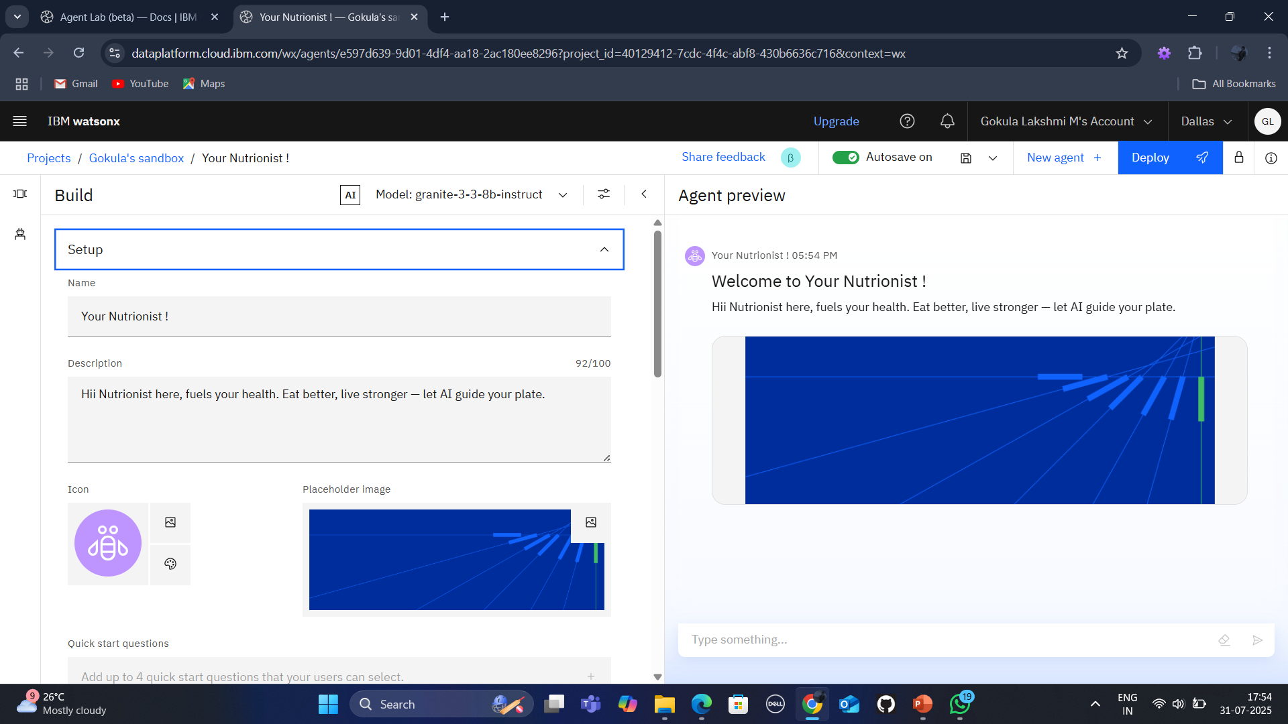
Results
Firstly, I have login to my IBM Cloud account and choosen lite cloud version. With help of wastonx.ai I have created an sandbox. And created an project in it called Nutritionist agent. And I have developed in it Agent Lab. Here I have customized the agent icon and placeholder’s background. Added an Description to it.

Slide 11
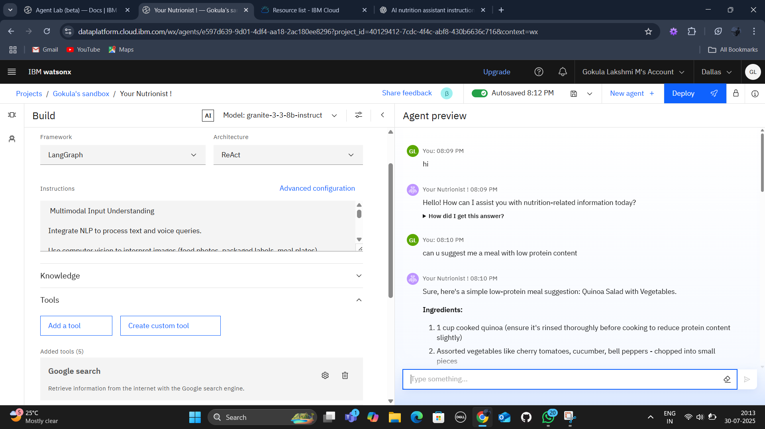
Results
Under build section I have specified the following:
Framework : LangGraph
Architecture : ReAct
Instructions : it includes what my agent have to do kinda of information.
Configuration : it is configured to reply to only questions related to food and neglects questions like what is python? Or sports or any others.
Knowledge : here I have uploaded an pdf consisting of information about the low protein in childrens.
Tools : Enabled Google search, Wikipedia search, DuckDuckgo etc.

Slide 12
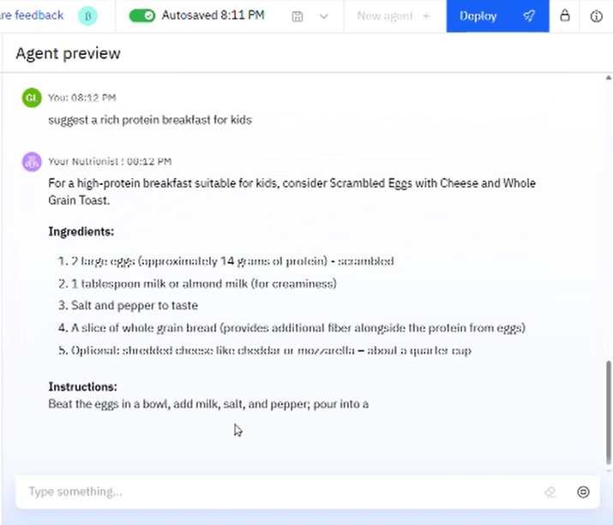
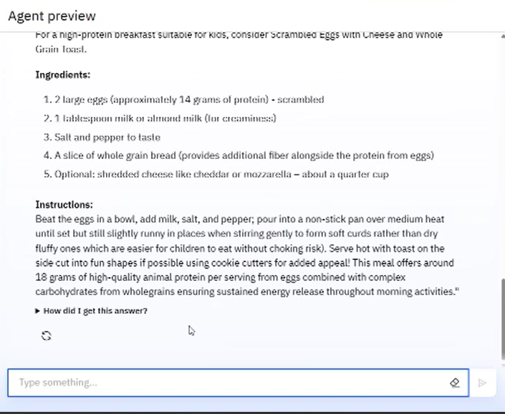
Results :
Final preview of my Nutritionist Agent

Slide 13
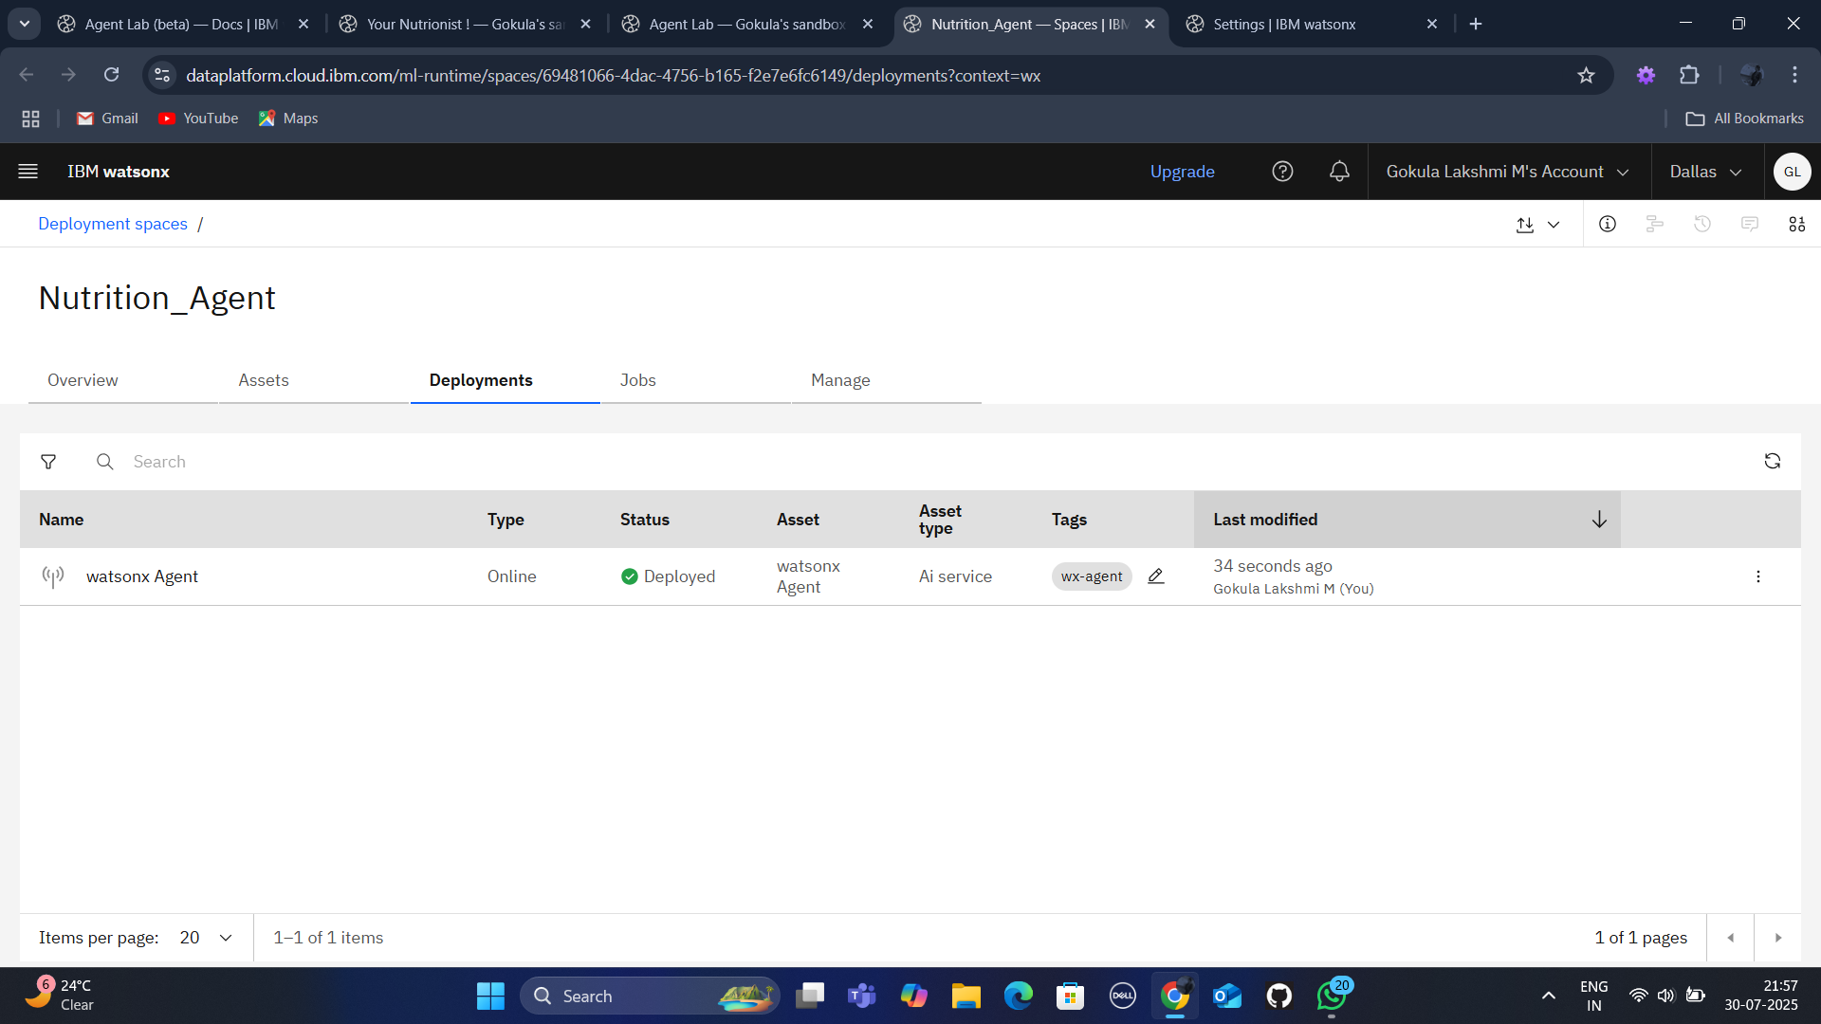
Results:
Successful deployment of my watsonx ai Agent.
Deployed AI Agent

Slide 14
Conclusion
The Nutrition AI Agent makes personalized, expert nutrition guidance available to everyone, anytime.
It removes the guesswork of generic diets by adapting to each person’s unique health goals and lifestyle.
It saves time for users and helps nutritionists and trainers reach more people effectively.
This project shows how AI can empower healthier living and build a future where smart eating is easy and accessible for all.

Slide 15
Future scope
Add voice support for hands-free interaction
Connect with fitness wearables for real-time data
Support multiple languages for global reach
Suggest recipes based on local, seasonal foods
Partner with grocery apps for easy ordering
Predict health trends and suggest proactive changes

Slide 16
GitHub Link
I have completed and uploaded my project details in my Github account.
Github link : NUTRITION AGENT GITHUB LINK
In Github I have attached few snapshots of my Agent development, preview and deployment stages, ppt of my project, as well as the readmd file.

Slide 17
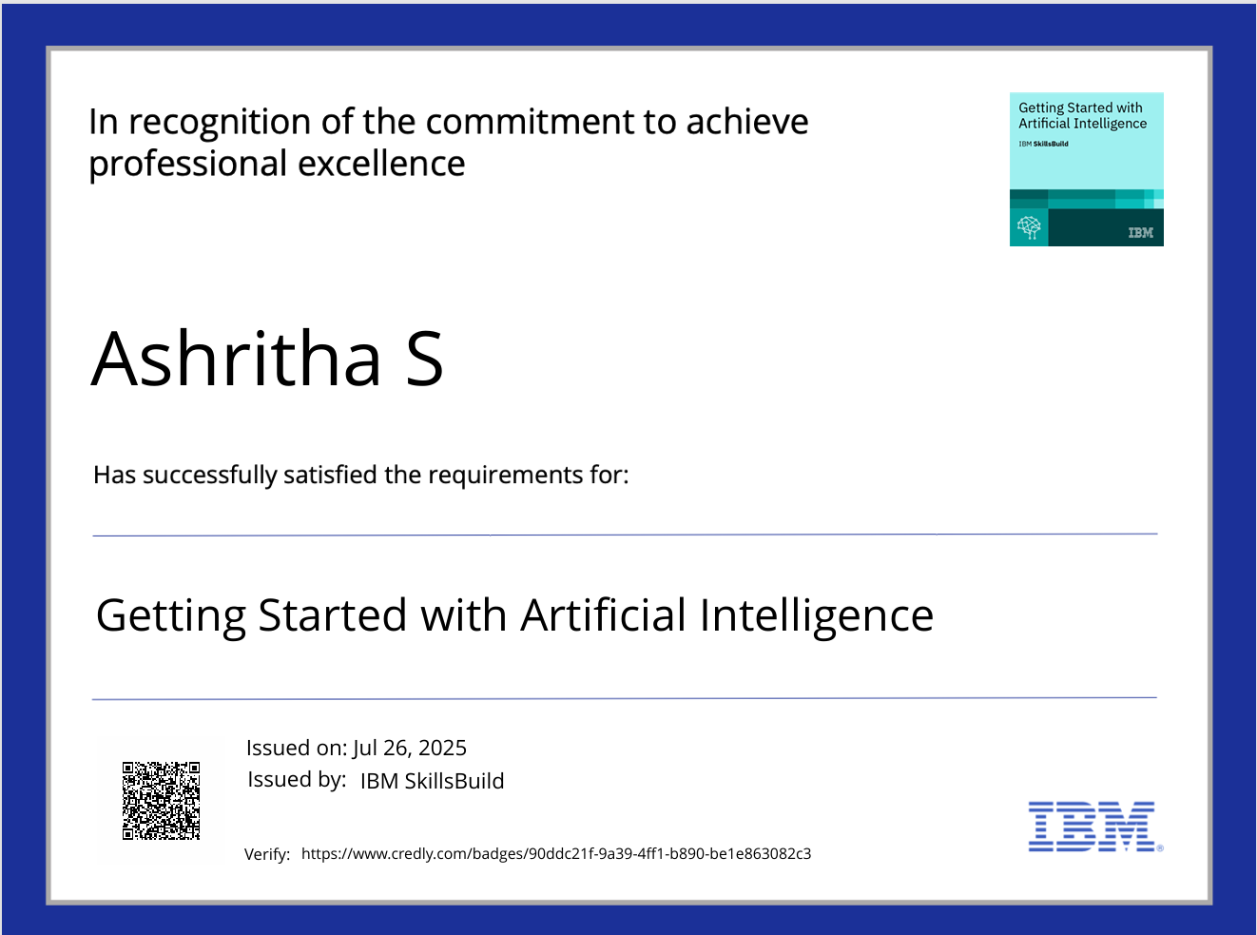
IBM Certifications
Here is my Getting Started with Artificial Intelligence of Credly.

Slide 18
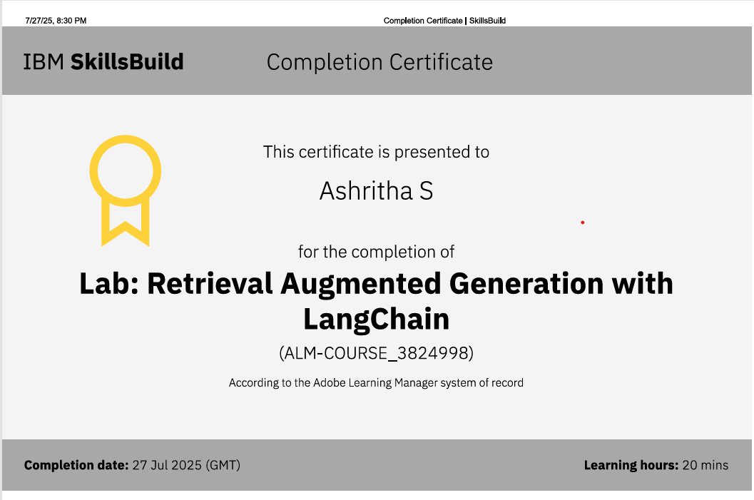
IBM Certifications
Here is my IBM Certificate of Retrieval Augmented Generation with LangChain

Slide 19
THANK YOU

