Slide 1

Department of Information Technology B.Tech IV year I Sem
IT – C
Batch : 2018 - 2022
Ashrith BR
Aakanksha Reddy
Satwik P
18311A12C7
18311A12F2
18311A12F3
Under the Guidance of
Dr.N.Divya
Assistant Professor Department of IT.
Team Number - 17

Slide 2

HAND GESTURE RECOGNITION
TABLE OF CONTENTS
Abstract
Existing System
Prosposed System
Software Requirments
Hardware Requirments
Software Requirment Specifications
Architecture
Analysis Model

Slide 3
TABLE OF CONTENTS
Structure design
Module Function
Technical Representation
UML Diagrams

Slide 4
ABSTRACT
In this we have discussed a low cost system which uses dynamic hand gesture recognition technique to control the VLC media player. This application contains a central computation module which segments the foreground part of the frame using skin detection and approximate median technique. This hand gesture recognition technique introduces a new, natural way to interact with computers.

Slide 5
EXISTING SYSTEM
In Recent Years,They increasingly influence many aspects of our lives; for example, the way we communicate, the way we perform our actions, and the way we interact with our environment. Thus a new concept of interaction emerged, Human Computer Interaction (HCI). Although computers have made tremendous advancements, the common HCI still relies on input devices such as keyboard, mouse, and joysticks. By the underlying prototype, users express their significance to the computer, a user using their hands to perform button clicks, positioning the mouse and key presses. This is rather an unnaturally restrictive way of interacting with end user systems.

Slide 6
PROPOSED SYSTEM
In this we are going to present an application which uses dynamic hand gestures as input to control the VLC media player. We have considered single handed gestures and their directional motion defines a gesture for the application. In this application image acquisition is done using a Webcam. Some functions in VLC media players are used more frequently and thus applying controls VLC media player for those functions using predefined gestures.

Slide 7
PURPOSE
This document is the only one that describes the requirements of the system. It is meant for the use by the developers, and will also by the basis for validating the final deliver system. Any changes made to the requirements in the future will have to go through a formal change approval process. The developer is responsible for asking for clarifications, where necessary, and will not make any alternations without the permission of the client.

Slide 8
SCOPE
The purpose of this document is to describe all external requirements for the E-learning System. It also describes the interfaces for the system.

Slide 9
Functional System Requirements
1) There should not be any object between the camera and hand of the user in order for
a successful tracking.
2)The software should take the input from the user.
3) The system should detect the gesture present in the image.
4)The software should be able to pre-process the gesture.
5)The software must be able to display the output.

Slide 10
Non-Functional System Requirements
Extensibility: The software shall be extensible to support future developments and add-ons to the HGR software. The gesture control module of HGR shall be at least 50% extensible to allow new gesture recognition features to be added to the system.
Performance: This software shall minimize the number of calculations needed to perform image processing and hand gesture detection. Each captured video frame shall be processed within 350 milliseconds to achieve 3 frames per second performance.
Usability: This software shall be easy to use for all users with minimal instructions. 100% of the languages on the graphical user interface (GUI) shall be intuitive and understandable by non-technical users.
Portability: The HGR software shall be 100% portable to all operating platforms that support Java Runtime Environment (JRE). Therefore, this software should not depend on the different operating systems.
Reliability:The HGR software shall be operable in all lighting conditions. Regardless of the brightness level in user’s operating environment, the program shall always detect user’s hands.

Slide 11
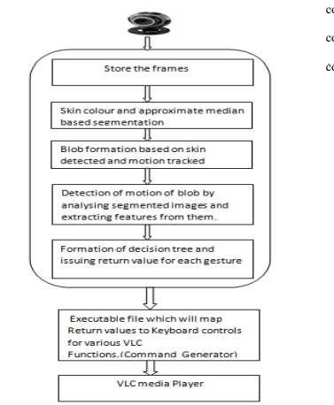
System Architecture

Slide 12
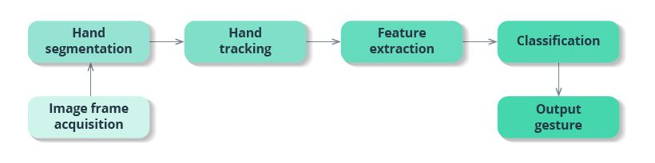
1) Data Flow Diagram

Slide 13
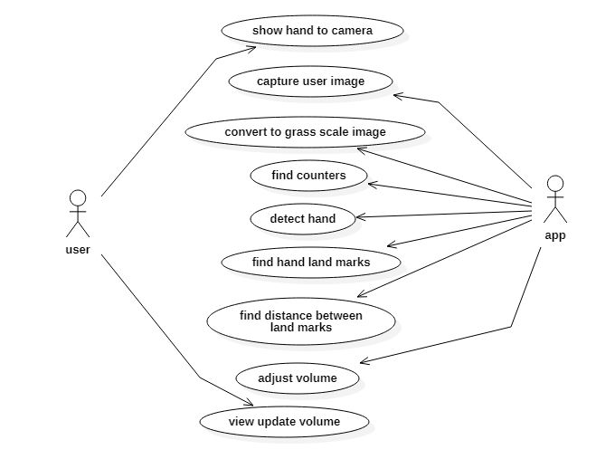
Use Case Diagram
A use case diagram in the Unified Modeling Language (UML) is a type of behavioral diagram defined by and created from a Use-case analysis. Its purpose is to present a graphical overview of the functionality provided by a system in terms of actors, their goals (represented as use cases), and any dependencies between those use cases. The main purpose of a use case diagram is to show what system functions are performed for which actor. Roles of the actors in the system can be depicted.

Slide 14
Implementation
Code Execution

Slide 15
Thankyou

