Slide 1
Presentation on Traffic Signs Classification Using CNN carried out as part of group project
B.R.Ashrith Under the guidance of
RollNo:18311A12C7 Ms.K.Srilaxmi
Moveena Niteshini
RollNo:18311A12D0
Rohith Dabla
RollNo:18311A12G3

Slide 2
Contents
Abstract
Introduction
Software and Hardware Requirements
Existing System
Proposed System
System Design
System Implementation
Source code
Output screens
Future Enhancement
Conclusion
References

Slide 3
Abstract
This project presents an effective solution to detecting traffic signs on road by first classifying the traffic sign images using Convolutional Neural Network (CNN) on the German Traffic Sign Recognition Benchmark (GTSRB)and then detecting the images of Indian Traffic Signs using the Indian Dataset which will be used as testing dataset while building classification model. Therefore this system helps electric cars or self driving cars to recognize the traffic signs efficiently and correctly. The system involves two parts, detection of traffic signs from the environment and classification based on CNN thereby recognizing the traffic sign. The classification involves building a CNN model of different filters of dimensions 3 × 3, 5 × 5, 9 × 9, 13 × 13, 15 × 15,19 × 19, 23 × 23, 25 × 25 and 31 ×31 from which the most efficient filter is chosen for further classifying the image detected.

Slide 4
Introduction
Developing an automated driver guidance system is very important in the context of Indian road conditions. Be it a human driver driving a car or a self driving car, following traffic signs on Indian roads is necessary. A lot of traffic sign violations are seen and heard of ,mainly the reasons for which are over speeding, broken traffic signs, distorted signs, night time conditions, etc.
In case of self driving cars, if such conditions prevail it will hardly be able to recognize the traffic sign and may cause serious problems for all vehicles surrounding it. Road safety is always a problem everywhere, especially in developed countries like the US, India etc. Thus it is necessary to develop a system which will help recognize traffic signs without being affected by these anomalies. Ultimate aim of such Intelligent Transport Systems is to realize fully autonomous vehicles. To identify road boundaries and barriers, well as recognize road signs, computer vision-based methods with high resolution can be used.
The manual control of road signs becomes more difficult as vehicle speeds increase. As a result, a vision-based road sign detection and recognition device is desirable for catching a driver’s attention and avoiding traffic hazards. For autonomous driving or driver assistance systems, automatic identification of traffic signals is important. There are some advantages to the issue of traffic sign identification. For starters, traffic sign designs are unique, so object variations are minimal. Further-more, sign colours often contrast well with the surrounding area. Furthermore, signs are rigidly arranged in relation to the environment, and are often placed in plain sight of the driver. The form and colour of traffic signs are often used in traffic sign detection algorithms

Slide 5
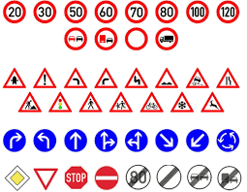
Traffic Signs

Slide 6
Software Requirements
Hardware Requirements
Operating System: Windows 10
Technology: Deep Learning, Image Processing, Machine Learning.
Programming Language: Python
IDE: Jupyter Notebook, PyCharm.
Softwarelibraries:Numpy,mathplotlib,scikitlearn, keras, Tensorflow, and OpenCV.
Hardware: Intel i5 processor 8th gen
Speed:1.2Ghz
RAM: 8GB
Storage: SSD Hardrive

Slide 7
Existing System
To solve the target recognition problem, most of the previous works use hand-crafted feature extracting methods like Scale-Invariant Feature Transform (SIFT) , Histogram of Oriented Gradient (HOG). Those conventional feature extraction methods, over-reliant on the designer’s experience, meet some restriction in feature expression. On the contrary, the deep network model based on CNN is more powerful in feature expression. CNN method, which possessing the characteristics of rotation, translation and scaling invariance, is able to realize weight sharing through local receptive fields. It’s widely used in the sub-area of target recognition e.g., image classification, face recognition and pedestrian detection.

Slide 8
Proposed System
In this project we will make two contributions; one is to develop a new dataset for Traffic and Road Signs and the other is develop and design a deep CNN architecture for Traffic sign recognition. The collected data set is given as an input to the proposed CNN architecture for training, validation and testing. The detailed explanation of the CNN architecture is provided in the next slide. Once the CNN is trained, it is ready to be used for classifying new images which were not part of the collected dataset. A Deep CNN architecture is also proposed for traffic sign recognition Generally, CNNs consist of multiple hidden layers between the input and output layers. The design of the proposed CNN is implemented using Python.

Slide 9
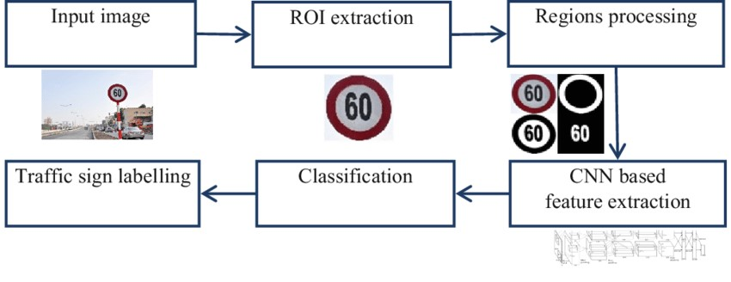
System Design
Architectural design

Slide 10
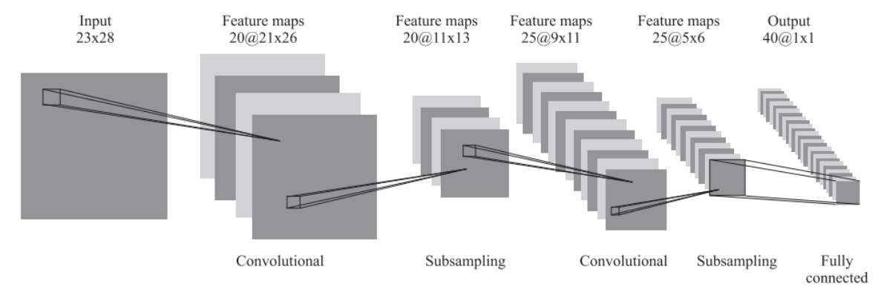
Convolutional Neural Network Structure

Slide 11
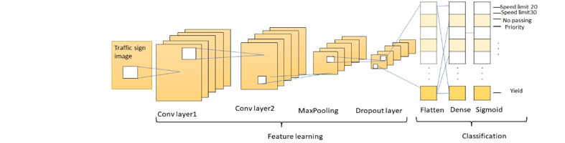
Convolutional Neural Network

Slide 12
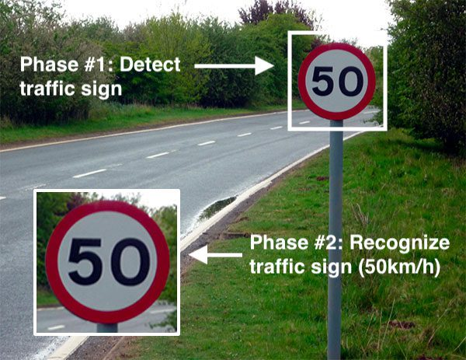

Slide 13
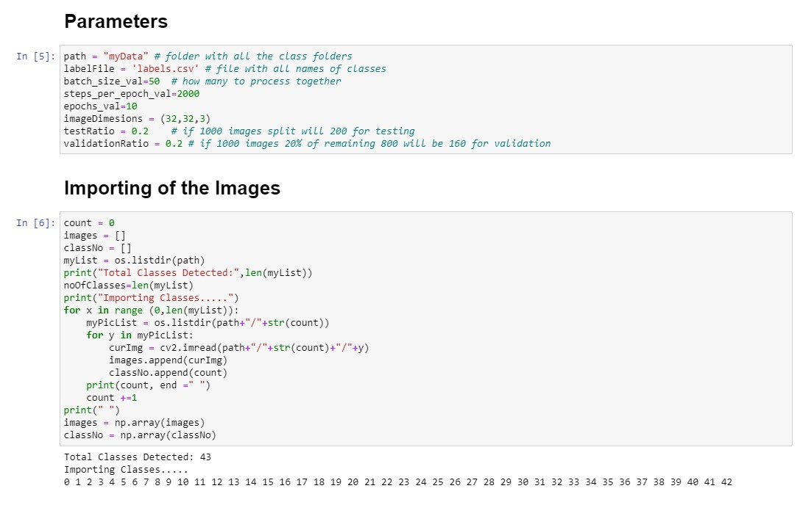
System Implementation
Data cleaning and preprocessing:
Reading the labels:

Slide 14
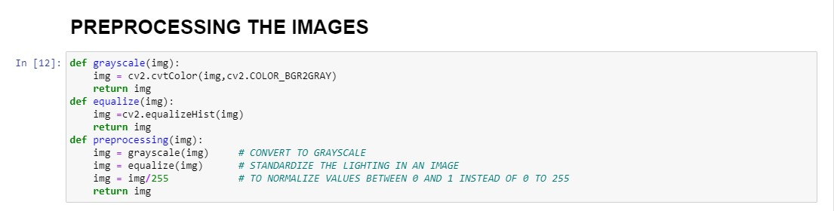
System Implementation
Reading and preprocessing the images:

Slide 15
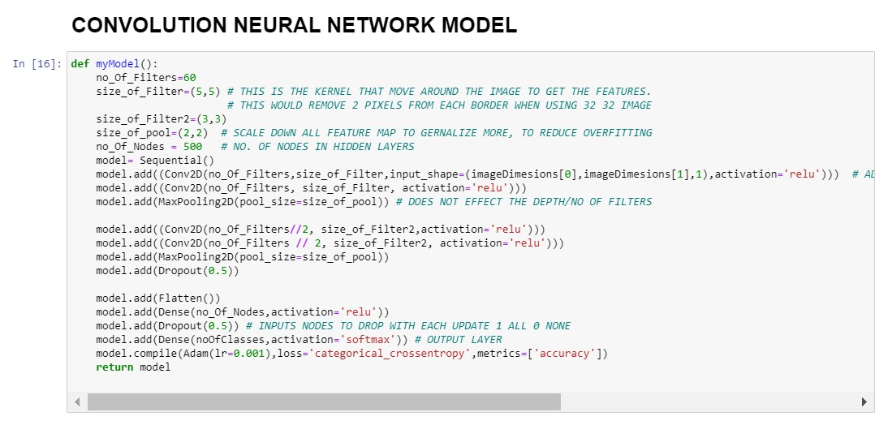
System Implementation
Building model architecture:

Slide 16
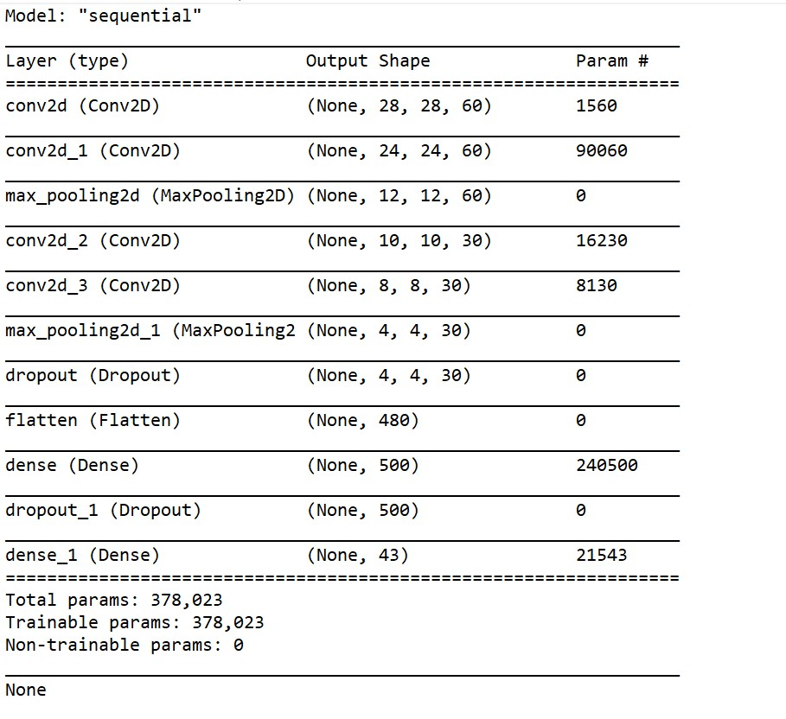
System Implementation
Parameters obtained:

Slide 17
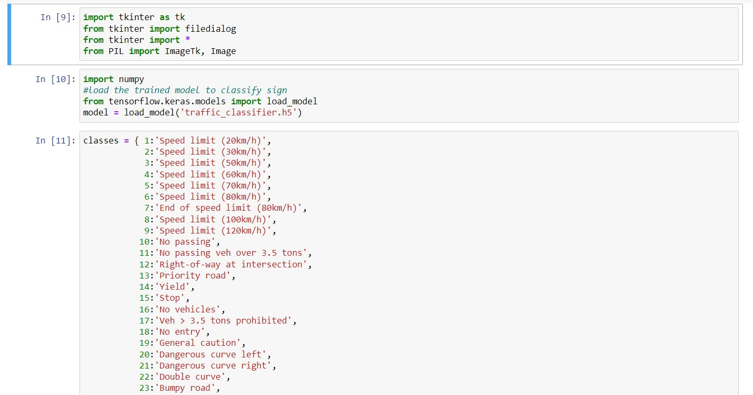
Source Code

Slide 18
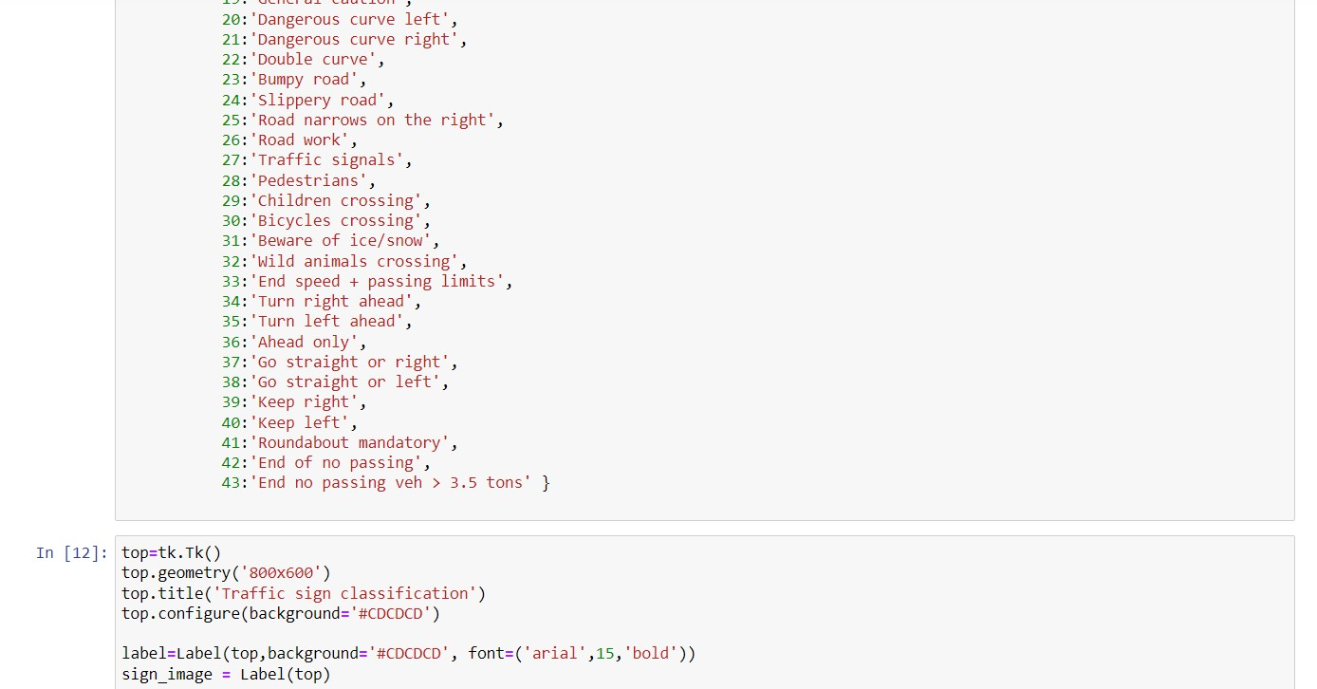
Source Code

Slide 19
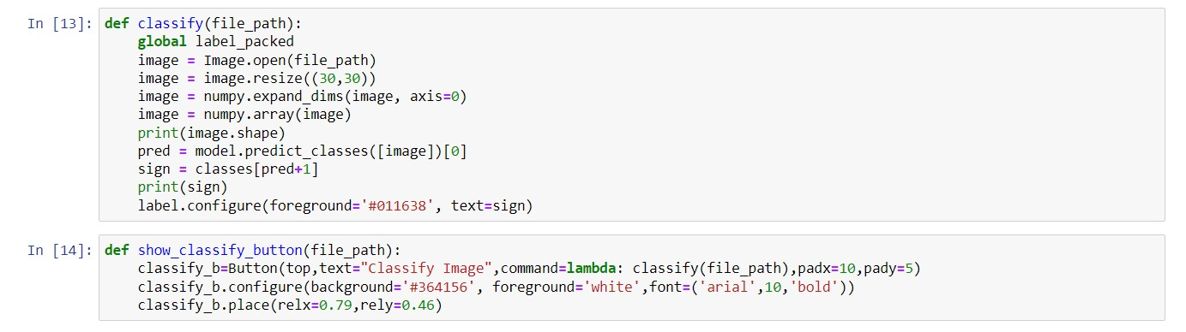
Source Code

Slide 20
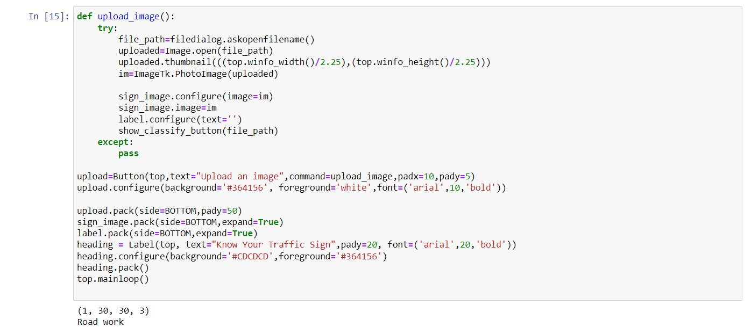
Source Code

Slide 21
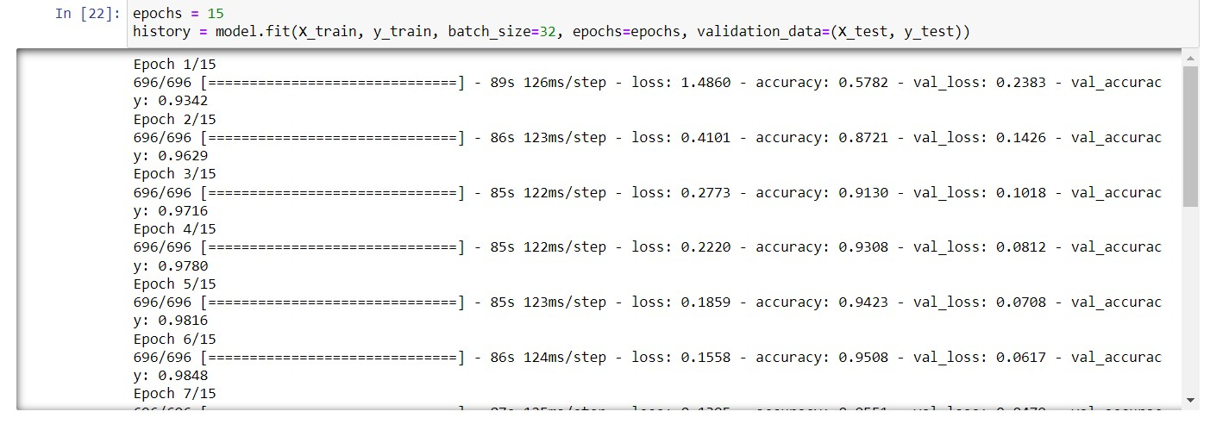
Output Screens

Slide 22
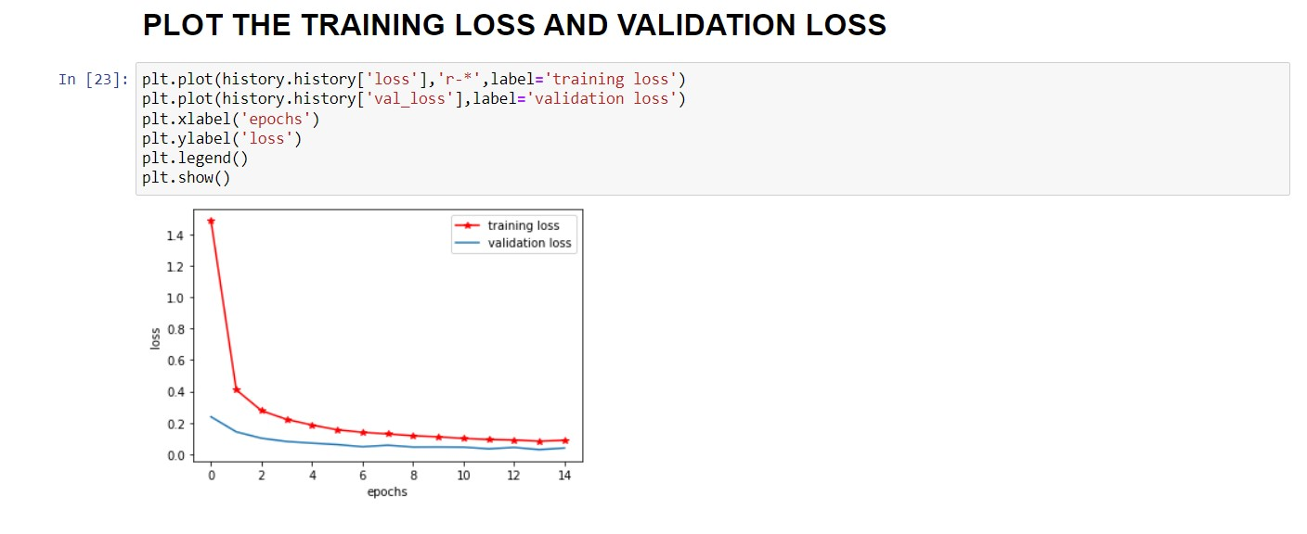
Output Screens

Slide 23
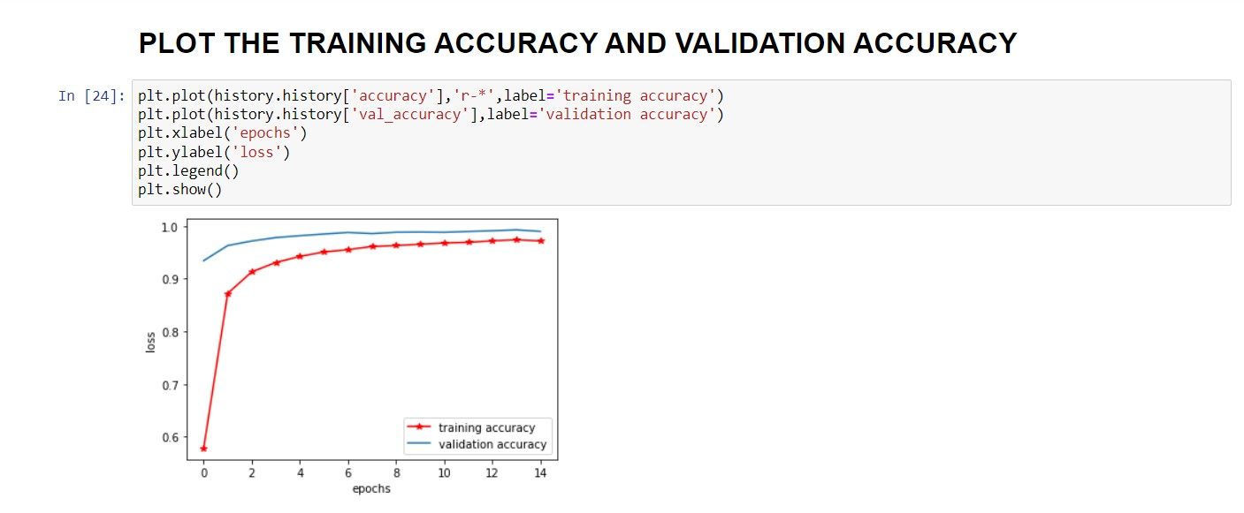
Output Screens

Slide 24
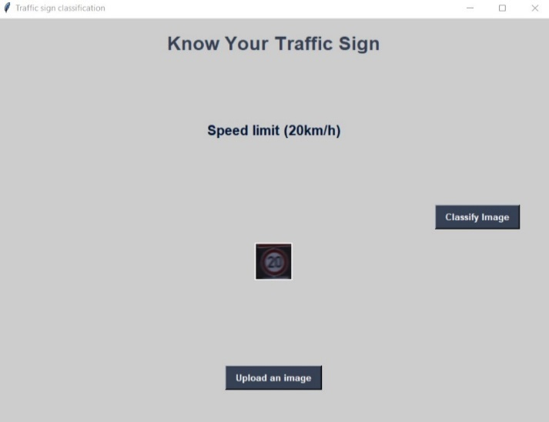
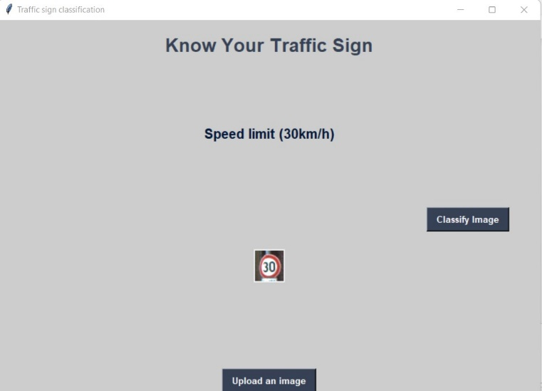
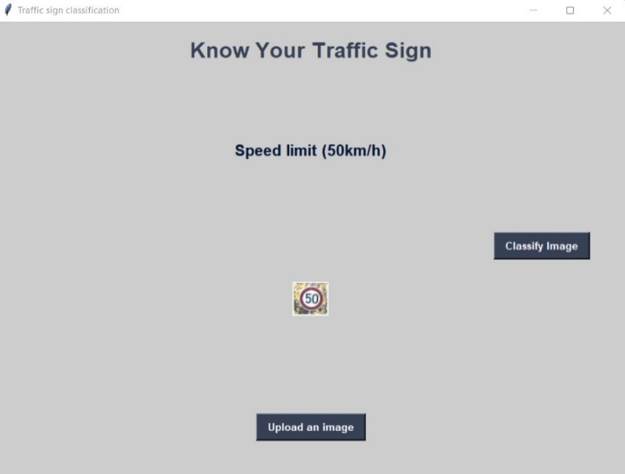
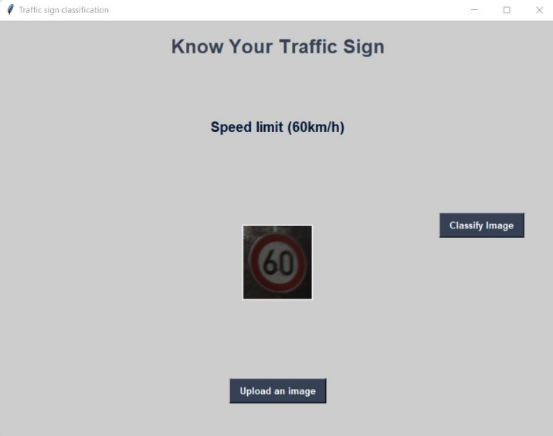
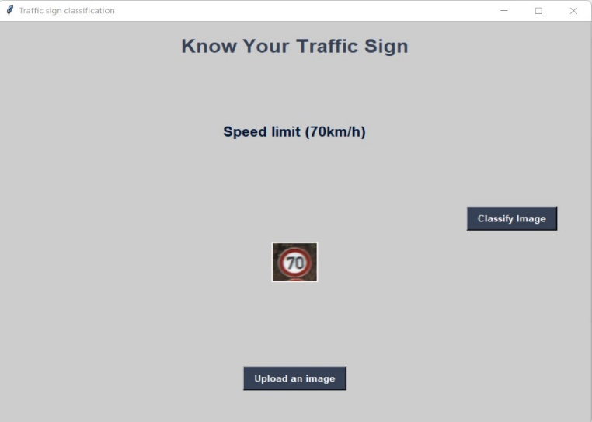
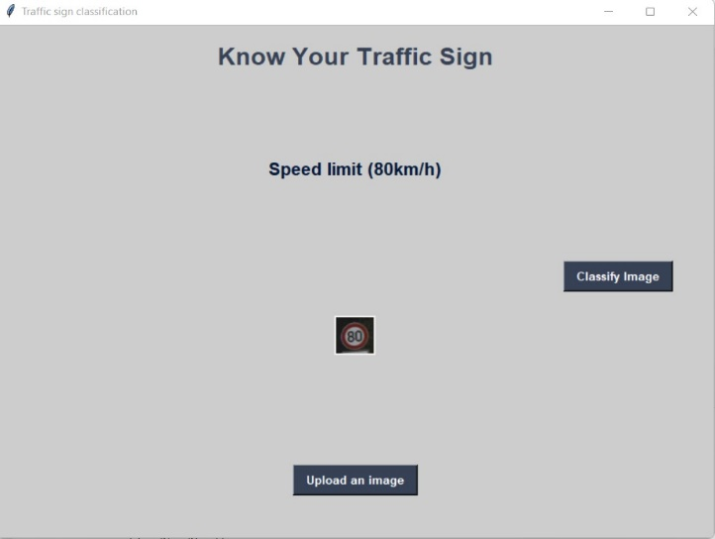
Output Screens

Slide 25
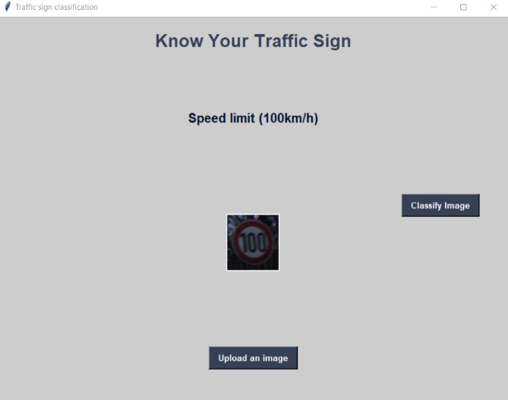

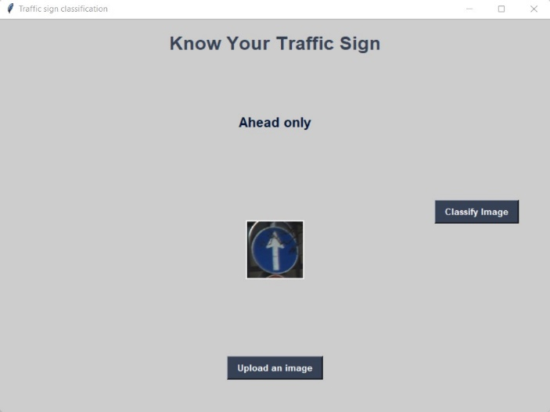
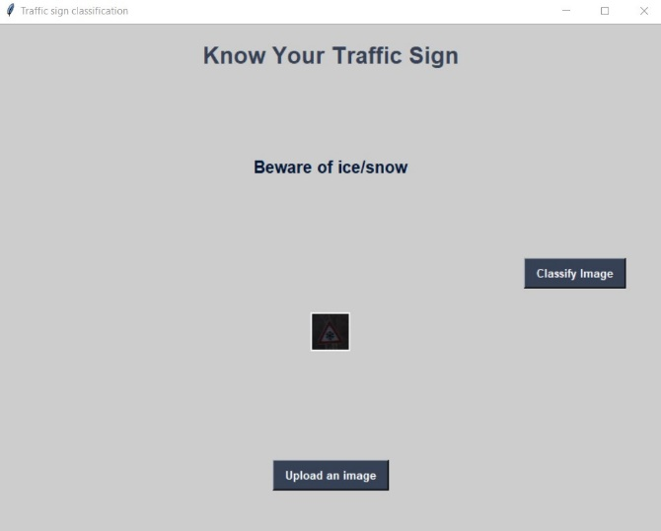
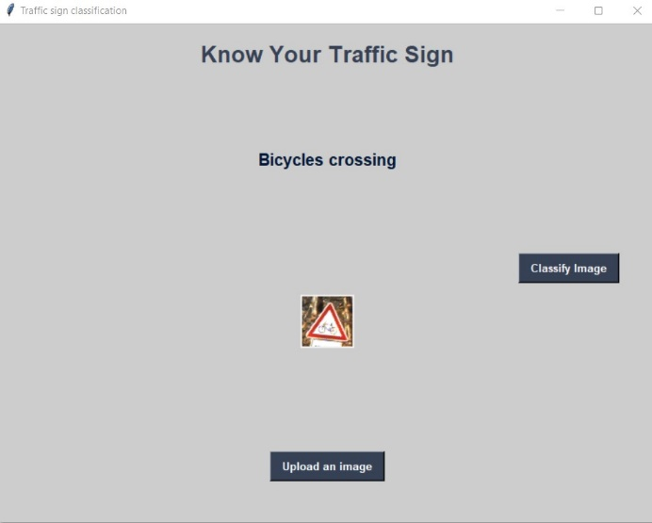
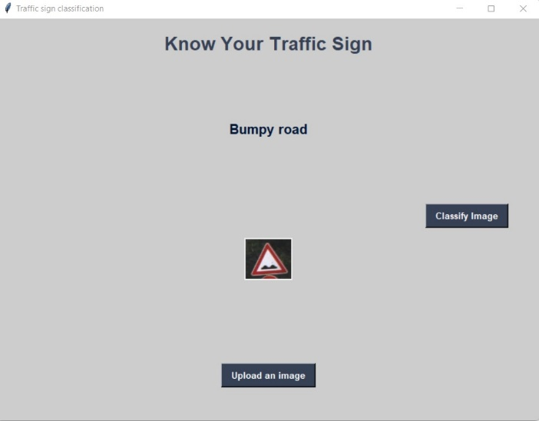
Output Screens

Slide 26
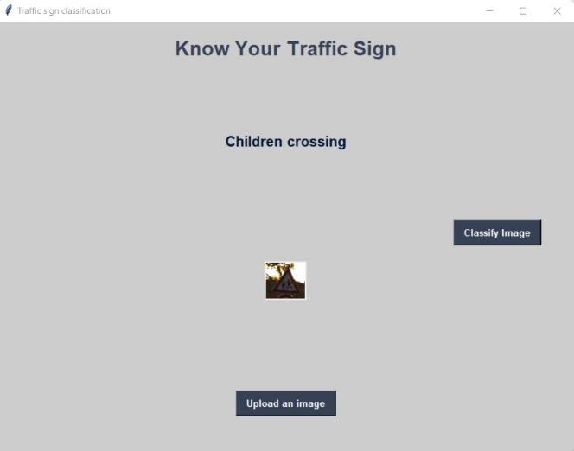

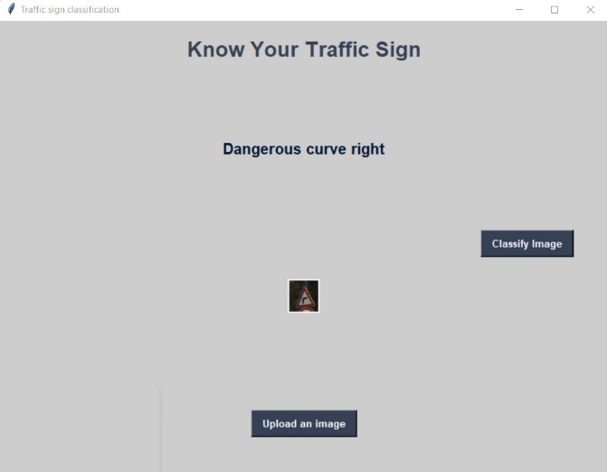
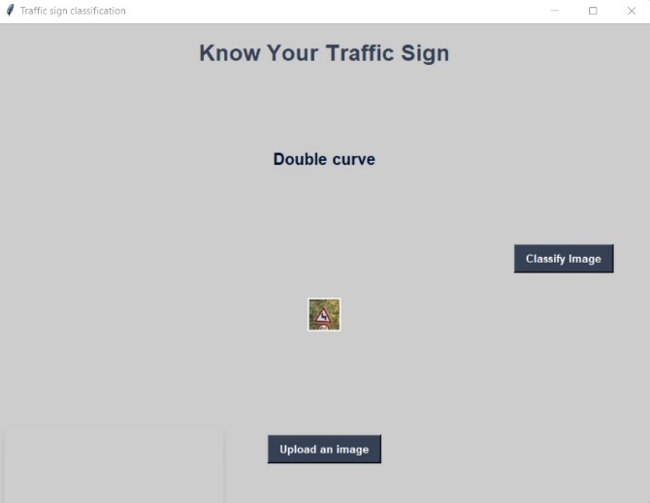
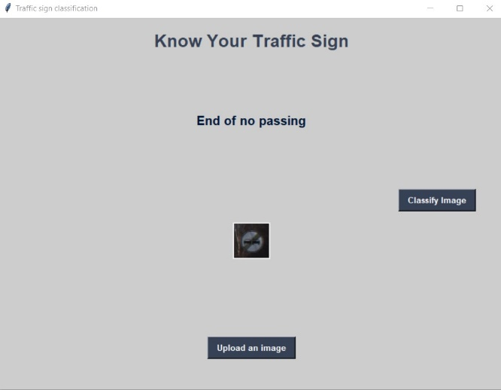
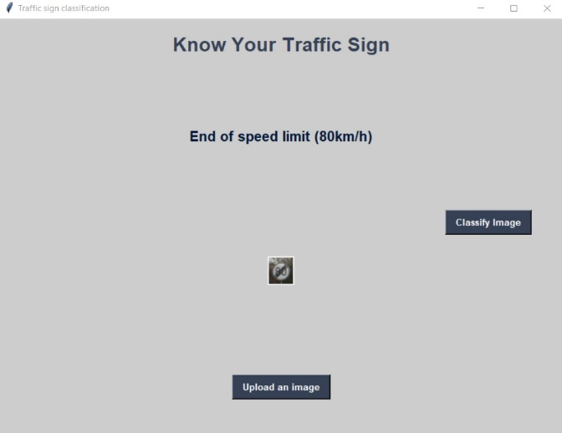
Output Screens

Slide 27
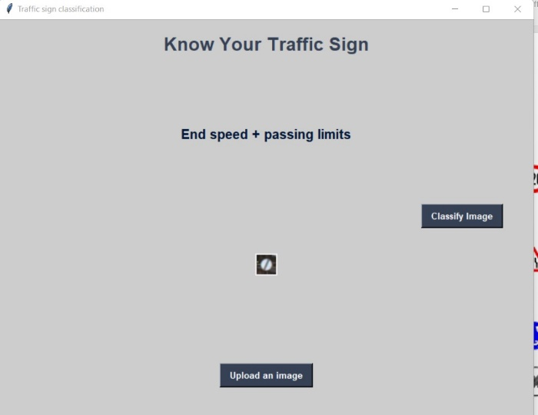
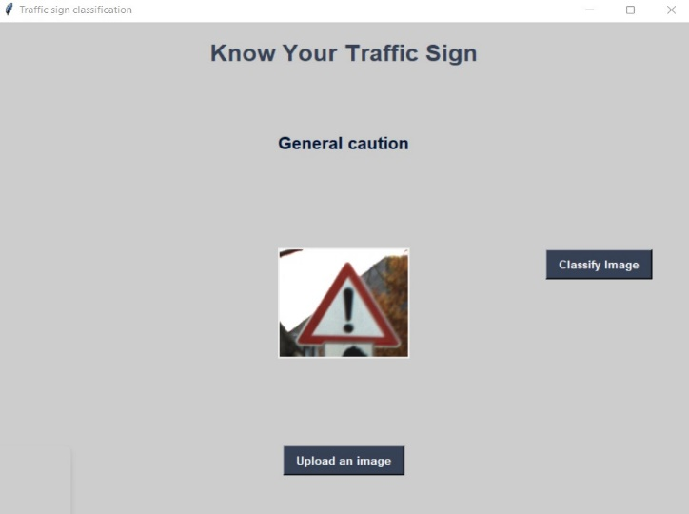
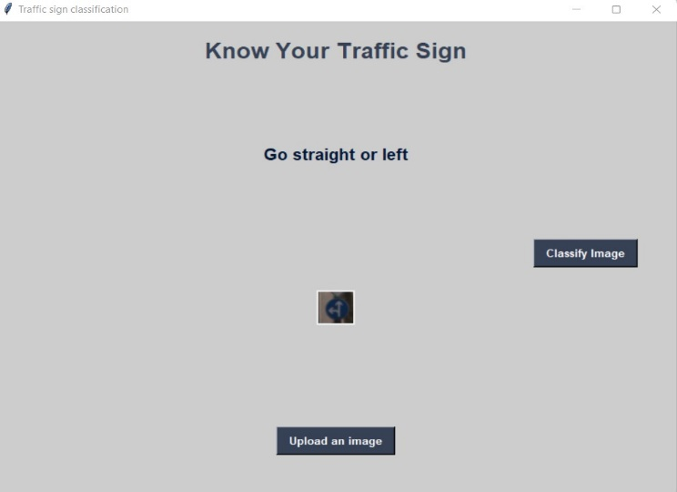
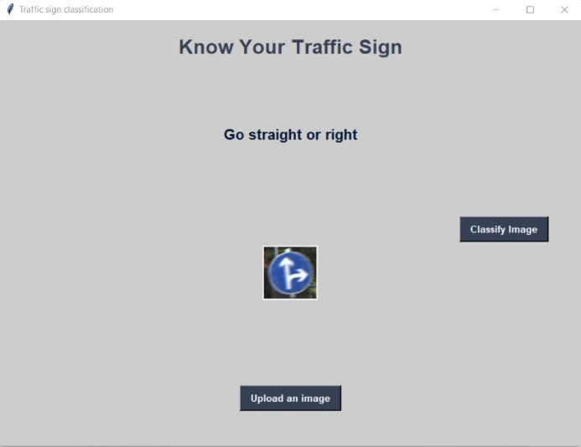
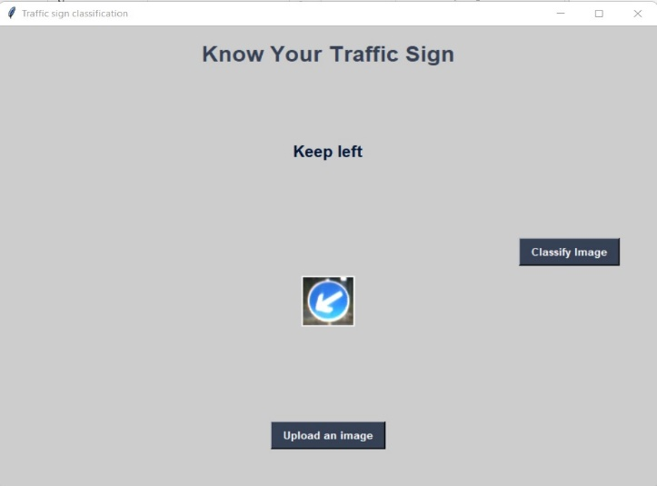
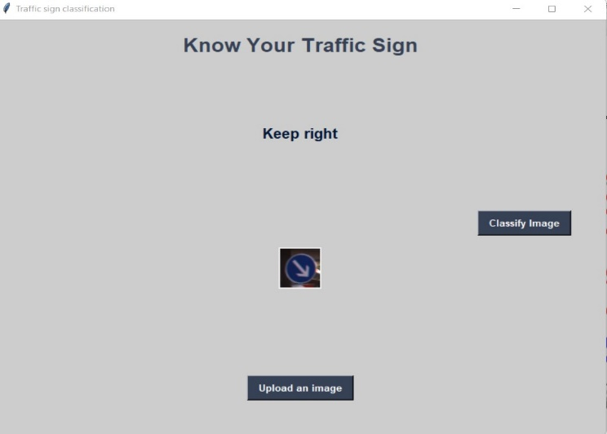
Output Screens

Slide 28
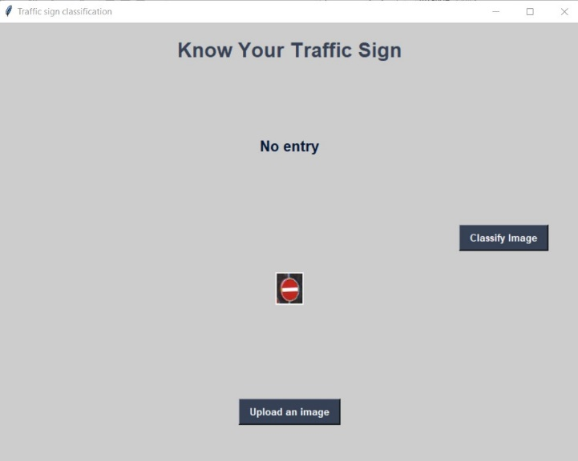
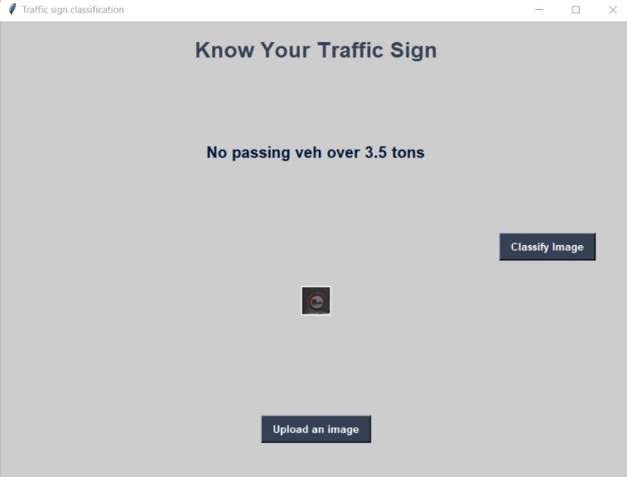
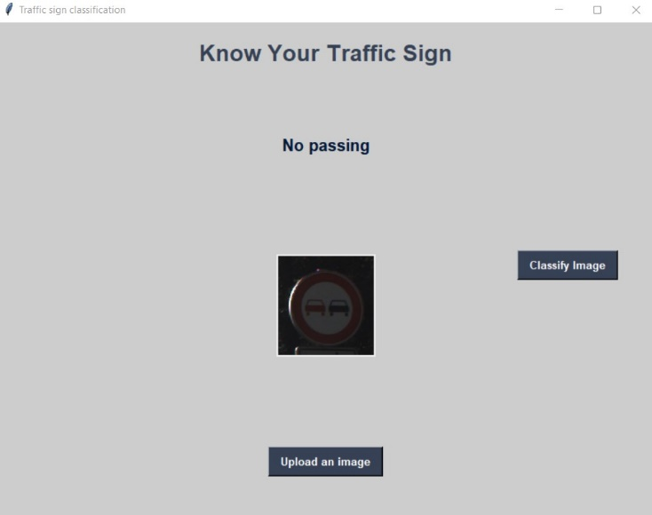
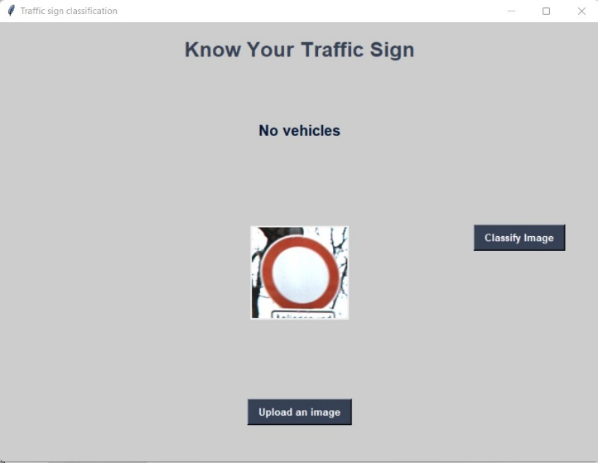
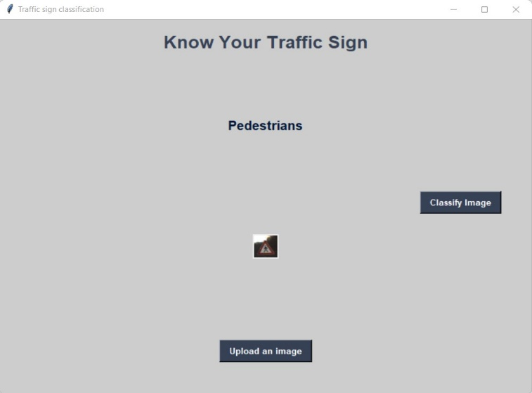

Output Screens

Slide 29
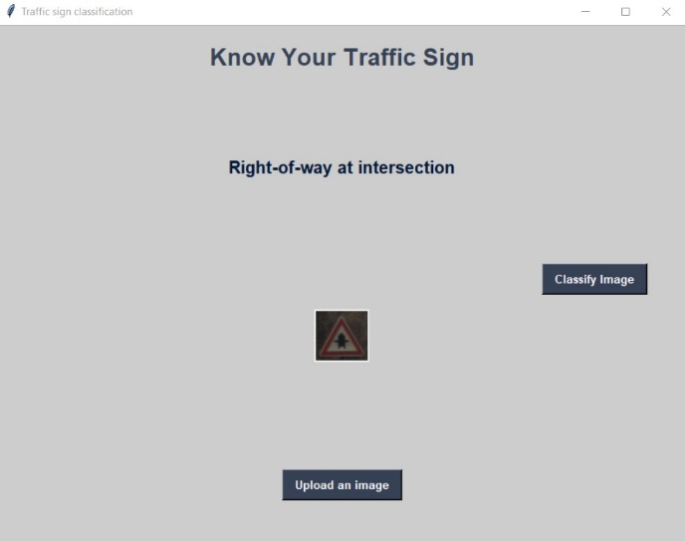
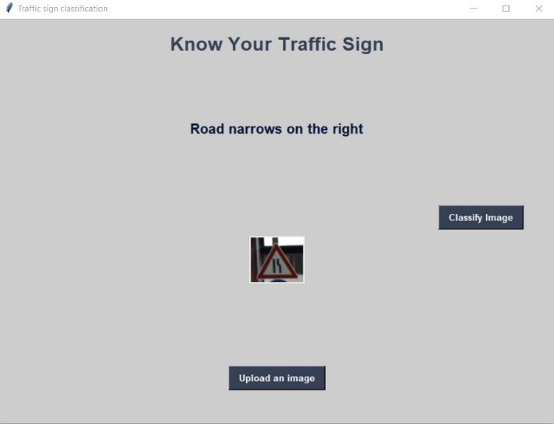
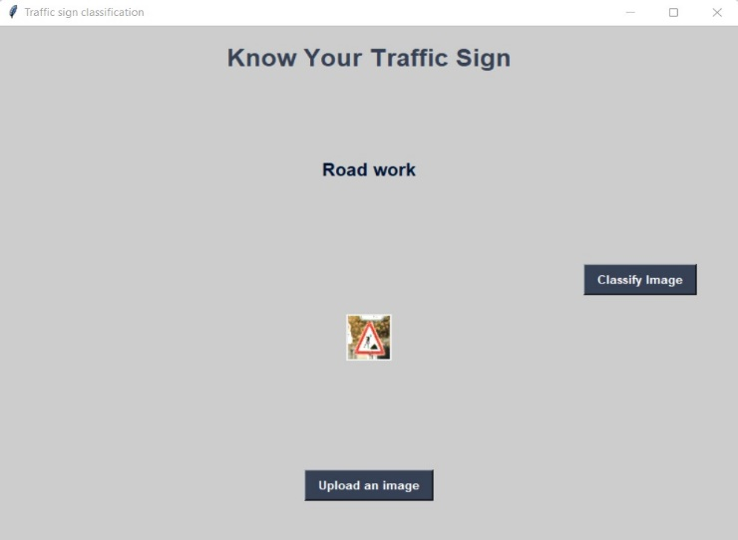
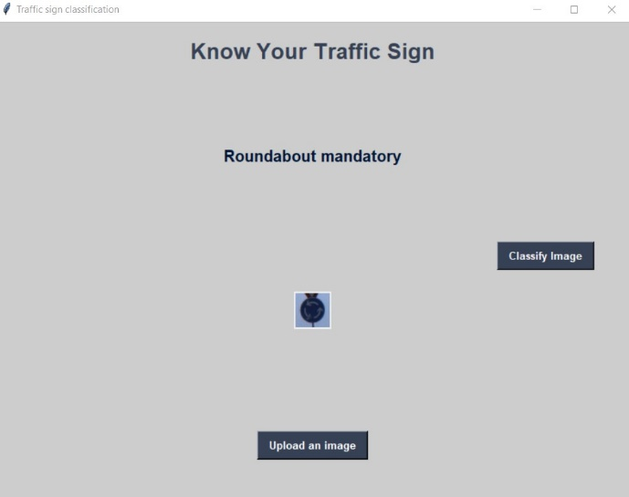
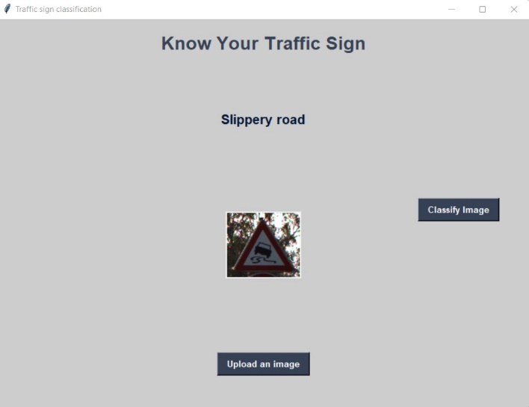
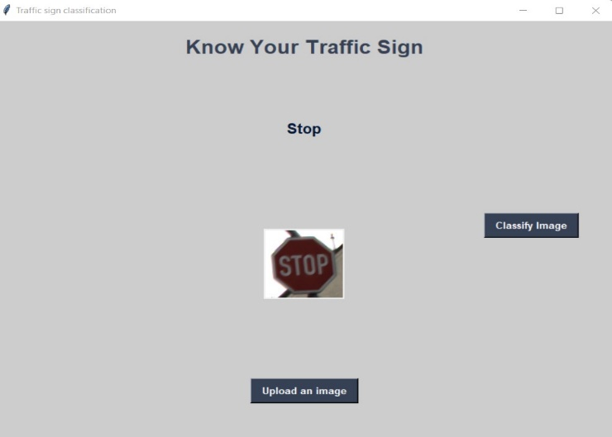
Output Screens

Slide 30
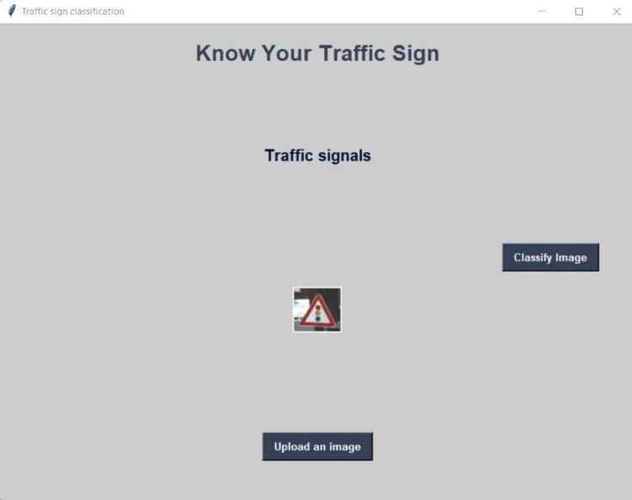





Output Screens

Slide 31
Future Enhancement
Another direction for further research is to develop a real time traffic sign recognition system which captures a video by a camera mounted on the vehicle, detects and recognises the traffic signs in real time and gives the result to the driver within a sufficient time frame in order to take the right action. More research can be done to make an AI that can verify reports ,images and videos automatically without human intervention and make the entire process smooth and fast.

Slide 32


Future Enhancement

Slide 33
Conclusion
An approach based on the combination of color transformation and Convolutional Neural Networks (CNN) is proposed. Working on the image preprocessed by color transformation, the CNN with fixed and learnable layers has achieved good results. The merits of the CNN we used are as follows: First, fixed layer can reduce the number of areas the classifier need to deal with, which could speed up the detection significantly. Second, the ROIs generated by fixed filter are very close to the borders of traffic signs, therefore the problem of alignment is avoided, otherwise performance of supervised convolution network would degrade. Third, CNN with appropriate architecture learned in the supervised way has been proved to be suitable to extract features for traffic sign classification. Our experiment results strongly supported our conclusion. Accuracy of 97.43% were the best results obtained for training the dataset with the modified CNN 8-layers model.

Slide 34
References
https://www.researchgate.net/publication/352393724_Traffic_Sign_Classification_and_Detection_of_Indian_Traffic_Signs_using_Deep_Learning/link/60c825fc299bf108abd967f4/download
https://www.kaggle.com/valentynsichkar/traffic-signs-classification-with-cnn
https://ieeexplore.ieee.org/document/9478172

Slide 35
Thank You

