Slide 1
AI-Powered Audio transcription system
Team Members :
Pulyala Ashritha – 2403A52229
Anumala Niharika – 2403A52234
Guide:
Dr. Venkataramana

Slide 2
Problem Statement
In daily life, people often forget tasks discussed in conversations or meetings.
Manual note-taking is inefficient and error-prone.
Important deadlines and action items may be missed.
Objective:
To build a system that:
Converts speech to text
Automatically extracts tasks
Detects deadlines
Alerts users about upcoming tasks

Slide 3
Stakeholders
Students → Track assignments & study tasks
Professionals → Manage meeting action items
Organizations → Record and monitor workflows
General Users → Daily reminders & productivity

Slide 4
Dataset & Model Discussion
Dataset:
Dataset consists of user-recorded audio files
Audio recordings are collected manually by users
These recordings act as input data for the system
Audio files are uploaded and processed dynamically
No pre-existing/static dataset is used
Models Used:
Whisper Model
Converts recorded audio → text (speech-to-text)
spaCy NLP Model
Identifies entities like DATE and TIME
Helps in extracting deadlines
DateParser Library
Converts natural language dates into structured format

Slide 5
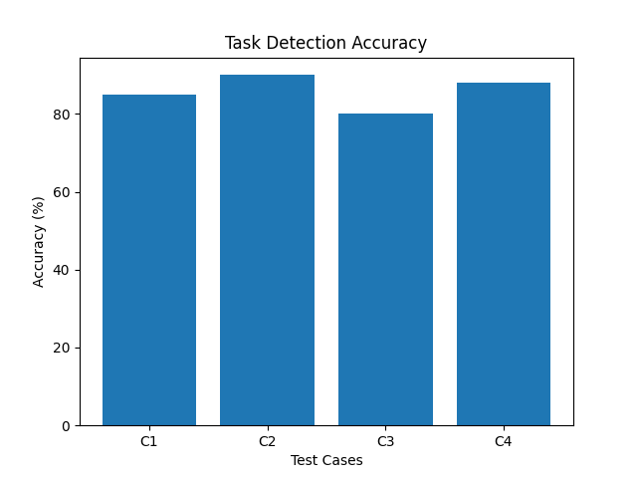
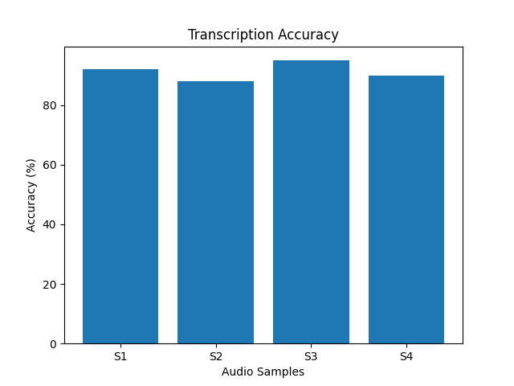
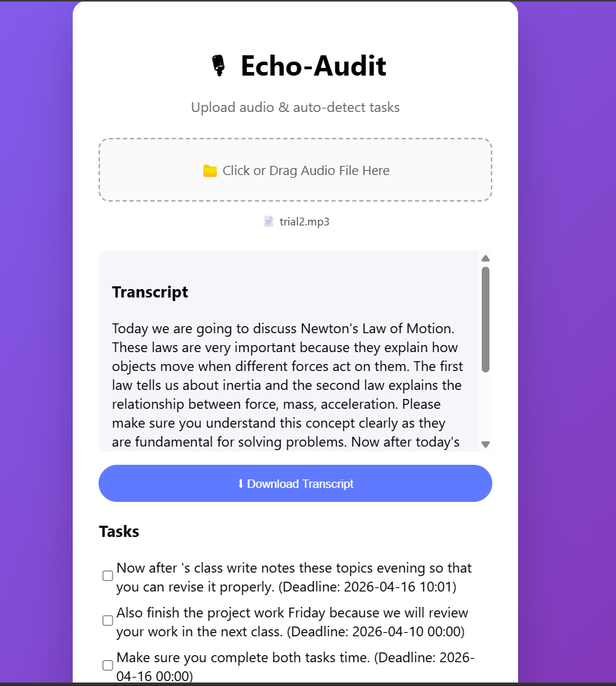
Results

Slide 6
Application
React Frontend → Uploads audio file
Node.js Server → Handles file upload
FastAPI Backend → Converts audio to text & extracts tasks
MongoDB → Stores tasks and deadlines

Slide 7
Conclusion
Developed a system that converts audio into meaningful tasks automatically
Reduced manual effort in note-taking and task tracking
Successfully integrated speech recognition and NLP techniques
Helps users stay organized with deadlines and alerts

Slide 8
References
Research on Speech-to-Text Systems and Applications
Natural Language Processing Techniques for Task Extraction
Named Entity Recognition (NER) for Date and Time Detection
Studies on Voice-Based Productivity and Task Management Systems
Documentation and tutorials from official libraries (FastAPI, React, MongoDB, spaCy)
Online resources and technical blogs related to full-stack development and AI integration

