Slide 1

EAGLE TRUST BANK
Autonomous Fraud Detection & Response Network
5 Autonomous AI Agents · Real-Time Detection · RBI/PMLA Compliant
Team Rudra
5 AI Agents
Vasala Pragvamsh (Leader) – 22951A6779 | Frontend & Backend Integration
Bolle Nihanth Bhargav – 22951A6773 | Backend Infrastructure & DevOps
Ganji Prasuna– 22951A6783 | Frontend UI/UX
Janapaneedi Nirmal Sai Swaroop – 22951A67B6 | Backend API & ML Algorithms
Tallapelly Ravali – 22951A67A0 | Database Operations
~6s Detection
95%+ Precision
Institute of Aeronautical Engineering, Hyderabad · Faculty Mentor: Mriank Gosh

Slide 2
Problem Statement
The Challenge: Preparing financial fraud reports — income statements, balance sheets, cash flow analysis — is time-consuming and error-prone at scale. Traditional rule-based systems cannot detect novel patterns, adapt to individual customer behavior, or automatically enforce RBI/PMLA regulations.
Time-Consuming
Error-Prone
Non-Compliant
Fraud analysis across large transaction datasets takes hours. By the time a pattern is flagged manually, funds have already moved.
Manual cross-referencing introduces inconsistencies and misses coordinated fraud patterns that span multiple customer accounts.
Meeting RBI, PMLA, and FIU-IND reporting deadlines manually is operationally unsustainable for high-volume banking environments.
Objective: Build an autonomous, multi-agent AI system that detects fraud in real-time, automatically enforces regulatory compliance (CTR/STR), and eliminates manual intervention entirely — with 95%+ precision.

Slide 3
Target Segment / Market Size
$1.95B
26.29%
$15.69B
Market Size 2025
CAGR 2025–2034
Projected by 2034
Target Customer Segments
→ Finance & Accounting Teams
→ Financial Planning & Analysis (FP&A) Teams
→ Chief Financial Officers (CFOs)
→ Controllers & Accounting Managers
→ Banks, Investment Firms & Fintech Companies
→ SaaS Companies with financial data platforms
The Global Generative AI in Financial Services market is forecast to grow from $1.95B in 2025 to $15.69B by 2034 — a CAGR of 26.29%. This System is positioned to serve this rapidly expanding market.

Slide 4
System Overview — The 5-Agent Pipeline
This project breaks fraud detection into 5 independent, asynchronous stages. The customer gets an immediate response while the pipeline runs in the background to a final verdict.
01
TMA
Real-time behavioral analysis — behavior profile, 15 anomaly features, Isolation Forest ML, ChromaDB RAG retrieval
Transaction Monitoring Agent
02
PRA
Cross-customer trend & typology detection — EWM temporal analysis, network fan-out, FIU-IND typology matching
Pattern Recognition Agent
03
RAA
Regulatory scoring & fusion — 5-dimension scoring, RAG retrieval, 60/40 score fusion, CTR/STR compliance, action package
Risk Assessment Agent
04
ABA
Verdict execution — gateway routing, transaction reversal, account freeze, customer notification, FIU-IND filing, case creation
Alert & Block Agent
05
CLA
Archive evidence, generate STR/CTR compliance documents, feed confirmed fraud back into RAG knowledge base
Case & Legal Agent
Final Decision at each stage: ALLOW · FLAG · ALERT · BLOCK

Slide 5
Agent 01 — TMA: Transaction Monitoring Agent
Role: Real-time behavioral analysis of individual transactions | Trigger: Immediately after payment commit | Duration: ~4.5 seconds
1
Build Behavior Profile
4
RAG Retrieval — ChromaDB
Fetches 90-day transaction history for the customer and computes rolling mean, standard deviation, and maximum values to establish a behavioral baseline.
Queries 4 ChromaDB collections: L2 fraud cases (k=15, 50%), L1 regulatory rules (k=3, 20%), L3 typologies (30%), and L4 dynamic weights for fusion calibration.
2
Extract Anomaly Features
5
Score Fusion & Decision Engine
Generates 15 signals: Z-score deviation, transaction velocity (per hour), new recipient flag, time-of-day anomaly, day-of-week pattern, amount percentile, and more.
Fuses ML score (60% weight) and RAG score (40% weight) using adaptive weights retrieved from L4. Decision thresholds: <40 ALLOW, 40–59 FLAG, 60–74 ALERT, ≥75 BLOCK.
3
ML Scoring — Isolation Forest
6
Response Executor
Trained anomaly detection model scores the transaction on a 0–100 scale. Higher score = more anomalous. Converted from Isolation Forest's [-1, 1] output range.
Writes a fraud_alert row to MySQL if fused score ≥ 40. Passes decision downstream to PRA. Includes anomaly flag list and confidence score for audit trail.
Output → tma_score: 56 | decision: FLAG | anomaly_flags: [High Z-score, Unusual recipient] | confidence: 0.87

Slide 6
Agent 02 — PRA: Pattern Recognition Agent
Role: Cross-customer fraud trend & typology detection | Trigger: After TMA (only if TMA decision ≠ ALLOW) | Duration: ~4–5 seconds
Temporal Analyzer
Network Analyzer
Applies Exponential Weighted Moving Average (EWM) to the customer's transaction risk history over the past 7 days. Detects if a customer's risk profile is accelerating — a strong early indicator of compromised accounts.
Checks fan-out: how many distinct customers are sending funds to the same recipient account within a rolling time window. A high-fan-out recipient hub is the primary indicator of a Money Mule Network scheme.
Typology Retrieval — ChromaDB L3
Score Aggregation & Verdict
Encodes the transaction's 15 anomaly flags as a 384-dimensional vector using Sentence Transformers and queries the ChromaDB L3_typologies collection. Returns the best-matching fraud typology with a cosine similarity score.
Combines temporal EWM risk trend + network fan-out score + typology similarity into a unified PRA score (0–100). Assigns a named typology: Money Mule Network, SIM Swap, Account Takeover, or Smurfing.
⚡ Fast-Escalation Rule: If pra_score ≥ 75, PRA triggers ABA immediately — bypassing RAA entirely to stop the transaction faster. For scores below 75, the fraud_alert row is updated and RAA picks it up on the next polling cycle (every 500ms).
Output → pra_score: 62 | decision: ALERT | typology: Money Mule Network | network_risk: HIGH | pattern_matches: 3

Slide 7
Agent 03 — RAA: Risk Assessment Agent
Role: Regulatory compliance scoring & final fusion | Trigger: Background poller every 500ms when pra_processed = 1 | Duration: ~3–6 seconds
1
Intelligence Aggregator: Reads the fraud_alert row and validates both TMA and PRA results, merging them into a unified intelligence context for multi-agent fusion.
2
Customer Tier Classifier: Assigns T1 (Low) → T4 (Critical) based on 90-day alert history, transaction volume, and watchlists. Auto-demotes to CRITICAL if previous_alerts_7d ≥ 3 or blocked amount > ₹5L.
3
5-Dimension Scorer (Score_A): D1: Velocity · D2: Typology Match · D3: Customer Tier · D4: Regulatory Flags · D5: Anomaly Strength. Each dimension scored 0–20 pts. Score_A = D1+D2+D3+D4+D5 (max 100).
4
RAG Retrieval (Score_B): Queries L2 (k=15, 50%) + L1 regulations (k=3, 20%) + L3 typologies (30%). Computes cosine-weighted average for Score_B (0–100).
5
Score Fusion Engine: final_score = (Score_A × 0.60) + (Score_B × 0.40). Floor adjustments: if Score_A > 75 → min final = 75; if Score_B > 80 → min final = 80.
6
Regulatory Engine: CTR trigger: transaction > ₹10L. STR trigger: final_score ≥ 70 AND amount > ₹50K, or multiple alerts in 30 days. Auto-drafts STR document for FIU-IND submission.
7
Action Package Builder: Constructs a structured JSON action package: verdict, gateway_action, freeze_account, notify_customer, file_str, str_summary. Writes to action_packages table for ABA.
8
DB Write-back: Updates fraud_alerts with raa_verdict, raa_score, customer_tier, d1_d5_scores, and sets raa_processed = 1 for audit trail and pipeline state management.
Output → raa_verdict: BLOCK | raa_score: 78 | customer_tier: T3 | D1-D5: [18,16,14,15,15] | gateway_action: STOPPED | file_str: true

Slide 8
Agent 04 — ABA: Alert & Block Agent
Role: Execute verdict-specific actions autonomously | Trigger: Action packages from RAA or PRA fast-escalation | Duration: ~2–3 seconds
1 Package Loader
2 Gateway Controller
Reads and validates the structured action package — verdict, gateway_action, freeze_account flag, notify_customer flag, file_str flag, and STR summary from the action_packages table.
Routes the decision to the payment gateway: APPROVE (clear transaction), APPROVE_AFTER_CONFIRM (trigger OTP verification), HELD (queue for manual review), STOPPED (initiate reversal).
3 Action Executor
4 Notification Engine
For BLOCK verdict: reverses the transaction, debits sender, credits recipient to unwind the transfer, and creates a timestamped action_log entry for the full audit trail.
Queues SMS and email alerts. Customer receives: 'Unusual activity detected — verify your account.' Bank operations team receives a high-risk transaction alert with alert_id and raa_score.
5 Account Controller
6 Regulatory Router
If verdict is BLOCK: sets account_frozen = 1 with frozen_reason = 'FRAUD_SUSPECTED' in customer_accounts table. Prevents all further outgoing transactions until analyst review.
Files the auto-drafted STR or CTR report to the FIU-IND portal. Logs the portal reference number to the audit trail for compliance verification and PMLA record-keeping.
7 Case Manager
Creates a fraud_cases row: case_id (FRAUD_YYYY_XXXXXX), status = PENDING_REVIEW, case_type (e.g., MONEY_MULE_NETWORK), assigned_to = null (queued for analyst). Passed to CLA.

Slide 9
Agent 05 — CLA: Case & Legal Agent
Role: Evidence archival, compliance document generation & RAG feedback | Trigger: Background processor on PENDING_REVIEW cases | Duration: ~5–10 seconds
1
Case Processor
Fetches the fraud_cases row created by ABA and contextualizes it by joining all related data: the original payment record, transaction timeline, full customer profile (KYC, history, tier), and all TMA, PRA, RAA decision outputs with scores and confidence values.
2
Citation Archiver
Generates and stores structured evidence PDFs in /cla_archive/{case_id}/. Files include: payment_detail.pdf, customer_profile.pdf, transaction_timeline.pdf, and rag_reasoning.pdf — which explains exactly why each agent reached its decision.
3
STR / CTR Document Generator
Generates Suspicious Transaction Reports and Cash Transaction Reports in Indian FIU-IND format (XBRL-compliant). Includes transaction details, customer KYC information, suspicious activity indicators, and all supporting evidence files as attachments.
4
Feedback Handler — The Learning Loop
When a case is marked CONFIRMED_FRAUD by an analyst: adds the feature vector to L2_fraud_cases collection, recalibrates L4_dynamic_weights to reflect updated ML vs RAG accuracy, and logs to L5_feedback_log. Every confirmed case permanently improves future detection — the system becomes smarter with volume.
CLA closes the learning loop — every confirmed fraud case improves future detection accuracy automatically and permanently.

Slide 10
RAG Layer — ChromaDB 4-Layer Knowledge Base
Retrieval-Augmented Generation combines ML predictions with a structured knowledge base in ChromaDB to produce explainable, regulation-grounded fraud scores. Transaction features are encoded into 384-dim vectors via Sentence Transformers.
L1
Regulatory
Updated by:
KB ingest scripts
Weight: 20%
RBI / PMLA / FIU-IND compliance rules. Queried k=3. Cosine similarity on semantic embeddings.
Text-based
L2
Fraud Cases
Updated by:
CLA on CONFIRMED_FRAUD
Weight: 50%
Historical confirmed fraud feature vectors. Queried k=15. Cosine sim threshold ≥ 0.70.
Vector 384-dim
L3
Typologies
Updated by:
KB ingest scripts
Weight: 30%
FIU-IND fraud typology patterns & indicators. Returns named typology + similarity score.
Vector
L4
Dynamic Weights
Updated by:
Monthly auto-update
Weight: Calibration
Tracks ML vs RAG monthly accuracy. Adjusts ml_weight / rag_weight adaptively. Default: 0.60 / 0.40.
Meta-learning
Score_B = L2 (50%) + L1 (20%) + L3 (30%) · Fusion: final = Score_A × 0.60 + Score_B × 0.40 (weights from L4)

Slide 11
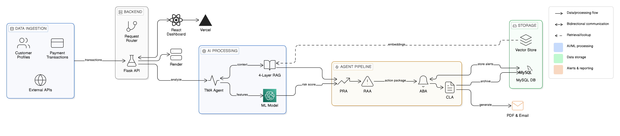
Architecture Diagram
Architecture Diagram
It is an end-to-end autonomous fraud detection system that ingests payment transactions and customer profiles through a Flask REST API. The Transaction Monitoring Agent (TMA) processes each payment through seven stages: behavioral profiling, anomaly signal extraction, Isolation Forest ML scoring, and 4-layer RAG knowledge retrieval. The system orchestrates a five-agent pipeline (TMA→PRA→RAA→ABA→CLA) that performs pattern recognition, risk assessment, alert execution, and case archival in real-time. All decisions are simultaneously stored in MySQL and ChromaDB vector databases, with automated PDF generation and email notifications dispatched to stakeholders. The React dashboard provides real-time visualization of the multi-agent pipeline, while deployment across Vercel (frontend) and Render (backend) ensures scalability and reliability.
Full-Stack AI-Driven: Next.js · Node.js API · MongoDB · Gemini 2.0 Flash · ChromaDB RAG · PDF Generation · Nodemailer | Deployed: Vercel (frontend) + Render (backend)

Slide 12
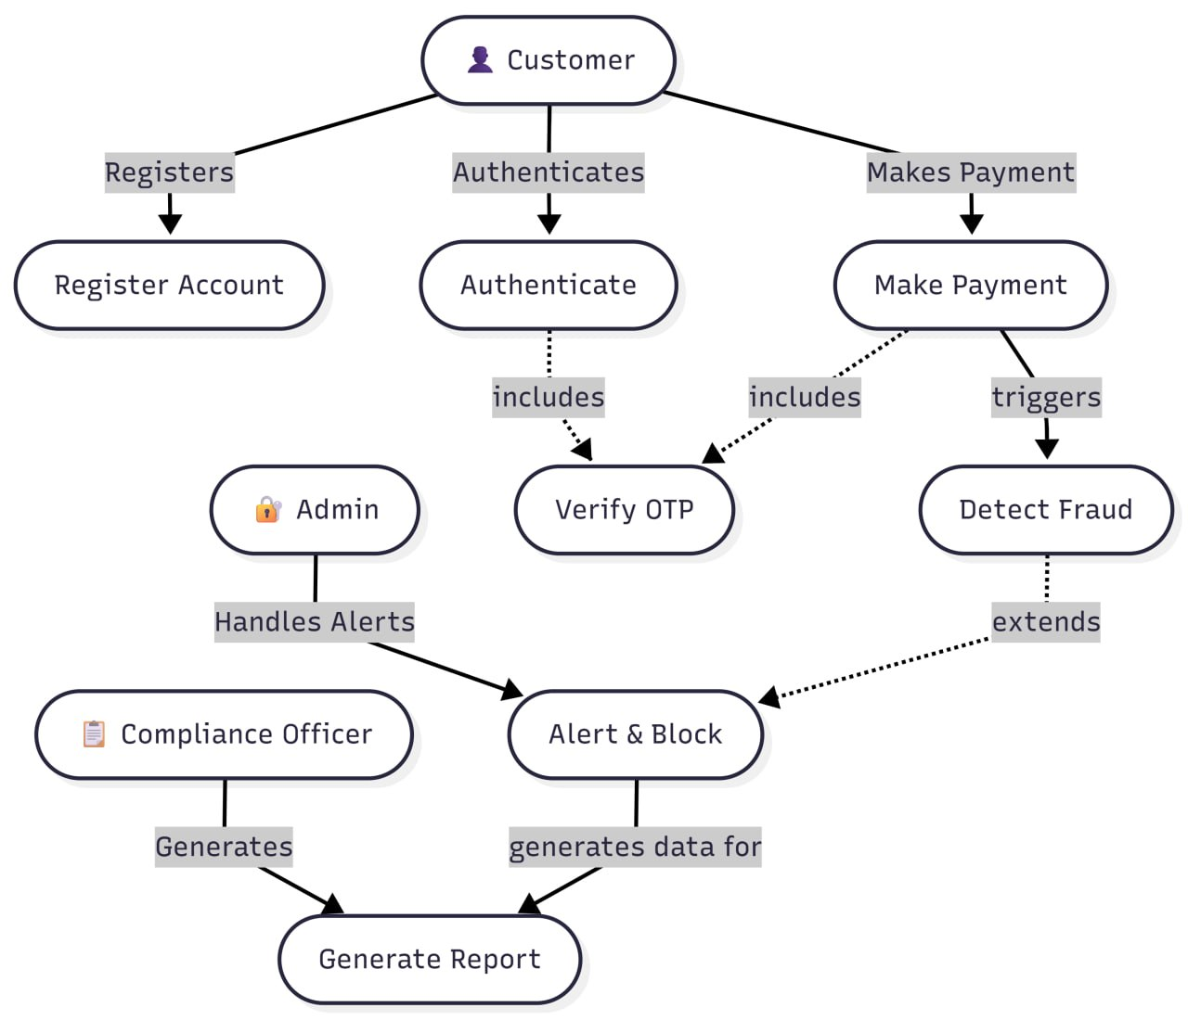
User Flow Chart
Customers interact with Jatayu through three primary workflows: account registration, authentication with OTP verification, and payment initiation. Upon payment submission, the system triggers the automated fraud detection pipeline, which performs real-time analysis across multiple agents (TMA, PRA, RAA, ABA). The system generates a fraud verdict (ALLOW, FLAG, ALERT, or BLOCK) based on ML scoring and RAG knowledge retrieval. Simultaneously, admin users monitor high-risk alerts and manage compliance actions through the Alert & Block interface. For flagged transactions, the Compliance Officer reviews detailed case information and generates regulatory reports (STR/CTR) along with PDF documentation. The entire workflow ensures customer transactions are processed instantly while maintaining real-time oversight and regulatory compliance throughout the detection lifecycle.
Journey: Landing Page → Register / Login → Onboarding → Dashboard → Upload Data → Preview → Anomaly Check → Compliance → Insights → Export PDF / Email

Slide 13
Why Our Solution Is Accurate
Isolation Forest ML Model
Multi-Agent Risk Orchestration Pipeline
Pre-trained scikit-learn Isolation Forest algorithm detects anomalies by isolating irregular transaction patterns in a high-dimensional feature space. The model is calibrated against your historical transaction dataset with dynamic min/max normalization. Fallback mechanism ensures pipeline continues even if model fails, preventing silent allowance of unscored transactions.
Five specialized agents (TMA→PRA→RAA→ABA→CLA) sequentially process each transaction: TMA scores individual transaction risk with ML+RAG fusion, PRA identifies temporal patterns and network anomalies, RAA aggregates multi-dimensional risk indicators, ABA executes gateway controls and regulatory filings, CLA archives case documentation. Non-blocking architecture returns immediately while agents process in background.
4-Layer Retrieval-Augmented Generation (RAG)
Confidence-Based Score Fusion & Thresholds
ChromaDB-powered knowledge base with four specialized retrieval layers: L1 handles regulatory rules compliance (RBI/PMLA standards), L2 matches against historical fraud cases with cosine similarity weighting, L3 compares fraud typology patterns, and L4 dynamically calibrates ML/RAG weight ratios based on accuracy history. Eliminates hallucinations through evidence-backed context retrieval.
Intelligently weights ML and RAG scores (default 60% ML + 40% RAG) with dynamic adjustment from L4 accuracy calibration. Applies confidence gates—high-similarity matches override lower-confidence predictions. Four decision verdicts (ALLOW | FLAG | ALERT | BLOCK ) with cold-start penalties and regulatory override checks ensure both accuracy and regulatory compliance.
Behavioral Profile Engineering
95%+
Precision Rate
across all financial
calculations & insights
Constructs 90-day customer behavioral baseline tracking 15 anomaly signals including Z-score amount deviation, transaction velocity (frequency/volume), recipient risk profiling, time-of-day patterns, and cross-customer network analysis. Cold-start detection identifies new accounts, triggering enhanced verification. Profile strength scoring adjusts confidence weighting across all downstream decisions.

Slide 14
Conclusion & Future Enhancements
This project is an AI-powered autonomous fraud detection platform that transforms raw transaction data into actionable fraud verdicts through a 5-agent pipeline, RAG-enhanced knowledge, and full RBI/PMLA compliance — with zero manual intervention required.
33%+
10–20%
30%
Cost Reduction
Productivity Gain
Faster Processing
Earlier fraud detection reduces operational loss exposure
Fewer false positives, reduced manual review burden
Automated pipeline vs. manual compilation time
Future Enhancements
Enterprise Integration
Enhanced User Experience
Platform Scalability
ERP connectivity — SAP, Oracle, QuickBooks
Real-time financial data streaming & live alerts
Blockchain immutable audit trails & smart contracts
Mobile native apps — iOS & Android with offline mode
Voice-activated financial query interface
Real-time collaborative workflows & approval flows
Kubernetes-based auto-scaling cloud infrastructure
Microservices architecture decomposition
Redis advanced caching for faster report generation
Modular RAG infrastructure enables seamless adaptation across industries — same architecture, sector-specific knowledge bases.

Slide 15
Thank You
Spread your wings and reach for your dream 🦅
Team Rudra
Vasala Pragvamsh (Leader) – 22951A6779 | Frontend & Backend Integration
Bolle Nihanth Bhargav – 22951A6773 | Backend Infrastructure & DevOps
Ganji Prasuna– 22951A6783 | Frontend UI/UX
Janapaneedi Nirmal Sai Swaroop – 22951A67B6 | Backend API & Database
Tallapelly Ravali – 22951A67A0 |
Institute of Aeronautical Engineering, Hyderabad · Faculty Mentor: Mriank Gosh · Virtusa Jatayu Program

