Slide 1
SECURE DATA HIDING IN IMAGE USING STEGANOGRAPHY
CAPSTONE PROJECT
Student Name : K.ASHRIT
College Name & Department : RAGHU ENGINEERING COLLEGE (CYBER SECURITY)

Slide 2
OUTLINE
Problem Statement
Technology used
Wow factor
End users
Result
Conclusion
Git-hub Link
Future scope

Slide 3
Problem Statement
The transmission of data(message) from sender to the receiver in its original form is prone to attack or disclosure to any unauthorized or illegal person with some destructive intention often hackers.
To make the transmission secure we should use a technique to either change the message into some other format or hide it in something, so we could protect it from being disclosed.
The problem is how and what should be used for a secure transmission so that the data is not available to unauthorized person.

Slide 4
Technology used
Python Programming language has been used for writing the code.
CV2, OS, String are the import libraries that are used for the program to work.
Python IDLE is the environment used to execute the program.

Slide 5
Wow factors
Like in every cryptography technique, the Steganography is also used to hide the original message from the unauthorised person and used a key to hide the message.
But the WOW factor in the steganography is, here the message(plain text or the original message) is hidden in an image without effecting the extension of the file too.
So it makes it difficult for somebody to guess that the data is stored in the image.
Even if he knows that, again he would require the key to decrypt the image to get the original required data, which makes it difficult to get the original message
This makes this secure from disclosure of the message to a non legitimate person.
In this project Python programming language is used to implement the Steganography, which makes it very easy to write the code than any other programming language.

Slide 6
End users
There is a use of this technique where ever there is a need of transmission of confidential data from a person(sender) to another person(receiver). Therefore, some examples of the end-users who would use steganography are:
Healthcare
Finance
Government Agencies
Legal
Businesses
Education
Research

Slide 7
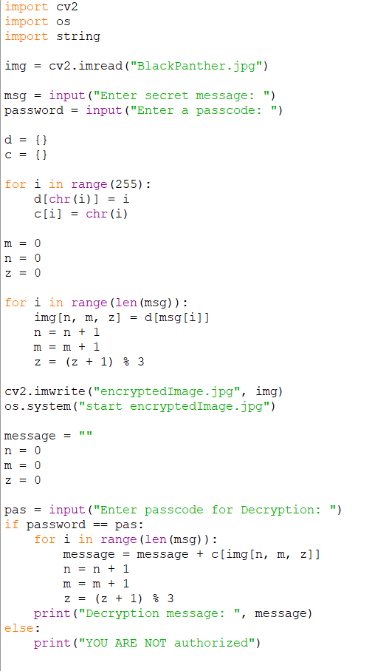
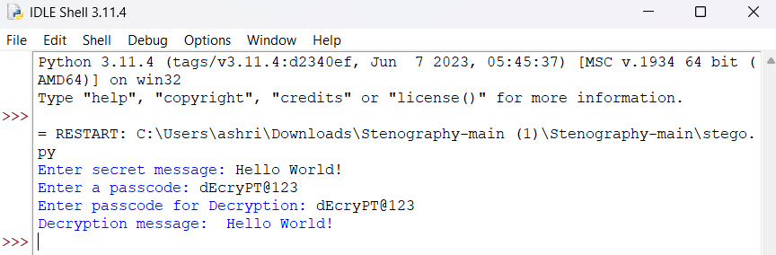
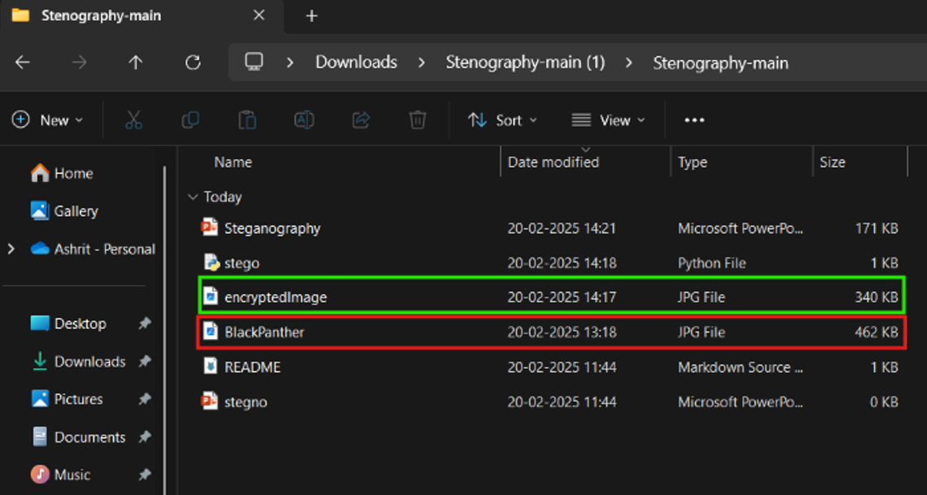
Results

Slide 8
Conclusion
With this project it could be concluded that Steganography can be used widely in different sectors where any official and confidential data needs to be transmitted from one source to another by hiding it inside a digital file such as image to make the data invisible to others, solving the problem that was there during the transmission of the data.

Slide 9
GitHub Link
You can all the required resources for this project in the below link
https://github.com/Ashritom/Steganography.git

Slide 10
Future scope
Enhanced Security: As cyber threats become more sophisticated, steganography can offer an additional layer of security by concealing the very existence of encrypted messages.
Digital Media: With the rise of digital media, steganography can be applied to images, videos, and audio files, making it harder for unauthorized parties to detect hidden information.
Big Data and IoT: As the Internet of Things (IoT) and big data technologies grow, steganography can be used to securely transmit data between devices without raising suspicion.
Artificial Intelligence: AI and machine learning can enhance steganographic techniques, making them more efficient and harder to detect.
Legal and Ethical Applications: Steganography can be used for protecting intellectual property, ensuring privacy in communications, and even in legal contexts to securely transmit sensitive information.

Slide 11
THANK YOU

