Slide 1

Fake Review Detection System
Using Supervised Machine Learning
Ashish Pal (MCA/25009/23)
Kushagra Bansal (MCA/25006/23)
Under the guidance of : Dr. Madhavi Sinha

Slide 2
Introduction
Problem Statement:
  Rise of fake reviews undermines trust in e-commerce, hospitality, etc.
  Detection of fake reviews out of a massive collection of reviews having various distinct categories like Home and Office, Sports, etc. with each review having a corresponding rating, label i.e. CG(Computer Generated Review) and OR(Original Review generated by humans) and the review text.
  The Dataset is collected from public source Kaggle which contains approximate 40 thousand records which contain both CG (Computer Generated Review) and OR(Original Review generated by humans) and the review text.

Slide 3
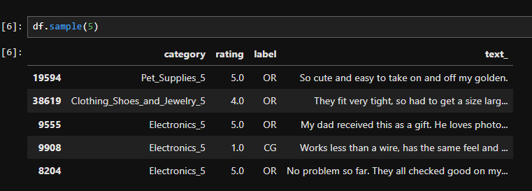
Dataset Overview

Slide 4
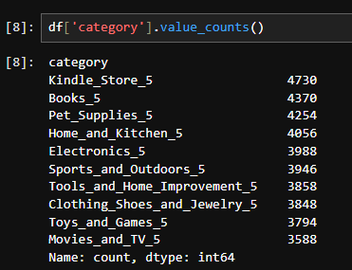
Category types

Slide 5
Objectives
Classify reviews as genuine or fake using machine learning.
Explore textual features and sentiment analysis.
Deploy a web application where users can submit reviews for validation.
Notes:
Sentiment Analysis
Sentiment analysis is a way for computers to understand and analyze the emotions expressed in text, like whether it's positive, negative, or neutral. Eg:
"This video is quite helpful"-->Positive sentiment [0,1] more it will close to 1 it will positve sentiment
"Unable to understand the topic" -->Negative sentiment[-1]
"I'm attending the lecture this afternoon."-->Neutral sentiment[0]
The polarity range refers to the scale used in sentiment analysis to measure the degree of positivity or negativity in text, typically ranging from -1 to 1
TextBlob Library is widely used for sentiment analysis:
#TextBlob is a Python library for processing textual data. It provides a simple API for common natural language processing (NLP) tasks

Slide 6
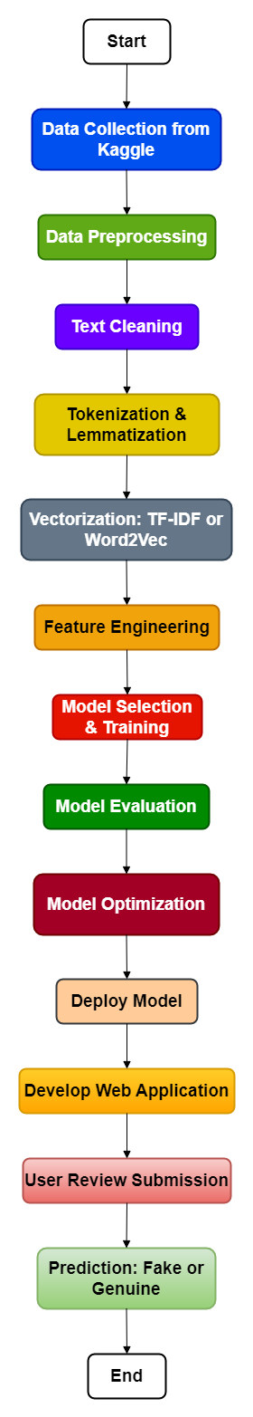
Workflow
Data Preprocessing
Feature Engineering
Model Selection
Model Training & Evaluation
Deployment

Slide 7
Data Preprocessing
Text Cleaning: Remove irrelevant data (stopwords, special characters).
Tokenization & Lemmatization: Convert reviews into tokens, normalize.
Vectorization: Convert text to numerical format (TF-IDF, Word2Vec).
Notes:
TF-IDF (Term Frequency-Inverse Document Frequency):
TF-IDF is a statistical technique used in text mining to evaluate the importance of a word in a document relative to a collection (corpus) of documents. It combines two metrics:
Term Frequency (TF): Measures how frequently a word appears in a document, emphasizing common words within that document.
Inverse Document Frequency (IDF): Reduces the weight of commonly occurring words across all documents (e.g., "the", "and"), giving more importance to rare but significant words.
Purpose:
TF-IDF converts raw text into numerical vectors by emphasizing important words in the context of the whole document set, making it a popular choice for tasks like text classification, document clustering, and information retrieval.
Word2Vec:
Word2Vec is a neural network-based technique used to convert words into continuous vector representations (embeddings) in a high-dimensional space. It captures semantic relationships between words by placing similar words closer together in this space.
There are two main models in Word2Vec:
CBOW (Continuous Bag of Words): Predicts a target word from its neighboring words (context).
Skip-gram: Predicts the neighboring words given a target word.
Purpose:
Word2Vec is used for tasks where semantic understanding of words is essential, such as text classification, machine translation, and natural language processing (NLP). It goes beyond mere word frequency by capturing the meaning and relationships between words.
Both techniques transform text data into numeric formats that machine learning algorithms can process for various NLP tasks.

Slide 8
Feature Engineering
Review length
Sentiment score
Excessive use of adjectives
N-grams to detect patterns
Notes:
Computer Generated Review
These reviews are often generated using algorithms or AI models.
Length can be controlled or adjusted based on the design of the algorithm.
Typically, these reviews might be shorter and more concise, focusing on key points or generated to a specific length for consistency.
Human Generated Review
Reviews written by humans can vary widely in length.
They tend to be more detailed, incorporating personal experiences, opinions,
Length can range from short paragraphs to several paragraphs or even longer essays depending on the reviewer's style and the complexity of the subject.
Adjectives
Beautiful, intelligent, tall, delicious, comfortable
Few, many, several, some, all
Sentiment Score
A sentiment score typically refers to a numerical representation of the sentiment expressed in a piece of text. It can range from -1 (very negative sentiment) to +1 (very positive sentiment), with 0 usually indicating neutral sentiment. Sentiment analysis tools or libraries like Vader (NLTK), TextBlob, or others can compute these scores based on the words and phrases used in the text.
N-gram
N-gram can be defined as the contiguous sequence of n items from a given sample of text or speech. The items can be letters, words, or base pairs according to the application. The N-grams typically are collected from a text or speech corpus (A long text dataset).
For instance, N-grams can be unigrams like (“This”, “article”, “is”, “on”, “NLP”) or bigrams (“This article”, “article is”, “is on”, “on NLP”).
N-gram Language Model
An N-gram language model predicts the probability of a given N-gram within any sequence of words in a language. A well-crafted N-gram model can effectively predict the next word in a sentence, which is essentially determining the value of p(w∣h), where h is the history or context and w is the word to predict.

Slide 9
Model Selection
Logistic Regression
K Nearest Neighbors
Support Vector Classifier
Decision Tree Classifier
Random Forests Classifier
Multinomial Naive Bayes

Slide 10
Model Training & Evaluation
Train-test split: 80/20
Hyperparameter tuning: GridSearchCV, RandomizedSearchCV
Metrics: Accuracy, Precision, Recall, F1-score
Notes:
Hyperparamter
Hyperparameters are the parameters that determine the behavior and performance of a machine-learning model. These parameters are not learned during training but are instead set prior to training. The process of finding the optimal values for these hyperparameters is known as hyperparameter optimization, and it is an important step in the development of any ML model.
Hyperparameter tuning, which we did through GridSearchCV and RandomizedSearchCV, allows us to find the optimal set of parameters that maximize the model’s performance. By fine-tuning parameters like regularization strength in Logistic Regression or the number of neighbors in K-Nearest Neighbors, we can significantly improve the accuracy and efficiency of the model. Without tuning, the model might either overfit or underfit, reducing its predictive power.
Accuracy , Precision , recall and F1-score
We used accuracy, precision, recall, and F1-score. Precision is important because we want to minimize false positives—incorrectly labeling genuine reviews as fake. Recall ensures we don’t miss too many fake reviews. F1-score, being the harmonic mean of precision and recall, gives us a balanced metric for evaluating the model’s overall performance. This comprehensive set of metrics ensures the model is both reliable and effective.
Arithmetic Mean = (a₁ + a₂ + a₃ +…..+a_{n} ) / n
Harmonic Mean = n / [(1/a₁)+(1/a₂)+(1/a₃)+…+(1/a_{n})]

Slide 11
Deployment
Web app developed using Flask/Streamlit.
Model integration to classify user-submitted reviews.
Hosted on Heroku or AWS.

Slide 12
References
Youtube : Krish Naik , CampusX
Hands on Machine Learning with scikit learn and tensor flow(BOOK) by Geron Aurelien

Slide 13
Thank You
Notes:
BERT (Bidirectional Encoder Representations from Transformers):
BERT is a transformer-based model developed by Google that excels at understanding the context of a word in a sentence by looking at both the words before and after it. Unlike traditional models, BERT is bidirectional, meaning it considers the entire context of a sentence instead of just reading it left-to-right or right-to-left.
Key Features:
Pre-training and fine-tuning: BERT is pre-trained on large text corpora (like Wikipedia) and can be fine-tuned for specific NLP tasks (e.g., question answering, sentiment analysis).
Bidirectional attention: BERT uses attention mechanisms to understand the context from both sides of a word, allowing it to capture deeper semantic meaning.
Tasks: BERT is commonly used for tasks such as text classification, named entity recognition (NER), question answering, and language inference.
Strength:
BERT is excellent for understanding the nuances and meaning of words in their context, making it powerful for tasks requiring a deep understanding of language.
GPT (Generative Pre-trained Transformer):
GPT, developed by OpenAI, is another transformer-based model, but it focuses on generating text. GPT models (e.g., GPT-2, GPT-3, and GPT-4) are unidirectional, meaning they generate text by predicting the next word in a sequence based only on previous words.
Key Features:
Text generation: GPT is highly effective in generating human-like text, completing prompts, and answering questions in a conversational way.
Pre-training on large datasets: GPT is trained on massive text datasets, enabling it to learn language patterns, grammar, and facts.
Few-shot learning: GPT-3 and GPT-4 can perform tasks with very few training examples, making them versatile across various domains.
Strength:
GPT is particularly good at generating coherent, creative, and contextually appropriate text, making it ideal for tasks like text generation, chatbots, summarization, and even creative writing.
Key Difference:
BERT is optimized for understanding the context and meaning of text for tasks like classification and sentiment analysis.
GPT is optimized for generating text and can handle creative tasks like answering questions or completing text prompts.
Both models represent breakthroughs in NLP, significantly advancing the field with their respective strengths in language understanding and generation.

