Slide 1
GevetiHub – Decentralized PaaS
“Let’s Connect It All”

Slide 2
Business Model:
Explain how the project will generate revenue.
Discuss the pricing model, customer segments, and sales strategy.

Slide 3
Problem Statement:
Centralized Control and Data Storage:
Issue: Centralized platforms often suffer from single points of failure, making them vulnerable to outages and cyber attacks. This centralized approach also raises concerns about data privacy and control, as user data is stored in centralized servers.
Impact: Increased risk of data breaches, loss of privacy, and limited user control over personal data.
Limited Customization and Flexibility:
Issue: Traditional platforms often offer limited customization options, making it challenging for users to tailor services to their specific needs. This one-size-fits-all approach can be inefficient and restrictive for diverse user requirements.
Impact: Reduced user satisfaction and inability to fully address specific business or personal needs.
Inefficient Resource Allocation:
Issue: Centralized systems may not efficiently utilize resources, leading to wasted computational power and storage.
Impact: Higher operational costs and environmental impact due to inefficient resource usage.
Scalability Constraints:
Issue: Scaling up services in a centralized infrastructure can be costly and complex, often requiring significant investments in hardware and bandwidth.
Impact: Slower response times during peak loads and potential service disruptions.
Dependency on Single Service Providers:
Issue: Users are often locked into using services from a single provider, leading to a lack of competition and innovation. This dependency also creates risks if the provider experiences downtime or decides to change terms of service.

Slide 4
Product Overview
GevetiHub: A Decentralized Platform-as-a-Service
Description: GevetiHub is the central pillar of Geveti's suite of services, offering a blockchain-based, secure, and scalable platform for modern business needs.
Key Features:
Scalable infrastructure built on blockchain technology.
Intuitive user interface for streamlined management and navigation.
Extensive integration capabilities with existing systems and third-party services.
Subscription Tiers:
Starter: Ideal for individuals or small teams needing basic access.
Professional: Equipped with advanced features to support growing businesses.
Premium: A comprehensive toolkit for established businesses.
Enterprise: A complete service range with premium support for large organizations.
Unlimited/Unlimited+: Tailored solutions for very large-scale operations with specific requirements.
Products Included:
GevetiAds: A decentralized advertising platform offering an alternative to traditional cookies.
GevetiID: A self-sovereign identity verification system enhancing privacy and reducing
GevetiML: Connects AI models for decentralized training and optimization.
GevetiSupply: A supply chain management tool leveraging decentralized networks.

Slide 5

GevetiAD - Decentralizing Advertising
Description:
Key Components:
Creative Tools: Craft compelling ads with ease.
Analytics: Gain insights with customizable dashboards.
Optimization: Enhance ad performance dynamically.
Why GevetiAD?:
Offers an alternative to cookie-dependent advertising.
Provides a subscription model for an ad-free user experience.
Innovates with ad postings and branded content creation.
GevetiAD disrupts traditional advertising by eliminating reliance on cookies, offering a privacy-centric ad marketplace. Its decentralized nature ensures transparency and control for both advertisers and consumers.

Slide 6

GevetiML - AI, Decentralized
Description:
Features:
Collaborative Training: Harness the power of collective intelligence.
Federated Learning: Train models without compromising data security.
Model Marketplace: Share or monetize your AI innovations.
Analytics: Monitor AI performance in real-time.
Advantages of GevetiML:
Facilitates decentralized AI development, avoiding data centralization risks.
Encourages a community-driven approach to AI problem-solving.
Generates revenue through a marketplace and custom AI services.
GevetiML is a cutting-edge platform that enables the collaborative training of AI models across decentralized networks, fostering innovation while protecting data privacy.

Slide 7

GevetiID - Identity Secured
Description:
Features:
Decentralized Authentication: Empower users with blockchain-based security.
User-Controlled Data: Users manage their own information with full transparency.
Multi-Factor Authentication: Multiple layers of security ensure authenticity.
Interoperability: Seamless use across various platforms and services.
Applications of GevetiID:
Online Banking: Streamline KYC processes while ensuring transaction security.
E-Commerce: Simplify transactions with secure customer verification.
Healthcare: Protect patient identities across different healthcare providers.
Government Services: Facilitate access to government services securely and efficiently.
GevetiID provides a self-sovereign identity solution, leveraging blockchain for secure and decentralized authentication that puts privacy first and reduces the risk of identity theft.

Slide 8

GevetiSupply - Next-Gen Supply Chain Management
Description:
GevetiSupply leverages the power of decentralized networks to bring unprecedented transparency and efficiency to supply chain management.
Features:
Customizable dashboards tailored to business size and needs
Seamless integration with existing ERP systems for streamlined operations
Real-time analytics for actionable insights and reporting
Why It's Useful:
Enhances traceability and accountability throughout the supply chain
Adapts to the diverse needs of businesses, from SMBs to large enterprises
Drives data-driven decisions for inventory management, logistics, and forecasting

Slide 9

Solution Overview:
Decentralized Data Storage and Control:
Solution: Geveti utilizes blockchain-based infrastructure, ensuring decentralized data storage and computations. This approach enhances data security and gives users greater control over their personal information.
Benefit: Increased data security, enhanced privacy, and user empowerment in data management.
Customizable Subscription Tiers:
Solution: Geveti offers various subscription tiers (Starter, Professional, Premium, Enterprise, Unlimited, Unlimited+), each tailored to different user needs. This allows for greater flexibility and customization.
Benefit: Users can choose a plan that best fits their specific requirements, ensuring optimal resource utilization and cost efficiency.
Efficient Resource Allocation with Decentralized Networking:
Solution: By implementing peer-to-peer (P2P) networking and a resource allocation engine, Geveti optimizes the use of computational resources across the network.
Benefit: More efficient use of resources, reducing operational costs and environmental impact.
Scalable and Robust Infrastructure:
Solution: The decentralized nature of Geveti's platform allows for easy scalability, accommodating growing user demands without the need for significant infrastructure investment.
Benefit: Enhanced capability to handle increased loads, ensuring consistent performance even during peak times.
Diverse Ecosystem with Multiple Service Offerings:
Solution: Geveti provides a range of decentralized services (GevetiAD, GevetiML, GevetiID, GevetiSupply), fostering an ecosystem of diverse and competitive offerings.
Benefit: Users benefit from a variety of choices and innovative solutions, reducing dependency on single service providers.

Slide 10
Market Opportunity:
Small to Medium-Sized Businesses (SMBs):
Scope: Seeking cost-effective, scalable, and secure IT solutions.
Potential: Large and growing segment with a need for customizable PaaS offerings.
Large Enterprises:
Scope: Require robust, secure, and comprehensive PaaS solutions.
Potential: High-value clients with complex needs and larger budgets.
Tech Startups and Innovators:
Scope: Need for flexible, scalable, and affordable development platforms.
Potential: Early adopters of cutting-edge technologies, driving future trends.
Government and Public Sector Entities:
Scope: Demand for secure, compliant, and reliable IT infrastructure.
Potential: Long-term contracts and opportunities for large-scale implementations.
Healthcare, Finance, and Retail Industries:
Scope: Require secure and efficient management of sensitive data and operations.
Potential: High demand for compliance with stringent regulatory standards and data protection.
Developers and Independent Software Vendors (ISVs):
Scope: Seeking platforms that offer flexibility, integration capabilities, and access to advanced tools.
Potential: Growing need for platforms that support rapid development and deployment.
Market Size and Growth Potential
Overall Market: The global Platform as a Service (PaaS) market size is projected to grow significantly, driven by the increasing adoption of cloud-based solutions and digital transformation across industries.
Decentralized Services Segment: Expected to see accelerated growth due to heightened concerns around data privacy, security, and the advantages of distributed ledger technology.

Slide 11
Go-to-Market Strategy:
Attracting Customers
Content Marketing and SEO
Targeted Digital Advertising
Social Media Engagement
Webinars and Online Workshops
Email Marketing Campaigns
Retaining Customers
Exceptional Customer Support
Continuous Product Improvement
Customer Success Stories
Partnerships
Academic and Research Collaborations
Advertising Strategies
Industry-Specific Campaigns
Participation in Trade Shows and Conferences
Influencer and Thought Leadership Marketing
Sales Channels
Direct Sales Team
Online Sales Platform
Partnership-Driven Sales
Referral Programs
Loyalty Programs and Discounts

Slide 12

Technology and Product Implementation – Visual: A central graphic that shows GevetiHub at the center with lines connecting to each satellite product (GevetiAD, GevetiML, GevetiID, GevetiSupply), symbolizing the integrated ecosystem.
GevetiHub: Core Technology Implementation
Infrastructure: Utilize a blockchain-based framework for robust, decentralized data management and smart contract functionality.
Deployment: Modular design with plug-and-play service integrations for existing systems.
Security: Implement state-of-the-art encryption and multi-factor authentication to ensure user data protection.
GevetiAD: Implementation for Market Disruption
AdTech Integration: Seamlessly integrates with digital marketing platforms using API connectors.
User Privacy: Deploy privacy-centric advertising protocols aligning with GDPR and other data protection standards.
Analytics and Optimization: Leverage AI-powered analytics tools for data-driven insights and dynamic ad optimization.
GevetiML: AI Model Development and Training
Collaborative Environment: Set up decentralized nodes for AI training, allowing simultaneous contributions while preserving data privacy.
Marketplace Infrastructure: Build a secure platform for users to share, sell, or license their AI models.
Real-Time Monitoring: Integrate dashboard for tracking AI model performance metrics and system health.
GevetiID: Secure Identity Verification System
Decentralized Authentication: Implement blockchain-based identity verification for enhanced security and user control.
Integration Capability: Ensure compatibility with various platforms for easy adoption across services.
Compliance Adherence: Follow strict industry standards for identity verification and data security.
GevetiSupply: Supply Chain Optimization
ERP Integration: Enable smooth integration with existing ERP systems for real-time data sync and management.
Scalability: Design infrastructure to scale with the supply chain's complexity and volume.
Customization and Analytics: Offer customizable dashboards and detailed analytics for end-to-end supply chain visibility.

Slide 13
Software Roll-Out Strategy
Pre-Launch: Ideation and Planning
Sprint 0: Product Planning
Alpha Release: Initial Testing and Feedback
Sprint 1-3: GevetiHub Alpha
Sprint 4-6: GevetiAD Alpha
Sprint 7-9: GevetiML Alpha
Sprint 10-12: GevetiID and GevetiSupply Alpha
Beta Release: Broader Testing and Market Feedback
Sprint 13-15: GevetiHub Beta
Sprint 16-18: GevetiAD Beta
Sprint 19-21: GevetiML Beta
Sprint 22-24: GevetiID and GevetiSupply Beta
Market Launch: Full-Scale Agile Deployment
Sprint 25-27: Full Market Release Preparation
Sprint 28: GevetiTech Platform Launch
Post-Launch: Continuous Improvement and Scaling
Sprint 29+: Iterative Development and Scaling
Continuous Sprints

Slide 14
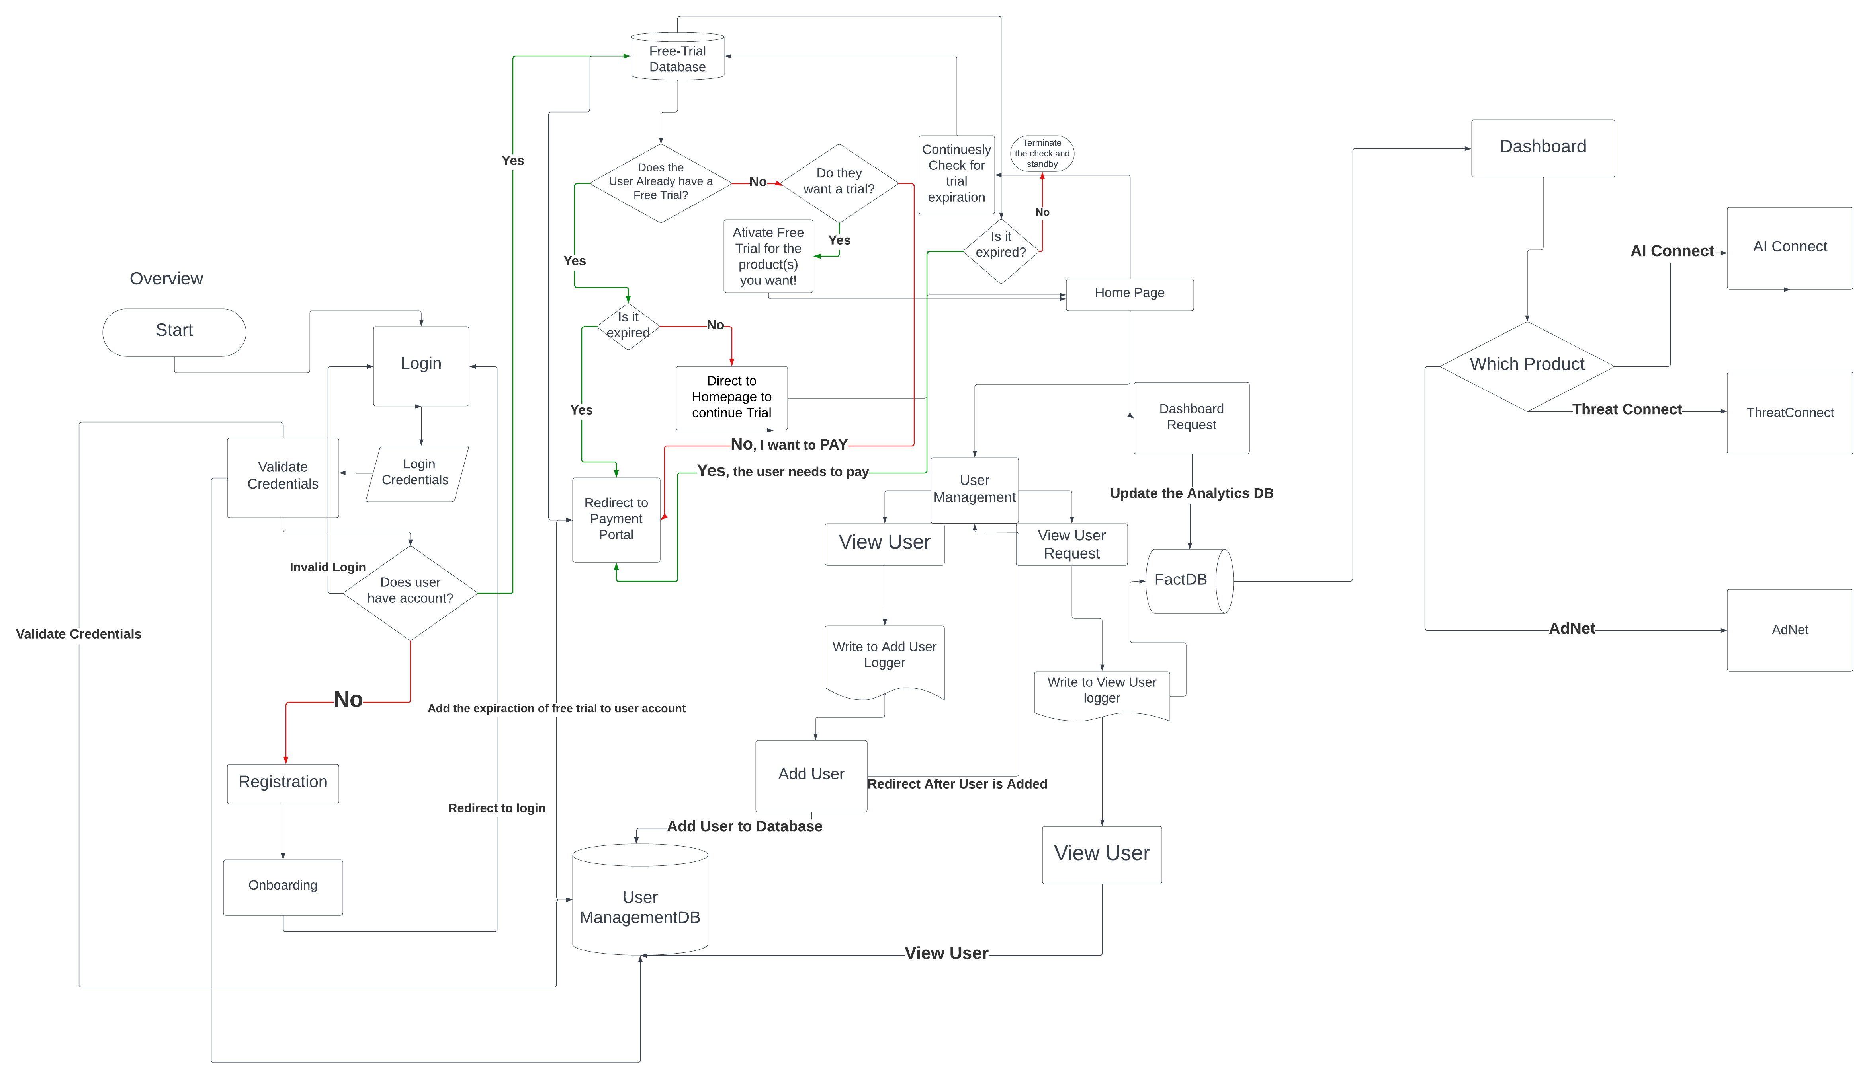
Technology Diagrams

Slide 15
Competitive Landscape:

Slide 16
Financial Projections and Needs:
Present projected financials, including revenue, expenses, and growth trajectory.
Clearly state what you are asking from your potential partner, whether it's funding, resources, expertise, or market access.

Slide 17
Funding Request
Funding Needs: How much funding you’re seeking.
Use of Funds: How you plan to use the investment (development, marketing, etc.).

Slide 18
Closing and Call to Action:
Summarize the key points.
End with a clear call to action: what you want the potential partner to do next.

