Slide 1
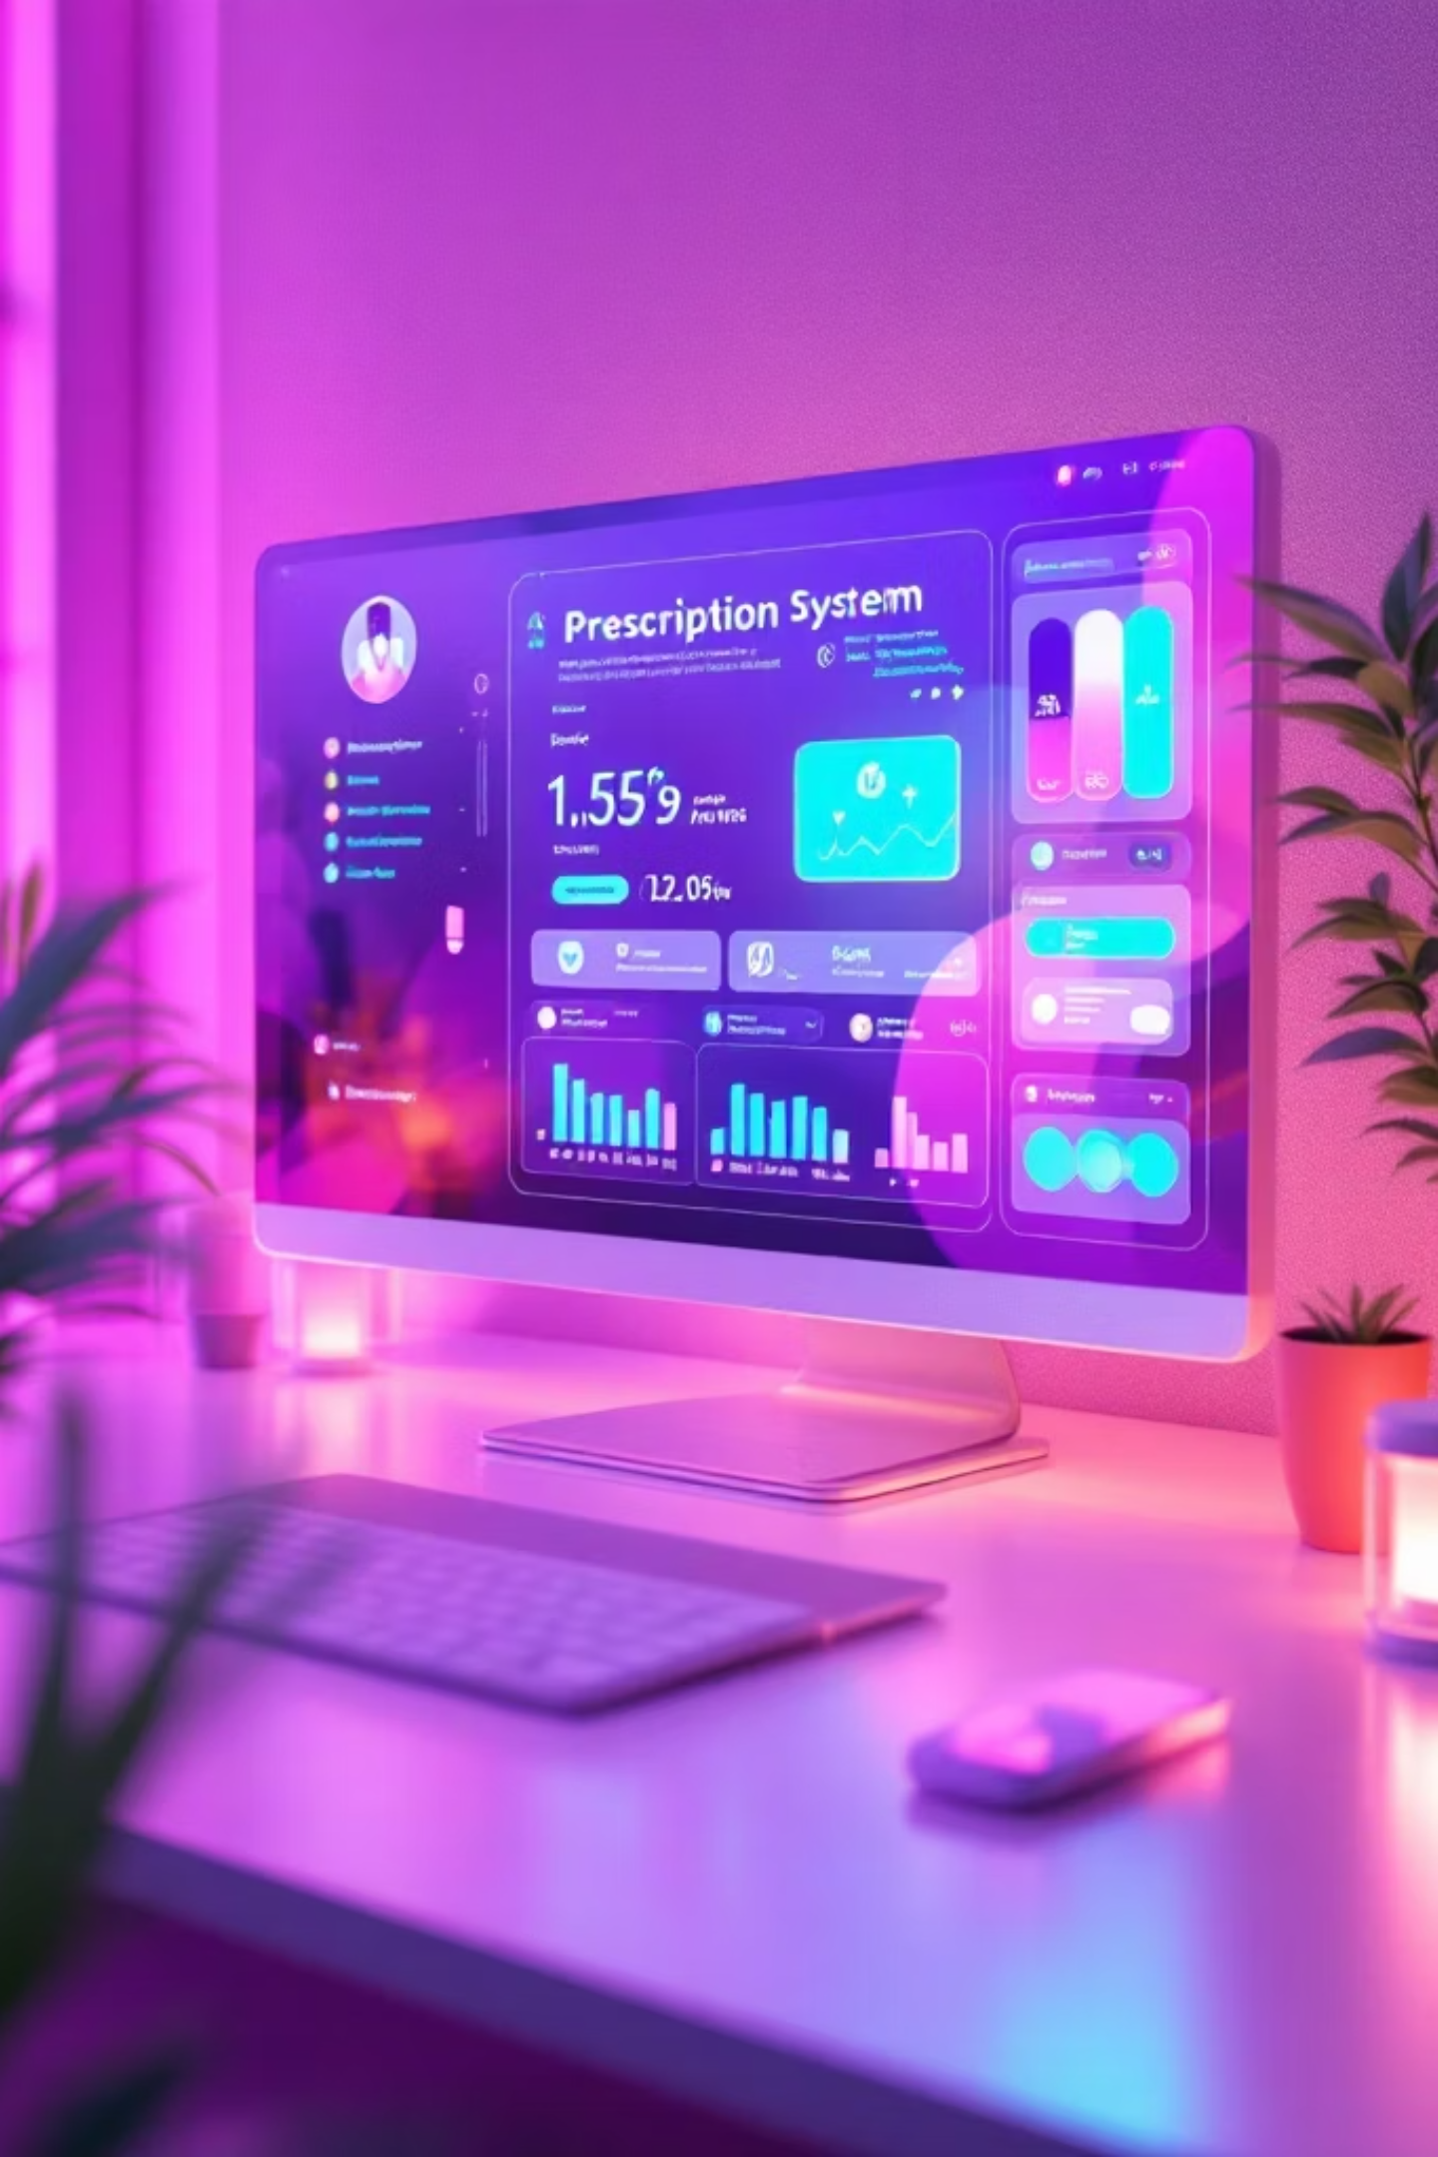




Online Medication
& Prescription Tracker
A secure, full-stack solution connecting patients, doctors, and healthcare administrators through intelligent medication management.

Slide 2
Team Members Name
Backend Developers
Responsibilities:
Developed REST APIs using Spring Boot
Backend Developers
Frontend Developers
Managed database integration using MongoDB
Integrated AI chatbot functionality using Groq API
Ashu
Archana T V
Implemented authentication and user profile
management
Revathi Baraju
Manswi Badgujar
Ravella Neeharikha
Frontend Developers
Responsibilities:
Built user interface using React and Vite
Implemented navigation using React Router
Designed responsive layouts using Tailwind CSS

Slide 3








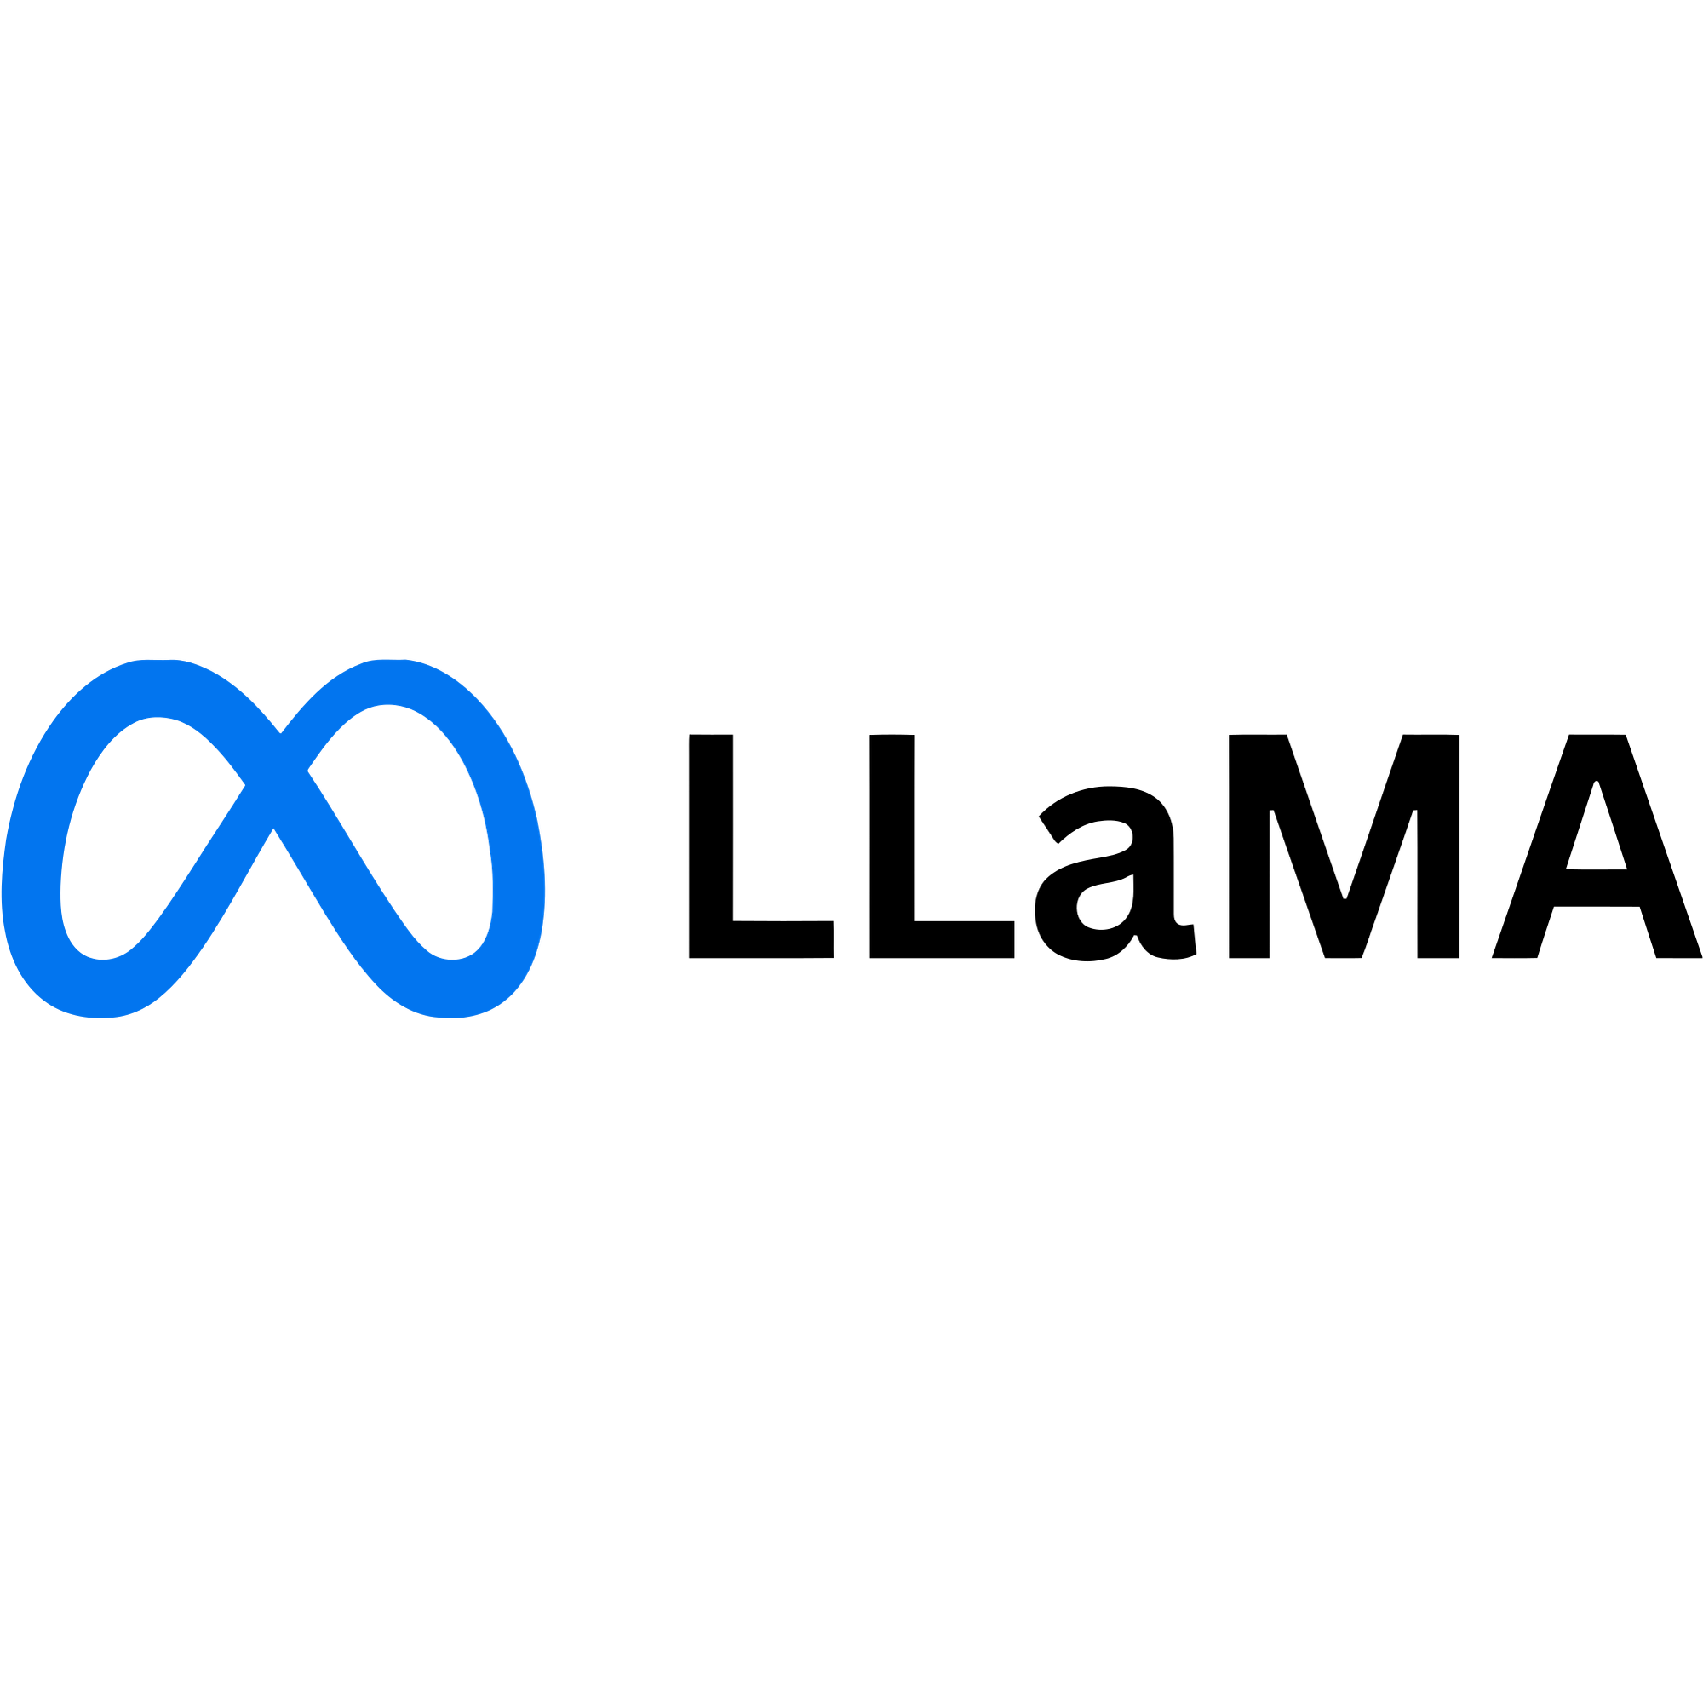


Technology Stack of Online Medication &Prescription Tracker
Backend Framework
Frontend
Tools Used
Java
React with
Vite
Tailwind CSS
Postman
Programming language used
for backend development
Used to build a fast and modern user interface with efficient development
and hot module replacement.
API testing and documentation
Utility-first CSS framework used
for responsive and customizable UI styling.
Dependency management and
project build tool.
Spring Boot
Backend framework for building
REST APIs and handling business logic
React Router
TypeScript
Enables client-side routing and navigation between different pages in the application.
Provides static typing to improve code reliability, maintainability, and scalability.
VS Code
Language model used for generating
intelligent chatbot responses.
Primary development environment
Cloud & Storage
Groq API
Git
Provides AI-powered chatbot
functionality to answer user queries
related to medicines and symptoms.
MongoDB
Version control and collaboration
Database used for storing user information,
medicine data, and application records.

Slide 4
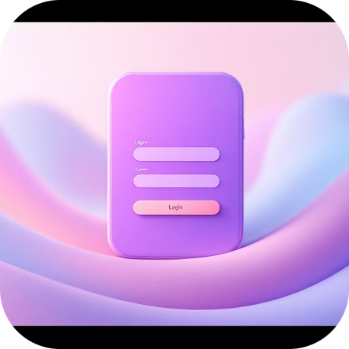
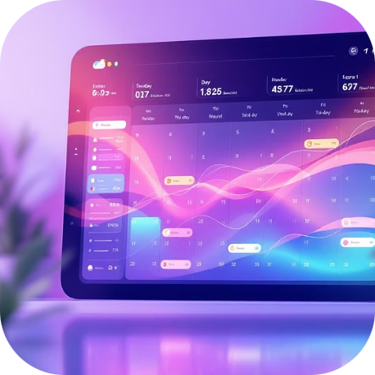
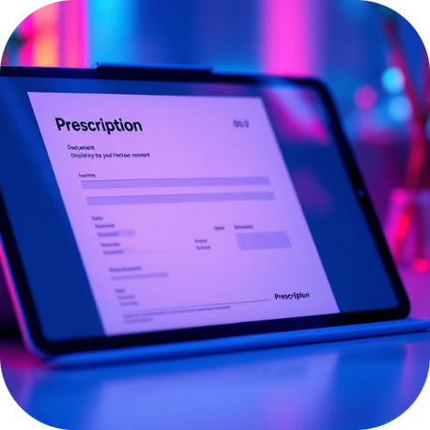
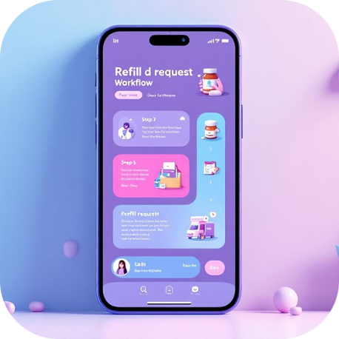
Key Features of Online Medication &Prescription Tracker
Secure Authentication
Medication Tracking
Prescription Management
Refill Requests
JWT-based login with encrypted credentials and session management protecting sensitive health data.
Visual calendar displaying daily medication schedules with dosage reminders and compliance tracking.
Doctors can create, update, and revoke prescriptions with real-time notifications to patients.
Patients initiate refill requests that route through approval workflows to doctors and pharmacies.

Slide 5
AI Features
The Online Medication & Prescription Tracker integrates Artificial Intelligence to enhance user experience and provide intelligent healthcare support.
1. AI Chatbot Support
The system includes an AI-powered chatbot to assist users with medical-related queries
Provides instant responses about medicines, dosage, and general health guidance
Reduces dependency on manual support and improves accessibility
2. Groq API Integration
The chatbot is powered using the Groq API with LLaMA model
Enables fast and efficient response generation
Ensures real-time interaction with users
3. Intelligent Query Handling
Understands user questions in natural language
Provides relevant and context-aware responses
Helps users get quick information without searching manually

Slide 6

Database Design & API Structure of Online Medication &Prescription Tracker
Core Collections
1
Users
User profiles with role-based permissions and authentication credentials.
REST API Endpoints
POST /API/auth/login – JWT
token generation
GET /API/medications - User
medication list
POST /API/prescriptions - New
prescription creation
PUT /API/refills/{id} - Refill
request approval
2
Medications
Drug catalogue with dosage information, schedules, and patient-specific instructions.
3
Prescriptions
Active and historical prescriptions linking doctors, patients, and medications.
4
Refill Requests
Transaction records tracking refill status from request to fulfillment.

Slide 7

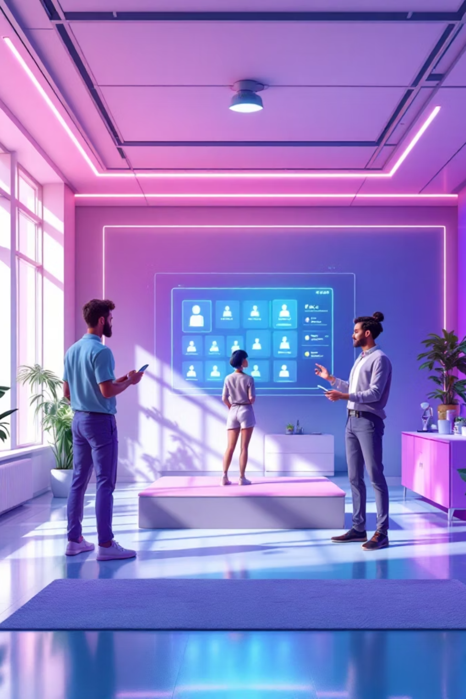

Roles & Access Control of
Online Medication &Prescription Tracker
Admin
Doctor
System configuration and maintenance
User account management
System monitoring and analytics
Database backup and recovery
View patient medication lists
Create and update prescriptions
Approve refill requests
Monitor treatment compliance
Patient
View personal medication schedule
Request prescription refills
Track dosage adherence
Access prescription history

Slide 8
Challenges & Solutions in
Online Medication &Prescription Tracker
Medication Adherence
Prescription Management
Refill Coordination
Challenge :Patients struggle to track multiple medications with complex schedules, leading to missed doses and treatment complications.
Solution: Implement a digital medication reminder system with personalized notifications and easy-to-read schedules to help patients take the right medicine at the right time.
Challenge: Fragmented systems make it difficult for doctors to monitor patient compliance and update treatment plans efficiently. Solution: Develop an integrated digital platform that consolidates patient medication data, allowing doctors to track adherence, adjust prescriptions in real time, and communicate directly with patients.
Challenge: Manual refill requests create friction
between patients and pharmacies, causing delays
in medication continuity.
Solution: Implement an automated refill
management system that allows patients to
request refills online and notifies pharmacies in
advance, ensuring timely medication availability
and reducing treatment gaps.

Slide 9

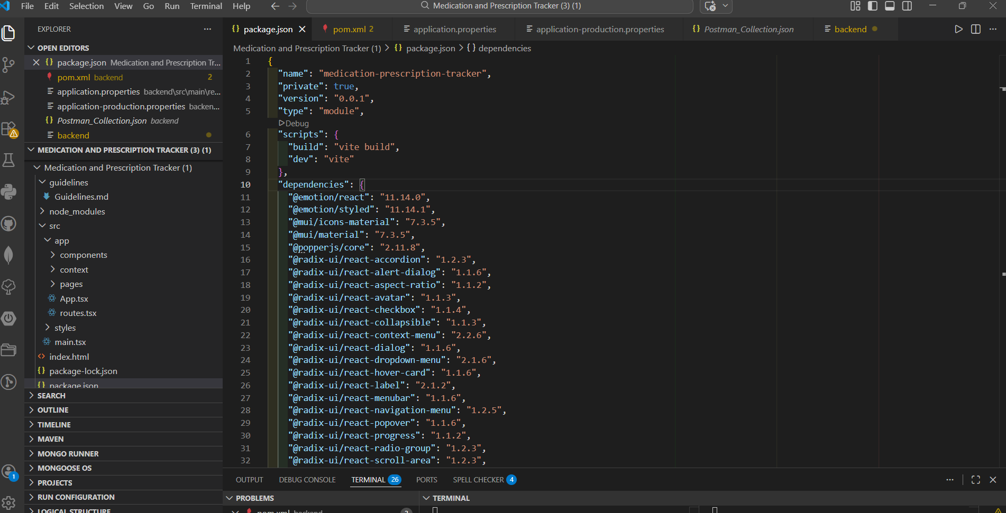


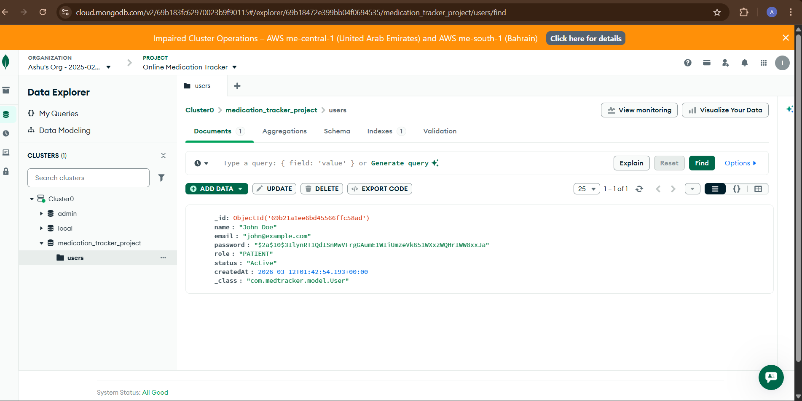

Architecture of Online
Medication & Prescription Tracker
React Frontend
Vite + Tailwind CSS + React Router for responsive, component-based UI with client-side routing.
Spring Boot Backend
RESTful APIs handling business logic, JWT authentication, and secure data processing.
MongoDB Storage
NoSQL database storing user profiles, medication records, prescriptions, and transaction history.

Slide 10
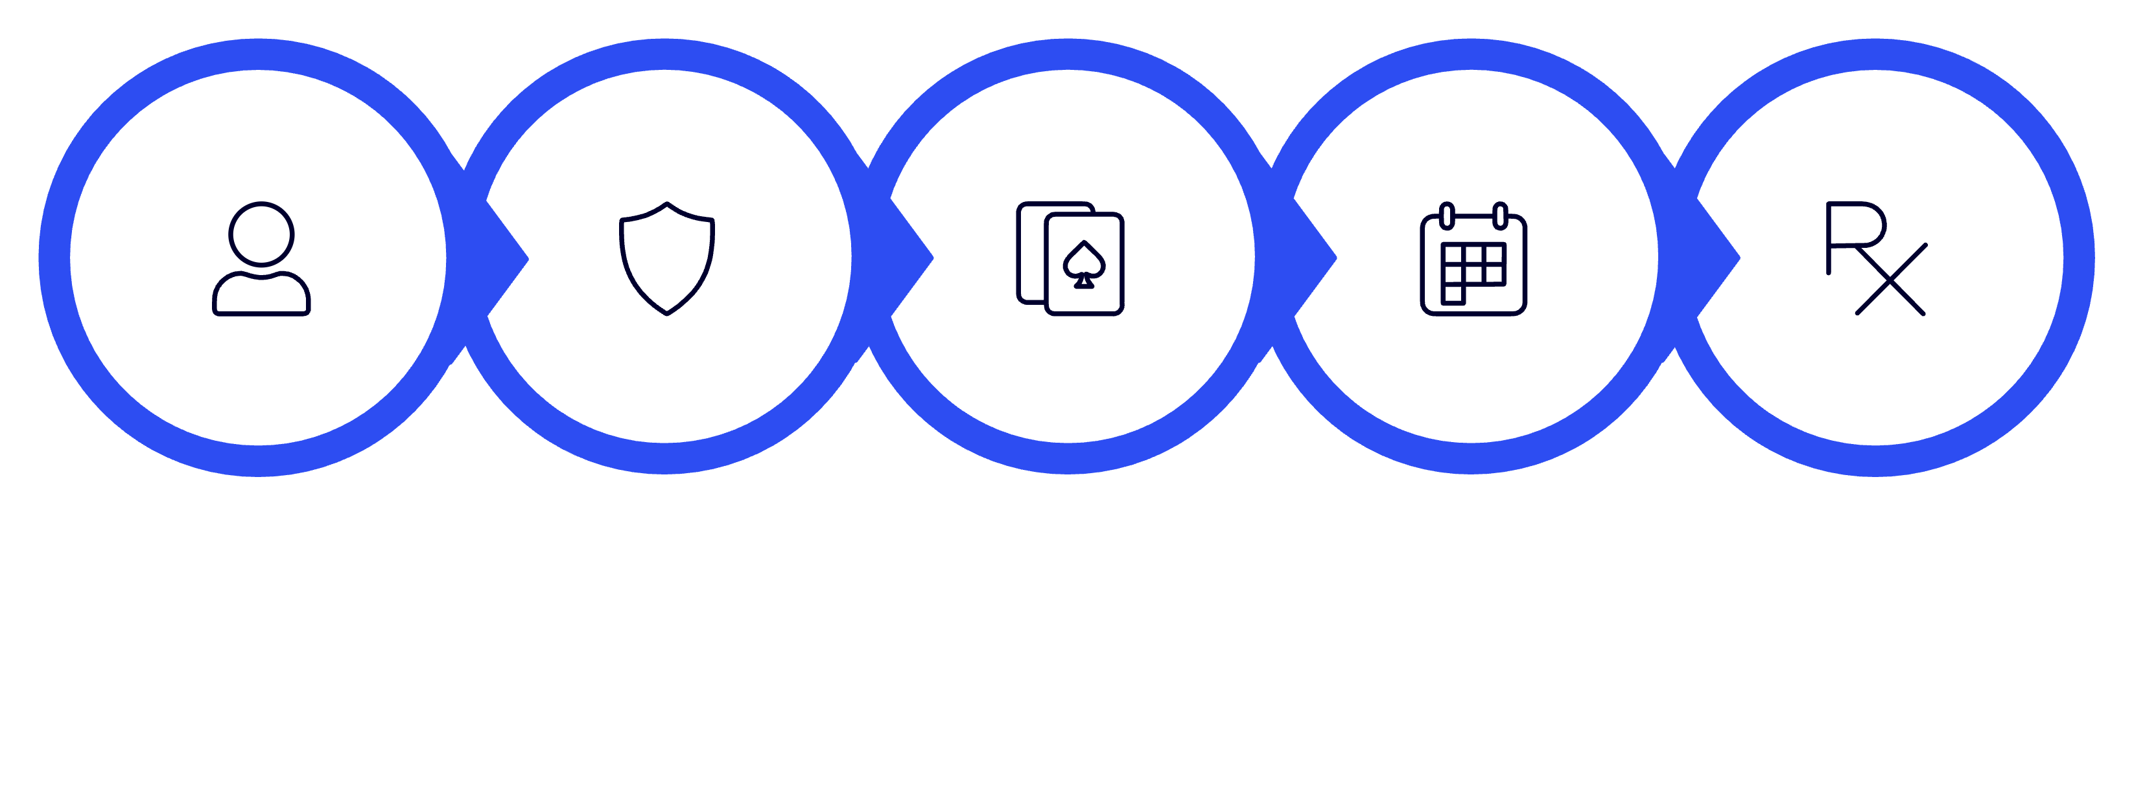
System Workflow Of Online Medication & Prescription Tracker
Registers
Authenticate
Profile
Track
Prescribe
The workflow starts with registration, where users create an account by selecting their role such as doctor, patient, or admin.
After that, they authenticate by logging in with their email and password
Once logged in, users manage their profile information.
Patients can then track their medications and schedules
while doctors prescribe medicines by adding prescription details for patients.

Slide 11
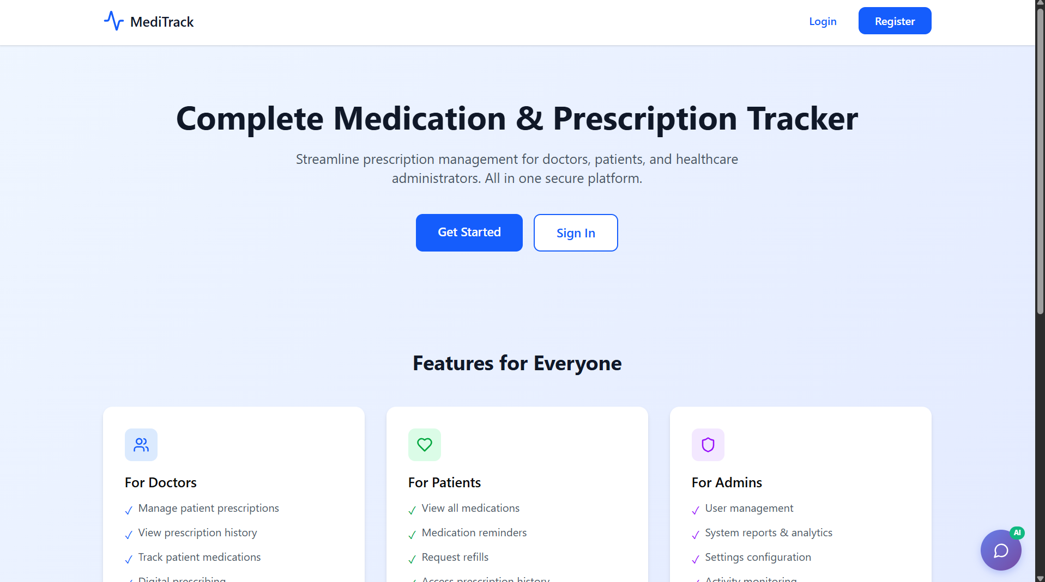
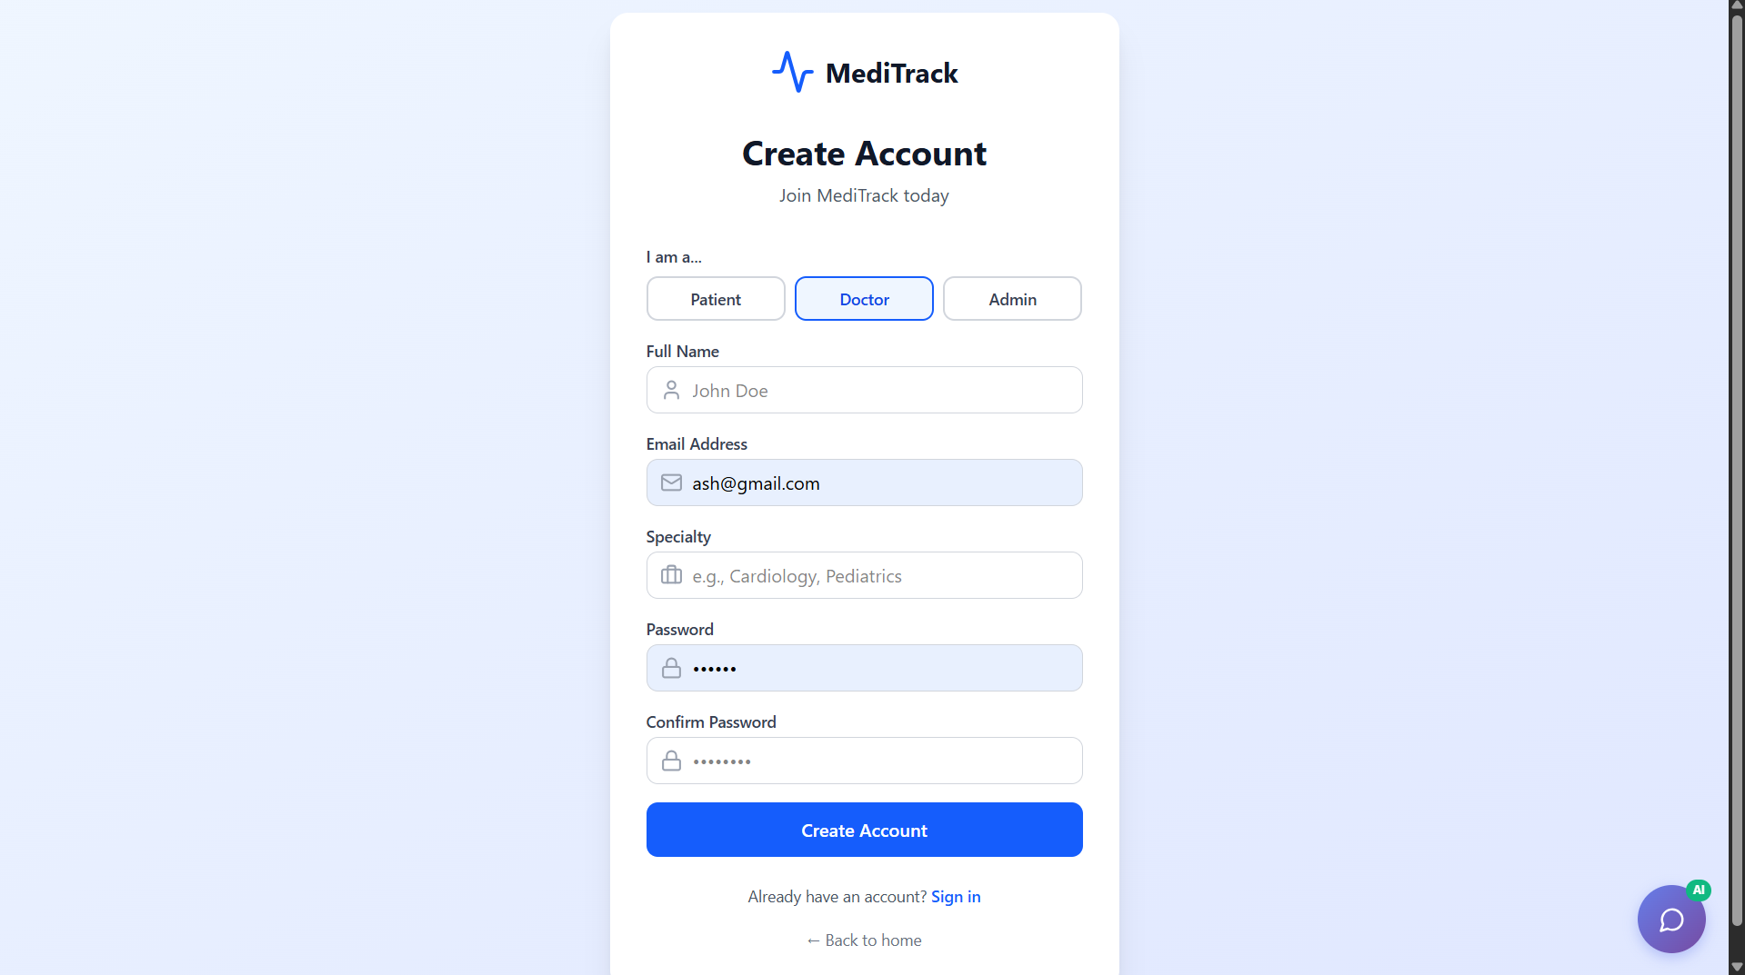
Figure 1: User Interface
This figure shows the main interface of the Online Medication and Prescription Tracker. It provides users with easy access to features such as registration, login, medication tracking, and prescription management through a simple and user-friendly design.
Figure 2: User Registration Interface
This page allows users to register as a doctor, patient, or admin.
Doctors provide details like specialization and experience, patients enter personal information such as date of birth, and admins manage and verify user accounts.

Slide 12
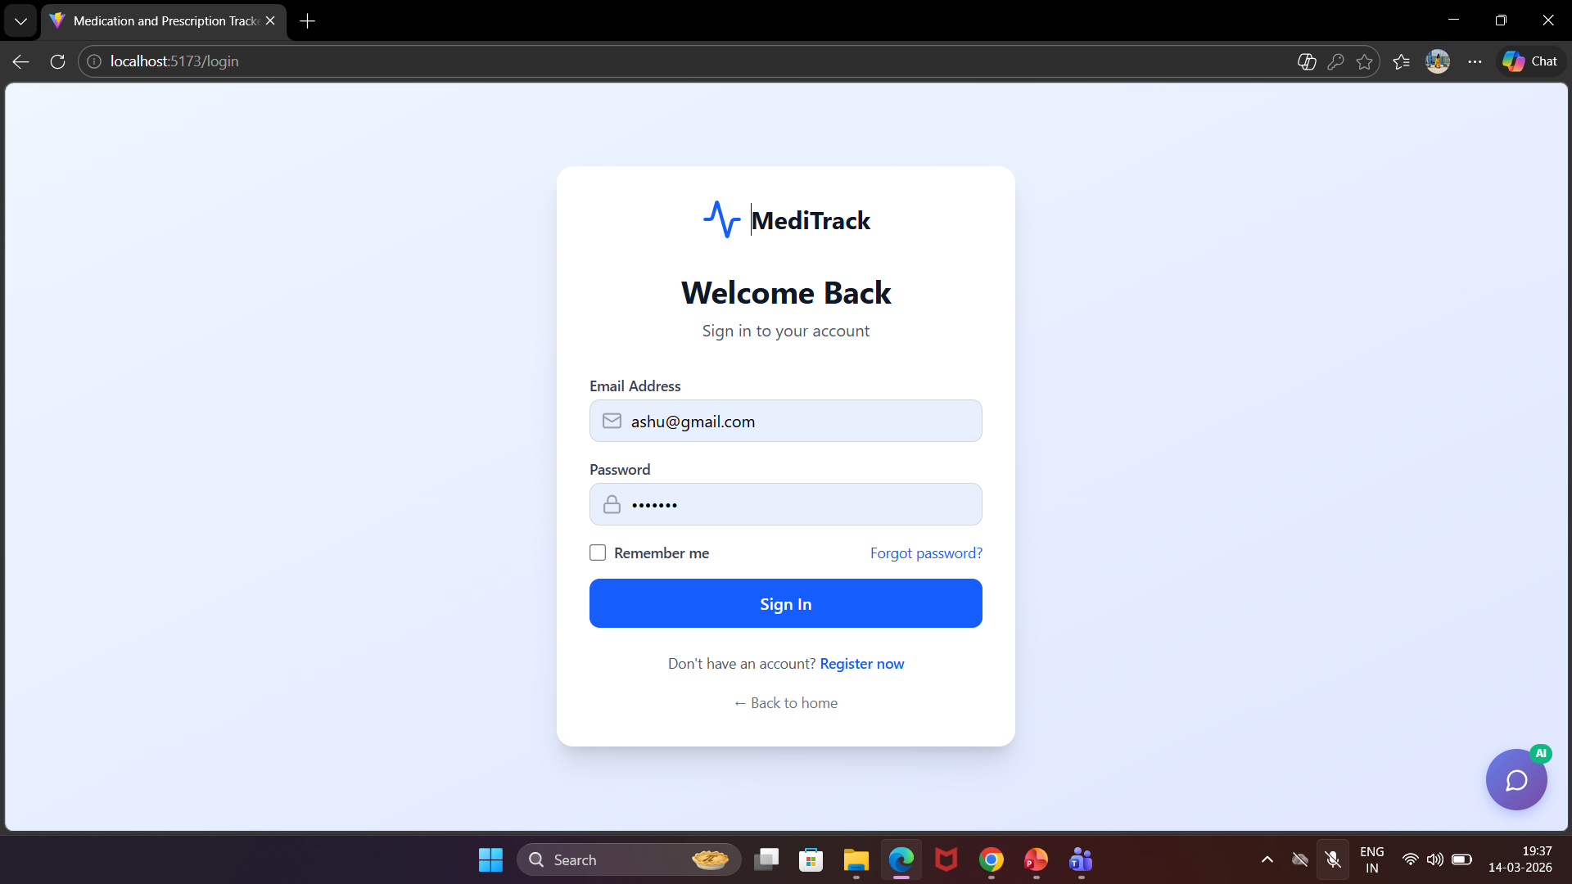
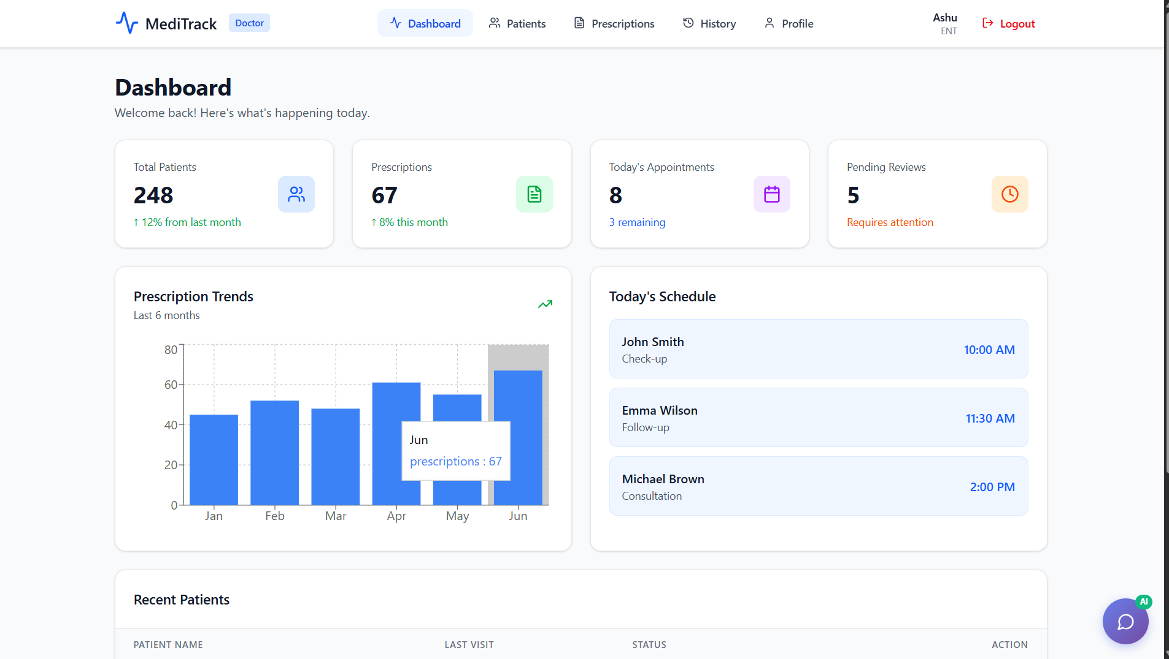
Figure 3: User Login Interface
Secure authentication screen allowing users to log in using email and password with JWT-based access control.
Figure 4: Doctor Dashboard
The doctor dashboard allows doctors to manage patient records and provide prescriptions. Doctors can view patient details and update medication information for better treatment management.

Slide 13
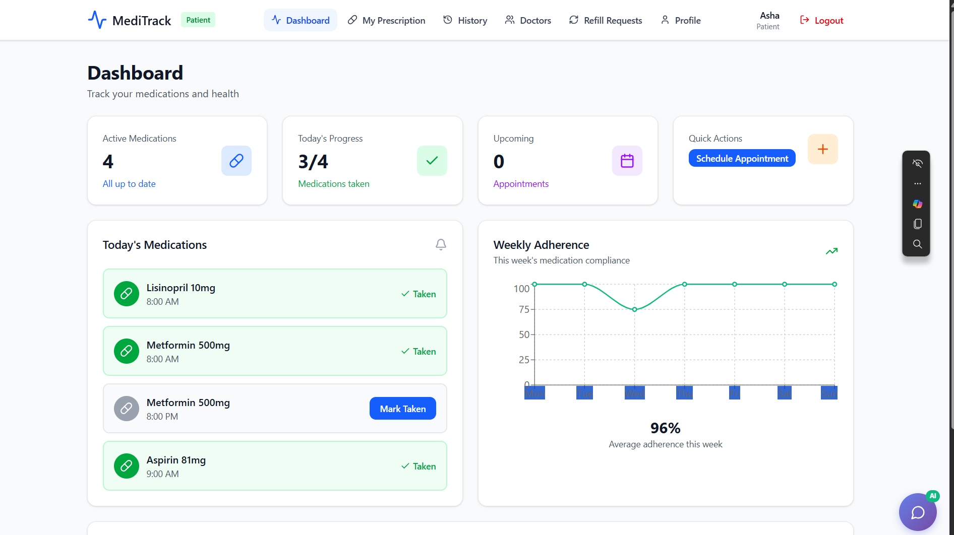
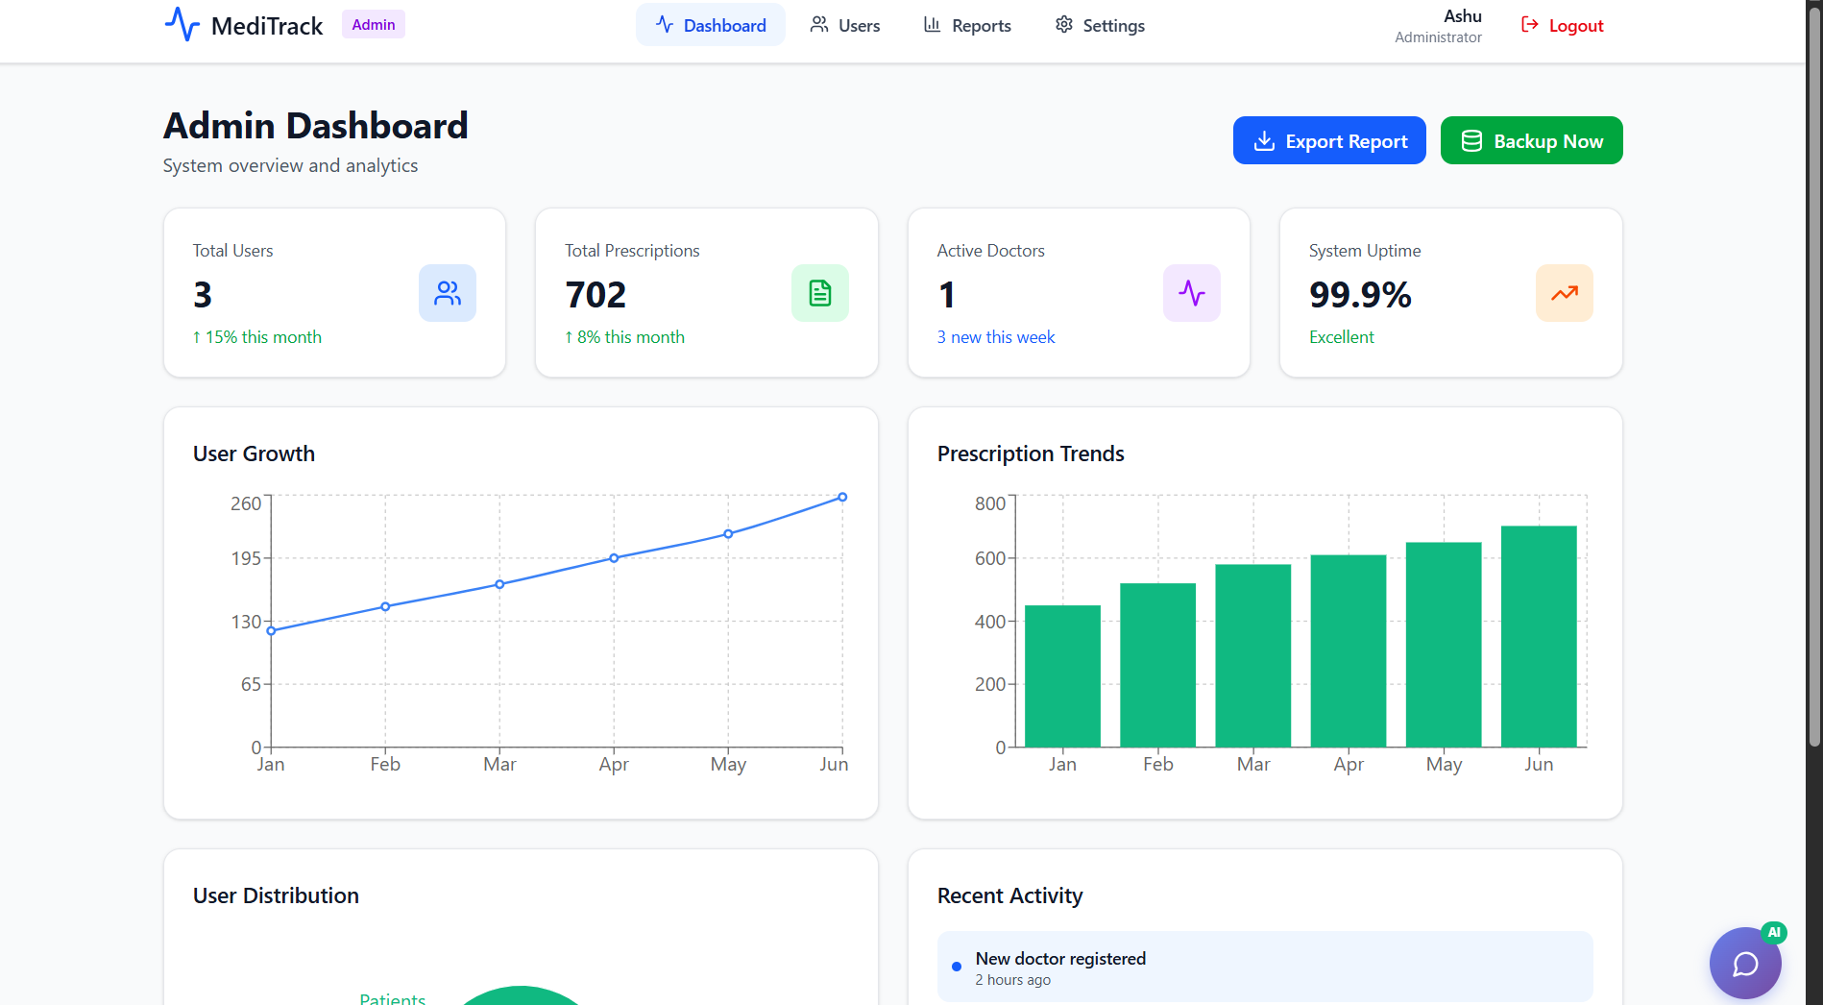
Figure 5: Patient Dashboard
The patient dashboard helps users track their medications and view prescriptions provided by doctors. It also allows patients to monitor their treatment and maintain their medical records.
Figure 6: Admin Dashboard
The admin page allows administrators to manage the system by verifying users and monitoring activities. It ensures secure access and smooth functioning of the online medication platform.

Slide 14
Future Enhancements of Online Medication &Prescription Tracker
Mobile Application
Integration Ecosystem
AI-driven personalized reminders that adjust timing based on user behavior and adherence patterns.
Voice assistant integration for hands-free medication logging and queries.
Offline mode to track medications and sync data when internet connectivity is restored.
Connect with pharmacy systems, electronic health records, and we
arable health devices.
Sync with wearable devices to monitor vital signs and detect early signs of medication side effects.
Automated alerts for potential drug interactions based on combined health data.
🛰️
AI & Smart Features
Analytics Dashboard
AI-driven personalized reminders based on user behavior and adherence patterns .
Intelligent alerts for missed doses and schedule optimization.
Enhanced chatbot capabilities for more accurate medical guidance.
Advanced reporting on medication adherence patterns and treatment outcomes for clinical insights.
Customizable dashboards for different stakeholders: doctors, pharmacists, and caregivers.
Trend analysis and benchmarking across populations to support research and public health initiatives.

Slide 15

-
Conclusion
The Online Medication & Prescription Tracker is a digital system that simplifies medication and prescription management for patients and doctors. It improves treatment tracking, communication, and overall efficiency.
The integration of an AI chatbot using the Groq API enhances user experience by providing instant support.
Overall, the project demonstrates how modern technologies like REST APIs, JWT authentication, and full-stack architecture can create a secure, scalable, and user-friendly healthcare solution.

Slide 16
Online Medication
& Prescription Tracker
APPLICATION DEMO…

Slide 17
Q & A

Slide 18

Infosys Springboard And Mentor
“Thanks you for your guidance, support , and valuable insights
throughout Infosys Springboard internship”
A Special Thanks To

