Slide 1

Chinook Music Store - Data Analysis & Strategic Recommendations
• Presenter: Ashutosh Kadam
• Project By: Newton School

Slide 2

Problem Statement
• Objective: Analyze music record sales data and derive insights.
• Business Need: Optimize revenue streams in the digital and physical music market.
• Approach: Leverage data analytics to identify customer behaviors, sales trends, and operational inefficiencies.

Slide 3

Introduction
• This project provides an in-depth analysis of the Chinook Music Store’s sales data.
• Key Focus Areas: Sales trends, customer behavior, employee performance.
• Methodology: SQL queries, sales pattern analysis, strategic recommendations.

Slide 4
Business Applications of Data Analysis
• Revenue Optimization: Identify high-performing albums and artists.
• Customer Segmentation: Analyze purchase behavior to refine marketing.
• Employee Performance: Track regional sales contributions.
• Market Expansion: Identify bundling and promotional opportunities.

Slide 5
Data Overview
• Chinook Database consists of 11 interconnected tables.
• Covers customers, invoices, tracks, albums, artists, and employees.
• Captures purchase trends and frequency over time.

Slide 6
Database Schema (ER Diagram)
• Artist → Album (artist_id)
• Album → Track (album_id)
• Track → Genre & MediaType (genre_id, media_type_id)
• Invoice → Customer (transaction linked to a buyer)
• Employee → Customer Support (assigned representatives).

Slide 7
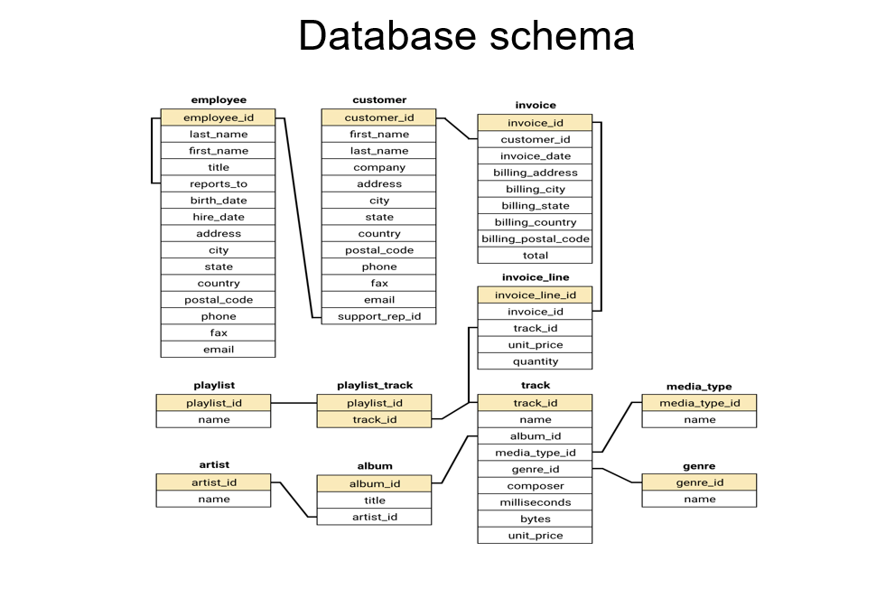

Slide 8
Analytical Approach
• Data Exploration: Understanding table structures.
• Data Cleaning: Removing inconsistencies and duplicates.
• SQL Querying: Extracting critical sales patterns.
• Insights Gathering: Analyzing trends and behaviors.
• Strategic Recommendations: Actionable growth strategies.

Slide 9
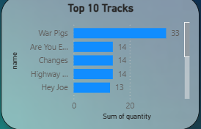
Sales Insights – Top 5 Purchased Tracks
• War Pigs – High repeat purchases.
• Highway Chile – Classic hit with consistent demand.
• Are You Experienced – Top album’s best-performing track.
• Hey Joe – Strong streaming and physical sales.
• Put the Finger on You – High international demand.

Slide 10
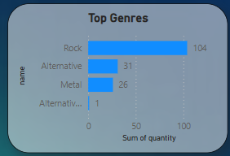
Top-Selling Music Genres
• Rock – 40%+ of total revenue.
• Metal – Strong niche audience.
• Alternative & Punk – Younger customer engagement.
• Latin – Growing in South America.
• R&B/Soul – High repeat purchase rate.

Slide 11
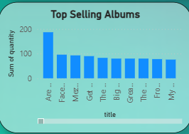
Best-Selling Albums
• Are You Experienced – High physical & digital sales.
• Faceless – Strong Metal & Alternative fan base.
• Mezmerize – High repeat purchases.
• Get Born – Cross-genre appeal.
• The Doors – Classic catalog sales remain strong.

Slide 12
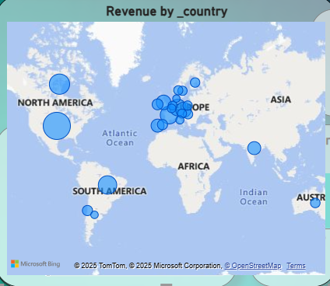
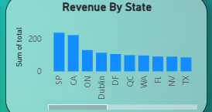
Market Trends – Regional Spending Insights
• By Country: USA (50%+ revenue), Canada, Brazil, France, Germany.
• By State: São Paulo, California, Ontario, Dublin, Federal District.
• Strategic Focus: Localized marketing strategies & regional pricing models.

Slide 13
Key Recommendations for Growth
• Inventory Optimization: Increase stock for top-selling genres.
• Customer Engagement: Loyalty programs & personalized recommendations.
• Operational Efficiency: Improved checkout & flexible payments.
• Marketing & Expansion: Targeted campaigns and exclusive artist deals.

Slide 14
Conclusion – A Data-Driven Future
• Comprehensive sales analysis revealed key revenue drivers.
• Genre and album insights highlight marketing opportunities.
• Regional spending patterns provide a roadmap for growth.
• Strategic recommendations focus on revenue and customer loyalty.

Slide 15
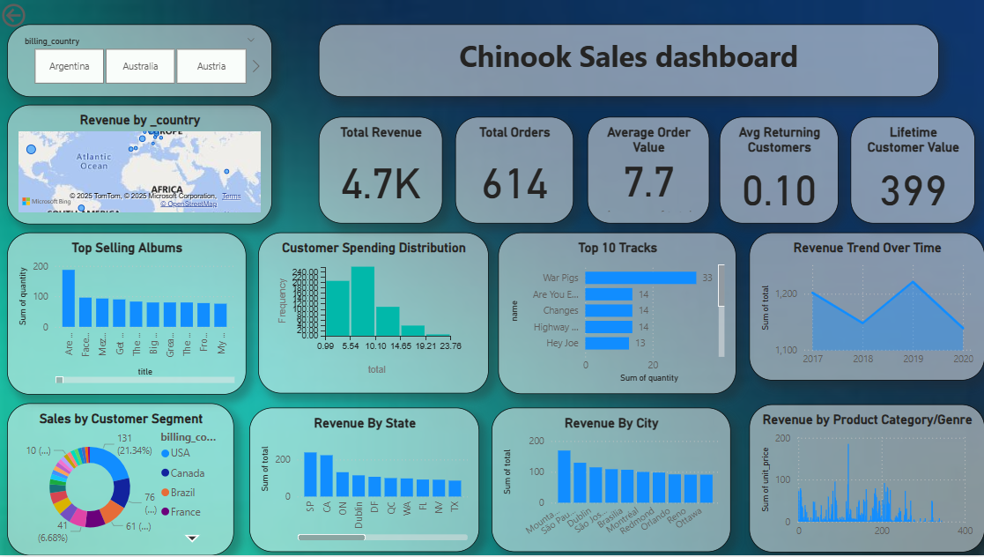
Dashboard Overview

Slide 16
Thank You
• Open for Questions & Discussion

