Slide 1
NETFLIX PRIZE · PERSONALIZED CONTENT DISCOVERY
Recommendation Systems for
Personalized Content Discovery
Bias · Matrix Factorization · Item-based Collaborative Filtering
Mandatory metrics: RMSE & MAP@10 | relevance threshold = 3.5★
Ashutosh Singh (23117033) · Ayush (23117036)
1 / 8

Slide 2
The Problem & The Data
Goal: learn preferences from past ratings and surface the right Top-10 unseen titles per user.
Two coupled tasks that don't always agree:
Working set (k-core)
Ratings
629,679
Users
28,411
• Rating prediction → measured by RMSE
• Ranking → measured by MAP@10
Movies
6,823
Density
0.325%
Core challenges: extreme sparsity, long-tail popularity, positivity bias, and cold-start.
Mean rating
3.51★
Sampled from the full 100M-rating corpus via reservoir sampling, then k-core filtered (users ≥ 15, movies ≥ 10).
2 / 8

Slide 3
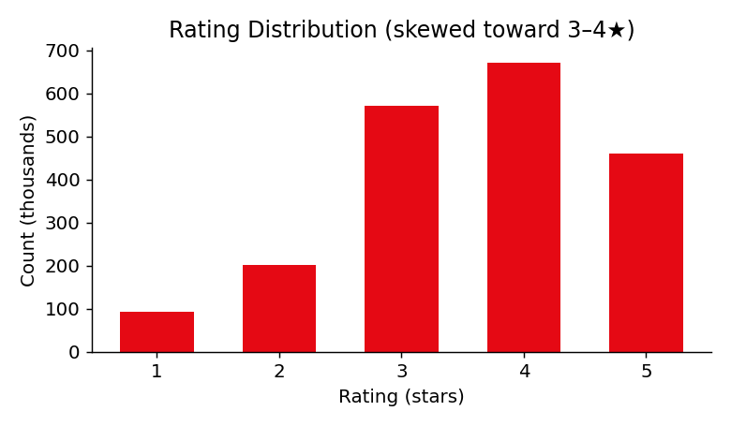
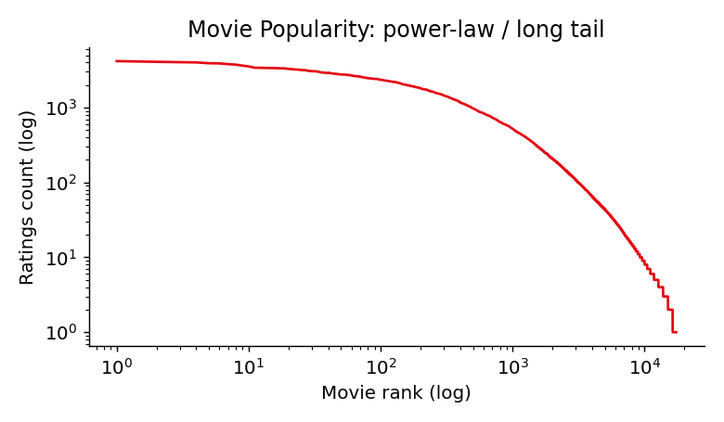
What the Data Told Us
• Positivity bias — ~85% of ratings are 3–5★; a model must beat the "predict the mean" trap.
• Power-law popularity — a few blockbusters dominate, making popularity a deceptively strong baseline.
• Temporal growth — rating volume rises sharply, so we use a temporal (past→future) split, not random.
3 / 8

Slide 4
Three Models, One Comparison
Model
Prediction
Strength
Baseline (Bias)
μ + b_u + b_i
Strong, cheap RMSE floor; popularity ranker
Matrix Factorization
μ + b_u + b_i + p_u·q_i
Latent-factor personalization (SGD)
Item-based CF
cosine item neighbours
Explainable, diversity-oriented
Evaluation protocol. Temporal 80/20 per-user split · relevance = rating ≥ 3.5 · Top-10 by scoring all items and masking seen ones · reported on both all-items and 100-sampled-negative protocols.
4 / 8

Slide 5
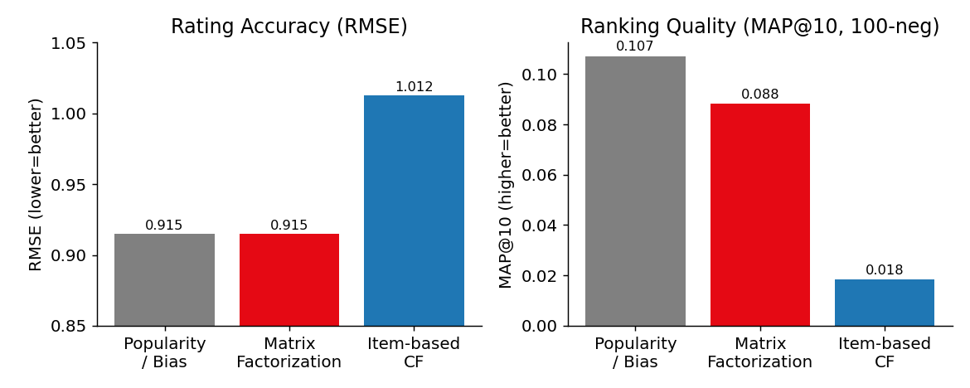
Results
Rating accuracy
Model
RMSE
Bias
0.915
MF
0.915
Item-CF
1.012
Ranking (100-neg)
Model
MAP@10
HR@10
Popularity
0.107
0.50
MF
0.088
0.45
Item-CF
0.018
0.13
5 / 8

Slide 6
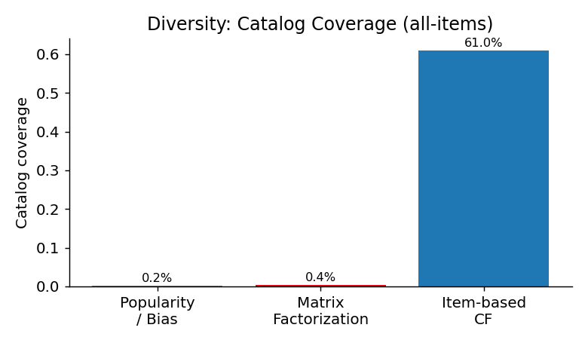
The Central Trade-off
Models that tie on RMSE behave completely differently when ranking.
• Popularity wins hit-rate — but covers <1% of the catalog.
• MF personalizes at near-equal quality.
• Item-CF reaches 61% coverage — far more diverse — at an accuracy cost.
No single model wins every metric. The right choice depends on the objective: hit-rate, personalization, or discovery.
6 / 8

Slide 7
Recommendations in Action
MF Top-10 for a user who loved epics & acclaimed series — it recovered a held-out relevant title (✓):
#
Recommended
Explainability. Item-CF supports natural "because you watched X" rationales — though sparse co-ratings make those similarities noisy, which is exactly why its ranking lags.
1
The Simpsons: Season 5
2
LOTR: Return of the King (Ext.)
3
LOTR: The Two Towers (Ext.)
5
Family Guy Collection ✓
8
The Shawshank Redemption
7 / 8

Slide 8
Key Insights & What's Next
INSIGHTS
FUTURE WORK
• RMSE ≠ recommendation quality.
• Popularity bias is strong but kills diversity.
• MF is the best balanced single choice.
• Sparsity punishes memory-based CF.
• Scale to the full 100M ratings.
• Implicit & ranking-native models (ALS, BPR).
• Hybrid / content features for cold-start.
• Diversity-aware re-ranking; neural CF.
Reproducible notebook · fixed seed 42 · 2,500 evaluation users
8 / 8

