Slide 1

Hospitality Operations Intelligence
Smarter hotels. Happier teams.
AI–Tourism Hackathon 2026 · Team Innov8
Notes:
Saturday, peak season in Mussoorie. Every room is full, two housekeepers didn't come, and the owner is planning shifts on WhatsApp. Nobody saw this Saturday coming. This is HOI, Hospitality Operations Intelligence.

Slide 2
THE PROBLEM
Hotels can't see the rush coming.
So peaks are short-staffed, good people burn out and leave, and guests wait.
1.1 M
1.8×
65%
workers short in Indian hospitality, 2025
higher quit rate in hotels and food service
of Char Dham pilgrims arrived by June
Sources HVS (Ministry of Tourism study) · US BLS JOLTS Table 4 · The Week, 24 Jun 2025
Notes:
Hotels can't see the rush coming. India's hospitality sector was projected to be short of 1.1 million workers in 2025; hotel workers quit about 1.8 times as often as others; and two thirds of Char Dham pilgrims arrive by June. So peaks are short-staffed, good people leave, and guests wait.

Slide 3
WHY · WHAT · FOR WHOM
Help small hotels run the day.
Why
What
For whom
Tourism comes in waves. Staff are planned by memory and WhatsApp.
Predict the rush, plan fair shifts, route every job, keep good people.
Small hotels and homestays in Uttarakhand, and everyone who works there.
Notes:
Why: tourism here comes in waves, and staff are planned by memory and WhatsApp. What: HOI predicts the rush, plans fair shifts, routes every job to the right phone and helps keep good people. For whom: small hotels and homestays in Uttarakhand, and everyone who works in them.

Slide 4


CUSTOMER VS USER
The owner pays. Everyone else uses it free.
Customer
Users
Hotel and homestay owners
Staff · guests · tourists · officials · job seekers
Can they buy it for themselves? Yes.
Free, any phone, in Hindi.
Notes:
The customer is the hotel or homestay owner; they can buy it for themselves. The users are staff, guests, tourists, officials and job seekers. They can't buy it, so it's free for them, works on any phone, and speaks Hindi. We built for the housekeeper with a basic Android phone first.

Slide 5
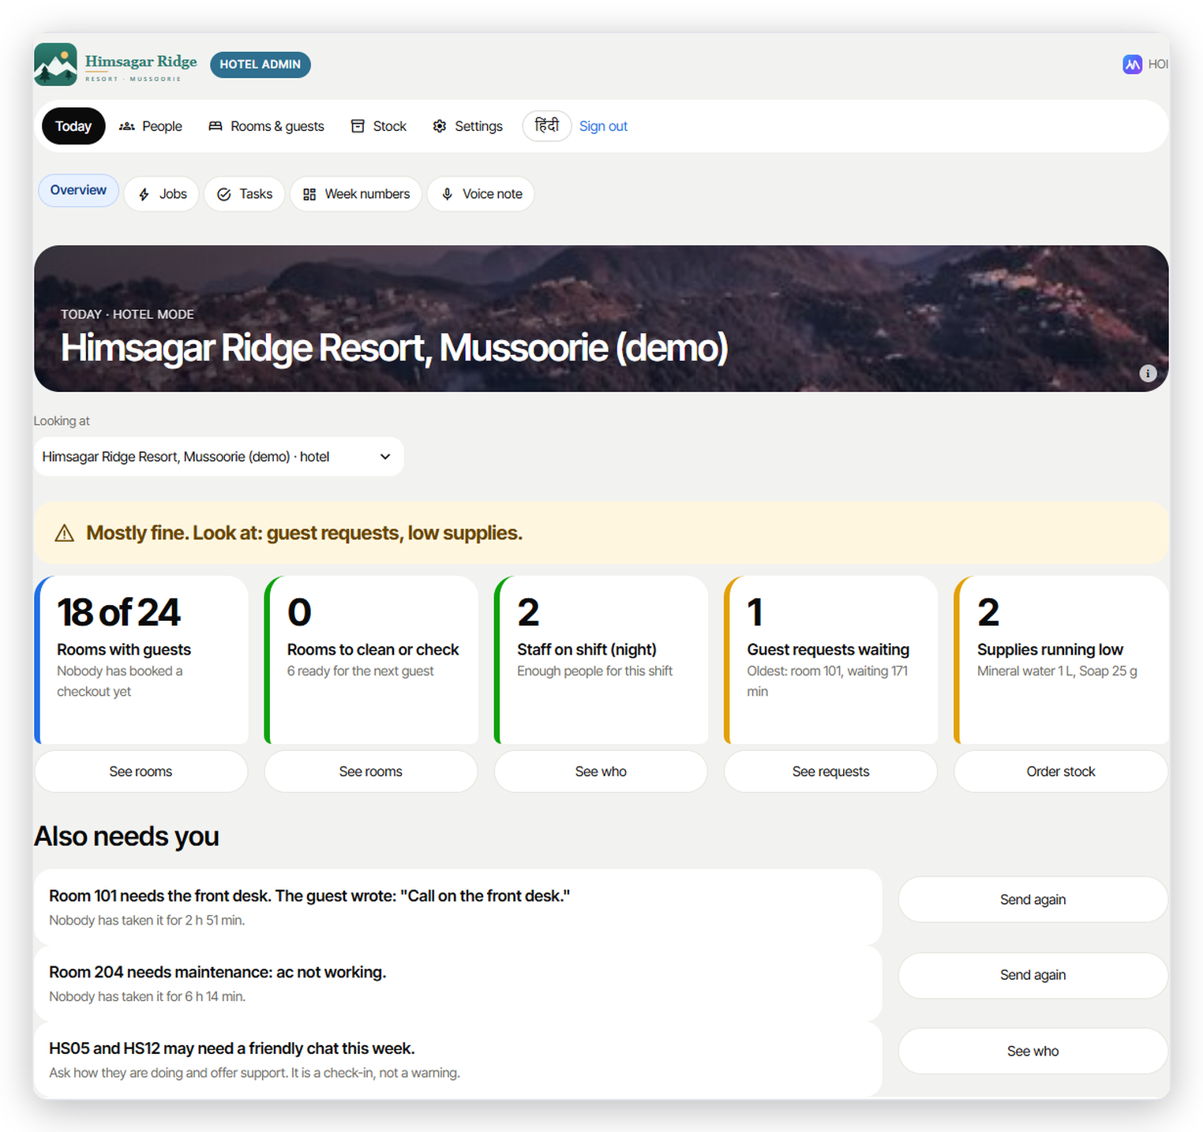
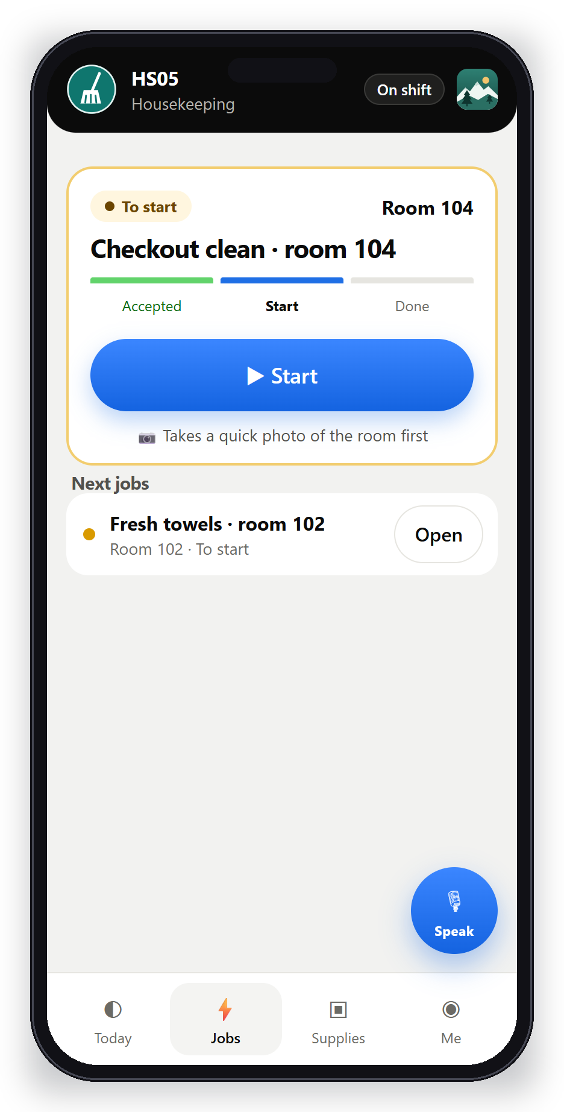
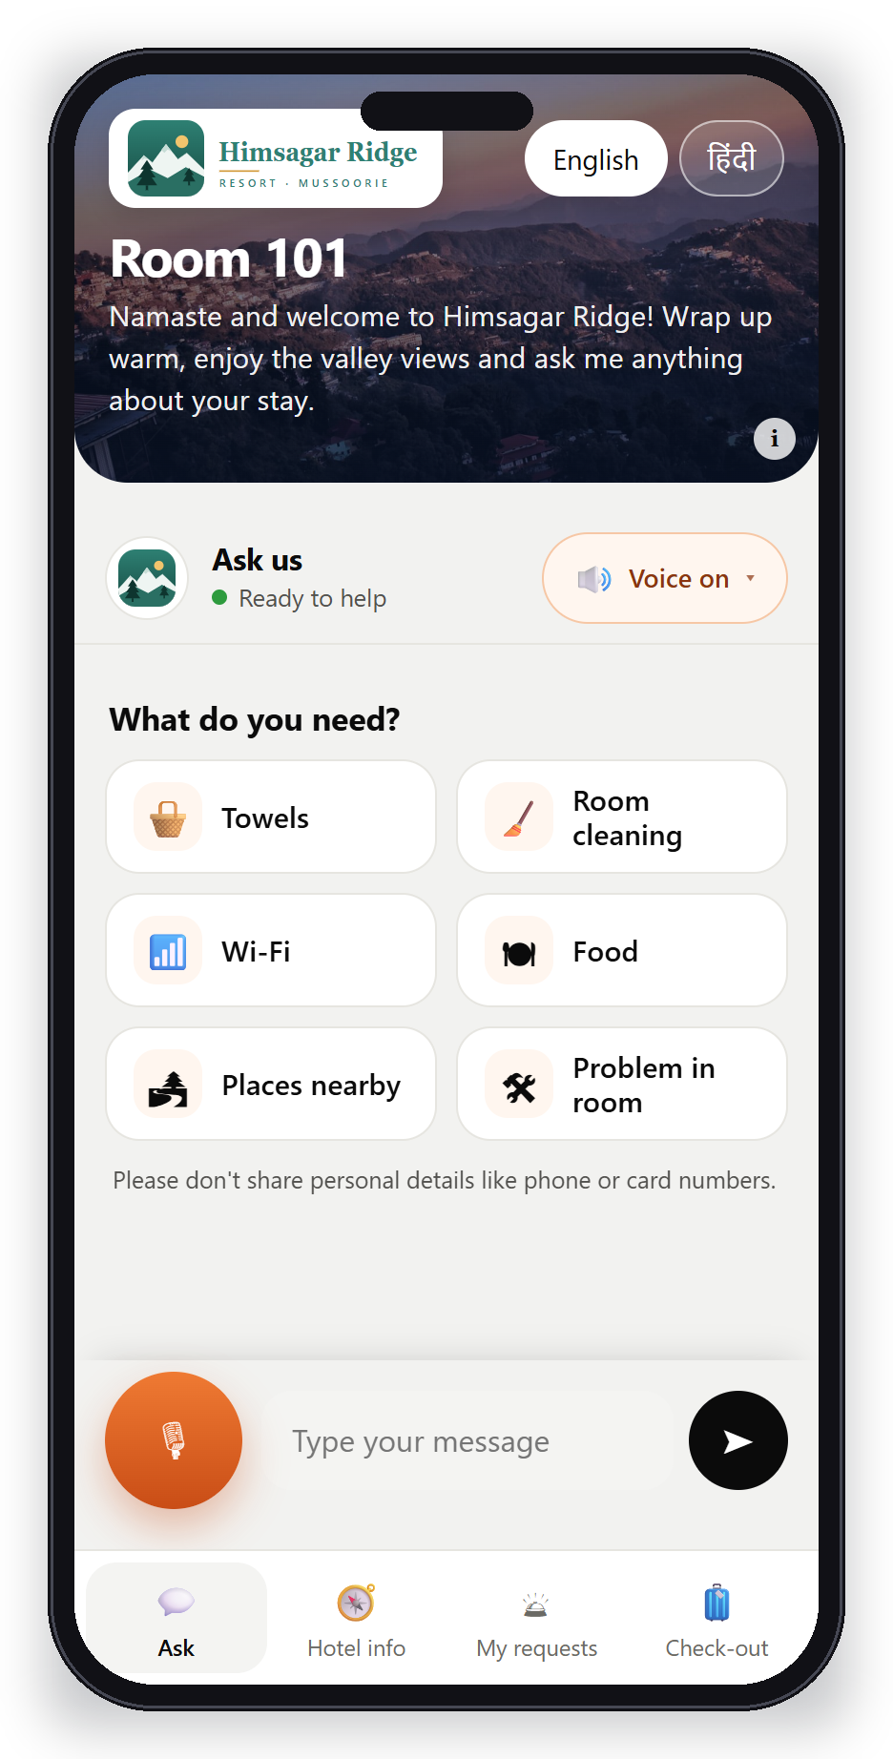
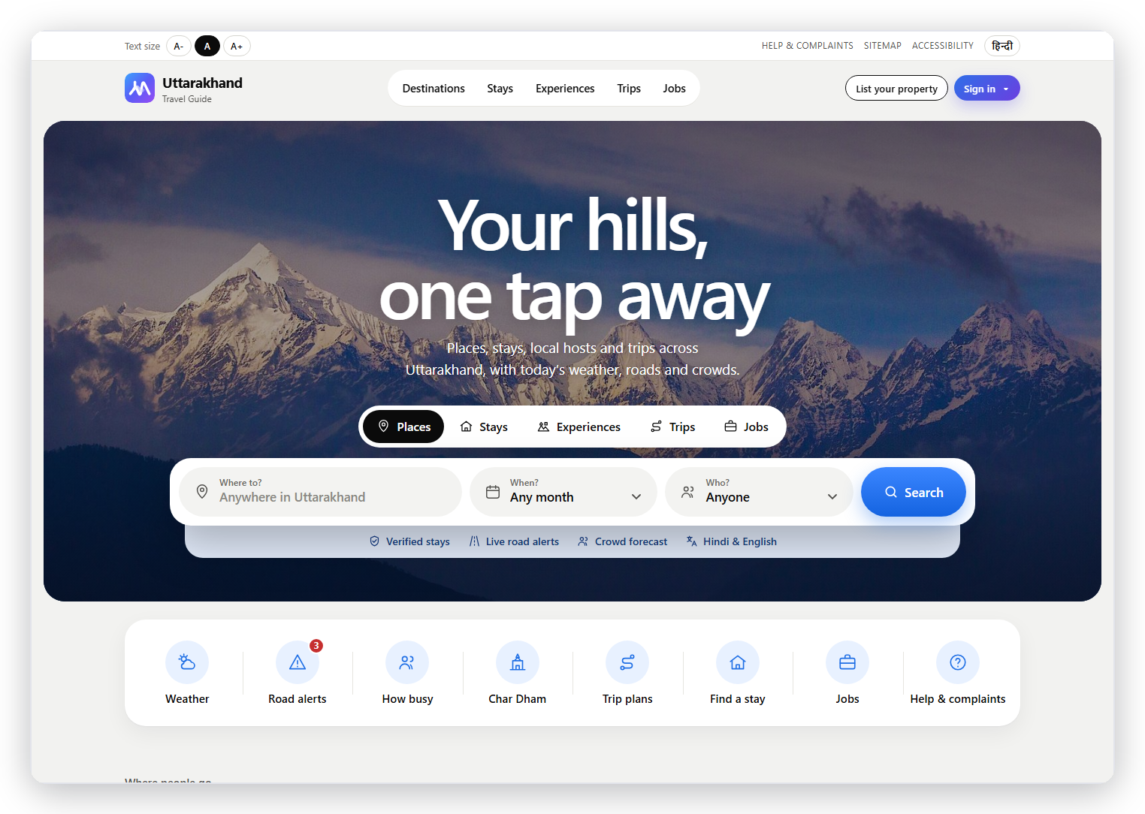
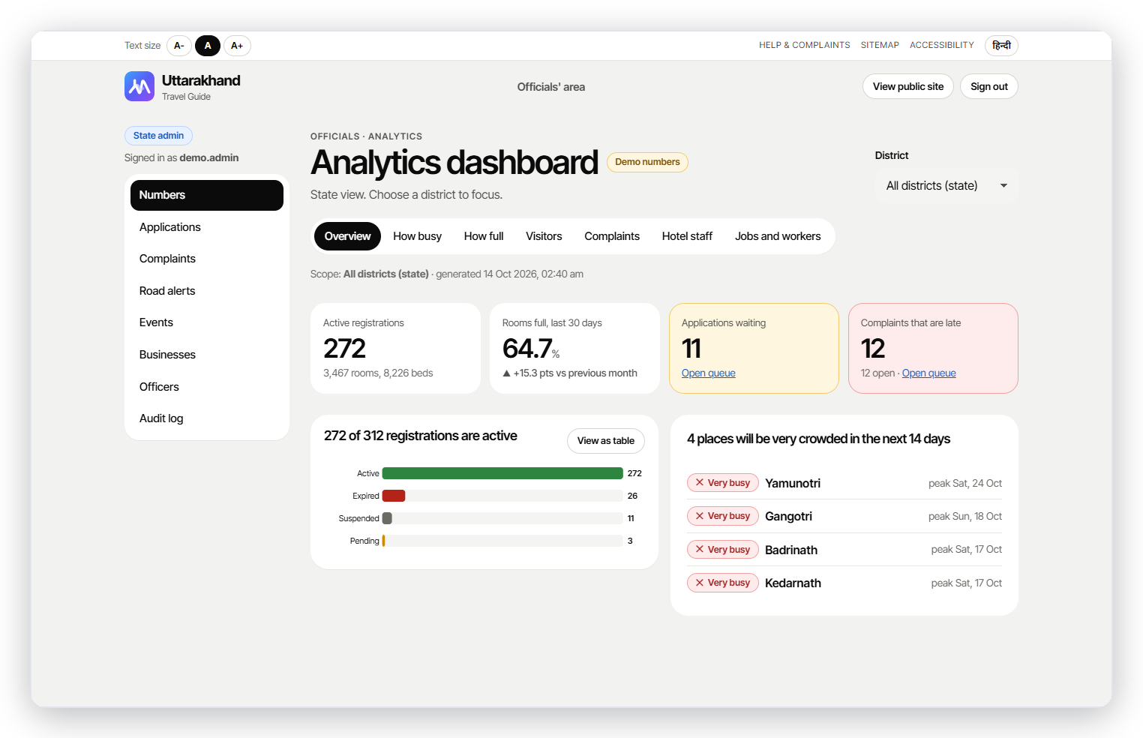
THE SOLUTION
One system. Five simple apps.
Owner
Staff
Guest
Travel guide
State
Predict → Plan → Act → Prove → Care
Notes:
One system with five simple apps on one loop. HOI predicts how full the hotel will be, plans fair shifts, sends each job to the right phone by tap or Hindi voice, proves the work with photos and times, and flags who may need a conversation. The owner, staff, guests, tourists and the state each get their own simple screen.

Slide 6
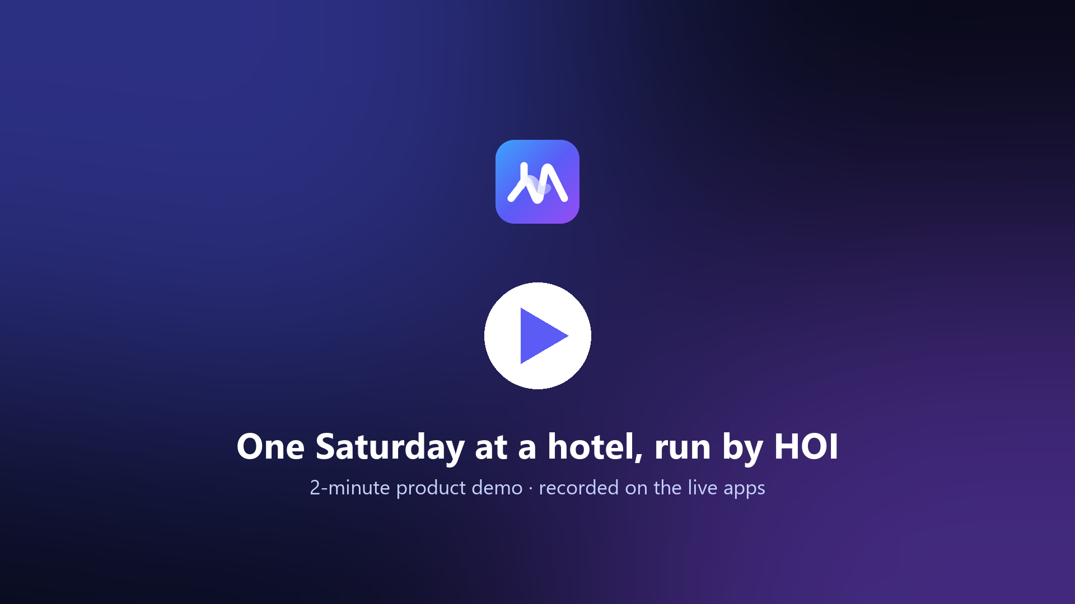
DEMO · 2 MINUTES
Recorded on the live apps
Notes:
TO ADD THE FILM: click the cover image, delete it, then Insert > Video > This Device > videos/HOI_demo_2min.mp4; place it at the same position and size (9.6 x 5.4 in), Playback > Start: When Clicked.

Slide 7


FOR THE STATE
One dataset for Uttarakhand tourism.
The travel guide plugs into the government portal, so the state can see and act early.
Crowds
Capacity
Complaints
Money flow
Live
Live
Live
Next
Anonymised · businesses opt in · small groups hidden
Notes:
Every stay feeds one anonymised picture of tourism that the state can use. Live today: crowd forecasts per destination, hotel capacity and occupancy, and complaints with response times, plus registrations, seasonal jobs and road alerts. Next: tourism money flow by district from hotels that opt in. Connecting to the official government portal is a proposal we'd like to discuss with the department.

Slide 8
OUTCOMES
Predictions that turn into action.
−83%
66%
4.4 s
forecast error, 1 day ahead
picks the leaver over a stayer (checklist: 55%)
from new job to the right phone
Forecast tested on real hotel data · turnover on 1,129 real employee records · speed measured live
Sources Hotel Booking Demand dataset, Data in Brief 2019
Notes:
One day ahead our forecast was off by 1.9 rooms against 10.9 for the usual rule: 83 percent less error, on real public hotel data. The turnover model ranks a leaver above a stayer 66 percent of the time against 55 for a checklist, so it's a prompt to talk, never a verdict. And in a live test a new job reached the on-shift staff member's phone in 4.4 seconds.

Slide 9



OUR MOAT
Booking tools sell the room. HOI runs the stay.
Own-data loop
Frontline first
State network
Trust
Forecasts improve every week
Hindi voice, one tap
Hotels, workers, government
No personal data, no commission
Notes:
Booking software like eZee or OYO helps hotels sell the room; HOI helps them run the stay, so we sit next to them, not against them. Our edge: every hotel's own data makes its forecasts better each week; it's built for the frontline with Hindi voice; it connects hotels, workers and the state on one network; and it's trusted by design, with no personal data and no booking commission.

Slide 10
LONG-TERM STRATEGY
Grow with every hotel that joins.
Start
Grow
Scale
Homestays and small hotels in Mussoorie and Rishikesh
Char Dham routes and homestay clusters
Other hill states, and the state as a data partner
Free for every worker and guest · owners subscribe · the data gets better with every stay
Notes:
We start with homestays and small hotels in Mussoorie and Rishikesh, grow along the Char Dham routes and into homestay clusters, then other hill states, with the state as a data partner. It's free for every worker and guest, owners subscribe, and the data gets better with every stay. We'll validate this with owner interviews and a free two-week pilot.

Slide 11
Thank You
Live today: hoi-portal.vercel.app · hoi-dashboard.onrender.com
Our ask: 3 pilot hotels · a conversation with the state tourism department
Smarter hotels. Happier teams.
Notes:
Everything you saw is running today. We're asking for three hotels or homestays for a free two-week pilot, and a conversation with the state tourism department about the data layer. Thank you.

