Slide 1

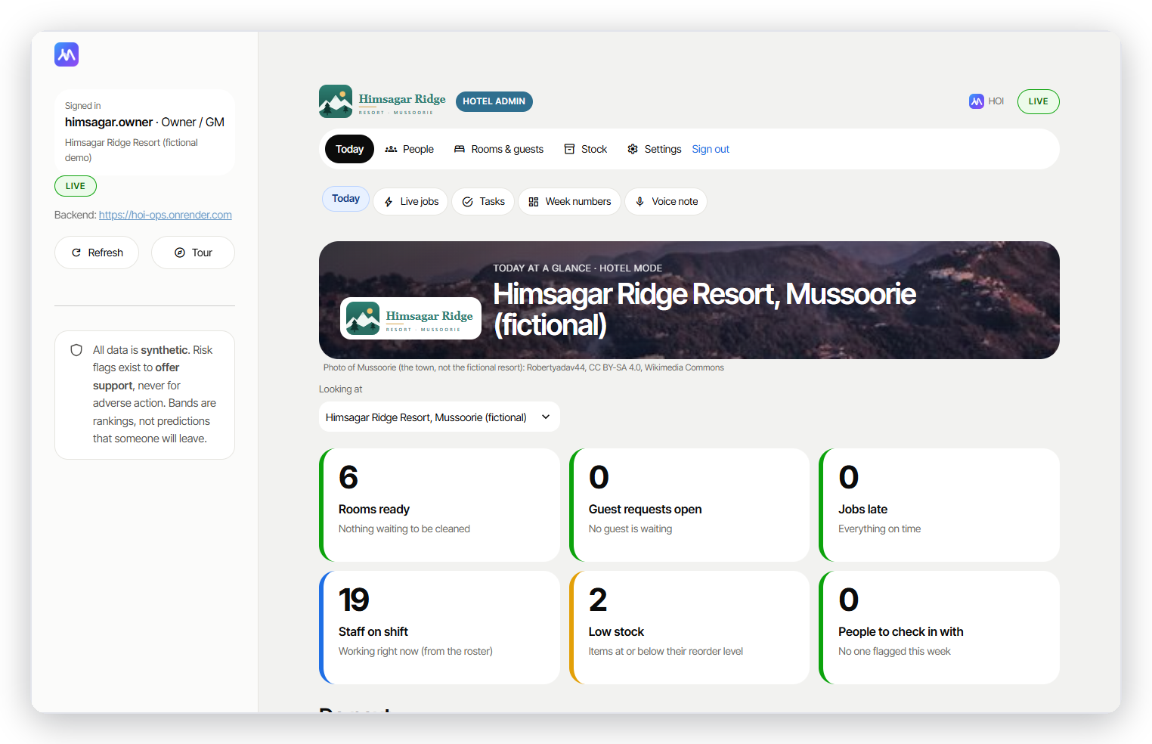
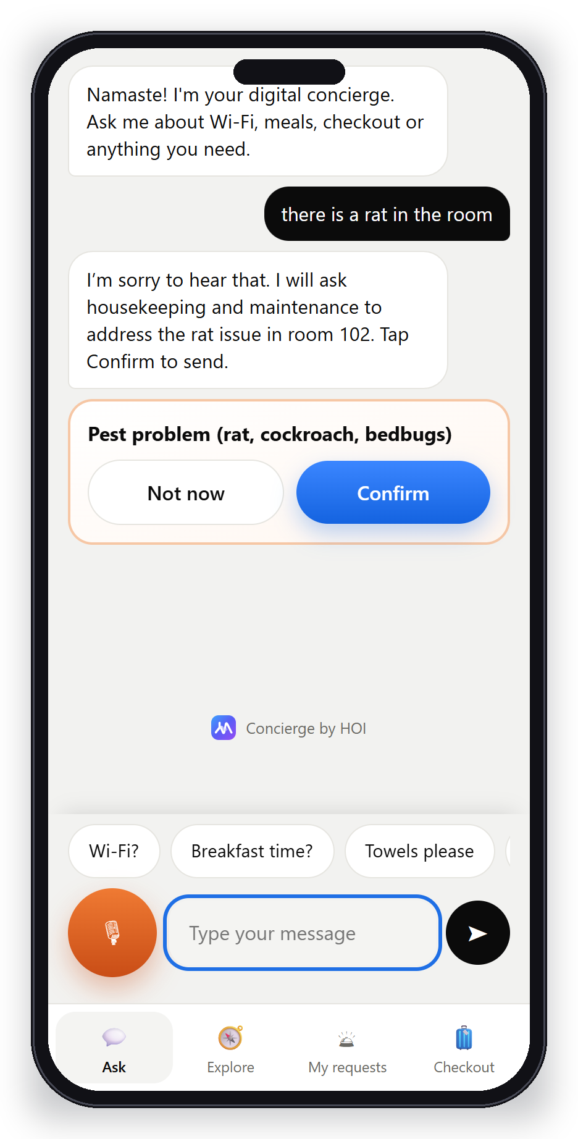
Hospitality Operations Intelligence
Progress update: from proposal to six live apps
AI-Tourism Hackathon 2026 · Team Innov8 · 13 October 2026

Slide 2
THE PROBLEM
Hill hotels run short of people, every season
1.1 M
1.8×
51 lakh
workers short
higher quit rate
Char Dham pilgrims
India's hospitality sector, projected 2025 (HVS / Ministry of Tourism study)
Accommodation & food vs all industries (US BLS)
Record 2025 season; two thirds arrived by late June
Rosters are made by hand, overtime piles up, and nobody notices who is about to leave until they do.
Sources: HVS; US BLS JOLTS Table 4; All India Radio; The Week (24 June 2025).

Slide 3
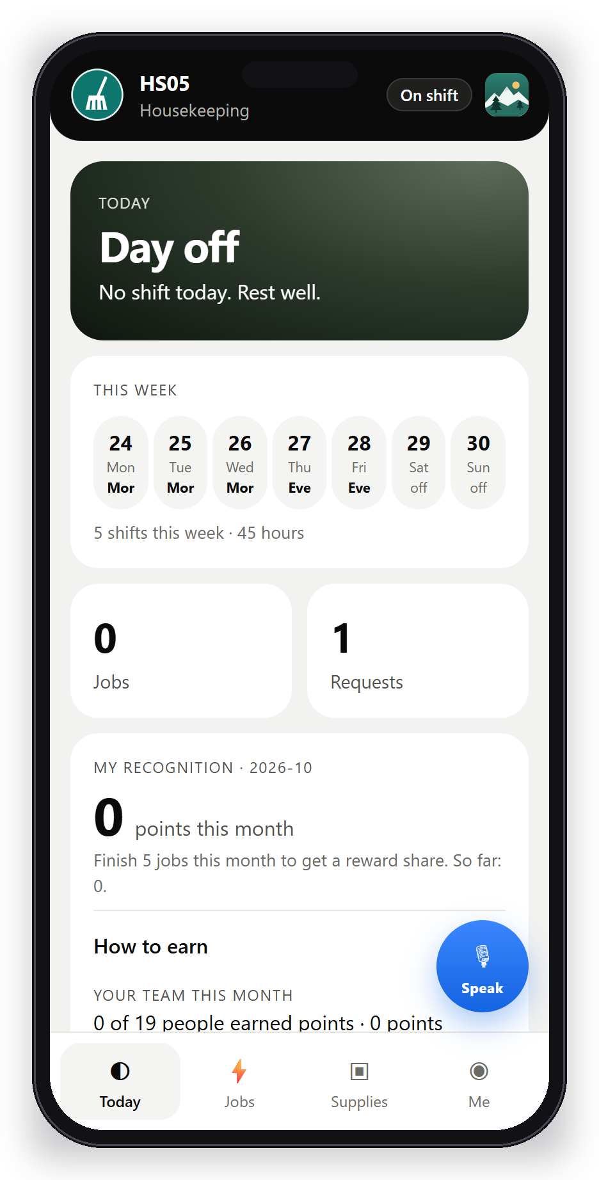
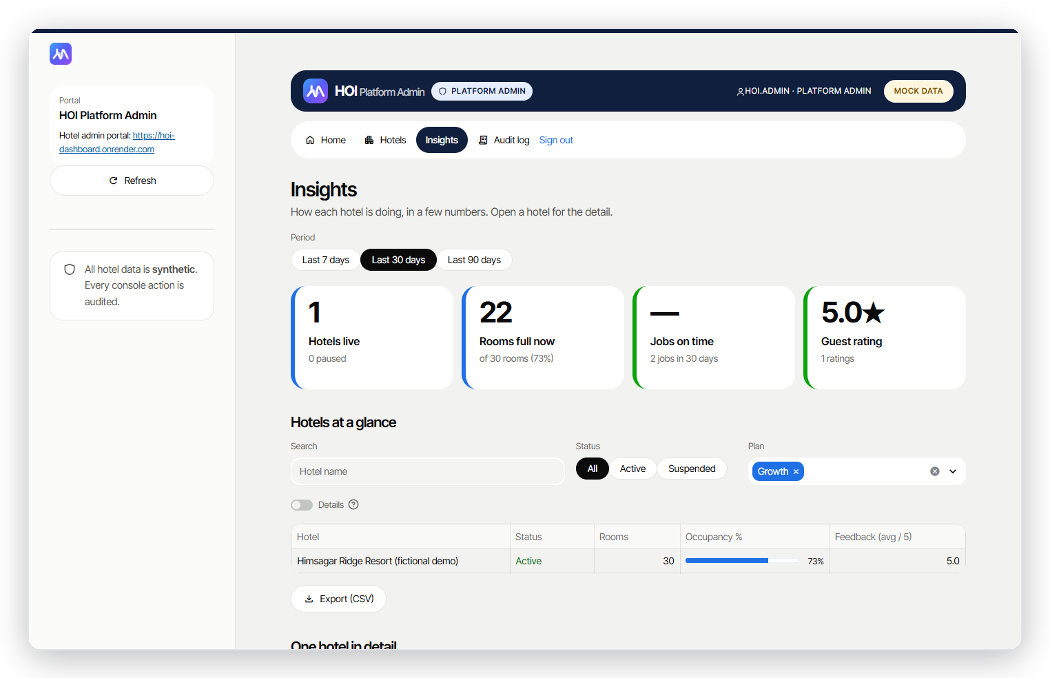
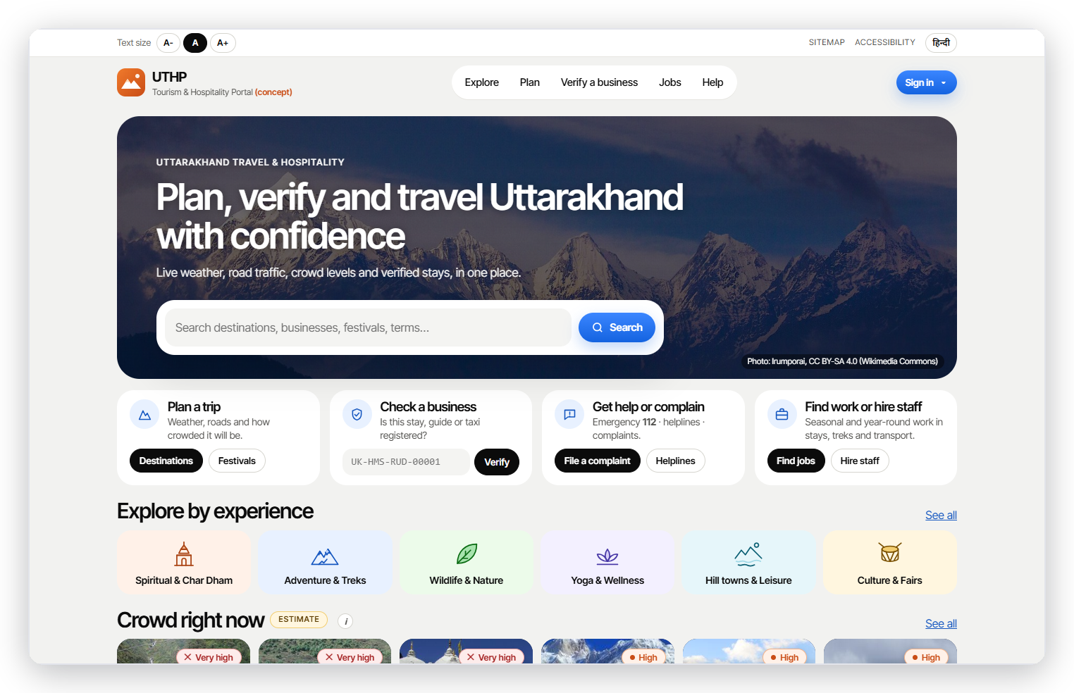
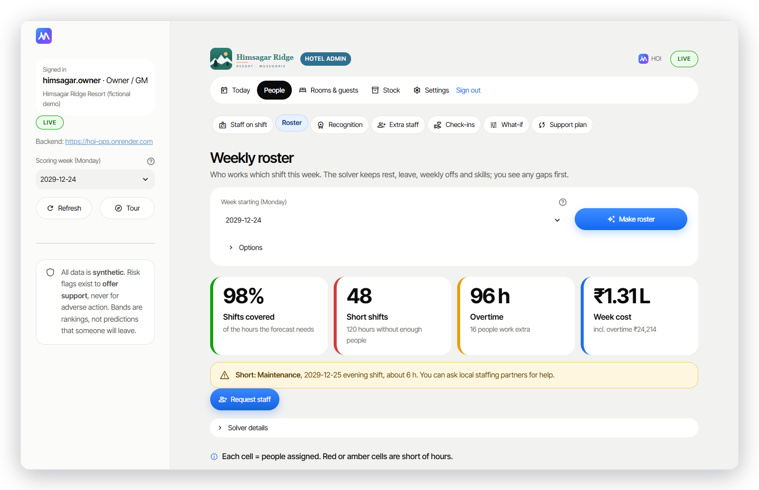
WHAT WE BUILT
One platform, six apps
Platform Admin
Hotel Admin
Worker app
Onboard hotels, portfolio insights, audit
Today view, roster, dispatch, rooms, stock
Shifts, job pings, photo proof, voice
Guest concierge
Tourism portal
Prediction engine
Room QR: ask by voice, requests, checkout
Weather, roads, crowds, stays, jobs
Predicts busy days, spots who may leave, plans shifts

Slide 4
01
For the hotel
Owner, managers and staff: one calm system for the day's work

Slide 5
HOTEL ADMIN
One calm Today screen
Answer first, details later
Five sections instead of 18 menu items
Big numbers: rooms ready, open requests, late jobs, staff on shift, low stock
A short Do-next list with one-click actions

Slide 6
ROSTER
Fair rosters that never break a rule
Smart scheduler, saved so it opens instantly
Built from how busy each day will be
Never breaks leave, rest hours, weekly off or skills
If a week cannot be staffed, it says which shift and why
Short week → one-click Request staff

Slide 7
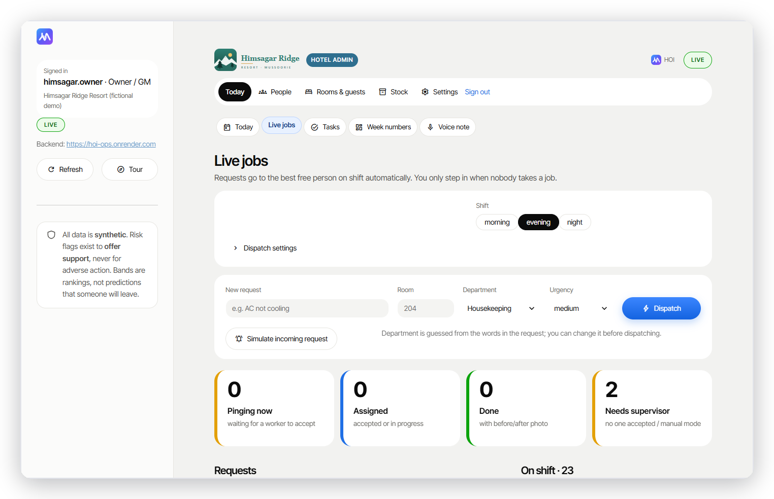
LIVE DISPATCH
The right person gets the job
Auto-assign with photo proof
Best on-shift worker by load and distance
Burnout guard: flagged staff get fewer extras
Simulated day: 80 / 80 jobs done, 0 sent off-shift

Slide 8
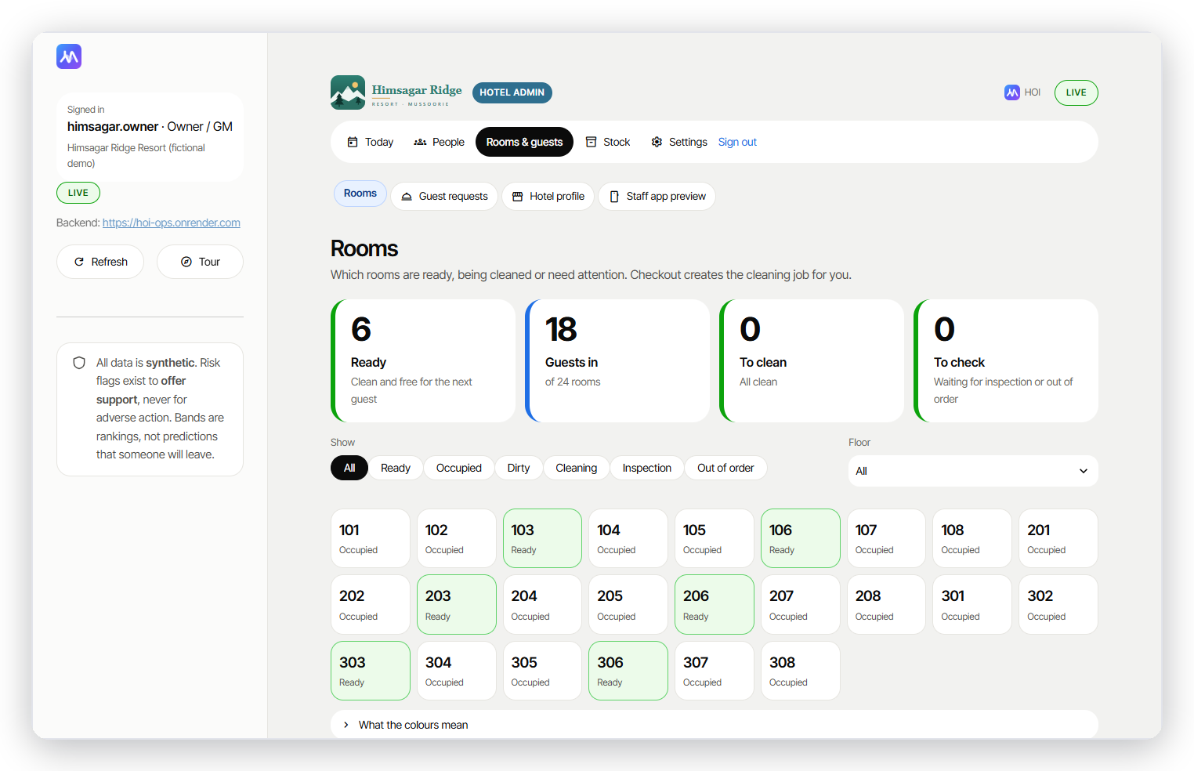
ROOMS & GUESTS
Every room, every request, one board
Checkout → clean → inspect → ready
24 rooms; median turnaround 51 min in the simulation
Guest requests and late-checkout approvals in one place
Each room has its own guest QR code

Slide 9
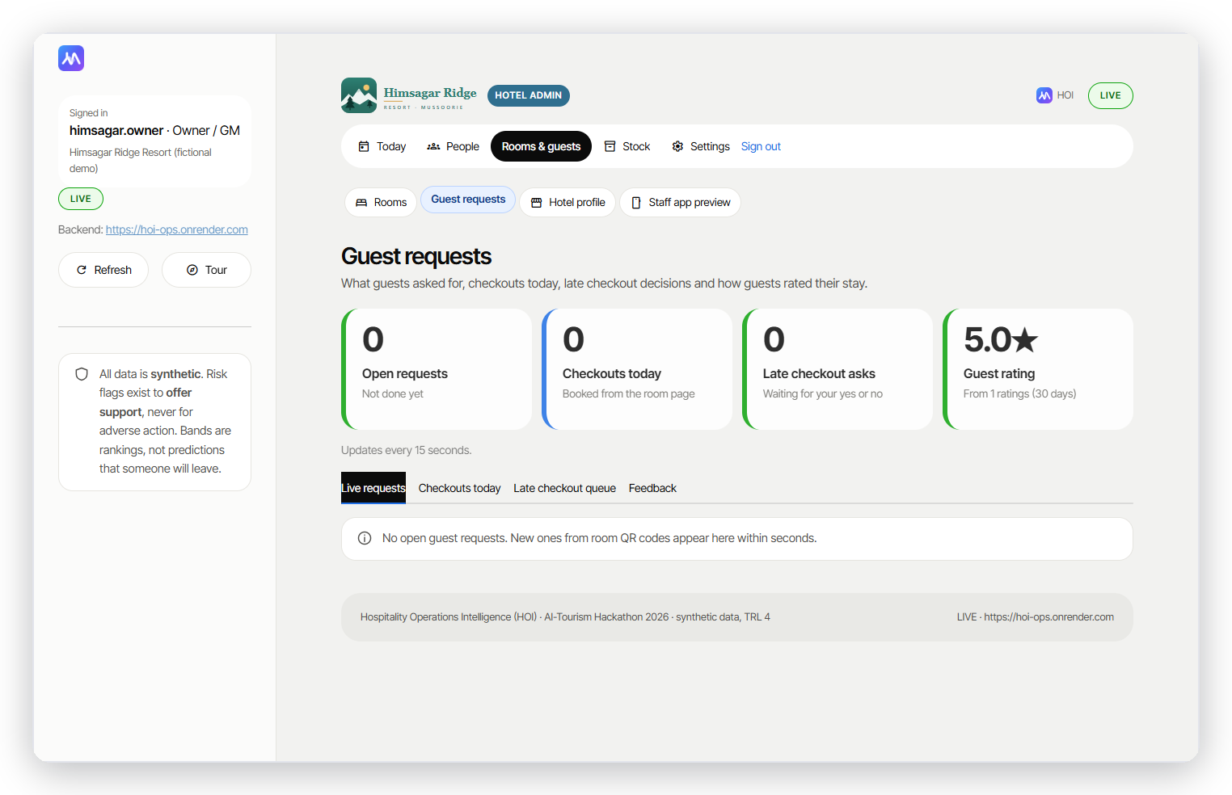
GUEST SERVICES
Guest requests, checkouts and feedback
Urgent safety and medical alerts shown first
Approve or decline late checkout with a note
Feedback trend with one-line meaning

Slide 10
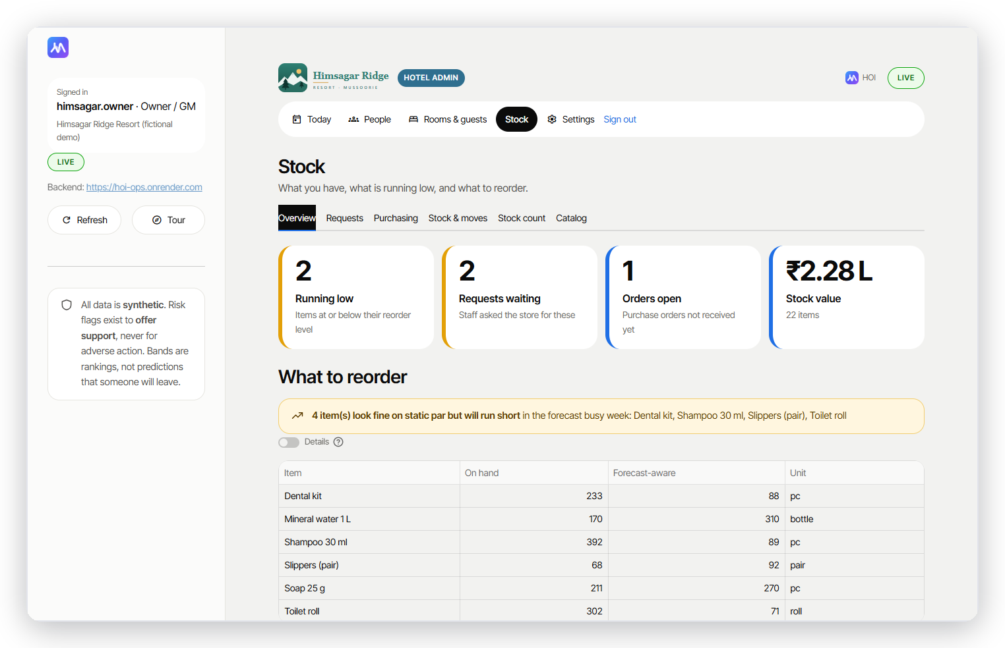
STOCK
Stock follows the forecast
GST-ready purchase orders
Reorder suggestions from expected occupancy
One ledger: stock always equals its movements
CGST/SGST or IGST split on every PO

Slide 11
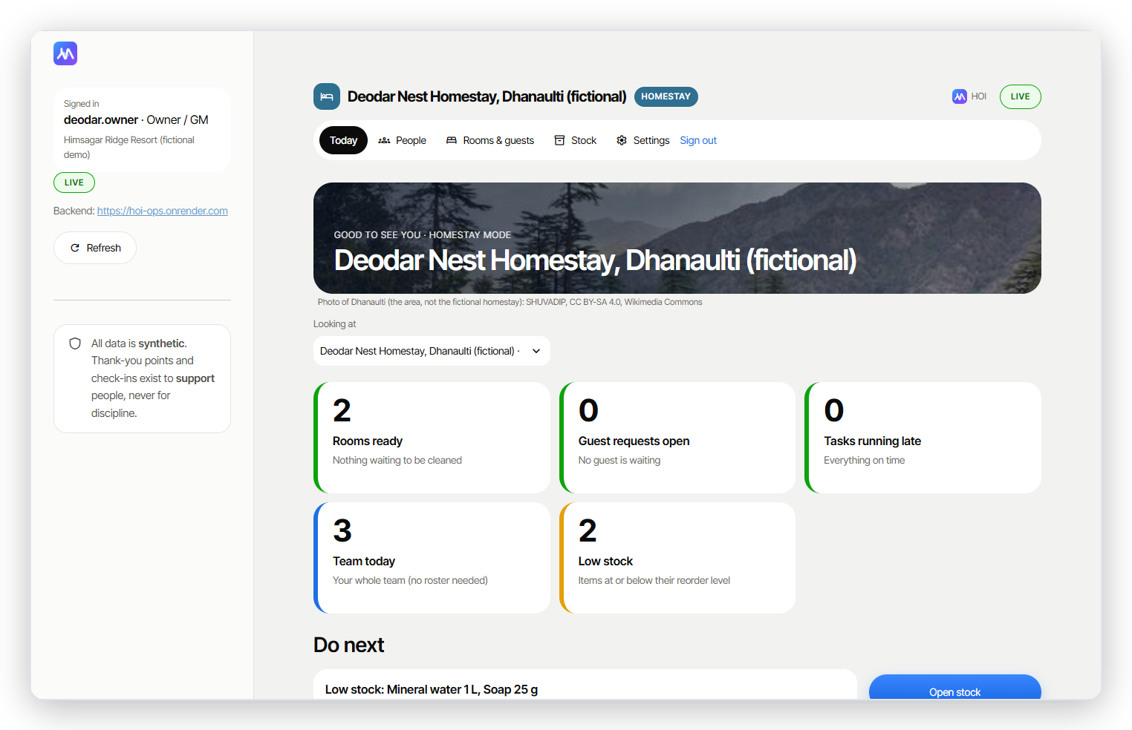
HOMESTAY MODE
Simple enough for a 6-room homestay
Deodar Nest, Dhanaulti (fictional)
Seven plain pages, no ML jargon
The owner's own team, no roster needed
Switch to hotel mode any time

Slide 12
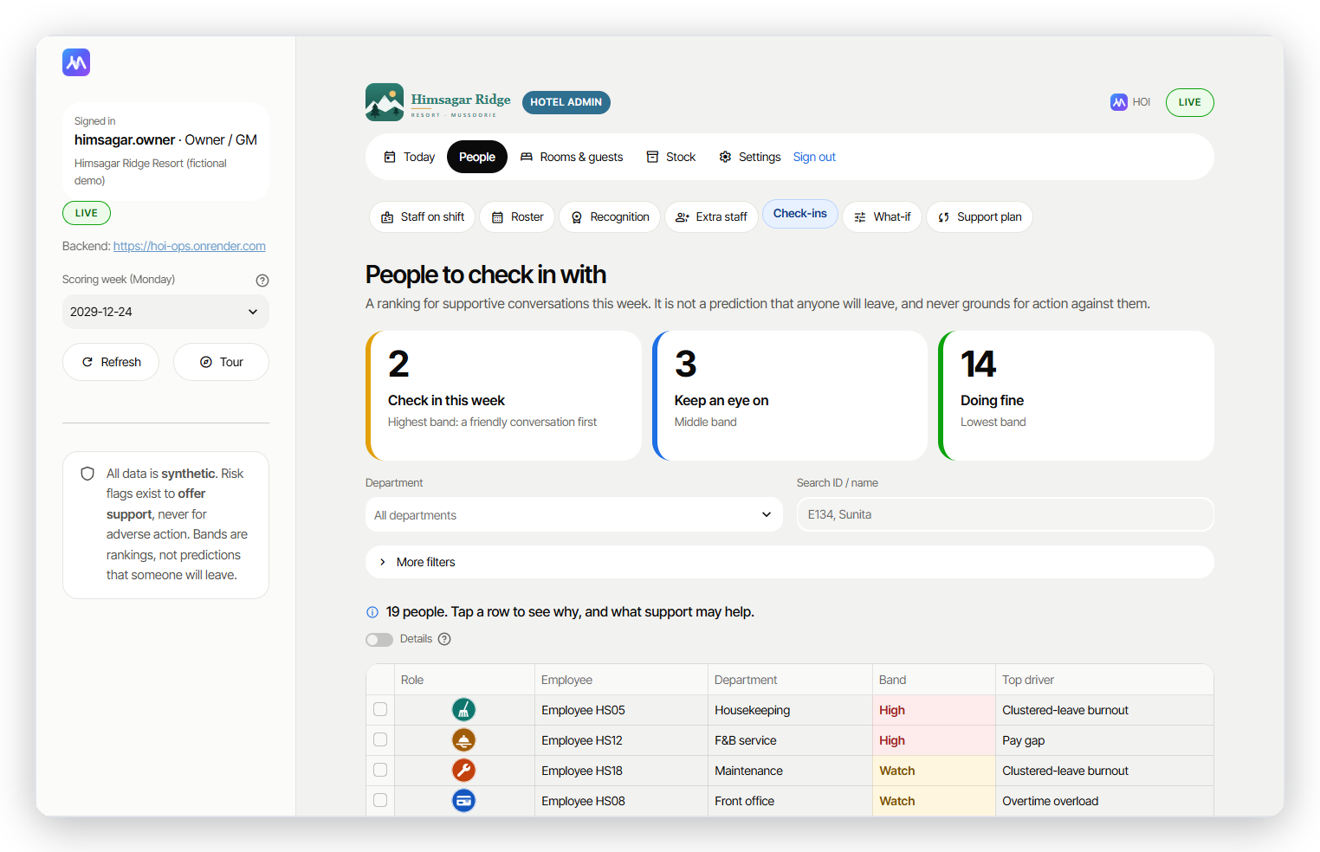
RETENTION
Who may need support, and why
A list of who to check in with, not a prediction
Seasonal staff: when their contract ends; permanent staff: the model's ranking
Every name comes with plain reasons and a suggested next step
Flags exist to offer support, never for adverse action

Slide 13
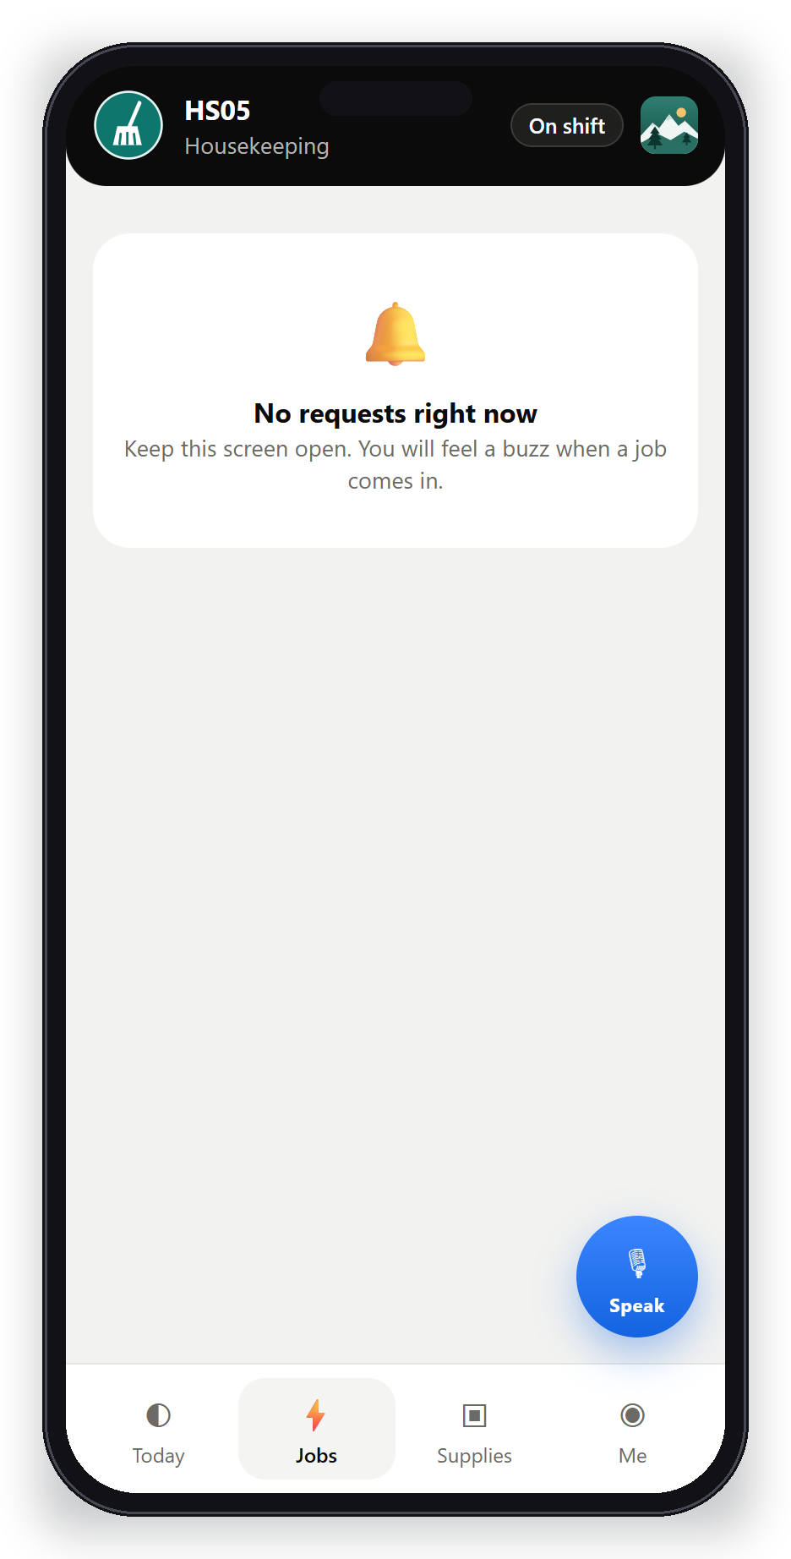
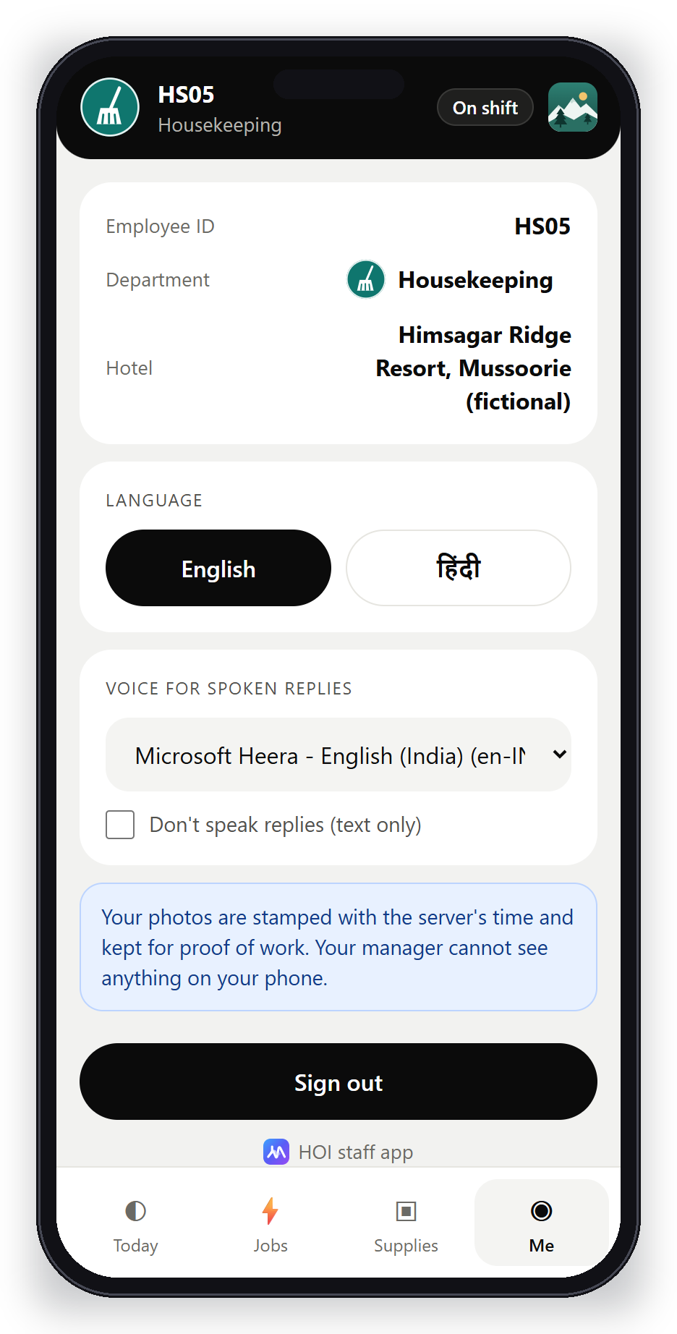
WORKER APP
In every worker's pocket
Today's shift
Live job pings
My recognition

Slide 14
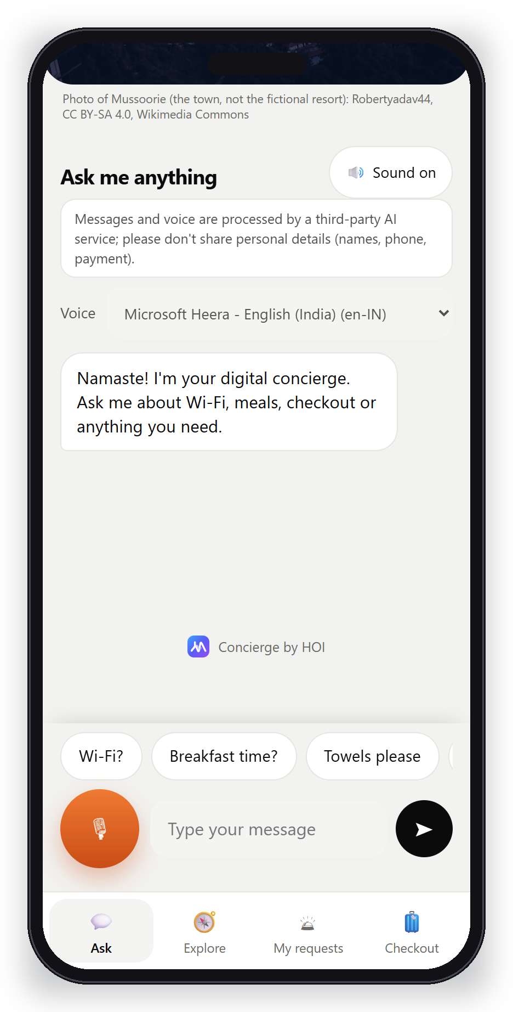
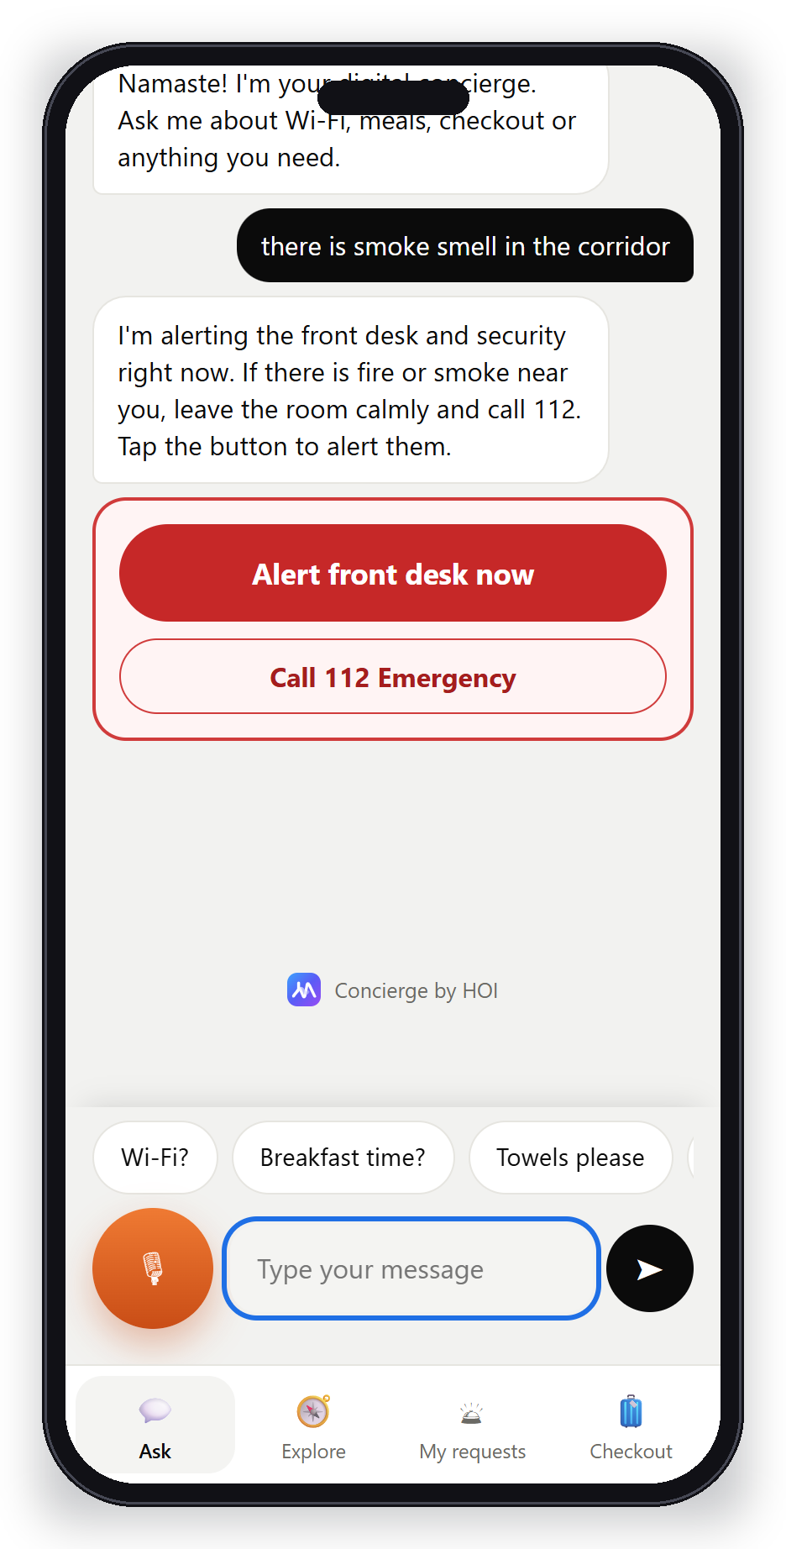
GUEST CONCIERGE
Guests just scan and ask
Ask anything
"Rat in the room" → pest control
Smoke smell → urgent, shows 112

Slide 15
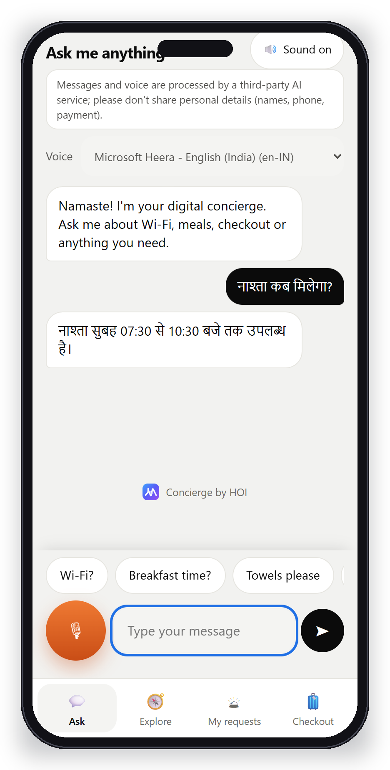
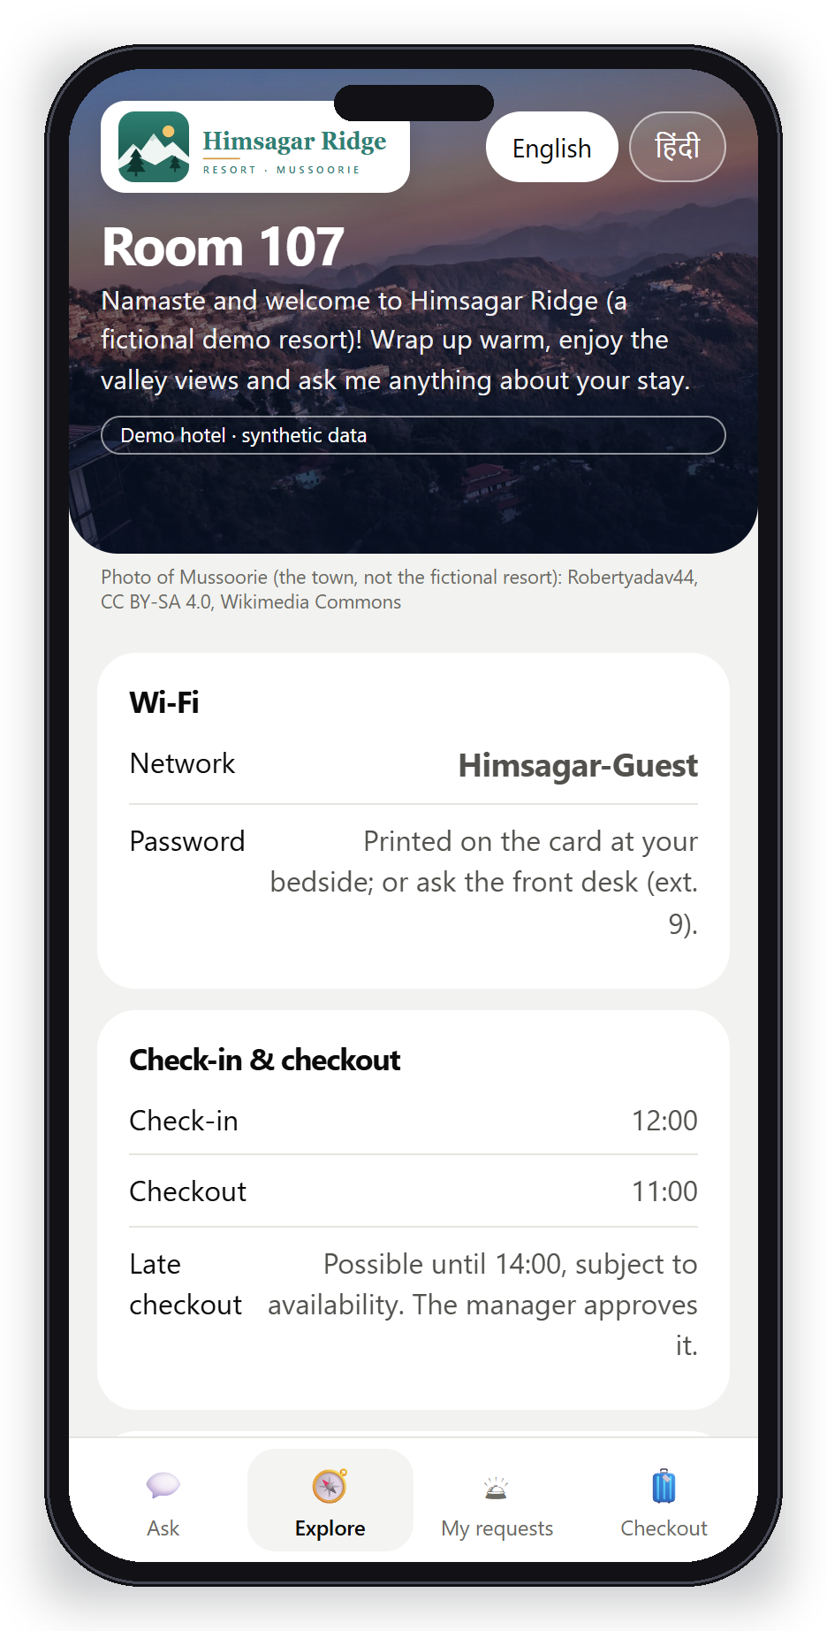
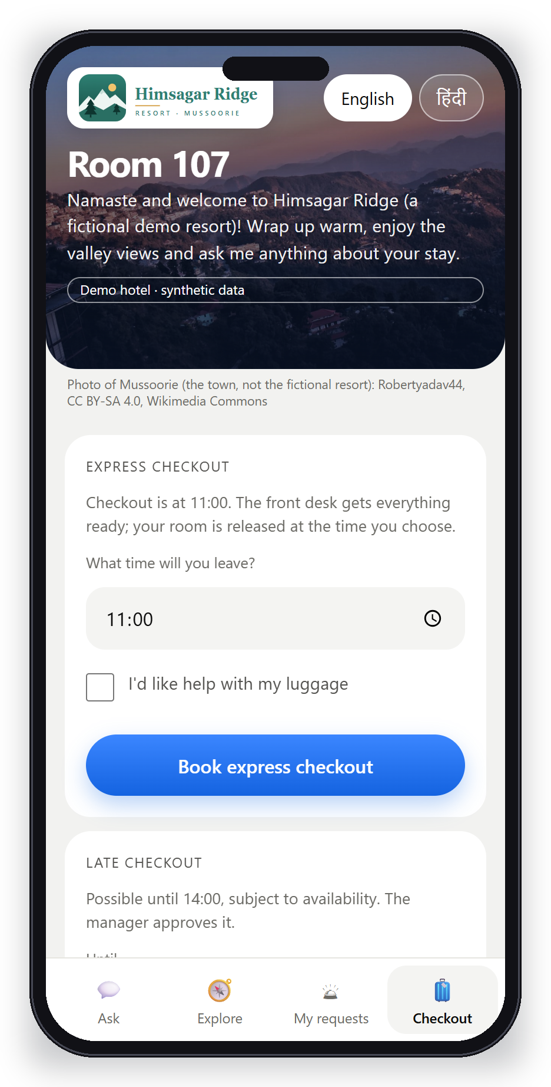
GUEST CONCIERGE
Hindi, explore and checkout
Replies in Hindi
Explore the hotel
Express or late checkout

Slide 16
PLATFORM ADMIN
We see every hotel at a glance
Separate portal for the HOI team
Rooms, occupancy, on-time jobs, response time, feedback, low stock
Hotel accounts cannot sign in here
Opening a hotel is audited

Slide 17
02
For the visitor and the state
Uttarakhand Tourism & Hospitality Portal: concept, not an official site

Slide 18
TOURISM PORTAL
Plan, verify and travel with confidence
hoi-portal.vercel.app
Live weather, roads and crowd levels
Verify a registered stay, guide or taxi
Complaints with tracking

Slide 19
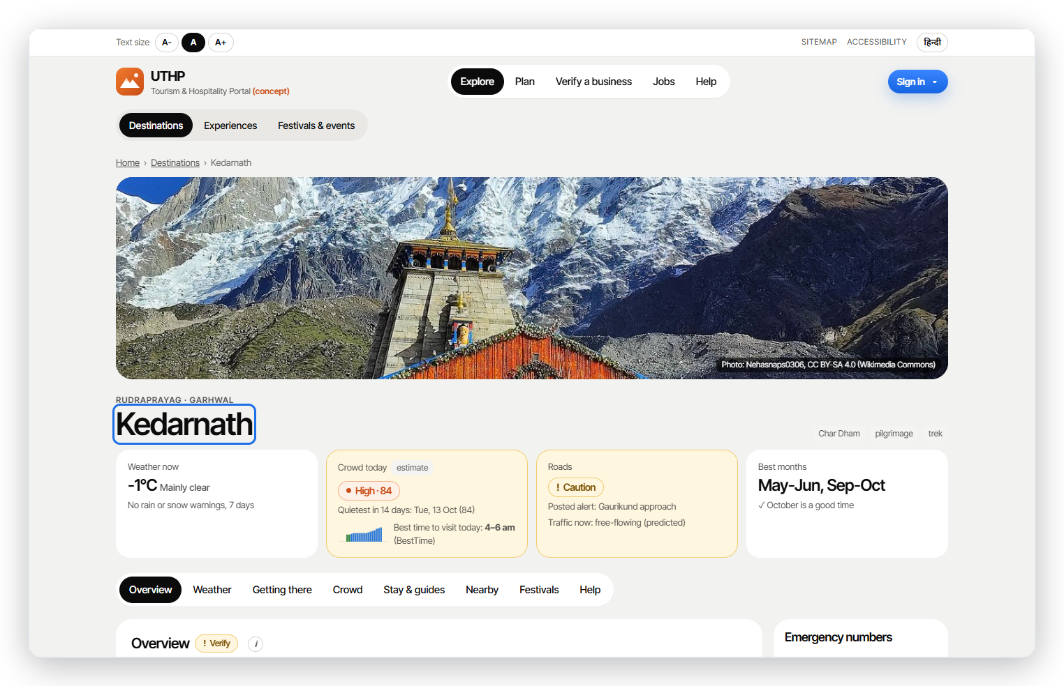
DESTINATIONS
Every place, answered at a glance
Weather · crowd · roads · best months
Real foot-traffic timings from BestTime
Traffic: TomTom live + our prediction model
Nearby hospitals, ATMs and fuel from LocationIQ

Slide 20
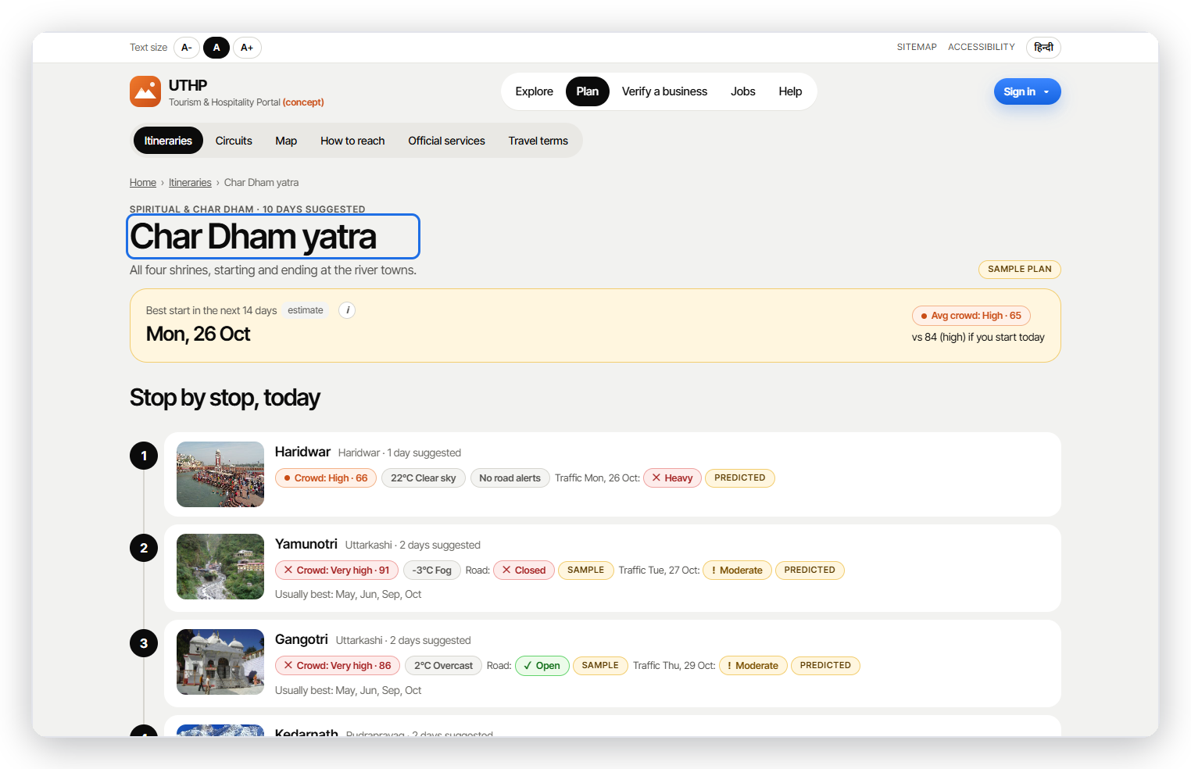
TRIPS
Itineraries with live conditions per stop
Best day to start in the next 14
8 sample trips built from checked facts
Crowd, weather and road status at every stop
No invented distances or prices

Slide 21
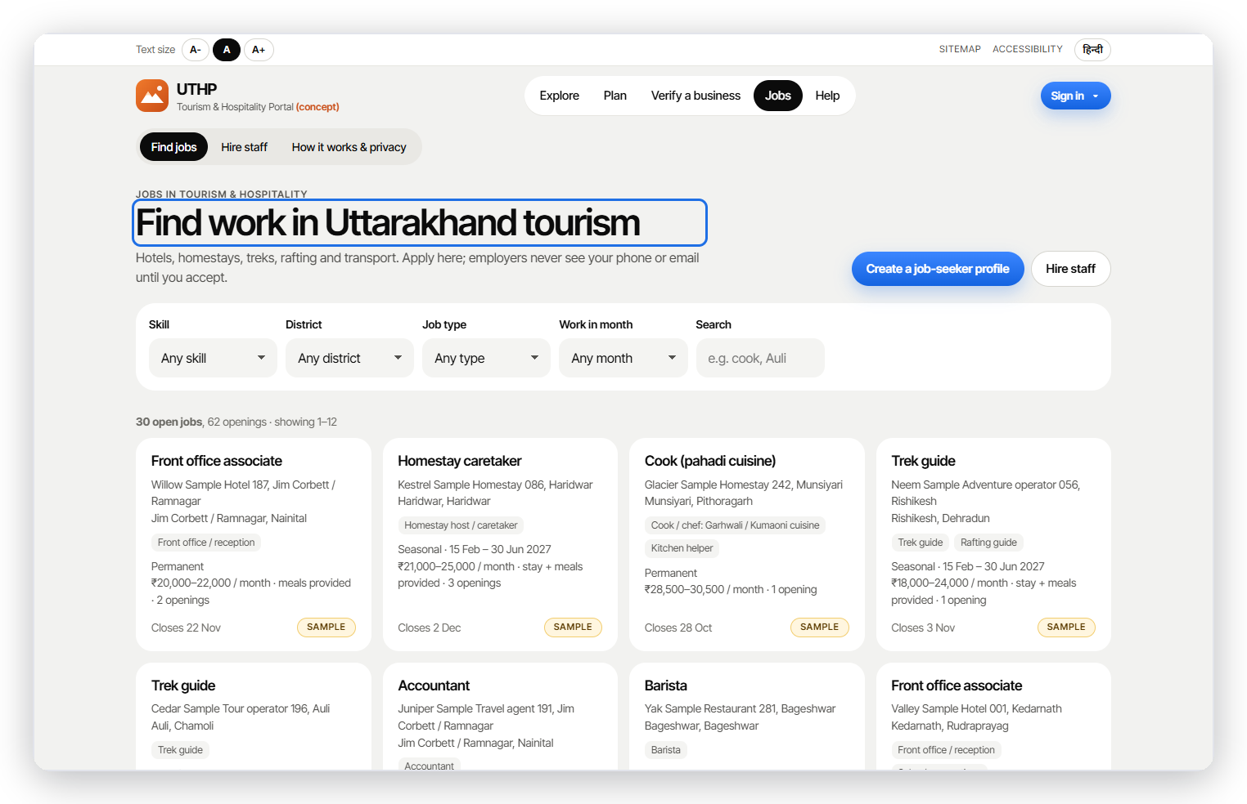
JOBS
Local jobs, matched by skill
Contact shared only after the candidate accepts
Job seekers list skills, languages and availability
Explained match score, never personal traits
Roster gaps from HOI hotels post here

Slide 22
03
Proof and position
What makes HOI different, and how we know it works

Slide 23
HOW IT WORKS
Predict → plan → spot → help → check again
Predict
Plan
Spot
Help
Check
→
→
→
→
12 s
2
Small
~1 s
for the whole cycle
staff to check in with this week
change after a better roster (honest)
to open a saved roster
We show small improvements as small. The list is for offering help, never for punishing anyone.

Slide 24
JUDGES' REVIEW
Your feedback, already built
GDS, OTAs and Zostel
Affordable for homestays
37-source study: HOI sits after the booking, beside the PMS
Homestay mode, phone-first, Hindi
Staffing and skill matching
Incentives
Jobs board + roster gap → staffing request
Recognition points, positive only, capped
Community and local links
Validated needs
Local experiences linked to homestays (in progress)
8-10 interviews, then a 2-week pilot

Slide 25
DIFFERENTIATOR
We work after the booking
GDS: systems travel agents book through
The staff and daily-work app for small hill hotels.
Amadeus, Sabre, Travelport
Booking websites (OTAs)
Booking.com, Agoda, MakeMyTrip, Airbnb
Works next to the hotel's booking software, does not replace it
We found no public evidence that Zostel or OYO offer rostering, job proof or retention for the owner's team
Travel-agent systems (GDS) do not matter to a 10-room homestay
Hotel booking software (PMS)
eZee, STAAH, Hotelogix
HOI: running the hotel after the booking
Staff shifts, jobs with photo proof, extra staff, guest help

Slide 26
HOW GOOD ARE THE PREDICTIONS?
Better than a simple guess, on test data
69 / 100
10 / 10
times it picks the person who left over one who stayed (coin toss: 50)
guest complaints sent to the right team
0 / 300
~1-2 rooms
test rosters broke a rule
typical miss for tomorrow in a 24-room hotel
All tested on made-up data for a made-up hotel. Real accuracy will be lower and is only known after a real pilot.

Slide 27
NEXT TWO WEEKS
From test data to a real hotel
1
Interview 8-10 homestay owners, GMs and staff in Mussoorie and Rishikesh
2
Two-week pilot on one real property
3
Hindi wording and every assumption reviewed by our HM student
4
Record voice clips and measure real speech accuracy
5
Finish local experiences and staffing-agency flows
Honest gaps today: no real hotel or owner yet · the free AI handles about 4 chats a minute · no billing yet

Slide 28
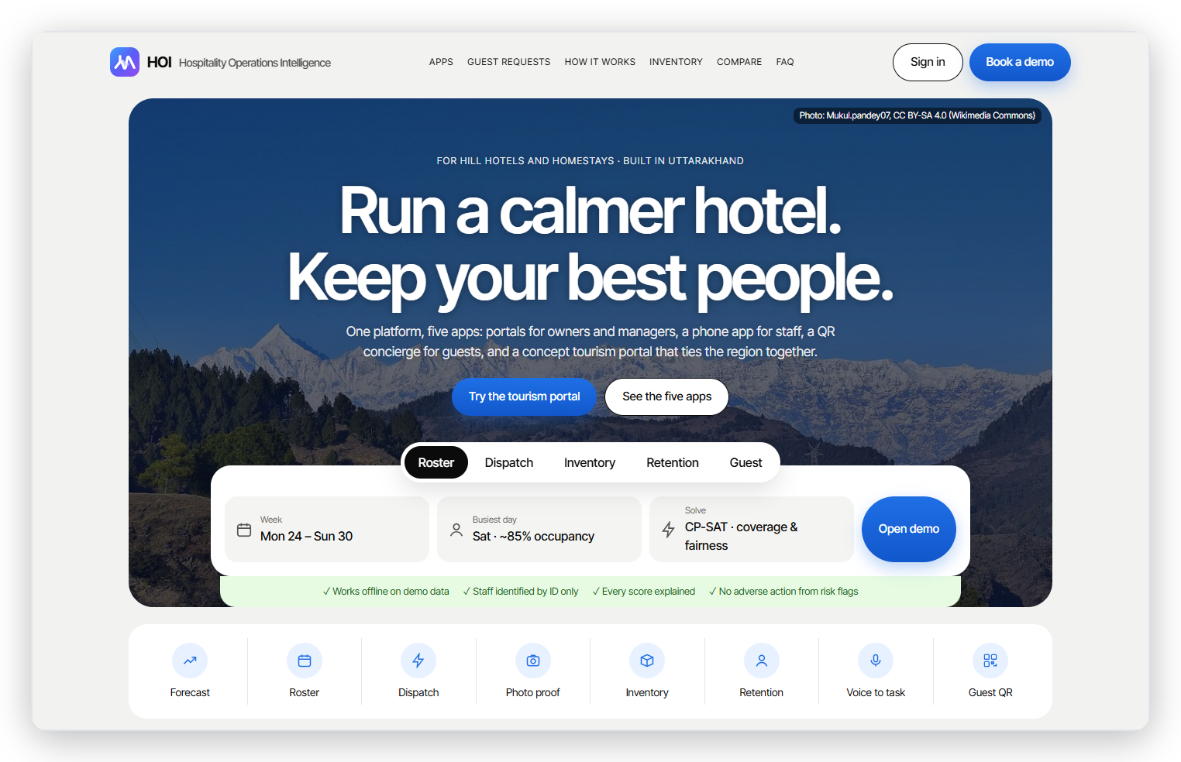
Thank you
Smarter hotels. Happier teams.

