Slide 1
Trust-Issues
Text Versus Metadata In The Detection Of Fraudulent E-commerce Reviews.
Ashutosh Nayak (MT/AI/10024/26)
Dipanshu Tripathi (MT/AI/10033/26)

Slide 2
Real World Problem
98%​
Consumers relying on reviews for online purchase.
The Threat :
Coordinated product review manipulation, bot-generated spam and competitor sabotage.
The Challenge :
Modern fake reviews are linguistically indistinguishable from genuine ones.

Slide 3



Research Question
Does Incorporating metadata features improve the performance of text based fake review detection models?
Hypothesis
Relying solely on text fails against generative bots. Fusing text features with behavioral inconsistencies yields higher detection accuracy.
Notes:
f

Slide 4
Dataset Architecture
5000
50/50
4
Reviews
Base text Input
Class Balance
Genuine Vs Fake
Base Features
Rating, Verified_purchase, Reviewer_Review_Count, Label

Slide 5
Methodology
Pipeline 1: Text Only
Pipeline 2: Text + Metadata
Text cleaning and tokenization: Review text is converted to lowercase and tokenized using the vectorizer.
Stop-word filtering: English stop words are removed during TF-IDF processing.
N-gram extraction: Unigrams and bigrams capture individual words and short phrases.
TF-IDF vectorization: Text is converted into numerical features using up to 3,000 TF-IDF features.
Purpose: Learns deceptive-review patterns from word and phrase usage alone.
Sentiment and subjectivity: A lightweight, self-contained positive/negative word lexicon is used to calculate sentiment score and subjectivity.
Reviewer metadata: Verified-purchase status and reviewer review count.
Feature preparation: Numeric features are standardized and concatenated with the TF-IDF representation.
Classification: A soft-voting ensemble of Logistic Regression and Random Forest predicts whether the review is genuine or likely fake.

Slide 6
Experimental Setup
Primary Models -
Data Split -
Core Metrics -
Logistic Regression
  Linear Baseline Standard
80/20 Train Test
Stratified Split
Precision
Recall
F1-Score
ROC-AUC
Confusion Matrix
Accuracy
Macro-F1
MCC
Random Forest
  Non-Linear Tree based Ensemble Classifier
The project combines both models in a soft-voting ensemble using TF-IDF text features and engineered reviews

Slide 7
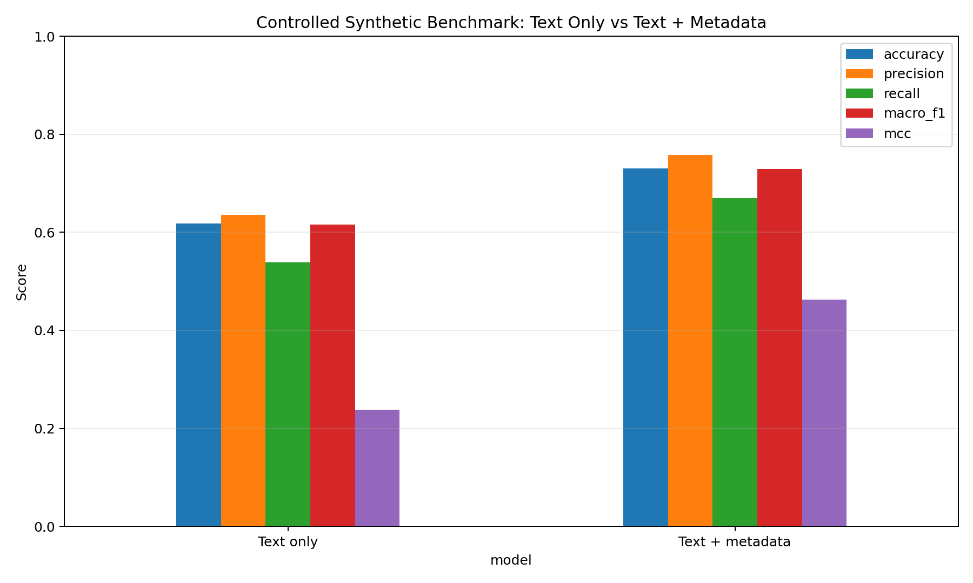
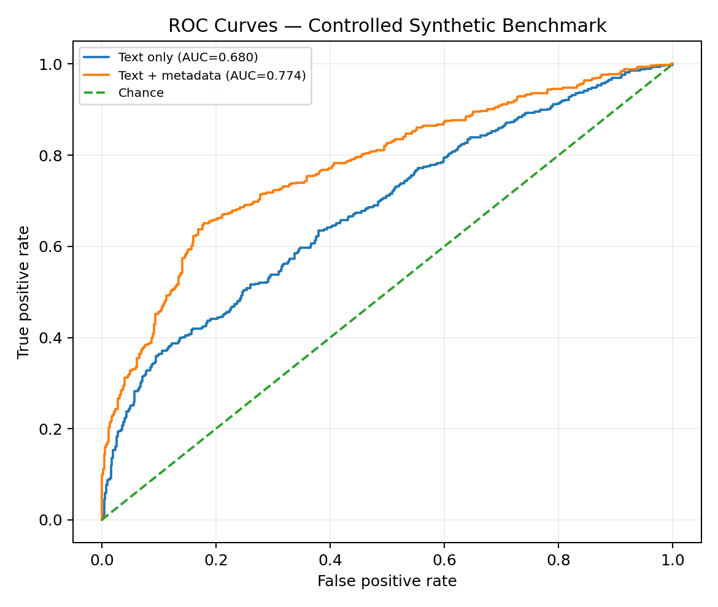
Results

Slide 8
Edge Case
False Positive
True Positive
False Negative
HUMAN SARCASM
“Wow, another broken screen. Best purchase ever!”
1-star rating flagged by mismatch.
THE LAZY BOT
“Highly recommended product”
Generic Praise with 1-star rating.
THE COPY-PASTE
(Identical 5-Star Texts)
Perfectly aligned duplicate text.

Slide 9
Conclusion &
Future Improvements
Metadata bridges the critical gap where isolated text analysis fails.
Limitations
Future Improvements
Struggles with human sarcasm
Lacks deep contextual references
Use a larger real dataset.
Log low confidence predictions from real usage and periodically retrain or relabel on them.
Bert Transformer LLM integration.

Slide 10
Thank you.

