Slide 1
Resume classification project
Presented By- GROUP 1

Slide 2
Group 1 Mentor’s Name : Priyanka Mam
Team Member’s : Mr. Kapil Deshmukh
Mrs. Vijaya Durga
Mr. Avinash Singh
Mrs. Vaishnavi Swamy
Mr. Pavan Kumar
Mr. Kamlesh Patil
Mr. Ashitosh Adsule

Slide 3
BUSINESS PROBLEM
Designing a cutting-edge Resume Parsing Model for efficient and accurate classification of resumes. Leveraging advanced natural language processing techniques, machine learning algorithms, and data engineering to extract and categorize key information from resumes, enabling streamlined talent acquisition and candidate evaluation processes.
OBJECTIVE:
Develop an advanced Resume Parsing Model utilizing state-of-the-art natural language processing (NLP) techniques to extract and classify relevant information from resumes, such as candidate qualifications, experience, and skills.
Enhance accuracy and efficiency in talent acquisition processes by automating resume screening and categorization, reducing manual effort, and accelerating candidate evaluation.
Implement machine learning algorithms and data engineering to ensure the model's ability to handle diverse resume formats and languages, optimizing its adaptability for a wide range of candidates.
Facilitate seamless integration of the Resume Parsing Model with existing applicant tracking systems (ATS) and HR software, providing recruiters and HR professionals with a user-friendly and impactful solution for candidate assessment and selection.

Slide 4
PROJECT ARCHITECTURE / PROJECT FLOW
Raw Data
Data Processing &
Data Cleaning
Exploratory data
Analysis
Model
Building
Deployment
Visualization
Decision Making

Slide 5
DATA SET DETAILS
The dataset comprises resumes of various professionals categorized as follows:
React Developer: 24 resumes
Workday Resumes: 21 resumes
Peoplesoft Resumes: 20 resumes
SQL Developer Lightning Insight: 14 resumes
These resume samples have been carefully collected and curated, providing valuable information for talent acquisition, HR evaluation, and skills analysis in their respective domains.
ATTRIBUTE INFORMATION
Attribute information refers to the characteristics or features present in a dataset that provide meaningful insights and enable analysis. In the context of resumes, potential attributes could include:
Name: The candidate's full name.
Contact Information: Phone number, email address, and location.
Experience: Work history, including job titles, companies, and dates.
Education: Educational qualifications and institutions attended.
Skills: Technical skills, languages, and certifications.
Projects: Details of relevant projects undertaken by the candidate.
Summary/Objective: A brief overview or career objective stated by the candidate.
Achievements: Notable accomplishments or awards received.
References: Contact information of professional references.
Keywords: Specific terms or phrases used for keyword-based matching.
These attributes enable efficient resume parsing and classification for effective talent acquisition and recruitment processes.

Slide 6
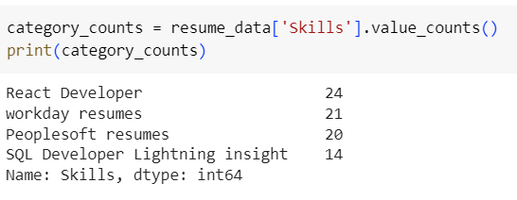
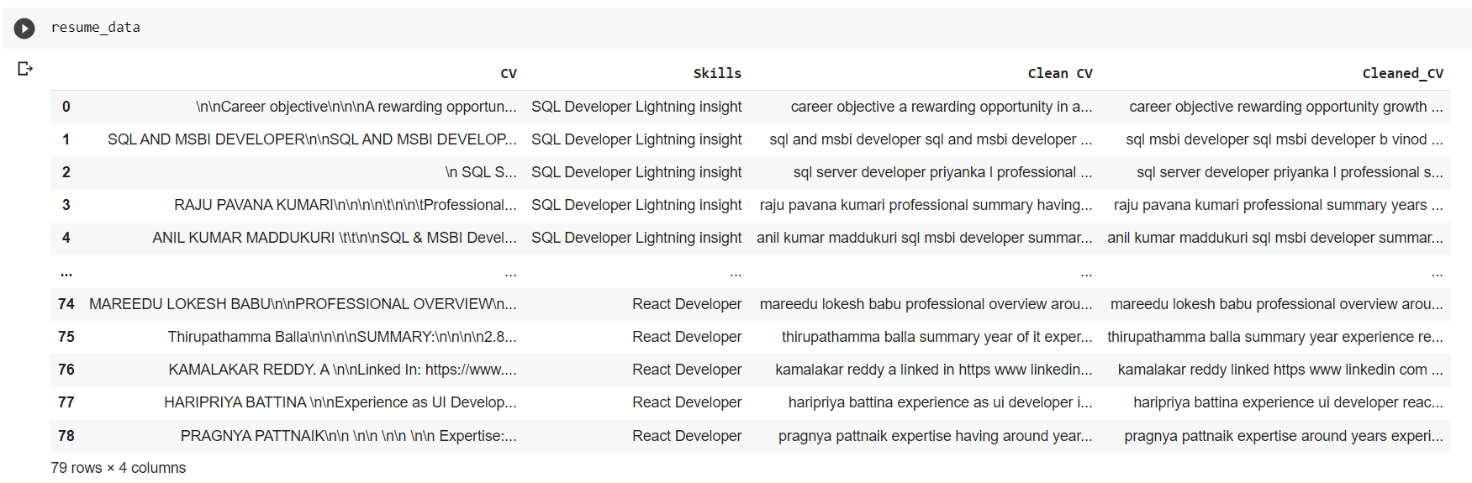
DATA SET DETAILS

Slide 7
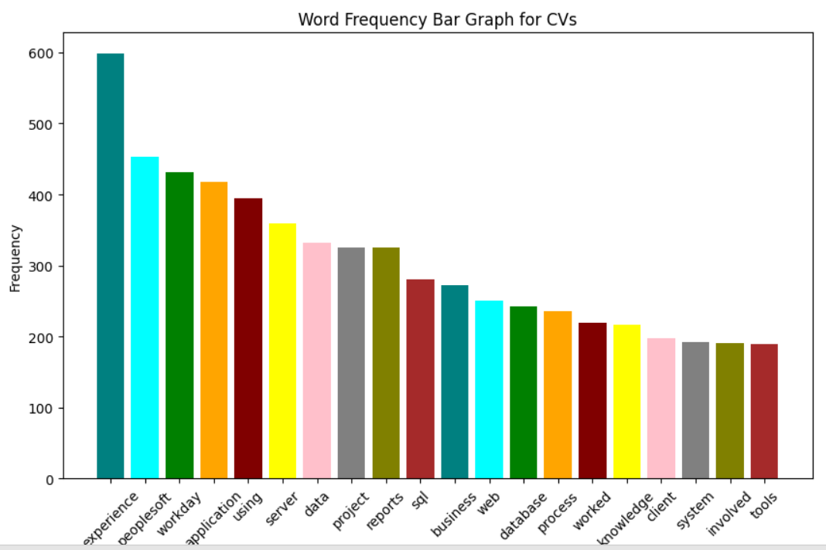
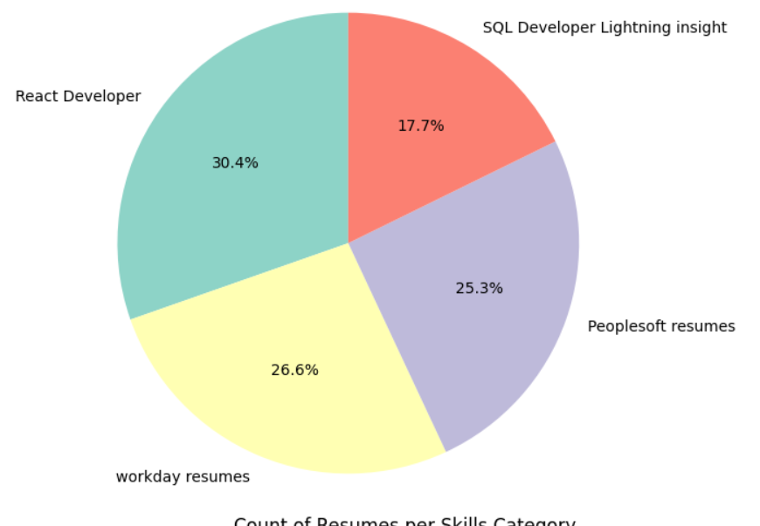
VISUALIZATIONS

Slide 8
Model Building
Logistic Regression
Support Vector Classifier
KNN Classifier
Decision Tree Classifier
Random Forest Classifier
Naïve Bayes Classifier
Xtreme Gradient Boosting Classifier
Light Gradient Boosting Classifier

Slide 9
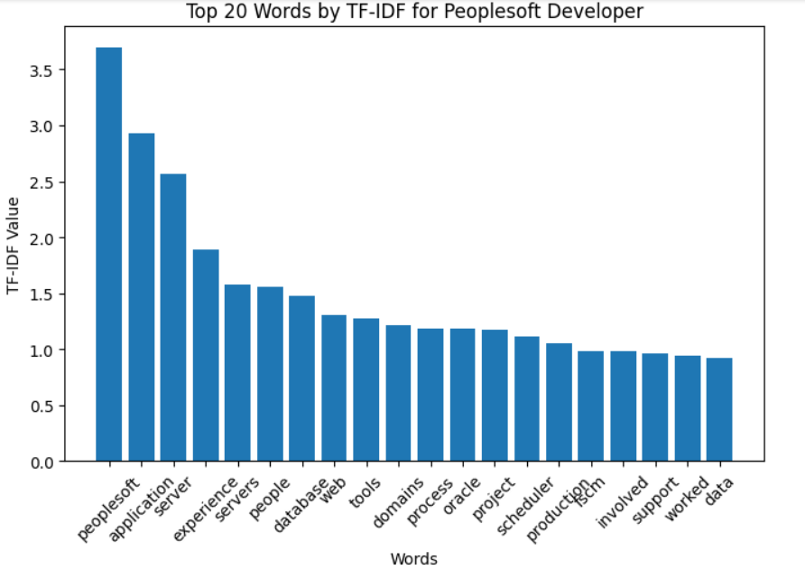
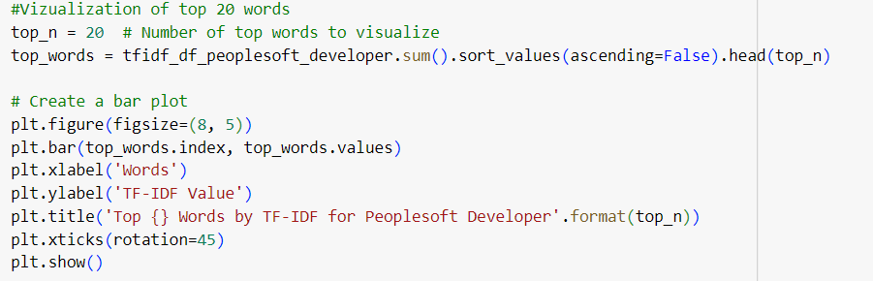
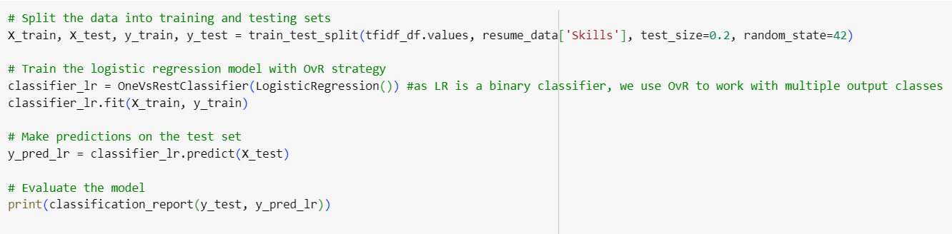

Slide 10
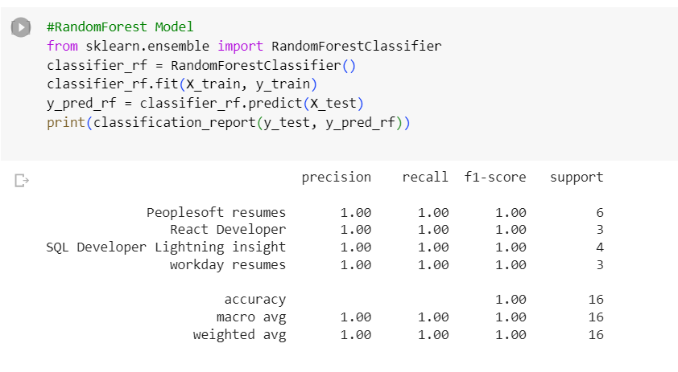
Random Forest Classifier

Slide 11
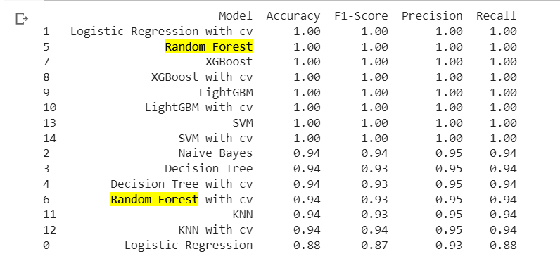
Combining All Models

Slide 12
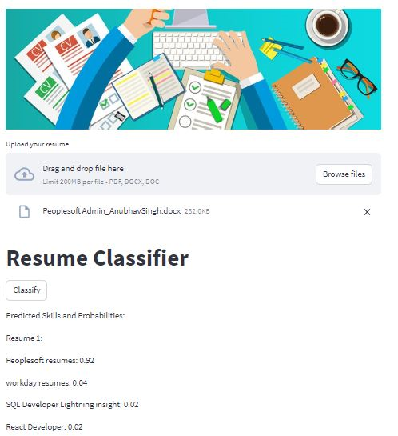
Model Deployment

Slide 13
Thank You!

