Slide 1
Deep Learning-Based
Chest X-Ray Classification
MEDVISION AI · Research prototype
Phase 1 project review · 13 September 2026
Notes:
Source: project dataset audit and measured local experiment outputs, 10 September 2026. This deck presents a research prototype only.

Slide 2
Problem statement and project scope
Project definition
This project evaluates deep learning for binary chest X-ray image classification: NORMAL versus PNEUMONIA. It supports educational research and model comparison. It does not diagnose patients or replace clinical judgment.
Notes:
Source: project dataset audit and measured local experiment outputs, 10 September 2026. This deck presents a research prototype only.

Slide 3
Verified dataset: key facts
The canonical folder was selected after excluding a nested duplicate dataset copy. Every image in the selected split opened successfully during the audit.
5,856
74.29%
0
JPEG images in the audited canonical dataset.
PNEUMONIA images in the training split; class weighting is used.
Unreadable images found by the complete audit.
Notes:
Source: project dataset audit and measured local experiment outputs, 10 September 2026. This deck presents a research prototype only.

Slide 4
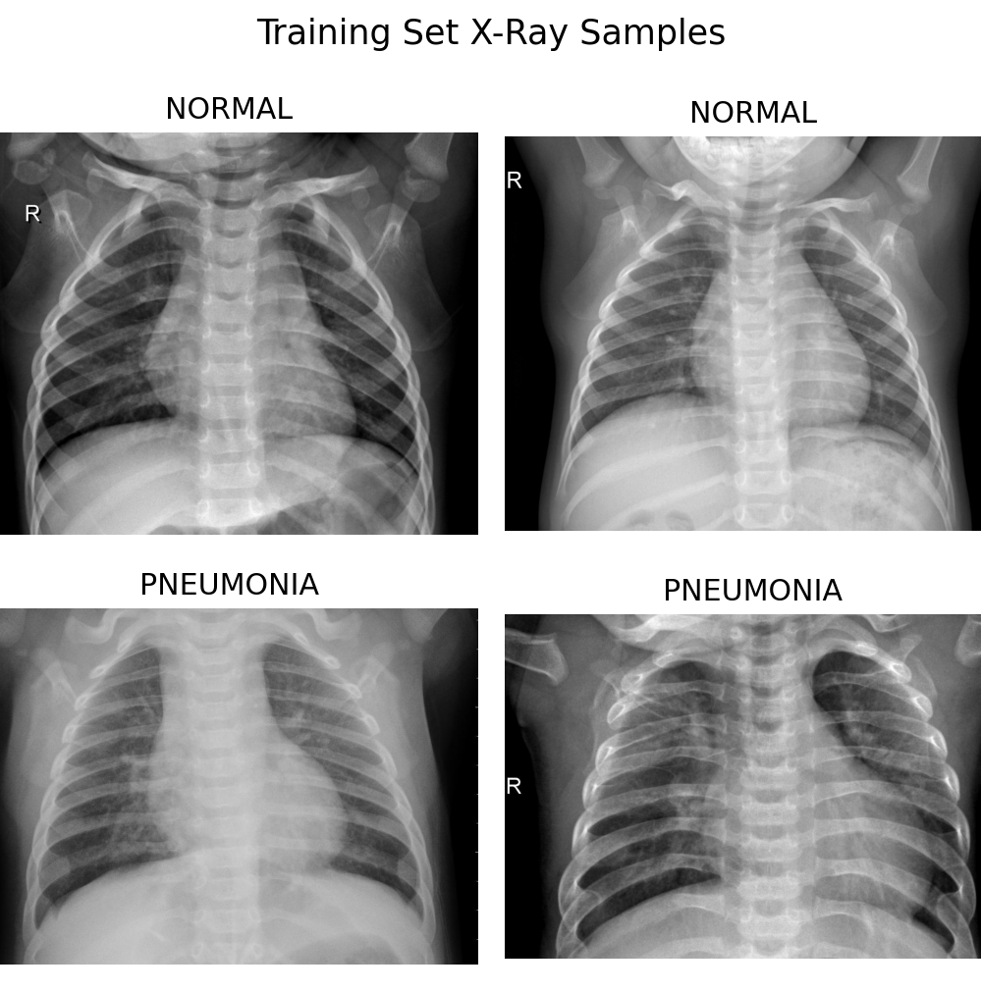
Dataset audit and sample images
Audited structure
train: 5,216 · val: 16 · test: 624
The dataset contains 1,341 NORMAL and 3,875 PNEUMONIA training images. Most files are grayscale, with 283 RGB files. Thirty exact duplicate groups exist within individual splits, while no exact duplicate group crosses train, validation, or test boundaries. The supplied validation set is too small for dependable model selection, so the pipeline creates a seeded internal validation split and keeps duplicate images together.
Notes:
Source: project dataset audit and measured local experiment outputs, 10 September 2026. This deck presents a research prototype only.

Slide 5
Phase 1 implementation plan
The project uses reproducible scripts, fixed seeds, saved manifests, and a preserved test split. Every performance value will come from actual test predictions.
Preprocessing uses tf.data rather than loading all images into memory. Images resize to 224×224 and decode to RGB for ResNet50 compatibility. Mild rotation, translation, and contrast augmentation apply only to the baseline training data. Validation and test data remain unaugmented.
Dataset audit complete
Preprocessing pipeline verified
Baseline CNN trained and evaluated
ResNet50 source pipeline ready
Grad-CAM and Streamlit interface implemented
Notes:
Source: project dataset audit and measured local experiment outputs, 10 September 2026. This deck presents a research prototype only.

Slide 6
Current model development status
The first baseline measurement is intentionally reported with its limitation. A single CPU-only epoch produced an unacceptable default-threshold classifier, so additional GPU training is the priority before any prototype model is selected.
Baseline CNN
One epoch completed on the fixed 624-image test set. Accuracy 0.625; sensitivity 1.000; specificity 0.000; ROC-AUC 0.817. It predicted PNEUMONIA for every test image at threshold 0.5.
ResNet50
Frozen-base transfer-learning architecture, evaluation pipeline, prediction API, Grad-CAM module, and Streamlit interface are implemented. Local ImageNet weights and GPU training are blocked by the host environment.
Next review actions
Run frozen ResNet50 head training in Google Colab with a GPU. Evaluate on the untouched test set. Compare actual metrics, then create Grad-CAM examples from the selected model.
Notes:
Source: project dataset audit and measured local experiment outputs, 10 September 2026. This deck presents a research prototype only.

