Slide 1
Chapter Two
Ethical and Social Issues In Information Systems

Slide 2
Ethics
It is Principles of right and wrong that individuals, acting as free moral agents, use to make choices to guide their behavior.
Information systems and ethics:- Information systems raise new ethical questions because they create opportunities for:
Intense social change, threatening existing distributions of power, money, rights, and obligations.
New kinds of crime.

Slide 3
Moral dimensions of the information age
Mainly there are five moral dimensions of the information age.
The introduction of new information technology has a ripple effect, raising new ethical, social, and legal issues that must be dealt with on the individual, social, and political levels.

Slide 4
Moral dimensions of the information age...
These issues have five moral dimensions:
information rights and obligations,
property rights and obligations,
system quality, quality of life, and
accountability and control.

Slide 5
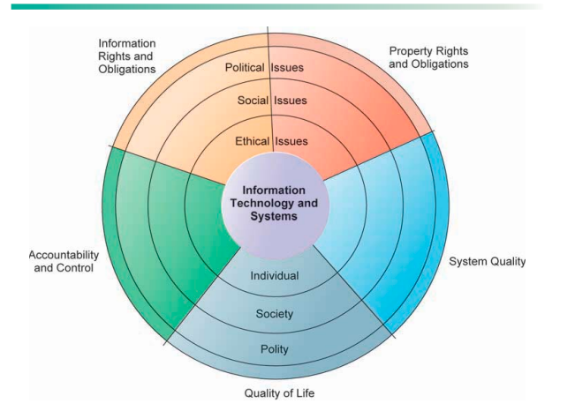
Moral dimensions of the information age...

Slide 6
Moral dimensions of the information age...
Information rights and obligations:- What information rights do individuals and organizations have with respect to themselves? What can they protect?
e.g. an employer using software to track every key stroke or website visit of a remote employee without their consent. Does the employee have a right to privacy during work hours?

Slide 7
Moral dimensions of the information age...
2. Property rights and obligations:- How will traditional intellectual property rights be protected in a digital society in which tracing and accounting for ownership are difficult and ignoring such property rights is so easy?
e.g. a student “cracked ” a version of expensive software instead of paying for a license. How does this impact the developer’s ability to create future innovations?

Slide 8
Moral dimensions of the information age...
3. Accountability and control:- Who can and will be held accountable and liable (responsible) for the harm done to individual and collective information and property rights?
e.g. If AI driven medical diagnosis tool gives a wrong prescription, who is liable? The doctor who use the program? The programmer who wrote the code? Or the hospital that bout it?

Slide 9
Moral dimensions of the information age...
4. System quality:- What standards of data and system quality should we demand to protect individual rights and the safety of society?
e.g. a bug in a bank’s database deletes customer transaction records. What is the “acceptable” level of error before a system is considered unethical to use?

Slide 10
Moral dimensions of the information age...
5.Quality of life: What values should be preserved in an information- and knowledge-based society?
Which institutions should we protect from violation?
Which cultural values and practices are supported by the new information technology?

Slide 11
Moral dimensions of the information age...
e.g. the “always on” culture where employees feel obligated to answer work telegram messages at 9:00 pm because technology allows them to be reached anywhere.
Nb. Technology act like a stone thrown into a pond, creating ripples that disturb existing social and political arrangements.

Slide 12
Key technology trends that raise ethical issues
Computing power doubles every 18 months: leading to a massive organizational dependency on computer systems for critical operations.
Data storage costs rapidly declining: Organizations can easily maintain detailed databases on individuals.

Slide 13
Key technology trends that raise ethical issues..
Data analysis advances
Greater ability to find detailed personal information on individuals
Profiling and nonobvious relationship awareness (NORA).
NORA: Combining data from multiple sources to find obscure (ambiguous) hidden connections that might help identify criminals or terrorists.

Slide 14
Key technology trends that raise ethical issues
Networking advances and the Internet: Copying data from one location to another and accessing personal data from remote locations are much easier.

Slide 15
Basic concepts for ethical analysis
Basic concepts for ethical analysis (key elements in ethical action):
Responsibility: Accepting the potential costs, duties, and obligations for decisions you make.
Accountability: Mechanisms for identifying responsible parties.

Slide 16
Basic concepts for ethical analysis...
Liability: Permits individuals (and firms) to recover damages done to them by other actors, systems, or organizations.
Due process: a process in which laws are known and understood, and there is an ability to appeal (request)to higher authorities to ensure that the laws are applied correctly.
Individuals can recover damages done to them through a set of laws characterized by due process.

Slide 17
Steps of ethical analysis
Ethical analysis have 5 steps:
Identify and clearly describe the facts
Define the conflict or dilemma and identify the higher-order values involved.
Identify the stakeholders
Identify the options that you can reasonably take
Identify the potential consequences of your options.

Slide 18
Steps of ethical analysis...
Identify and clearly describe the facts
Find out who did what to whom, and where, when, and how.
It also helps to get the opposing parties involved in an ethical dilemma or conflict to agree on the facts.

Slide 19
Steps of ethical analysis...
2. Define the conflict or dilemma and identify the higher-order values involved.
Ethical, social, and political issues always reference higher values.
example:-freedom, privacy, protection of property, and the free enterprise system.

Slide 20
Steps of ethical analysis...
3. Identify the stakeholders: Every ethical, social, and political issue has stakeholders:
players in the game who have an interest in the outcome, who have invested in the situation, and usually who have vocal opinions.
Find out the identity of these groups and what they want.
This will be useful later when designing a solution.

Slide 21
Steps of ethical analysis...
4. Identify the options that you can reasonably take
You may find that none of the options satisfy all the interests involved, but that some options do a better job than others.
Sometimes arriving at a good or ethical solution may not always be a balancing of consequences to stakeholders.

Slide 22
Steps of ethical analysis...
5. Identify the potential consequences of your options.
Some options may be ethically correct but disastrous from other points of view.
Other options may work in one instance but not in other similar instances.
Always ask yourself, “What if I choose this option consistently over time?”

Slide 23
Internet Challenges to Privacy
Privacy
Claim of individuals to be left alone, free from surveillance or interference from other individuals, organizations, or the state.
Ability to control information about yourself.
E.g. let you will search books that assist me on exam on google after a while there are many options comes to in your website based on your search history with out your consent…this violates the rights of free from surveillance.

Slide 24
Internet Challenges to Privacy...
Cookies
Tiny files downloaded by Web site to visitor’s hard drive
Identify visitor’s browser and track visits to site
Allow Web sites to develop profiles on visitors
e.g. if you was ordered online goods from Amazon earlier the cookies save the data the for the next day if you will visit the page the website says welcome the it will list the choices of you that are related with your previous choice so this implies the cookies track your status quo on the website.

Slide 25
Internet Challenges to Privacy...
Web bugs (Web beacons ): tiny graphics embedded in e-mail messages and Web pages.
Designed to monitor who is reading a message and transmitting that information to another computer on the Internet.
e.g. if a super market sends an email to its customer by saying “big sale” then when the customer opens the email the web bug is already loaded on the supermarket’s server so they track who, when, where does open the email by computer or phone so the customer will track by the market with out his knowledge.

Slide 26
Internet Challenges to Privacy...
Spyware: Secretly installed on user’s computer
May transmit user’s keystrokes or display unwanted ads.
E.g. if you can download a free film then hackers load spyware on your computer with out your knowledge the they will save the password that you insert for your accounts including bank account then it transfer or send the recorded data for the previous hackers.

Slide 27
Property Rights
Intellectual property: Intangible property of any kind created by individuals or corporations.
Three ways that intellectual property is protected
Trade secret: Intellectual work or product belonging to business, not in the public domain.
Software that contains novel or unique elements, procedures, or compilations can be included as a trade secret.
E.g. coca cola formula

Slide 28
Property Rights...
Copyright: Statutory grant protecting intellectual property from being copied for the life of the author, plus 70 years.
e.g. books author, poem and lyrics writer right
Patents: Grants creator of invention an exclusive monopoly on ideas behind invention for 20 years.
e.g innovations related with engineering inventions

Slide 29
Challenges to Intellectual Property Rights
Digital media different from physical media (e.g. books)
Ease of replication
Ease of transmission (networks, Internet)
Difficulty in classifying software
Compactness
Difficulties in establishing uniqueness

Slide 30
Principal sources of poor system performance
Three principal sources of poor system performance.:
Software bugs, errors
Hardware or facility failures
Poor input data quality (most common source of business system failure)

Slide 31
Negative social consequences of systems
Computer crime and abuse
Computer crime: illegal act through use of computer or against a computer system.
computer may be object or instrument of crime.
e.g hacking

Slide 32
Negative social consequences of systems…
Computer abuse: unethical acts, not illegal
e.g. an organizational employee scroll social media by using organizations computer during work time.
Spam: high costs for businesses in dealing with spam
Spam is junk e-mail sent by an organization or individual to a mass audience of Internet users who have expressed no interest in the product or service being marketed.

Slide 33
Negative social consequences of systems...
Dependence and vulnerability: public and private organizations ever more dependent on computer systems, therefore, they are highly vulnerable if these systems fail.
Maintaining boundaries: Technology impact the balance between Family, Work, and Leisure.
Equity and access: the digital divide.

Slide 34
End of chapter 2
thank you!

