Slide 1

Asset Servicing
Text Analytics - Service Director Dashboard
BKI Analytics

Slide 2

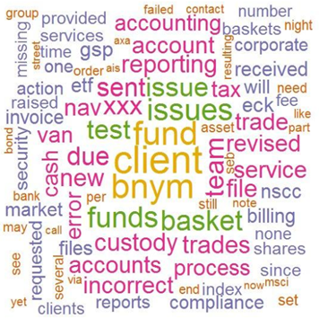
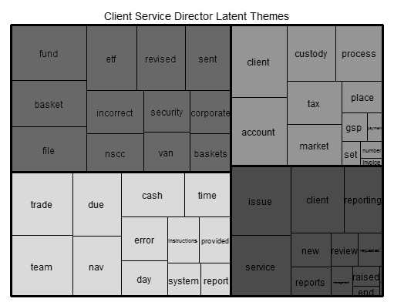

Service Director Dashboard – CIS Text Analytics
BACKGROUND
Service Director dashboard is used to report issues flagged by the Service Director indicating Business at risk
Based on data from BNYM SharePoint & RAG/Business at Risk (based on Engage/Salesforce)
GAPS
Lack of appropriate data validations for enhanced data quality
Issue description is not effectively linked with Departments during Reporting
CURRENT SOLUTION BENEFITS
Text Analytics to
Identify latent themes running behind the reported issues
Further drill down individual issue categories and detail Reporting
FURTHER OPPORTUNITES
Integrate data from different sources in a single repository
Issue Root Cause Identification
Client Churn/ Business Loss prediction
Identified different issues reported against BNY product / service offerings
Topic Modeling discovers latent themes flowing through the reported issues
Identified categories with issues
Inverse Document Frequency
Reporting | Fund Accounting
Technology Migration | Corporate Action
ETF Services | Billing / Invoice
Custody Accounts | Client Service
NAV | Asset Servicing
Topic Modelling using LDA
Need
SME expertise
RAG details
Consolidated data source / migration of relevant data to data warehouse (WIP)

Slide 3
Service Director Dashboard – CIS Text Analytics (Issue Categories)
Reporting
11 %
11 %
17%
ETF Services
Technology
Incorrect Reporting
Tread related reporting delay or incorrect
Incomplete reporting
ETF Basket related issues (NAV, Revision)
Advisor Shares
Migration issues (to GSP)
Effect on business due to migration
Connectivity and knowledge sharing with GSP
48
98
42
10
109
06
40
61
18
Custody Accounts
Billing / Invoice
NAV
9%
9%
8%
Missed information (incorrect)
Custody services
Fees
Delay in billing/invoice
Incorrect invoice/billing due to system
Fees
NAV Error
Overstated NAV
30
48
17
32
37
12
22
55
08
Fund Accounting
Corporate Action
Client Service
5%
4%
3%
Pricing error
Trade related
10
38
03
Missed or delay in informing
Services related issues
09
35
02
Lack of timely response
Not happy with service
Incorrect information
10
109
06
Asset Servicing
1%
FX Issue
Timely processing
03
10
01

