Slide 1
API / Web services

Slide 2
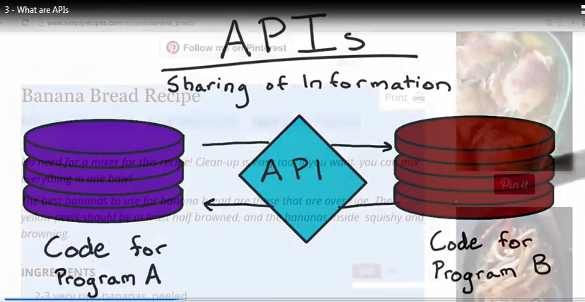
What is API?

Slide 3
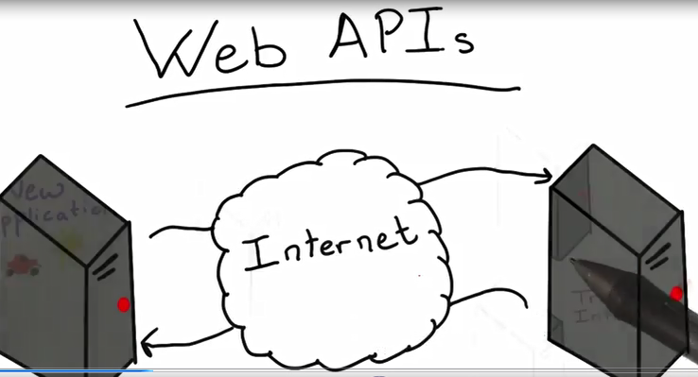

Slide 4
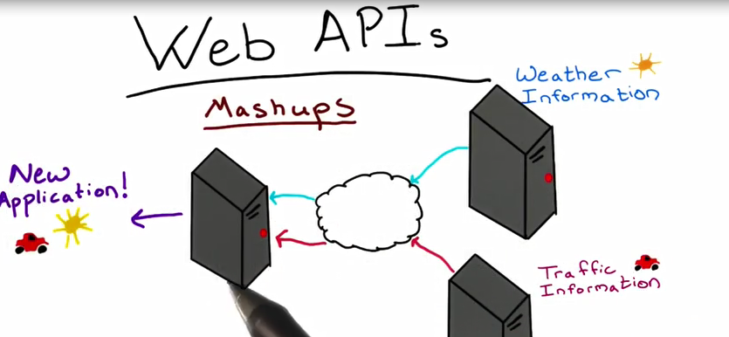

Slide 5
OSI Model
Protocols
OSI Model : Open system Interconnection

Slide 6
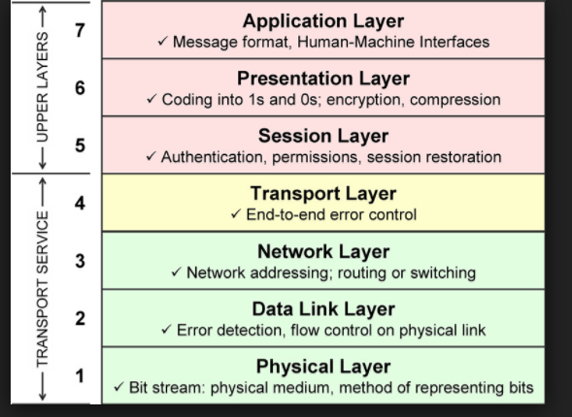

Slide 7
Application Layer
Protocol : HTTP
Hyper text Transfer Protocol
FTP
POP
SSH

Slide 8
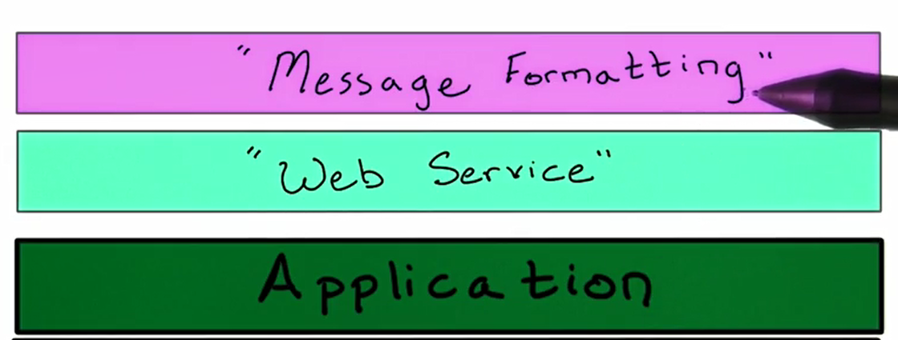

Slide 9
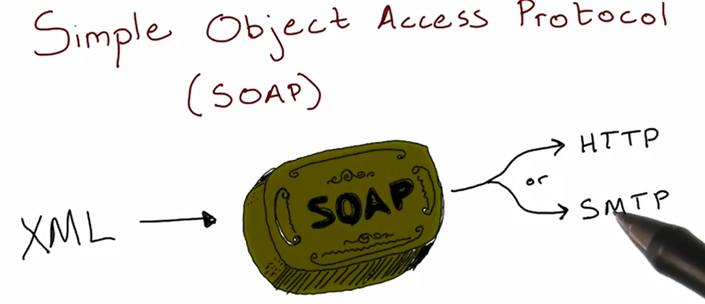
Web Service

Slide 10
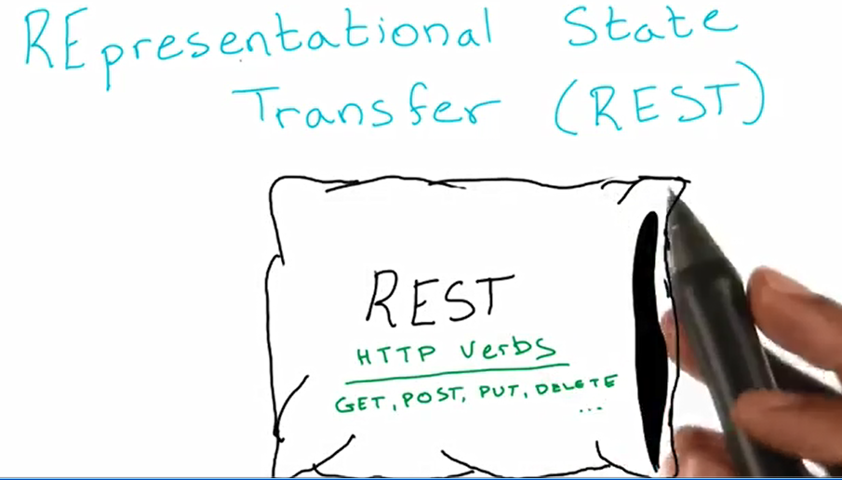
REST

Slide 11
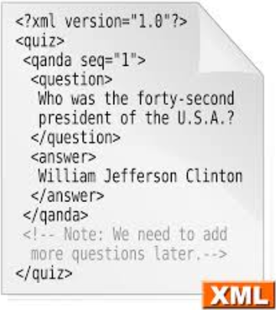
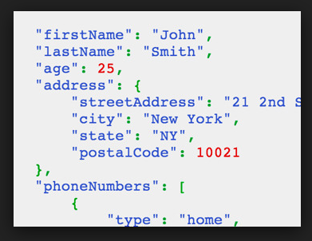
Message Formating
XML
JSON

Slide 12
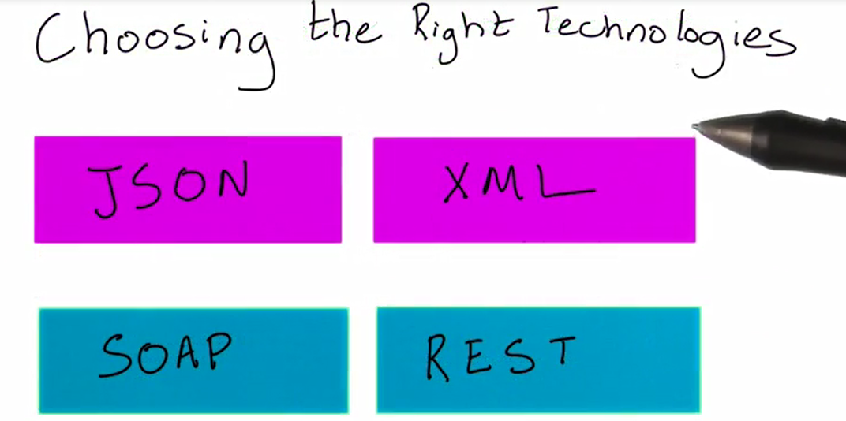

Slide 13
Google Trends

Slide 14
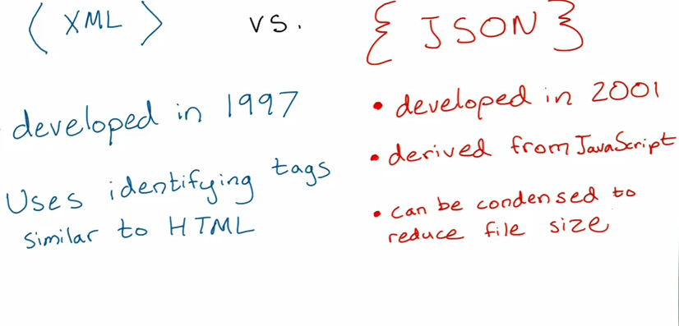

Slide 15
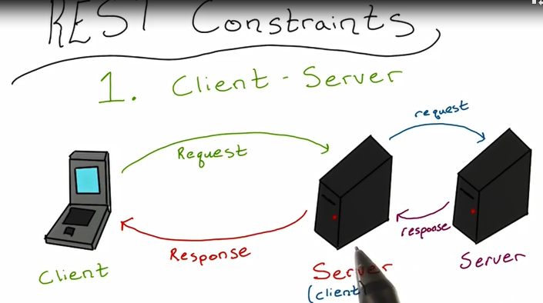

Slide 16
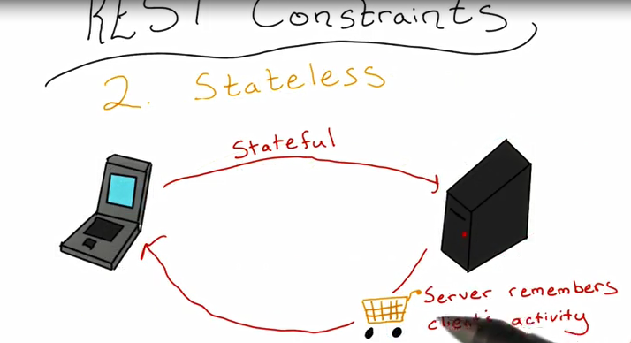
Stateless / Stateful

