Slide 1
Web Services

Slide 2
WSDL
WSDL stands for Web Services Description Language
WSDL is used to describe web services
WSDL is written in XML
WSDL is a W3C recommendation from 26. June 2007

Slide 3
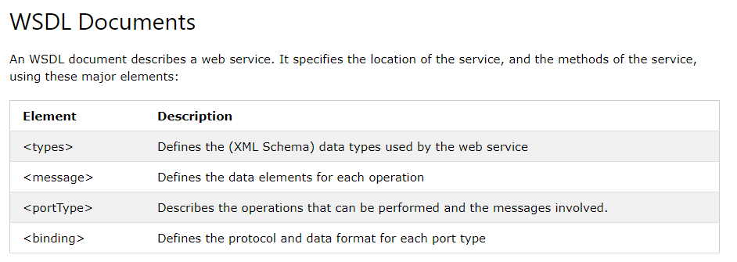

Slide 4
