Slide 1

CRYPTO BOARD
Name : Ashutosh N Kesarkar
Roll no : 714

Slide 2
ABOUT THE PROJECT
1

Slide 3
ABOUT PROJECT
A cryptocurrency is a digital or virtual currency that is secured by cryptography, which makes it nearly impossible to counterfeit or double-spend. Many cryptocurrencies are decentralized networks based on blockchain technology—a distributed ledger enforced by a disparate network of computers. The project is the analysis of different types of cryptocurrency over various years.

Slide 4
ABOUT THE DATA
2

Slide 5
ABOUT DATA SET
The dataset has one csv file for each currency. Price history is available on a daily basis from April 28, 2013. This
dataset has the historical price information of some of the top crypto currencies by market capitalization.

Slide 6
DETAILS OF DATASET
1
DATE
The DATE describes the date of observations.
2
OPEN
The OPEN is the Opening Price on the given day.
3
HIGH
The HIGH is the highest price on the given day.
4
LOW
The LOW is the lowest price on the given day.

Slide 7
DETAILS OF DATASET
5
CLOSE
The CLOSE is the closing price on the given day.
6
VOLUME
The VOLUMNE is the volume of transactions on the given day.
7
MARKET CAP
The MARKET CAP is the market capitalization in USD.

Slide 8















CRYPTOCURRIENCIES USED
AAVE COIN
COSMOS COIN
IOTA COIN
BINANCE COIN
CRYPTO.COM COIN
LITE COIN
BITCOIN
DOGE COIN
MONOCOIN
CARDANO COIN
EOS COIN
NEM COIN
CHAINLINK COIN
ETHERIUM
POLKADOT COIN

Slide 9








CRYPTOCURRIENCIES USED
SOLANA COIN
UNISWAP COIN
STELLAR COIN
USD COIN
TETHER COIN
WRAPPED BITCOIN
TRON COIN
XRP COIN

Slide 10
INSIGHTS TO FIND OUT?
3

Slide 11
INSIGHTS TO BE FOUND?
1
What is the Final Close Price?
2
What is the highest close price?
3
What is the lowest close price?
4
What is the average daily volume?
5
What is comparison of Close Price within selected time?

Slide 12
INSIGHTS TO BE FOUND?
6
What is Average Volume by Date range?
7
What is Price Comparison table of various cryptocurrencies?
8
Who are the best performers in last 30 Days and 365
Days?
Who are the worst performers in last 30 Days and 365
Days?
What is Price correlation of various cryptocurrencies?
9
10

Slide 13
VISUAL ANALYTICS AND FINDINGS
4

Slide 14
SUMMARY OF DATA
Close Price (Final)
Close Price (High)
2,324.68
4,168.70
Close Price (Low)
Average Daily Volume
84.31
13,492

Slide 15
4.1 OVERALL ANALYSIS

Slide 16
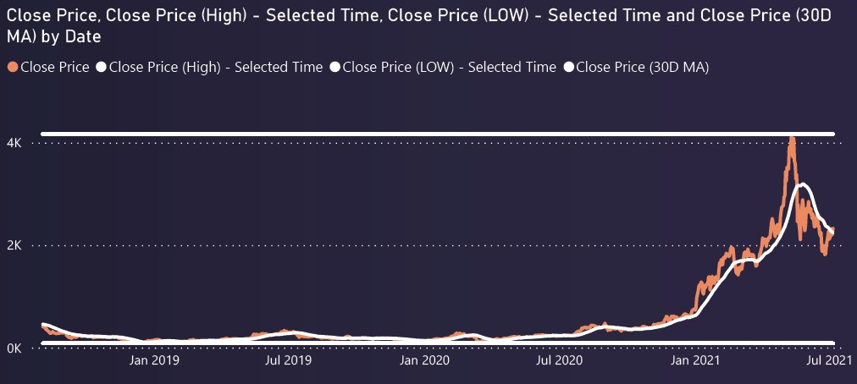
CLOSE PRICE WITHIN SELECTED DATE

Slide 17
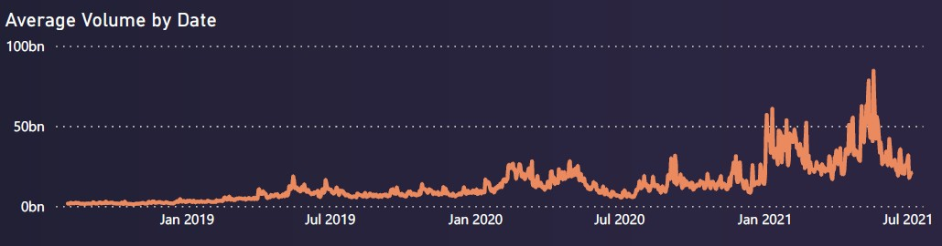
AVERAGE VOLUME BY DATE

Slide 18
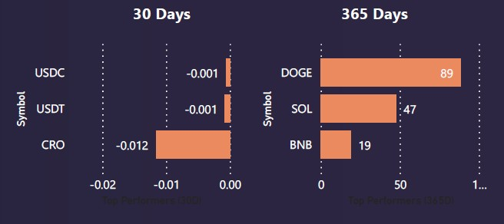
BEST PERFORMERS

Slide 19
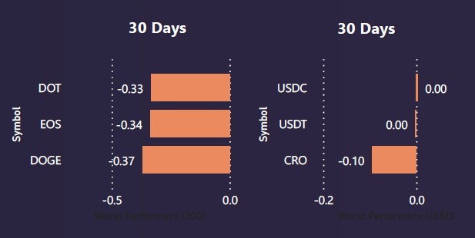
WORST PERFORMERS

Slide 20
Thank You

