Slide 1
SQL

Slide 2
Agenda
DDL/DML Statements
Select Queries and Built-In Functions.

Slide 3
Database Systems
Database Systems -
Database Application Program –special purpose Client Components – general purpose- to access data stored – local/remote
Database Server – manage data -
Databases- collection of data –logically belong together

Slide 4
A Database Must Provide
Variety of UI – GUI/CUI
Physical Data Independence –
Logical Data Independence-
Query Optimization-subcomponent – variety of query execution strategies
Data Integrity- identify logically inconsistent data and reject its storage in a database e.g. Feb 30 / 6.89 PM
Concurrency Control -
Backup Recovery – if query fails – rollback systems
Security – Authentication /Authorization

Slide 5
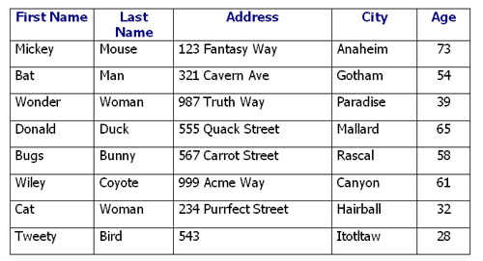
Relational Database System
Based on Relational Data Model:
Collection of concepts/ their relationships/ their constraints - represents real-world problem
Central Concept is a Relation – (table)
Table – 1 > columns/rows -
exactly one data value at cross-section

Slide 6
Tables in RDBMS
Rows – no particular order
Column- no particular order
Column- must have unique name- 2 tables different
At the cross-section - only single value

Slide 7
SQL- Language to interact with RDMS
It’s a set-oriented language – input and output – to/from SQL -both Tables.
Two – sub languages - DDL(Data definition Language)/ DML(Data Manipulation Language)
DDL - describe the Schema of Database Tables – CREATE/ALTER/DROP objects- database/column/tables/indexes
DML - all operation of manipulating the data –Basically CRUD- Insert/Select/Update and Delete.

Slide 8
T-SQL (Implementation by MS) - Basics
Literals Values - alphanumerical, hexadecimal, or numeric - "Name", 'A', 3453, hx
Identifiers- names representing T-SQL objects- tables/databases etc..
Delimiters- characters with special meaning - , {} etc..
Comments- /* and */ | --remainder of the line is comment.
Reserved Keywords

Slide 9
Data Types
Numeric data types - integer/decimal
Character data types - fixed/variable
Temporal (date and/or time) data types – DATETIME(01/01/1753 to 12/31/9999) etc..
Miscellaneous data types - User Defined DataTypes/XML etc..

Slide 10
T-SQL Function
Aggregate Functions – applied to group of columns- returns single value- AVG() - of data values of column / sum()
Scalar Functions – operates on Single Value or List -
- rand()- return random no between – 0&1/ getdate() /lower()/ current_user() /
___________________________________________________
Global Variables - @@servername

Slide 11
DDL/DML
Create Database
Create Table
Alter Table - Add or drop one or more columns
Modify column properties
Add or remove integrity constraints
Enable or disable constraints
Rename tables and other database objects

Slide 12
Installation
An instance is an installation of SQL Server.
An instance is an exact copy of the same software.
If we install 'n' times, then 'n' instances will be created.
There are two types of instances in SQL Server a) Default b) Named.
Only one default instance will be supported in one Server.
Multiple named instances will be supported in one Server.
Default instance will take the server name as Instance name.
Default instance service name is MSSQLSERVER.
16 instances will be supported in 2000 version.
50 instances will supported in 2005 and later versions.

Slide 13
Create
create table ABC(
OrderID int not null primary key,
Zip_Code int,
LocationArea varchar(50),
Check(Zip_Code Between 2000 AND 5000)
)

Slide 14
Insert
INSERT INTO table_name (column1, column2, column3, ...) VALUES (value1, value2, value3, ...);

Slide 15
Update
UPDATE table_name SET column1 = value1, column2 = value2, ... WHERE condition;

Slide 16
Delete
DELETE FROM table_name WHERE condition;

Slide 17
Drop/Truncate
Drop – deletes data + schema
Truncate –deletes only data

Slide 18
Select Statement
One basic statement to retrieve data from database.
- single table/ multiple tables/ multiple databases
Select all/distinct from nameofthetable where
Boolean operators-and/ or/ not
In and Between Operators
Is / is not null
Like – pattern matching - % - 'a%' (contains)

Slide 19
SubQueries
Upto 32 levels are possible.
Inner and outer Query – inner query evaluated first

Slide 20
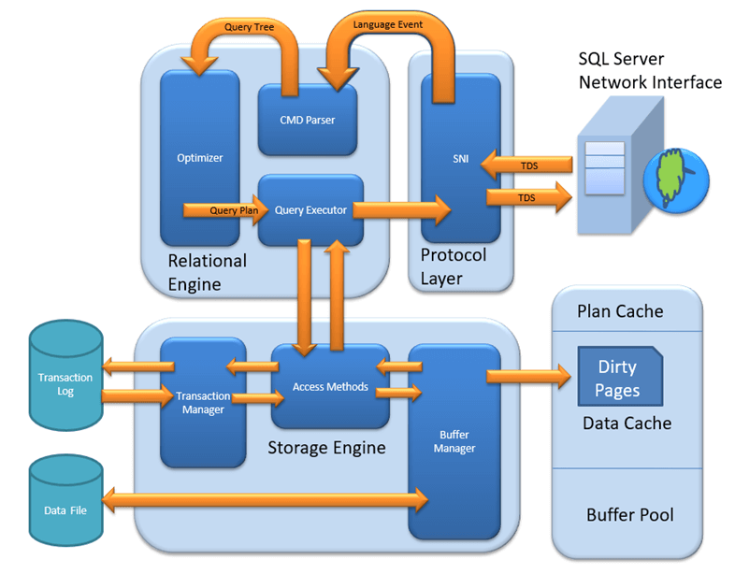
SQL Server Architecture

Slide 21
Architecture
Protocol Layer
Shared Memory
TCP/IP
Named Pipes
Relational Layer
Cmd Parser
Optimizer
Query Selector
Storage Engine
File Types
Access Method
Buffer Manager
Plan Cache
Data Parser
Transaction Manager

Slide 22
Agenda
Views
Stored Procedure and UDF

Slide 23
Joins
SELECT Orders.OrderID, Customers.CustomerName, Orders.OrderDate FROM Orders INNER JOIN Customers ON Orders.CustomerID=Customers.CustomerID;
SELECT country.country_name_eng, city.city_name, customer.customer_name
FROM country
INNER JOIN city ON city.country_id = country.id
INNER JOIN customer ON customer.city_id = city.id;
(INNER) JOIN: Returns records that have matching values in both tables
LEFT (OUTER) JOIN: Returns all records from the left table, and the matched records from the right table
RIGHT (OUTER) JOIN: Returns all records from the right table, and the matched records from the left table
FULL (OUTER) JOIN: Returns all records when there is a match in either left or right table

Slide 24
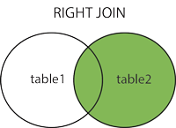
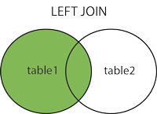
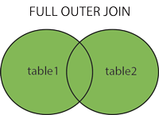
Joins

Slide 25
Views
Used for restriction / security mechanism in the SQL server.
CREATE VIEW [Brazil Customers] AS SELECT CustomerName, ContactName FROM Customers WHERE Country = 'Brazil';

Slide 26
Stored Procedure
Collection of SQL statements
create procedure ABCD1
as
Select * from TemTable
go
exec ABCD1

Slide 27
Parameterized SP
CREATE PROCEDURE SelectAllCustomers @City nvarchar(30) AS SELECT * FROM Customers WHERE City = @City GO;
EXEC SelectAllCustomers @City = 'London';

Slide 28
CREATE FUNCTION [database_name.]function_name (parameters)
RETURNS data_type AS
BEGIN
SQL statements
RETURN value
END;

Slide 29
User Defined Function
CREATE FUNCTION scalar_func ( @a AS INT, -- parameter a @b AS INT -- parameter b ) RETURNS INT -- return type AS BEGIN RETURN @a + @b -- return statement END;
SELECT dbo.scalar_func(60,80)
DECLARE @TestVariable AS VARCHAR(100)
SET @TestVariable = 'Planet Earth'
PRINT @TestVariable

Slide 30
CREATE FUNCTION Sales(@storeid int)
RETURNS TABLE
AS
RETURN
(
select * from TemTable
)
End
select * from dbo.Sales(9)

Slide 31
Stored Procedure vs Functions
Stored Procedures are pre-compiled objects which are compiled for the first time and its compiled format is saved,
A function is compiled and executed every time whenever it is called- it must return a value
Functions can be called from Procedure whereas Procedures cannot be called from a Function.

Slide 32
Try..Catch
BEGIN TRY
insert into TemTable values(1,'ABC',567,90,'A')
END TRY
BEGIN CATCH
SELECT
ERROR_NUMBER() AS ErrorNumber
,ERROR_SEVERITY() AS ErrorSeverity
,ERROR_LINE() AS ErrorLine
,ERROR_MESSAGE() AS ErrorMessage;
END CATCH

Slide 33
Transactions in SQL
Atomicity − all or not
Consistency − properly changes states upon a successfully committed transaction.
Isolation − to operate independently of and transparent to each other.
Durability − effect of a committed transaction persists in case of a system failure

Slide 34
Begin try
Begin tran
insert into TemTable values(1000,'ABc',789,45,90)
insert into TemTable values(10000,'ABc',789,45,90)
Commit tran
End try
Begin catch
Rollback tran
End catch

Slide 35
Triggers
Reaction for an Event
Before – abstract but works with update
After / Instead of
Stored procedure - predefined

Slide 36
After – DML Trigger
Create trigger Trg
on TemTable
after INSERT
as
begin
insert into TemTable2 values(45,'Name',890)
end

Slide 37
Instead of
CREATE TRIGGER instoftr
ON TemTable
INSTEAD OF INSERT
AS
BEGIN
INSERT INTO TemTable2 values(34,'Hello',90)
END

Slide 38
IF..Else
IF Boolean_expression
BEGIN -- {
-- true
End }
ELSE
BEGIN {
--false
END }

Slide 39
Referential Integirty –Foreign Key
Table A Table B
FK PK

