Slide 1
Entity Framework

Slide 2
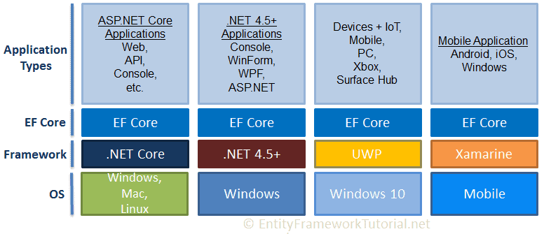
Entity Framework

Slide 3
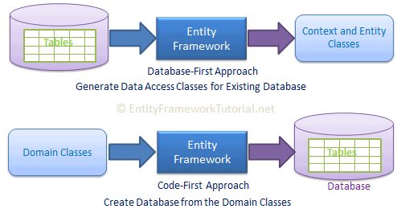
Approaches

Slide 4
API Requirements
Microsoft.EntityFrameworkCore.SqlServer (Provider of the database)
Microsoft.EntityFrameworkCore.Tools ( tools -to execute EF Core commands/ such as migrations, scaffolding, etc-directly from Package Manager Console (PMC) within Visual Studio.)

Slide 5
Database First Approach
Scaffold-DbContext [-Connection] [-Provider]
[-OutputDir] [-Context] [-Schemas>] [-Tables>] [-DataAnnotations] [-Force] [-Project] [StartupProject] [<CommonParameters>]
e.g. scaffold-DbContext 'Server=.;Database=TemDB;Trusted_Connection=True;' Microsoft.EntityFrameworkCore.SqlServer -OutputDir Models

Slide 6
Key
Primary Key is mandatory.

Slide 7
DbContext Class
Manage database connection
Configure model & relationship
Querying database
Saving data to the database
Configure change tracking
Caching
Transaction management

Slide 8
DbContext Class
OnConfiguring() - select and configure the data source to be used with a context.
OnModelCreating() - further configure the model that was discovered by convention
SaveChanges() - Execute INSERT, UPDATE or DELETE command to the database for the entities.

Slide 9
Querying
LinQ To Entities

Slide 10
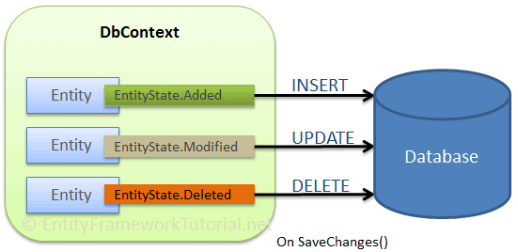
IUD

Slide 11
IUD ...
Insert -
DbSet.Add() and DbContext.Add()
SaveChanges()
Remove -
Remove()
SaveChanges()
Update -
SaveChanges()

Slide 12
Stored Procedures
cntx.students.FromSqlRaw<Students>(proc);

Slide 13
Code- First
Domain Driven Desing

Slide 14
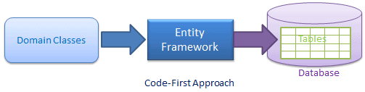
Architecture

Slide 15
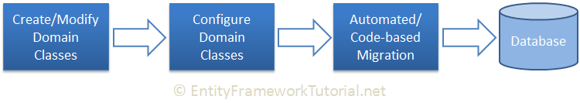
Code-First Work-Flow

Slide 16
Steps
Install Packages – EntityFrameowork ..
Derived the class from DbContext.
Create property of type DbSet<classname>
Configure database connection string in OnConfigure()
Add-Migration – EntityFrameworkCore\Add-Migration(EntityFrameworkCore\Add-Migration)
Update database - EntityFrameworkCore\Update-Database

Slide 17
Mappings
C# Data Type | Mapping to SQL Server Data Type
int | int
string | nvarchar(Max)
decimal | decimal(18,2)
float | real
byte[] | varbinary(Max)
datetime | datetime
bool | bit
byte | tinyint
short | smallint
long | bigint
double | float
char | No mapping
sbyte | No mapping (throws exception)
object | No mapping

Slide 18
Code-First Conventions
Primary key Name | 1) Id 2) <Entity Class Name> + "Id" (case insensitive)

Slide 19
Data Annotations
Required​ | On property to specify that the corresponding column is a NotNull column in the database.​
MinLength​ | to specify the minimum string length allowed in the corresponding column in the database.​
MaxLength​ | To a property to specify the maximum string length allowed in the corresponding column in the database.​
StringLength​ | to a property to specify the maximum string length allowed in the corresponding column in the database.​

Slide 20
ForeignKey | Can be applied to a property to mark it as a foreign key property.
NotMapped | to a property or entity class which should be excluded from the model and should not generate a corresponding column or table in the database.
Table | Can be applied to an entity class to configure the corresponding table name and schema in the database.
Column | Can be applied to a property to configure the corresponding column name, order and data type in the database.

