Slide 1
Dot Net

Slide 2
NUnit C#

Slide 3
Agenda
SDLC
Bug
Testing Terminologies
Types of Test

Slide 4
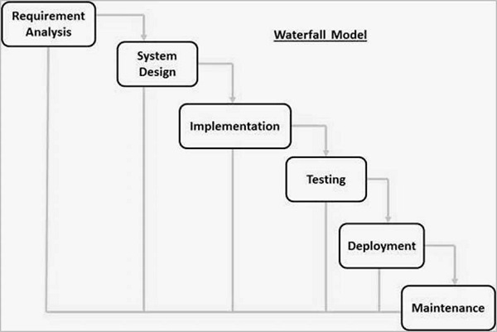
SDLC Waterfall

Slide 5
Planning /Requirement Analysis
SDLC Starts with origin of requirements.
Done by senior members of the team
inputs from the customer, the sales department, market surveys and domain experts in the industry are taken.
Used to plan the basic project approach
Result is Software Requirements Specifications doc

Slide 6
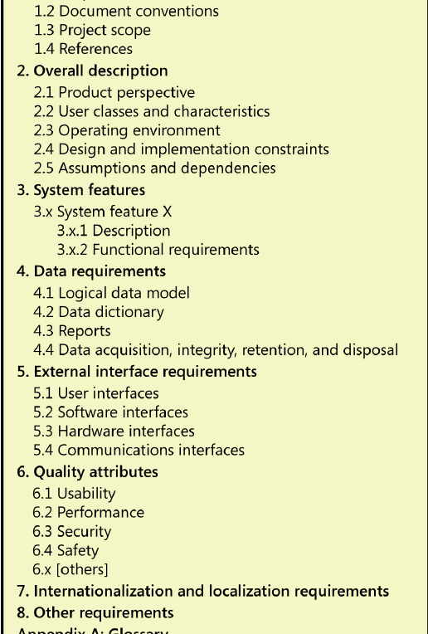
SRC Doc

Slide 7
Design
Based on SRF.
Design Document Specification is prepared.
Architectural modules of the products are created.
Design Database (If applicable),
Design User Interfaces
Select or Develop Algorithms

Slide 8
DDS

Slide 9
Implementation
Actual development starts
Programming code is generated as per DDS during this stage.
C, C++, Pascal, Java, c# and PHP are used for coding.

Slide 10
TESTING
testing only stage of the product
product defects are reported, tracked, fixed and retested.
This phase is iterative as long as the bugs are fixed

Slide 11
Deployment
Software are installed at the client place.

Slide 12
Maintenance
Enhancements/New Features
SDLC life cycle starts again.

Slide 13
Bug
coding error-unexpected defect, fault, flaw, or imperfection in a computer program.
Reasons for Bugs :-
constantly changing requirements
programming errors
errors in bug tracking
documentation errors
communication gap
software complexity

Slide 14
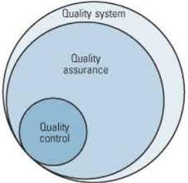
Testing Terms
Quality Assurance- process of managing quality- how a product is made
Quality Control – verification of the quality of the output –testing/ code inspection etc.

Slide 15
Testing Terminologies
Error – mistake in code.
Defect – error found by tester during testing phase.
Bug – defect accepted by development team to be resolved.
Failure -

Slide 16
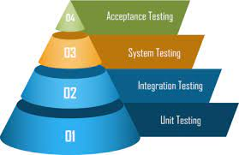
Types of Testing
By Level -

Slide 17
Types of Testing – By Level
Unit Testing ->Tests Individual Component
Integration Testing -> different software modules are combined-tested as a group.
System Testing -> tests the overall interaction of components/most often the final test to verify/functional and non-functional need for the testing
Acceptance Testing -> basically done by the user or customer.

Slide 18
Integration Testing Tools
Citrus.
FitNesse.
TESSY.

Slide 19
Unit
-smallest piece of testable software
-Or the logical path (path that the execution of the code takes)
-individual, public operations in each class

Slide 20
Unit Testing
From MSDN:
"The primary goal of unit testing is to take the smallest piece of testable software in the application, isolate it from the remainder of the code, and determine whether it behaves exactly as you expect…"

Slide 21
Basic
Arrange – setup the testing object
Act - execute for result
Assert – verify the result

Slide 22
NSubstitute
On the fly : Arrange / Act and Assert

