Slide 1
Ado.Net

Slide 2
Agenda
Ado.Net
Architecture
Connection
Command
DataReader
DataAdapter
DataSet

Slide 3
Ado.net
It’s a set of classes.
Helps to interact with Databases/xml files.

Slide 4
Architecture
Connected / DisConnected

Slide 5
Connected Architecture
Connection is established for the full time – database & application
It is forward only and read-only.
Object of DataReader is used to - retrive the data from dbase & connection is maintained

Slide 6
Disconnected Architecture
Connectivity between Dbase and App is not maintained for full time.
Only for reading and updating.
Data is retrieved and stored in the App.
SqlDataAdapter and DataSet classes

Slide 7
Connection Class
allows you to establish a connection to the data source.
needs the necessary information to discover the data source- connection string.

Slide 8
Command
provides methods for storing and executing SQL statements and Stored Procedures.
ExecuteReader- returns data adapter
ExecuteNonQuery-IUD – returns int
ExecuteScalar- single value

Slide 9
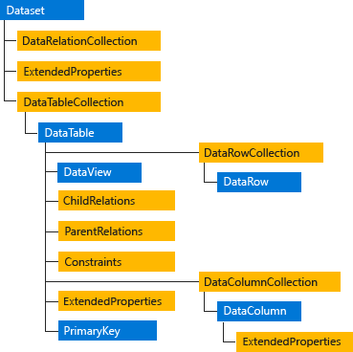
SqlDataAdapter/DataSet

