Slide 1
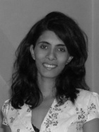

Slide 2
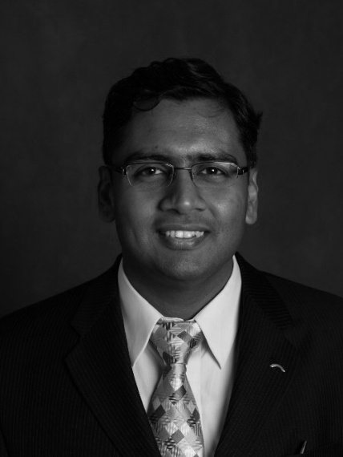

Slide 3
Preeti Saini

Slide 4
Ajay Thapa

Slide 5
Sharukh Khan

Slide 6
Lopsang Ringchen

Slide 7
Gyanpal Rawat

