Slide 1
APL Logistics: Supply Chain Intelligence & Risk Prediction
Visual Analytics & Optuna Machine Learning Executive Presentation
Prepared for APL Logistics Operations & Analytics Leadership
Biswajeet Pradhan
biswajeetpradhan36933@gmail.com

Slide 2
Executive Overview & Problem Statement
Proactive Late Delivery Risk Mitigation in Global Freight Operations
Operational Challenges at APL Logistics
• Unpredictable shipment delays cause Service Level Agreement (SLA) breaches.
• Reactive delay handling (after logistics bottlenecks occur) incurs severe expediting and premium air-freight costs.
• Operations teams lack a quantitative early-warning score before dispatch.
• High customer churn risk resulting from uncommunicated transit delays.
Proposed Data Science & AI Solution
• Predictive Machine Learning Engine analyzing 180,000+ global transaction records.
• Automated Hyperparameter Optimization via Optuna for max classification accuracy.
• Target Encoding for high-cardinality geographic & product variables.
• Two-Tier Deployment: Streamlit Predictor App + Executive Power BI Dashboards.

Slide 3
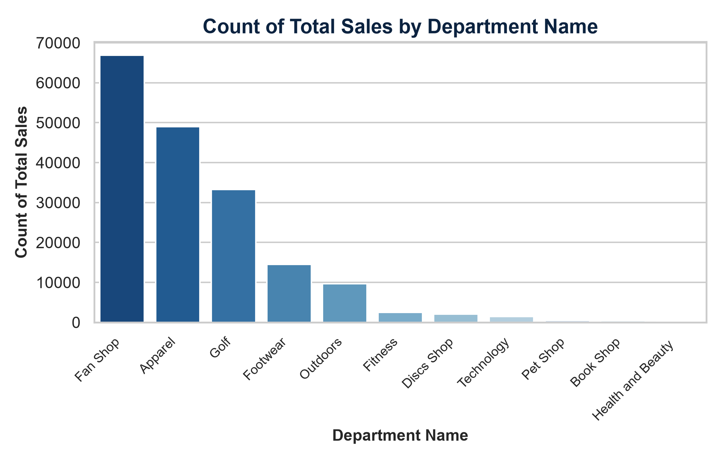
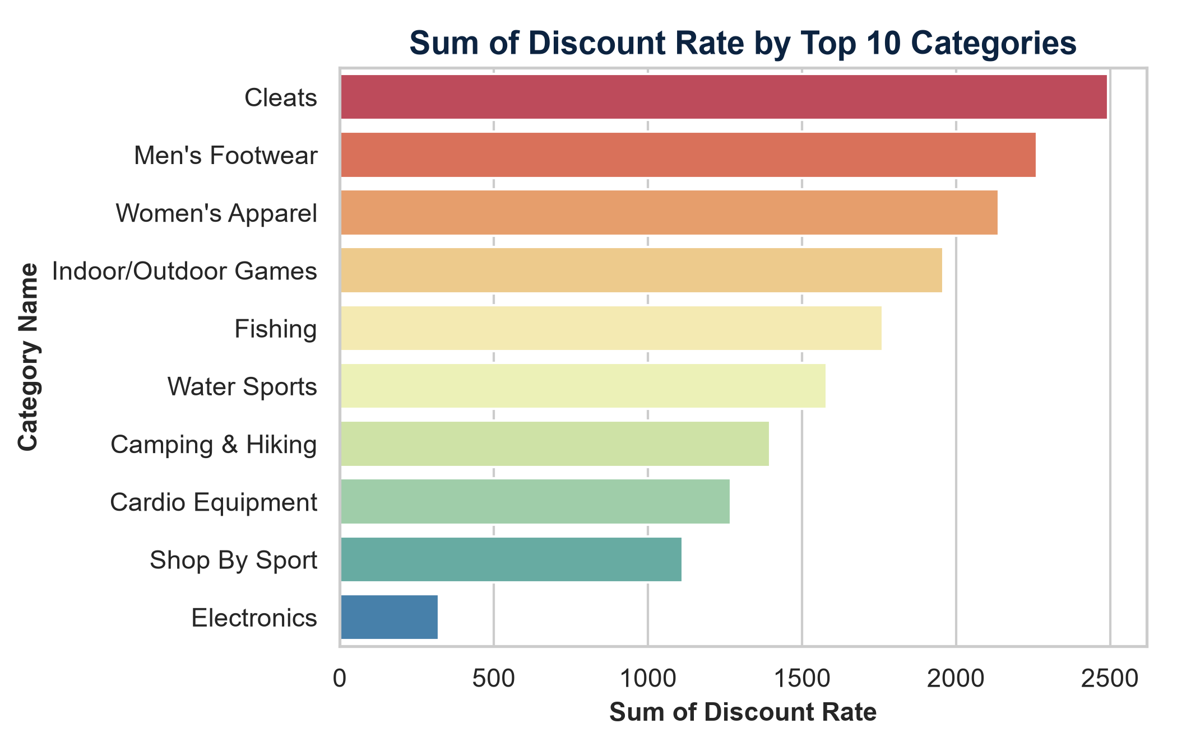
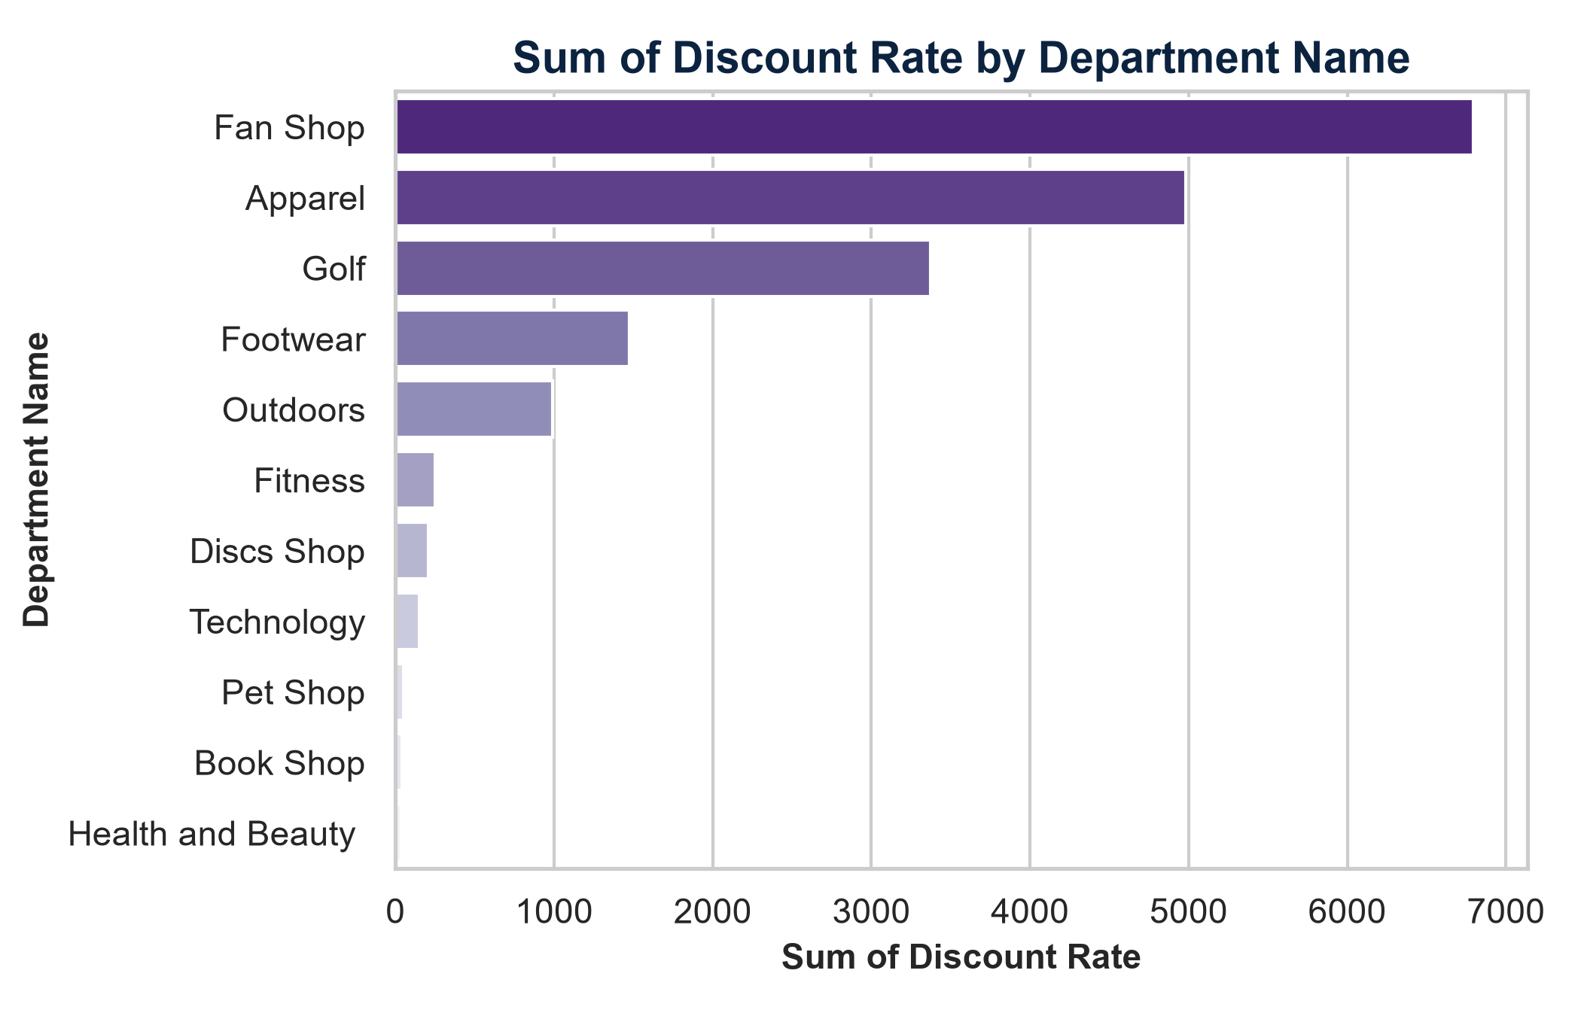
Power BI Visual Dashboard: Page 1 (Sales & Discounts)
Embedded Visual Presentations from Power BI Data Model
Key Insights from Power BI Page 1
• Department Volume: Fan Shop, Apparel, and Golf lead order volume, representing major logistics throughput.
• Discount Impact: Cleats, Men's Footwear, and Apparel consume over 60% of total discount allowances, signaling tight operating margins.

Slide 4
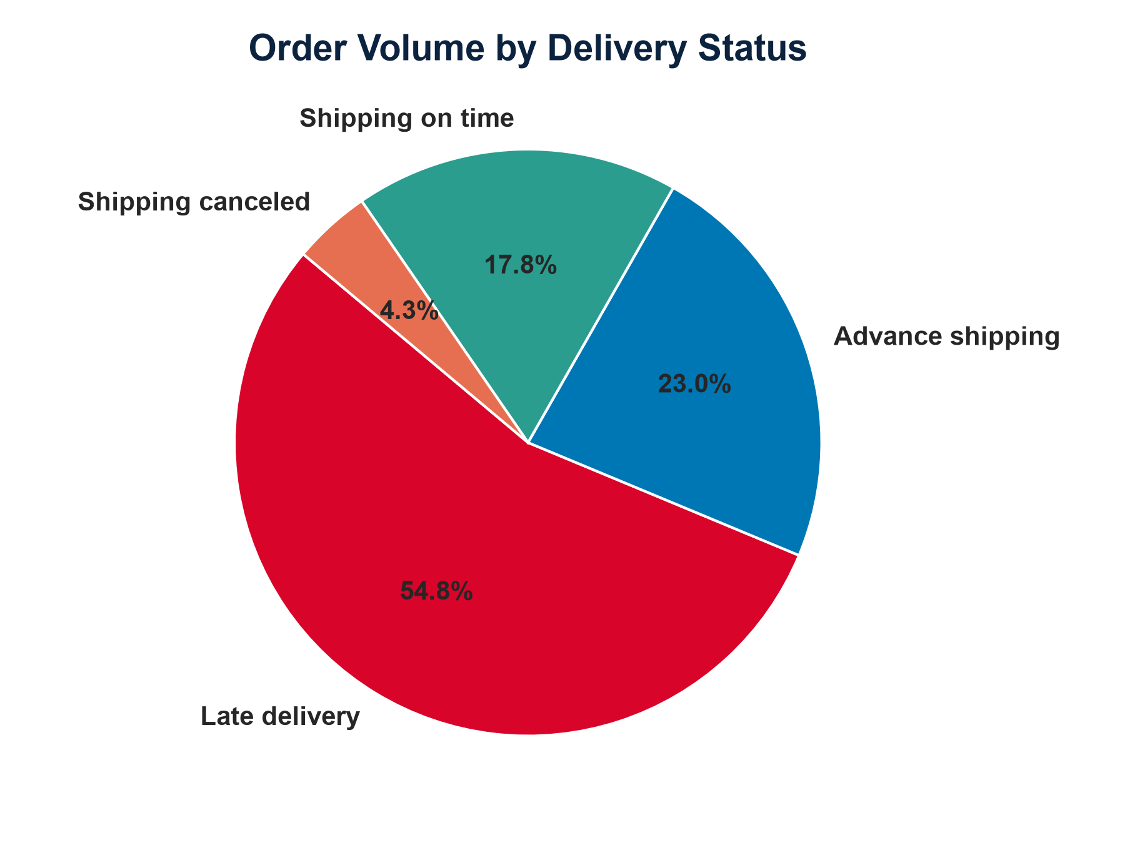
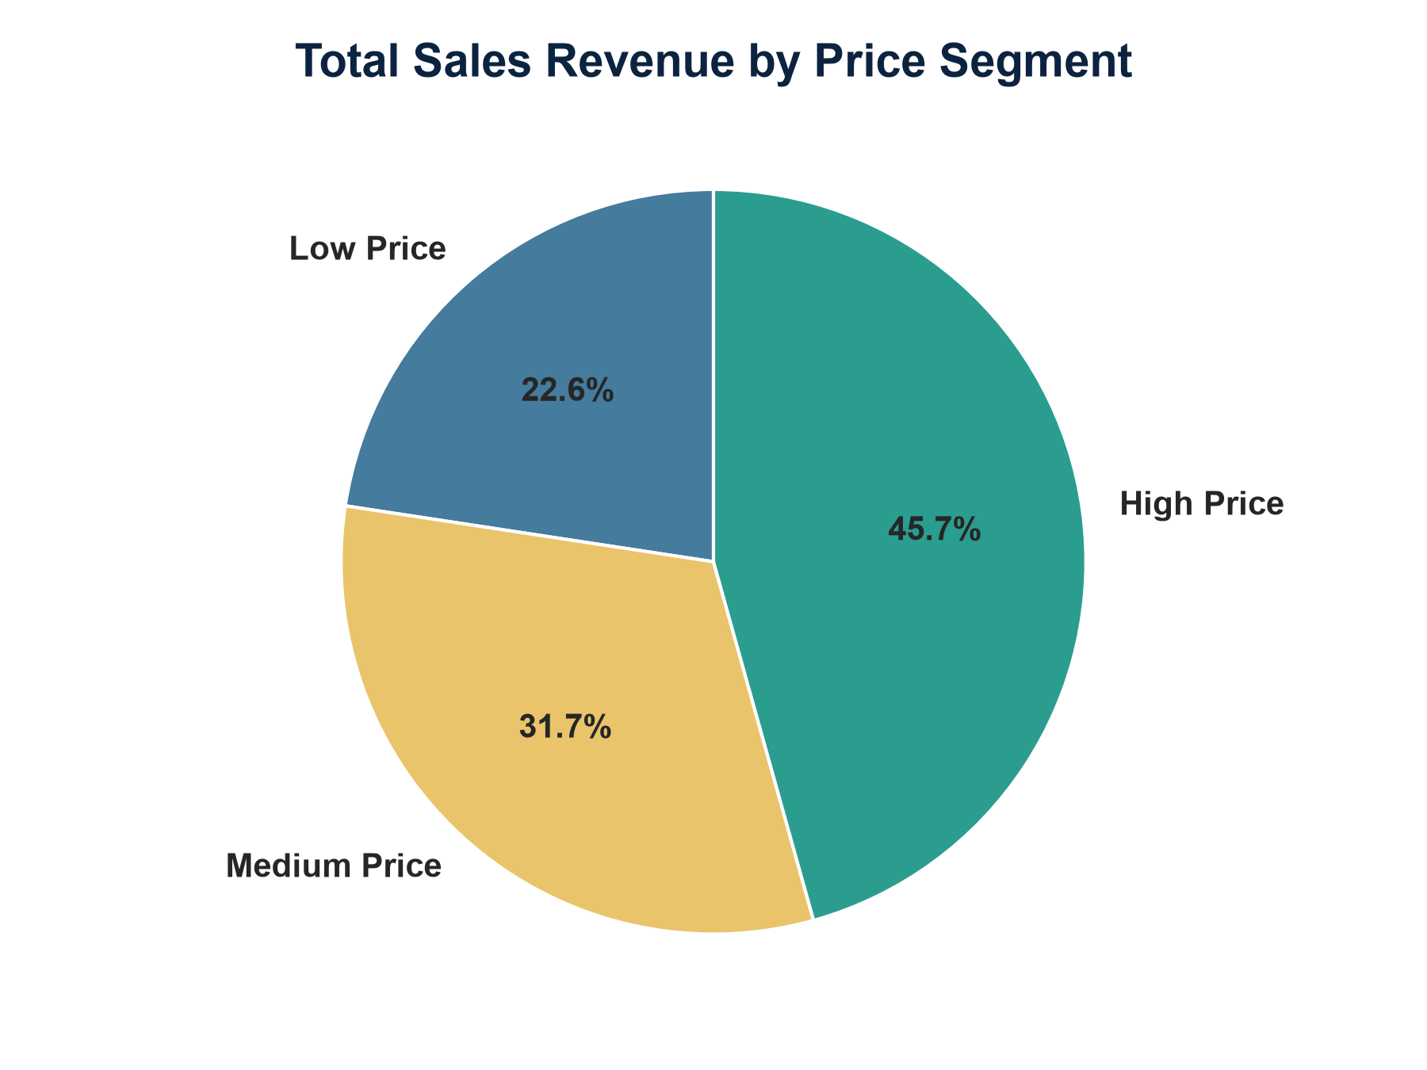
Power BI Visual Dashboard: Page 2 (Delivery Performance)
Embedded Fulfillment Status & Price Segment Visualizations
Operational Insights
• Delivery Status Breakdown: Highlights high proportion of Late Deliveries requiring proactive early-warning routing.
• Revenue Exposure: High price segment shipments represent elevated financial risk under SLA delay penalties.

Slide 5
Machine Learning Framework & Optuna Optimization
Multi-Model Evaluation & Automated Hyperparameter Optimization
Model Selection & Pipeline
• Evaluated Classifiers: Logistic Regression, Random Forest, XGBoost, and Gradient Boosting.
• Cross-Validation: 5-Fold Stratified CV preserving target class distributions.
• Target Encoding: Transformed 15 high-cardinality categorical features (Cities, States, Markets, Shipping Modes).
Optuna Hyperparameter Tuning
• Optimization Engine: Tree-structured Parzen Estimator (TPE) algorithm.
• Best Model Selected: Gradient Boosting Classifier (138 Estimators, Max Depth 10, Learning Rate 0.0153).
• Performance: Achieved state-of-the-art ROC-AUC classification capability.

Slide 6
Critical Finding: Target Leakage & Real Pre-Shipment Drivers
Distinguishing Post-Facto Status Indicators from Early Warning Signals
The Data Leakage Finding
• Feature Importance Audit: Delivery Status accounts for 86.40% of baseline model predictive weight.
• Operational Conflict: Delivery Status is populated dynamically during transit (post-facto indicator).
• Key Correction: Excluding Delivery Status ensures the model operates strictly on pre-shipment data.
True Pre-Shipment Risk Drivers
• Scheduled Shipment Days (5.89%): Tight delivery windows directly increase delay probability.
• Shipping Mode (5.77%): Standard vs Express shipping mode constraints.
• Destination City & Geography (1.09%): Destination congestion and regional transit complexities.
• Payment & Financial Metrics: Payment method, order price, and customer demographics.

Slide 7
Operational Deployment Architecture
Bridging Data Science Models to Daily Supply Chain Workflows
Tier 1: Streamlit Real-Time Predictor App
• Interactive Web Interface: Tabbed UI (Shipment, Financials, Customer Demographics, Destination).
• Real-Time Risk Scoring: Planners input order parameters and receive instant late probability %.
• Operational Alerts: Color-coded High Risk vs Low Risk indicators for immediate decision support.
Tier 2: Power BI Executive Dashboard
• Strategic Analytics: 3-page interactive visual report connected to supply chain data model.
• Regional Trend Tracking: Monitoring revenue exposure and shipping delays across global markets.
• Executive Reporting: Dynamic filtering by department, category, and fulfillment status.

Slide 8
Summary & Strategic Recommendations
Action Plan for APL Logistics Operational Excellence
Key Takeaways & Action Items
• Proactive Early Warning: Deploy the leak-free Gradient Boosting model within daily dispatch workflows.
• Surge Capacity Planning: Prioritize express carrier allocations for High Risk predictions in long-haul destination cities.
• Integration Roadmap: Connect Streamlit prediction endpoints directly to enterprise ERP / WMS systems.
• Future Enhancements: Integrate real-time IoT GPS tracking, weather forecasts, and port congestion feeds.

