Slide 1


SMART DOOR LOCK
z

Slide 2
z
BABU BANARASI DAS NORTHERN INDIA INSTITUTE OF TECHNOLOGY
PROJECT :-
SMART DOOR LOCK
GUIDED BY :-
MR. RAGHVENDRA PRATAP SINGH
PRESENTED BY :-
ASHU RAI - 1900560200004
DEEPAK VERMA - 1900560200005
SOURABH - 1900560200011

Slide 3
CONTENT
z
ABSTRACT
INTRODUCTION
LITRATURE REVIEW
WORKING PRINCIPLE
CIRCUIT DIAGRAM
COMPONENT LISTS AND DETAILS
MECHANICAL DESIGNING
ADVANTAGES AND DISADVANATGES
FUTURE SCOPE
CONCLUSIONS

Slide 4
ABSTRACT
z
Nowadays, there is a drastic increase of corporate, startup companies and apartment houses, due to the smart city project, business and huge population in cities. The digital lock system plays a significant role, to provide the security and reduce the manpower in smart home and building automation scenario. The proposed system implements the digital lock system using Internet of Things (IoT), to provide the security for an authorized and a guest user. If the person is an authorized, and their details (password) are already stored in a local database or cloud storage. Whenever the person wants to enter/leave the home or office, they need to enter the pin in app, pin on the lock or the physical key, and the door will be open automatically. If the person may be a guest, they need to enter the guest option in the hardware device. It will send notification to the administrator, owner through the internet. The admin or owner can see their details through mobile application or E-Mail. Once, they will give the approval to the digital lock system, and it will be open/close the door automatically by pin.

Slide 5
INTRODUCTION
z
In our daily lives, safety is a major concern. Every person requires a sense of safety. Our security pattern includes an access control system for doors. Traditional locks are no longer as secure as they once were; anyone can gain access by breaking these locks. We need to create a system that will assist 24 hours a day, seven days a week. Only authorized individuals have access to restricted areas thanks to a password-based door lock system. Arduino is in charge of the entire system. A keypad can be used to enter the password. The door opens if the password matches the password entered in Arduino. This password-based bolt structure will provide clients with a more secure and low-effort locking-opening mechanism. Mechanical door locks will be replaced by electronic door locks in the future, thanks to the security door lock automation system.
Objective :-
The goal of this project is to research and analyze a suitable collection of components for developing a smart door lock using Arduino that provides excellent security and quick access. The following are the specific project goals:
Familiarity with a smart door locking system based on a microcontroller.
Using Arduino to create a simple and smart door locking system
Increase the security level to prevent an unauthorized unlocking of the door.
Give the flexibility to the user to change or reset the password in case the user forgets that combination.
Lock the door by using password.
To give user more secure yet cost-efficient way of door locking system.

Slide 6
LITRATURE REVIEW
z
Among the existing smart door lock systems, designed using different technologies, a few selected systems are discussed below, along with their features. As soon as a person is detected, the door would open, and they would be welcomed.
Smart Door Lock System based card recognition system is a proactive approach that can take immediate action upon a security threat. The system recognizes the person nearby the door and compares it pin with the uploaded to the database. A message with will be sent to the owner in the event that an unknown person enters the building. This system uses Arduino, a RFID that is installed near the door to recognize an intruder's card, Direct Current (DC) motors connected through system to open the door, LCD to indicate whether the door is open, and a GSM module is used to send texts to the registered mobile number.
Microcontroller-based Password Enabled Door Lock System is an electronic security system that can detect an intruder and report it to the security personnel. The construction of an electronic digital lock using a microcontroller based on security information using a four digit pass key. This operation involves opening the door, closing the door, changing the password, and alerting when entering the wrong password. The research objectives are achieved by using a micro-controller that interfaces the ATMEGA328P microprocessor with all the other components in the circuit. In the end, the circuit has activated directly and triggers the alarm(buzzer0). The password protected lock system is designed previously using a microcontroller known as an 8051, accompanied by a 4*3 keypad for entering the password. A comparison is made between the entered password and the predefined password. If the password is correct, the door will be unlocked by rotating the door motor and the status of the door will be displayed on Liquid Crystal Display (LCD). On the other hand, when the password is incorrect, the door remains locked and a message appears on the LCD that reads "Password incorrect". The information will be stored in the database. However, when the correct password is received, the DC motor performs the action of unlocking the door as per the instructions of the controller. The door lock system is secured with the user's password. A door lock can only be opened if the correct password is entered. However, the option to change the password appears to be more secure since only authorized persons have access to it.
Knock-pattern using Arduino and GSM Communication This technique uses a 'Secret Knocking Pattern,' which is only known by the owner of the safe, luggage, or other object or item on which the device is installed. It is necessary to apply the knocking pattern only at a specific spot known only by the owner in order to open the lock. Changing the secret pattern is only possible after unlocking

Slide 7
WOKING PRINCIPLE
Process of Work :-
The purpose of this experiment is to implement a door-locking mechanism that opens or closes the lock on the door automatically with a key code. There are two work processes for this experiment which are :-
Case 1:- The lock will open: A Keypad will input values allowing us to compare the values with the string of integer values that are set in the code. When inputting a code comprising of integer values with the help of the Keypad, if the string of integer values matches the string of integer values already fixed in the code, the keypad will send a signal to the display and the “Code Accepted” message will be shown. If the code is accepted, the Arduino will send a signal to Servo Motor. The Motor will then rotate 90° and open the lock, allowing the door to be unlocked.
Case 2:- The lock will not open: If the code inserted in the Keypad does not match the fixed string in the code, the Keypad will send a signal to the Display to show the “Wrong Code” message. Pressing the wrong values in the Keypad will automatically instruct the user to start again from the beginning. If the “Wrong Code” message is shown, the Servo Motor will not rotate and the lock will not open allowing the door to remain locked.

Slide 8
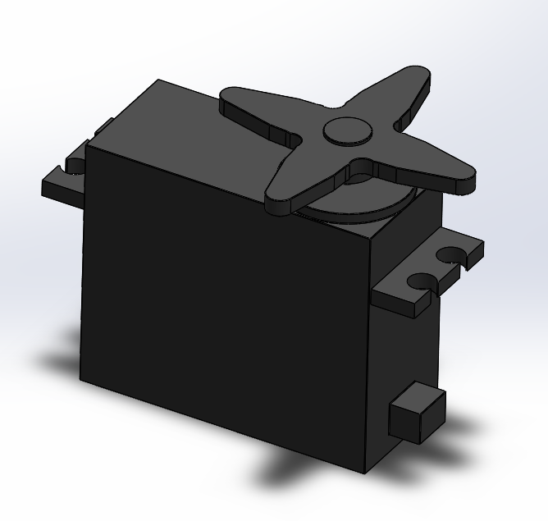
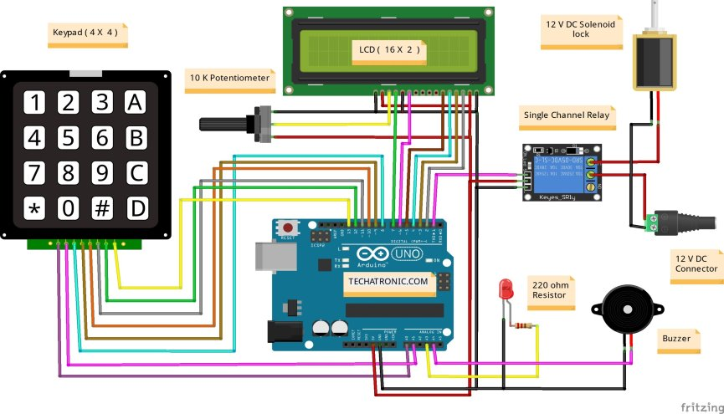
CIRCUIT DIAGRAM
z

Slide 9
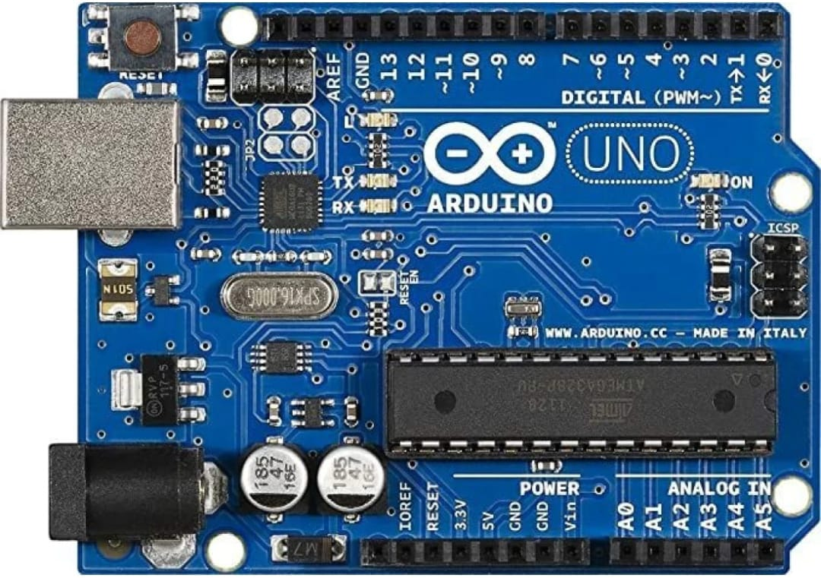
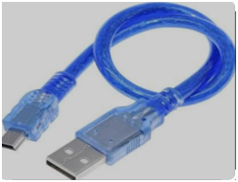
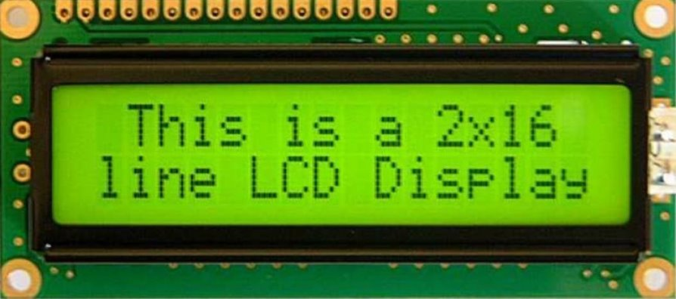
COMPONENT LISTS AND DETAILS
z
Arduino Uno (R3) :-
The Arduino Nano has a number of facilities for communicating with a computer, another Arduino or other microcontrollers. The ATmega328 provide UART TTL (8V-20V) serial communication, which is available on digital pins 0 (RX) and 1 (TX).
Arduino nano cable :-
The Arduino Nano is a small, complete, and breadboard-friendly board based on the ATmega328 (Arduino Nano 3. x). It has more or less the same functionality of the Arduino Du emilanove, but in a different package. It lacks only a DC power jack, and works with a Mini-B USB cable instead of a standard one.
LCD :-
LCD (Liquid Crystal Display) is a type of flat panel display which uses liquid crystals in its primary form of operation. LCDs are available to display arbitrary images (as in a general-purpose computer display) or fixed images with low information content, which can be displayed or hidden. For instance: preset words, digits, and seven-segment displays, as in a digital clock, are all good examples of devices with these displays.

Slide 10
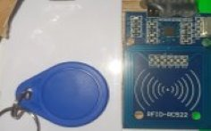
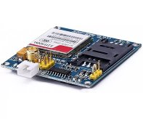

Radio Frequency Identification (RFID) :-
Radio Frequency Identification (RFID) is a technology that uses radio waves to passively identify a tagged object. It is used in several commercial and industrial applications, from tracking items along a supply chain to keeping track of items checked out of a library.
GSM (Global System for Mobile Communications) :-
It is a set of mobile communications standards and protocols governing second-generation or 2G networks, first developed and deployed in Europe. GSM is a digital cellular communication standard that is universally accepted.
Zero PCB :-
Zero PCB is basically a general-purpose printed circuit board (PCB), also known as perf board or DOT PCB. It is a thin rigid copper sheet with holes pre-drilled at standard intervals across a grid with 2.54mm (0.1-inch) spacing between holes.
z

Slide 11
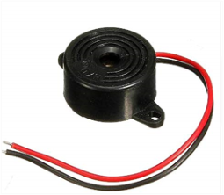
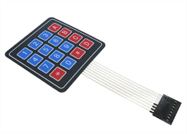
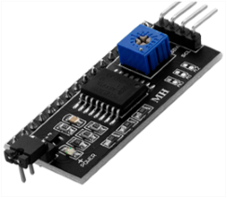
Buzzer :-
Also known as a sounder, audio alarm or audio indicator, a buzzer is a basic audio device that generates a sound from an incoming electrical signal.
4x4 Matrix 16 key membrane switch keypad 8-pin Keyboard :-
The 4x4 matrix keypad is a simple mechanism that resembles the numeric input on your computer keyboard, except that it has an additional '*,' '#' and 4 other auxiliary buttons that can be used for various functions in the application.
I2C Led Interface Device :-
The Inter-Integrated Circuit (I²C) Protocol is a protocol intended to allow multiple "peripheral" digital integrated circuits ("chips") to communicate with one or more "controller" chips. Like the Serial Peripheral Interface (SPI), it is only intended for short distance communications within a single device.
z

Slide 12
Soldering Wire :-
Solder wires are wires with a low melting point which can melt along with the soldering iron. Depending on the application and soldering temperature, many different types of soldering wires are available. Solder wires are generally two different types - lead alloy solder wire and lead-free solder.
Hookup wire :-
Hook up wires, also known as lead wires, are single core insulated cables used in the internal wiring of electronic and electrical equipment. Specific applications include motors transformer, switchboard, panels, rectifier and electronic circuits.
Servo-motor :-
A DC motor is defined as a class of electrical motors that convert direct current electrical energy into mechanical energy.
Charger(12V) :-
To convert A.C supply into D.C and give power supply to the system.
Small Wooden Plank :-
Where the whole system is installed and run.
Jumper Wire :-​
Jumper wires are electrical wires with connector pins at each end. They are used to connect two points in a circuit without soldering. You can use jumper wires to modify a circuit or diagnose problems in a circuit.​
z

Slide 13
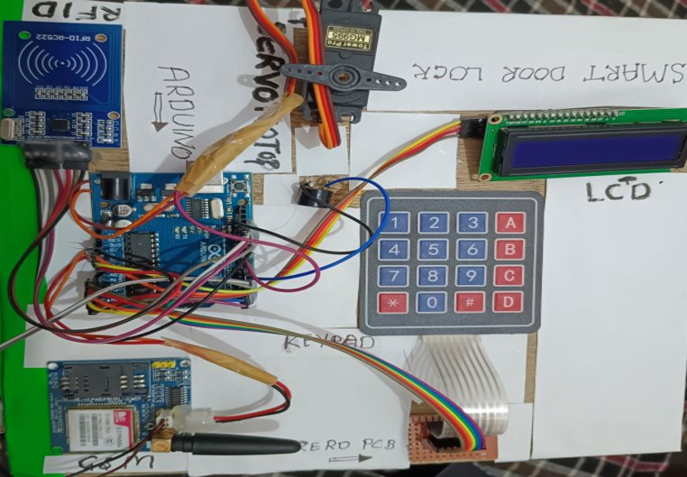
MECHANICAL DESIGNING
z

Slide 14
ADVANTAGES AND DISADVANTAGES
z
Advantages :-
You can track who comes and goes.
No more getting locked out.
Convenience to operate.
No more hiding a spare key outside.
You still need to track a keycard or remote instead of a key.
Able to link locking system to each other.
Disadvantages :-
Power failure of the system (discontinuity in power supply to the system).
Hacking and Jamming of the lock system.

Slide 15
FUTURE SCOPE
z
The above proposed system can have a large number of applications due to its practicality and its security aspect. Some of them are:
1. Can be used for doors at Home and Offices
2. Can be used for Industrial doors
3. Can be used for high security Bank vault doors
4. And practically any place where remote controlling is required
5.In the future smart locks are expected to improve their security features by incorporating advanced technology such as biometrics multifactor authentication and encryption.
6. Able to link other Microcontroller devices to each other.
7.Reducing the percentage of theft.

Slide 16
CONCLUSION
z
Thus “Smart Door Locking System using Arduino” is a modern successor of the conventional door locking system. The conclusion of the discussion of smart Lock using Arduino is the innovation created from the lock system with no more direct contact between the user and the lock. This system is very cost-effective and easy to install. In conclusion, it was discovered that the project performed according to specification and can be implemented. The use of the Arduino UNO microcontroller in this project allows for design simplicity, hence, the project can be achieved in lesser time compared to other techniques previously employed. This work proposes a secure locking/unlocking system based on a keypad and Arduino. Adding password to the Arduino side increase the system security. The system also has a feature for locking itself after some delayed time. This system could be used to prevent houses, companies, institutions from stealing or losing the ordinary key.

