Slide 1



Applied Internet of Things(CSE 2198)
Project Presentation on
Intelligent Home Automation System Using
Hand Gesture Recognition and Raspberry Pi for Seamless Control.
Supervisor Biswaranjan Swain Bhanja Kishor Swain
Presented by
Ashutosh Baliarsingh
Department of Computer Science and Engineering (IOT)
Institute of Technical Education & Research (FET)
Siksha ‘O’ Anusandhan Deemed to be University, Bhubaneswar
May, 2025

Slide 2
Contents
Introduction
Literature Survey
Design Scheme
Testing, Analysis, And Evaluation
Socio-economic Issues Associated With The Project
Engineering Tools And Standards
Conclusion

Slide 3

Introduction
Without home automation, users must physically interact with every switch and appliance. This becomes inconvenient, especially in large homes..
Physically challenged or elderly people may find it difficult to operate household devices. basic actions like turning on lights or operating a fan can become daily challenges, reducing independence and safety.
Smart homes (Home automation) used to be something only rich people had. But now, it’s become very important, especially for making life easier and safer— like turning lights on automatically

Slide 4
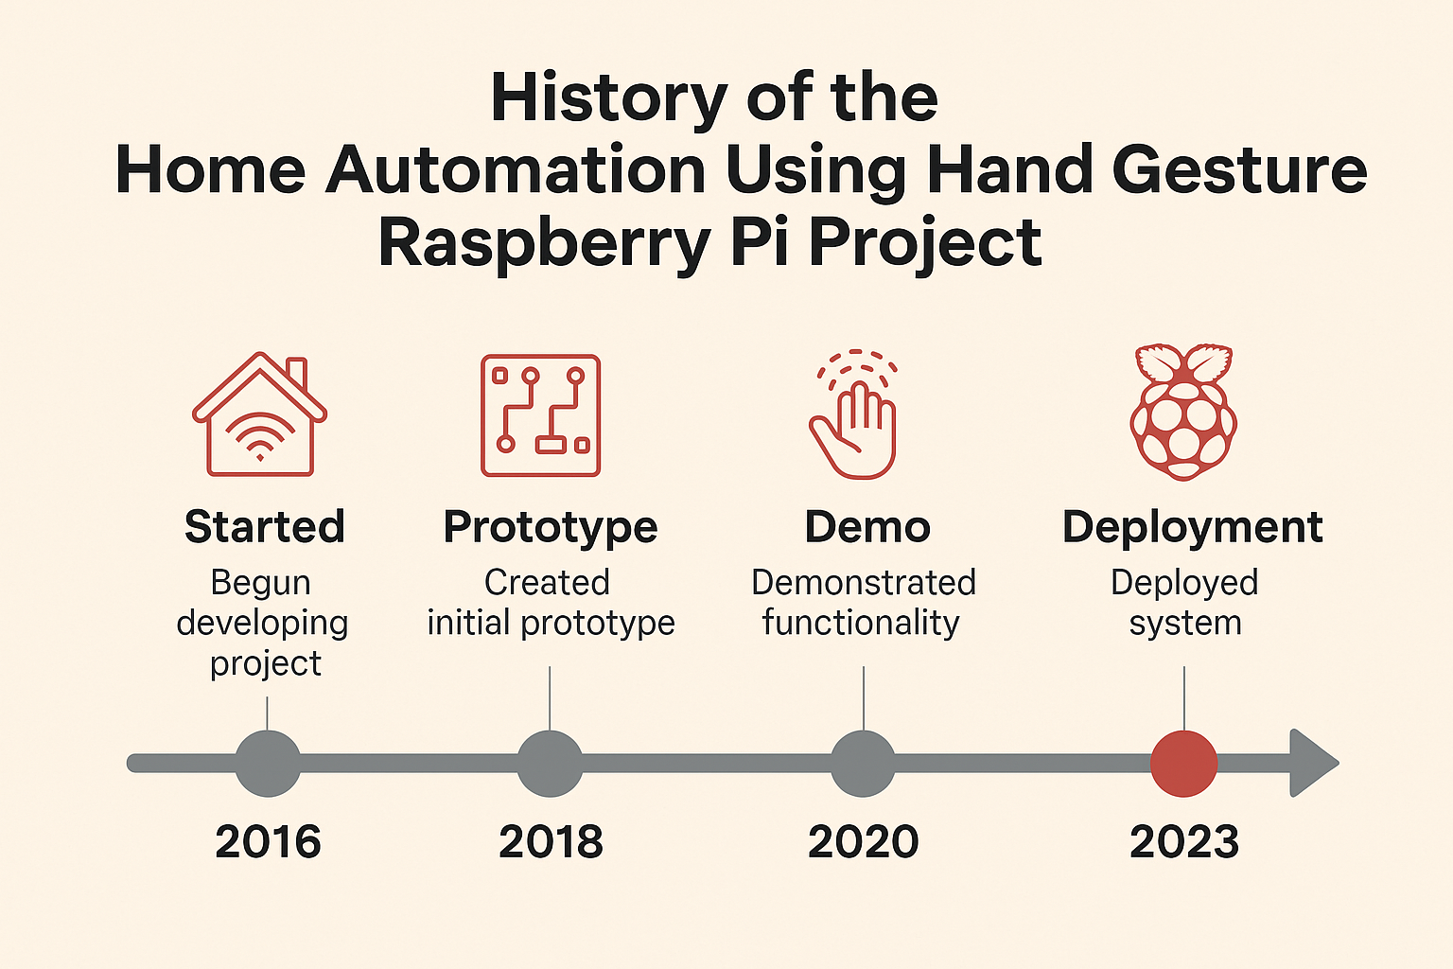
Literature Survey
Developers used Raspberry Pi with simple sensors to implement basic finger gesture recognition.
OpenCV and Python enabled more accurate and complex gesture detection using Raspberry Pi.
Finger gesture control gained popularity as a hygienic, touch-free solution for smart homes.
Modern Raspberry Pi models support machine learning for precise, real-time finger gesture automation.

Slide 5
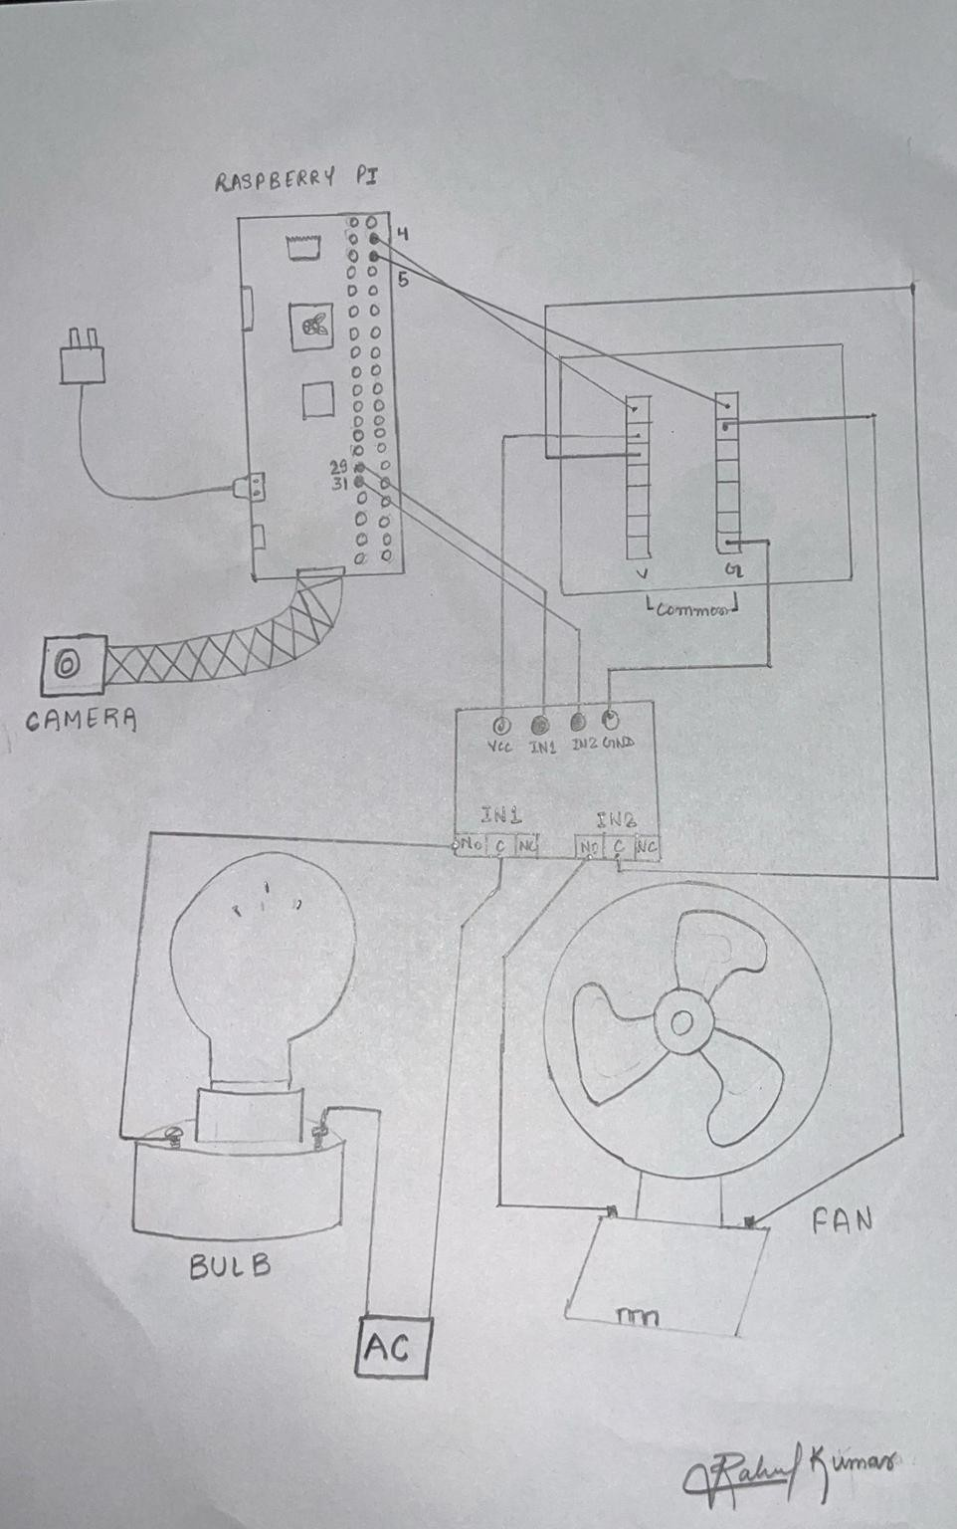
Design Scheme

Slide 6
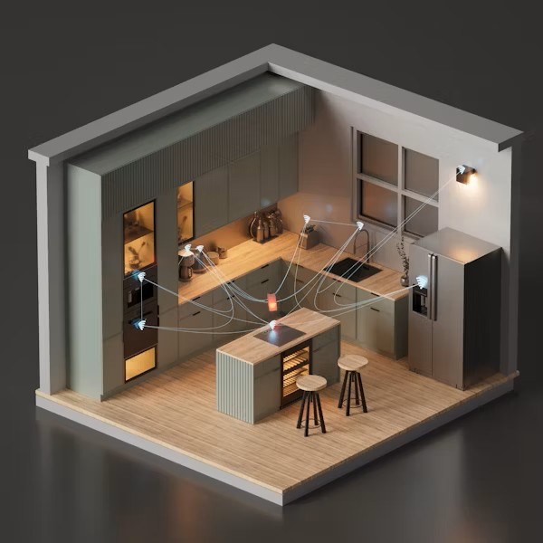
Testing (Veroboard Implementation)
Visual Inspection
Checked for loose connections, shorts, and correct orientation of components.
Functional Testing
Applied test inputs and observed outputs using multimeter, LED indicators
Power Supply Verification
Measured voltage across power rails using multimeter
Used current-limited power source to prevent damage during initial testing
Debugging and Corrections
Checked voltages at key nodes
Compared actual behavior with expected outputs
Documentation
Updated circuit design based on Recorded test feedback

Slide 7
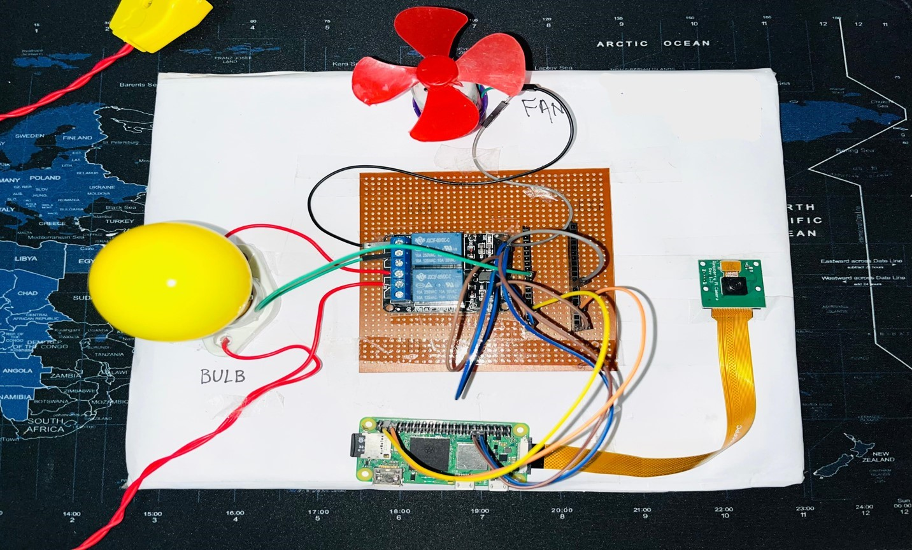
Testing (Veroboard Implementation)

Slide 8
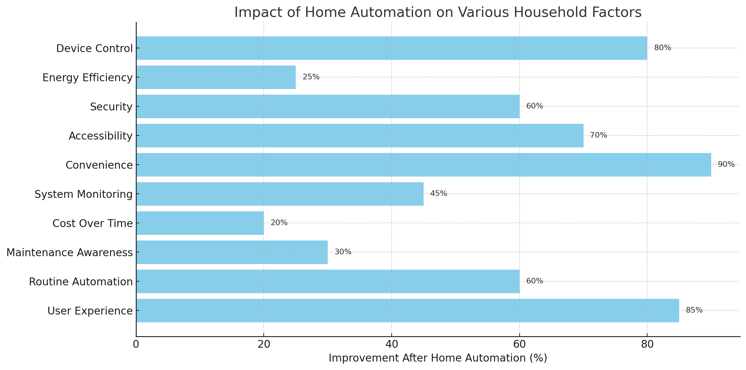

Results, Analysis and Evaluation
Result:-
The developed system successfully recognized predefined hand gestures.
The system achieved real-time performance with a response time of less than 1 second.
It used the Raspberry Pi Zero 2 W as the core processing unit.
The results demonstrated the system’s efficiency and practical viability.
Analysis→

Slide 9
Results, Analysis and Evaluation
Evaluation:-
Enabled hands-free, contactless control.
Delivered reliable performance in real-world conditions.
Maintained low power and cost, ideal for scalable deployment.
Pros | Cons
Touchless control – hygienic and intuitive. | May not work well in poor lighting or cluttered environments
Increases accessibility for elderly and disabled users. | Requires calibration and training for accurate gesture recognition.
Cost-effective with low-power devices like Raspberry Pi Zero 2W. | Privacy concerns if vision-based (camera always on).
Can be integrated with smart home systems and IoT devices. | Gesture fatigue – repetitive motions may cause discomfort.

Slide 10
Socio-economic Issues Associated With The Project
Affordability: While low-cost platforms like Raspberry Pi make gesture-based automation more accessible, the initial setup cost (including sensors, cameras, and installation) can still be a barrier for low-income households.
Employment Displacement: Increased automation may reduce the need for domestic help, impacting jobs, especially in economies where household labor is a common livelihood.
Digital Divide: The technology may be challenging to adopt in rural or underdeveloped regions due to a lack of digital literacy, poor internet connectivity, or limited access to smart devices.
Maintenance Costs: Ongoing maintenance or technical support for sensors and software can incur additional costs, which may not be feasible for economically weaker sections.

Slide 11
Engineering Tools and Standards
Development Tools:-
Raspberry Pi OS / Raspbian OS platform to program and run services on the Raspberry Pi Zero 2W.
Python/Thonny:-
Main language for:
Gesture recognition (OpenCV)
GPIO control
MQTT communication
OpenCV:-
For hand gesture detection using computer vision.
Engineering standards:-
IEEE 802.11 (Wi-Fi) and IEEE 802.1X: Wireless communication standard for network connectivity and secure communication
IEC 60364: Electrical installations and safety standards for buildings.
UL 61010: Safety standards for electrical equipment.

Slide 12
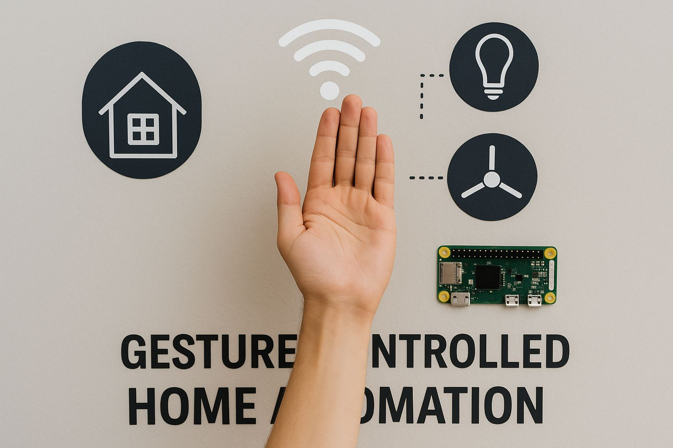
Conclusion
This project is not just about controlling devices it’s about making life easier for everyone.It shows how technology can be simple, smart, and helpful at the same time.By using hand gestures, we’ve made a system that is easy to use, and doesn’t need any special device to wear.Even with a small device like the Raspberry Pi Zero 2 W, we made a system that brings comfort, safety, and a bit of fun into everyday life. It feels natural and easy — just like magic!This is not just a project — it’s a step toward a smarter and more caring future.

Slide 13
References
1.)Documentation & Research Papers:
OpenCV official documentation: https://docs.opencv.org/
2.)Blogs & Articles:
Raspberry Pi home automation camera setup: https//:www.raspberrypi.org/blog/

Slide 14


