Slide 1
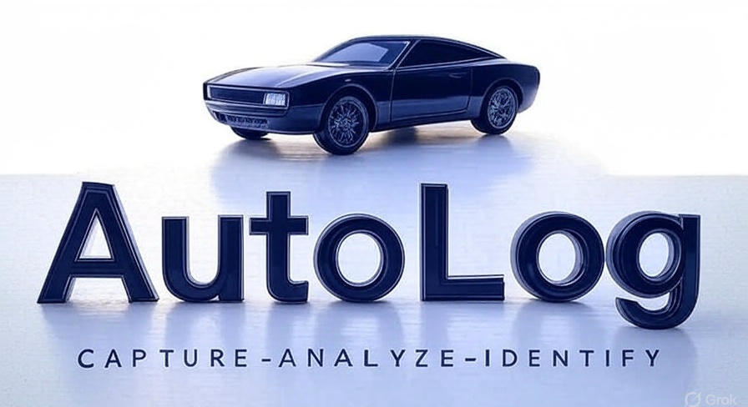

Slide 2

Project Team
Sujal Jamsandekar
Front End Developer
Ashutosh Jarag
LLM Model Engineer
Aditya Khadke
Database Engineer
Aniket Mali
Back End Developer

Slide 3



AutoLog: Vehicle Identification and Logging

Slide 4
TABLE OF CONTENTS
01
02
01
INTRODUCTION
PROBLEM STATEMENT
03
SCOPE AND LIMITATIONS
04
OBJECTIVE
05
PROJECT WORKFLOW
SYSTEM ARCHITECTURE
06
07
TECHNOLOGIES USED
USE CASES
08
09
FUTURE SCOPE
CONCLUSION
10

Slide 5


INTRODUCTION
AutoLog is a smart, automated vehicle logging system designed for parking areas and entry gates. It leverages camera-based detection and AI to capture vehicle identity, type, and time logs, eliminating the need for manual tracking. With real-time data stored in the cloud and presented via a web dashboard, AutoLog enhances speed, accuracy, and transparency in vehicle monitoring.

Slide 6

PROBLEM STATEMENT
Traditional vehicle logging is often manual, time-consuming, and error-prone. Security personal must physically record license plates and entry/exit times, leading to delays and inaccuracies. Lack of real-time monitoring and inefficient fare calculation further impacts operations. There's a pressing need for an intelligent, automated solution.

Slide 7


OBJECTIVE
Eliminate manual entry to reduce errors and save time.
Automatically log vehicle data using advanced AI-based image processing and OCR techniques.
Provide real-time access to logs through an admin dashboard.
Enable automated fare calculations based on parking duration.
Enhance parking management for residential, commercial, and smart city ecosystems.
To present all data via a user-friendly web dashboard.

Slide 8

SCOPE AND LIMITATIONS
🔍 Scope
Suitable for malls, corporate offices, apartments, and smart city parking
Works with various vehicle types (bike, car, etc.)
Real-time dashboard and data insights for admin
⚠️ Limitations
Performance may vary with poor lighting or blurred plates
Internet connection required for cloud operations
Currently supports single-camera input (can be expanded)

Slide 9


PROJECT WORKFLOW
Vehicle Detection
Entry gate camera continuously monitors for approaching vehicles and triggers image capture when motion is detected.
Image Capture & Preprocessing
The system captures a clear frame and enhances it (cropping, denoising, contrast adjustment) for better number plate visibility.
Number Plate Recognition (LLM-based)
The system uses an LLM to process. The captured image of the number plate, accurately extracting the vehicle number, even in challenging conditions
Data Logging in Database
The extracted number, timestamp, and vehicle image are automatically stored in a secure database for tracking and audit.
Admin Dashboard Access
Admin/staff can log in to view live logs, search past entries, and generate reports through a user-friendly dashboard.

Slide 10
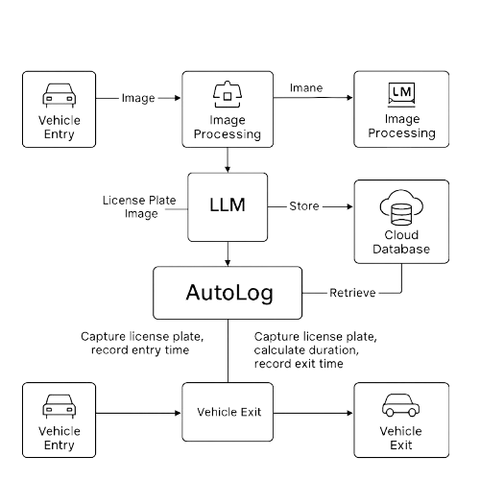
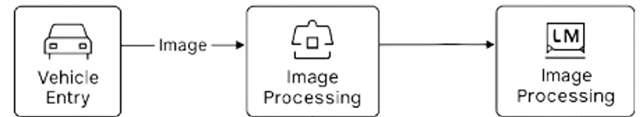
SYSTEM ARCHITECTURE

Slide 11
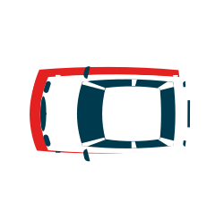
TECHNOLGY USED
🔍 For Image Processing & OCR: LLM Model and Traditional Image Processing
💻 Frontend: React, HTML, CSS, Tailwind
🛠️ Backend: Python with FastAPI for API handling
🗄️Database: PostgreSQL (cloud-hosted)
☁️ Cloud Storage: For real-time and secure data access

Slide 12



Why LLM 🤖?
🧠 High Accuracy: LLMs handle distorted, angled, or low-light license plates better than traditional OCR.
🏎️ Speed & Real-Time Capability: Processes image data quickly for seamless entry/exit logging.
🧩 Multi-Tasking: Recognizes both vehicle number and vehicle type in one shot.
🌐 Context-Aware Understanding: Adapts to various license formats and environments intelligently.
🚀 Future-Ready: Scalable for more complex tasks like driver ID detection, behavior prediction, etc.

Slide 13


Why FastAPI⚡ ?
🚀 High Performance: One of the fastest Python frameworks, ideal for real-time systems
🧩 Easy Integration: Smoothly connects backend logic with frontend dashboards
📦 Built-in Data Validation: Ensures clean and reliable API communication
⚙️ Asynchronous Support: Handles multiple requests efficiently (great for camera-triggered events)
🧪 Interactive Docs (Swagger UI): Auto-generated API testing interface for quick debugging

Slide 14


Why PostgreSQL🐘?
🗄️ Reliable & Robust: Handles structured vehicle data (number, type, timestamps) efficiently
🔒 Secure: Advanced authentication and data protection features
⚡ High Performance: Optimized for complex queries and large datasets
🔄 ACID Compliant: Ensures accurate logging without data loss
☁️ Cloud-Friendly: Easily deployable on cloud platforms for remote access

Slide 15

Use Cases
🚗 Malls & Shopping Complexes
Automatically detects vehicle entry and exit
Logs license plate, vehicle type, and time
Real-time fare calculation and digital ticketing
🏢 Corporate Office Premises
Ensures secure vehicle tracking for employees and visitors
Dashboards for security/admin to monitor logs
Prevents unauthorized vehicle access
🏘️ Residential Societies
Efficient entry for residents and visitors
Maintains logs for security reference
🌆 Smart City Parking Solutions
Scalable solution for public parking areas
Cloud-based centralized vehicle data management

Slide 16
FUTURE SCOPE
Multiple Camera Support :
Deploy across multiple gates with centralized monitoring and unified database access.
AI Improvement :
Enhance ML model accuracy using larger, more diverse datasets to handle poor lighting and angle variations.
Integration with RFID or Smart ID Systems :
Allow seamless verification by linking vehicle data with employee or student ID cards.
Integration with Parking Management :
Track available parking spots and assign slots automatically based on entry.

Slide 17
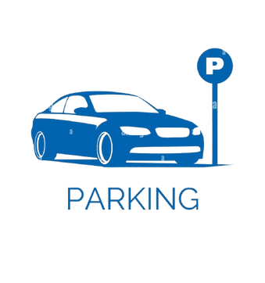
CONCLUSION
AutoLog bridges the gap between traditional manual systems and modern smart parking solutions. By leveraging AI and cloud integration, it provides a reliable, scalable, and accurate system that enhances operational efficiency and user experience. It lays the foundation for future smart city traffic and parking automation.

Slide 18

THANK YOU...

