Slide 1
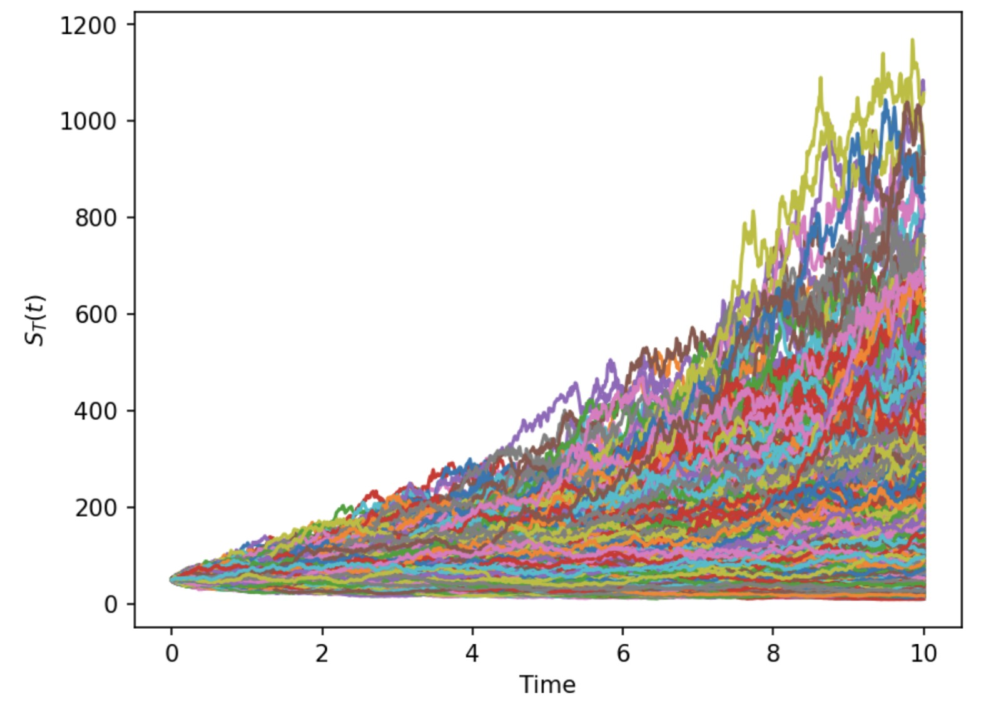
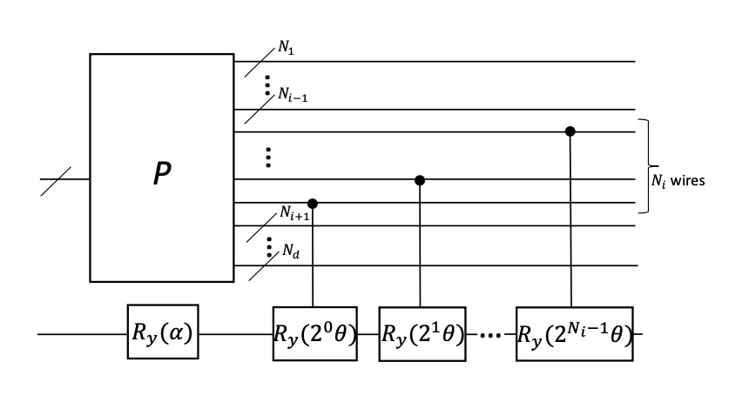
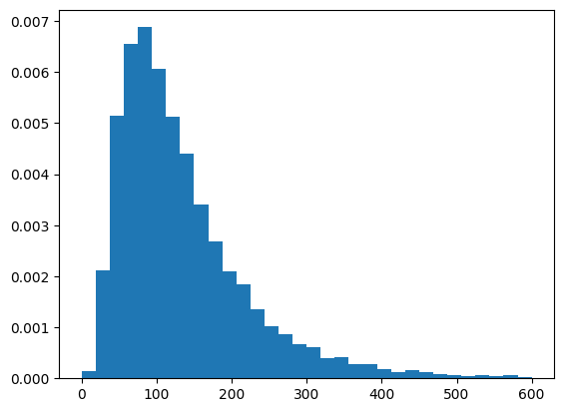

-Quantum Encoding
-Amp. Estimation (get Expectation)
Stochastic Process
5-Qubit represantation
Want to estimate

Slide 2

Quantum Pitch
Team Lindblad

Slide 3
The Primer
Quantum = Explorations by Water | Classical = Explorations by Land
Quantum = Vertical Progress (0 -> 1) | Classical = Horizontal Progress (think mass-scaling)
The world works on Quantum Mechanics, advanced math is involved!

Slide 4
Some explorations
In Finance and QML
– Recession Prediction 7% (Moody’s), Handwritten Digit Generation 9.5% (Zapata)
In Search and Graph Theory (supply chain, scheduling)
– Studies on Graph QAOA (Google Quantum AI)
In Chemistry
– Most accurate H₂O VQE simulation (IBM), Gaussian Boson Sampling

Slide 5
Quantum Inspirations
Cost Implications
Upto €10 billion savings in financial services industry
Quantum-accelerated workflows forecasted to have at least quadratic improvement
Future Directions
Killer Apps in Quantum Monte Carlo
Early quantum adopters uniquely positioned for rapid growth upon tech maturement

Slide 6
The New Electricity!
Michael Faraday / Electricity
“One Day Sir, You May Tax It”
Team Lindblad / Quantum Computing
“One Day Sir, You May Make Billions out of It”

