Slide 1
3
Interdependence and the Gains from Trade

Slide 2
Consider your typical day:
You wake up to an alarm clock made in Korea.
You pour yourself orange juice made from Florida oranges and coffee from beans grown in Brazil.
You put on some clothes made of cotton grown in Georgia and sewn in factories in Thailand.
You watch the morning news broadcast from New York on your TV made in Japan.
You drive to class in a car made of parts manufactured in a half-dozen different countries.

Slide 3
. . . and you haven’t been up for more than two hours yet!

Slide 4
Interdependence and the Gains from Trade
Remember, economics is the study of how societies produce and distribute goods in an attempt to satisfy the wants and needs of its members.
Notes:
2

Slide 5

Interdependence and the Gains from Trade
How do we satisfy our wants and needs in a global economy?
We can be economically self-sufficient.
We can specialize and trade with others, leading to economic interdependence.
Notes:
3

Slide 6
Interdependence and the Gains from Trade
Individuals and nations rely on specialized production and exchange as a way to address problems caused by scarcity.
But this gives rise to two questions:
Why is interdependence the norm?
What determines production and trade?
Notes:
4

Slide 7
Interdependence and the Gains from Trade
Why is interdependence the norm?
Interdependence occurs because people are better off when they specialize and trade with others.
What determines the pattern of production and trade?
Patterns of production and trade are based upon differences in opportunity costs.

Slide 8

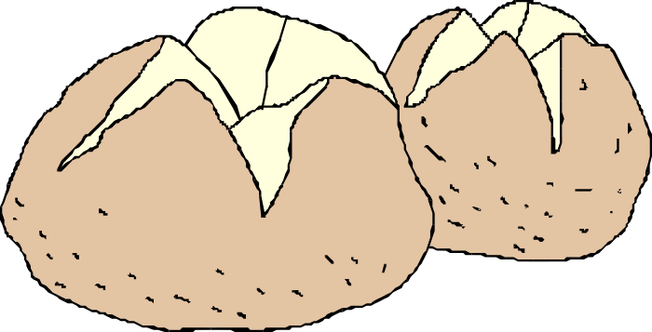
A PARABLE FOR THE MODERN ECONOMY
Imagine . . .
only two goods: potatoes and meat
only two people: a potato farmer and a cattle rancher
What should each produce?
Why should they trade?

Slide 9

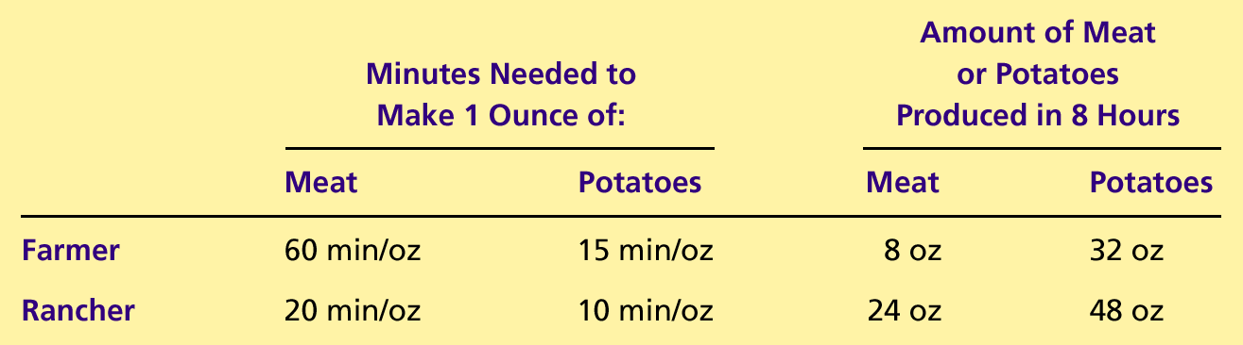
Table 1 The Production Opportunities of the Farmer and Rancher
Copyright © 2004 South-Western

Slide 10
Production Possibilities
Self-Sufficiency
By ignoring each other:
Each consumes what they each produce.
The production possibilities frontier is also the consumption possibilities frontier.
Without trade, economic gains are diminished.
Notes:
8

Slide 11

Figure 1 The Production Possibilities Curve
(a) The Farmer
’
s Production Possibilities Frontier
Meat (ounces)
If there is no trade,
the farmer chooses
8
this production and
consumption.
4
A
0
16
32
Potatoes (ounces)
Copyright©2003 Southwestern/Thomson Learning

Slide 12
Figure 1 The Production Possibilities Curve
(b) The Rancher
’
s Production Possibilities Frontier
Meat (ounces)
24
If there is no trade,
the rancher chooses
this production and
consumption.
12
B
0
24
48
Potatoes (ounces)
Copyright©2003 Southwestern/Thomson Learning

Slide 13
Specialization and Trade
The Farmer and the Rancher Specialize and Trade
Each would be better off if they specialized in producing the product they are more suited to produce, and then trade with each other.
The farmer should produce potatoes.
The rancher should produce meat.
Notes:
10

Slide 14
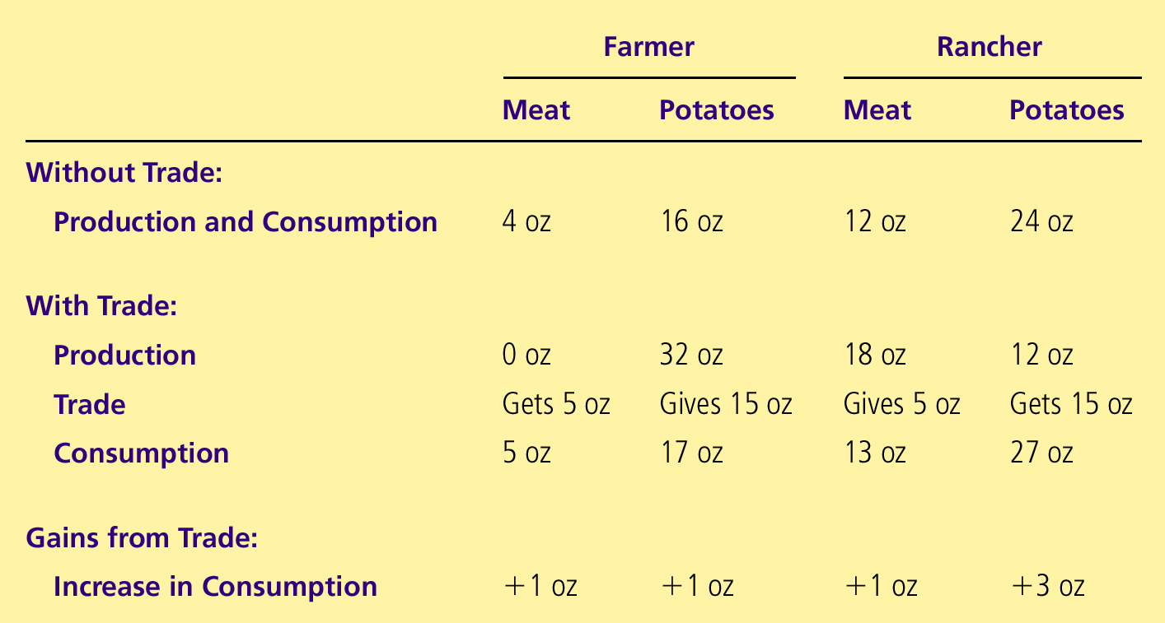
Table 2 The Gains from Trade: A Summary
Copyright © 2004 South-Western

Slide 15
Figure 2 How Trade Expands the Set of Consumption Opportunities
(a) The Farmer
’
s Production and Consumption
Meat (ounces)
Farmer's
consumption
8
with trade
Farmer's
production and
A*
consumption
5
without trade
4
A
Farmer's
production
with trade
0
32
Potatoes (ounces)
16
17
Copyright©2003 Southwestern/Thomson Learning

Slide 16
Figure 2 How Trade Expands the Set of Consumption Opportunities
(b) The Rancher
’
s Production and Consumption
Meat (ounces)
24
Rancher's
production
with trade
Rancher's
consumption
18
with trade
13
B*
Rancher's
B
production and
12
consumption
without trade
0
12
24
27
48
Potatoes (ounces)
Copyright © 2004 South-Western

Slide 17
Table 2 The Gains from Trade: A Summary
Copyright © 2004 South-Western

Slide 18
THE PRINCIPLE OF COMPARATIVE ADVANTAGE
Differences in the costs of production determine the following:
Who should produce what?
How much should be traded for each product?
Who can produce potatoes at a lower cost--the farmer or the rancher?
Notes:
11

Slide 19
THE PRINCIPLE OF COMPARATIVE ADVANTAGE
Differences in Costs of Production
Two ways to measure differences in costs of production:
The number of hours required to produce a unit of output (for example, one pound of potatoes).
The opportunity cost of sacrificing one good for another.

Slide 20
Absolute Advantage
The comparison among producers of a good according to their productivity—absolute advantage
Describes the productivity of one person, firm, or nation compared to that of another.
The producer that requires a smaller quantity of inputs to produce a good is said to have an absolute advantage in producing that good.
Notes:
13

Slide 21
Absolute Advantage
The Rancher needs only 10 minutes to produce an ounce of potatoes, whereas the Farmer needs 15 minutes.
The Rancher needs only 20 minutes to produce an ounce of meat, whereas the Farmer needs 60 minutes.
The Rancher has an absolute advantage in the production of both meat and potatoes.

Slide 22
Opportunity Cost and Comparative Advantage
Compares producers of a good according to their opportunity cost.
Whatever must be given up to obtain some item
The producer who has the smaller opportunity cost of producing a good is said to have a comparative advantage in producing that good.
Notes:
14

Slide 23
Comparative Advantage and Trade
Who has the absolute advantage?
The farmer or the rancher?
Who has the comparative advantage?
The farmer or the rancher?
Notes:
15

Slide 24
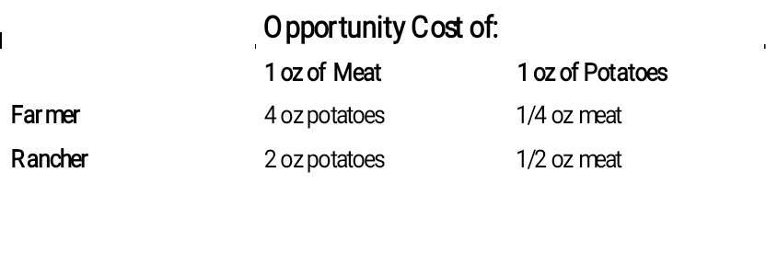
Table 3 The Opportunity Cost of Meat and Potatoes

Slide 25
Comparative Advantage and Trade
The Rancher’s opportunity cost of an ounce of potatoes is ¼ an ounce of meat, whereas the Farmer’s opportunity cost of an ounce of potatoes is ½ an ounce of meat.
The Rancher’s opportunity cost of a pound of meat is only 4 ounces of potatoes, while the Farmer’s opportunity cost of an ounce of meat is only 2 ounces of potatoes...

Slide 26
Comparative Advantage and Trade
…so, the Rancher has a comparative advantage in the production of meat but the Farmer has a comparative advantage in the production of potatoes.

Slide 27
Comparative Advantage and Trade
Comparative advantage and differences in opportunity costs are the basis for specialized production and trade.
Whenever potential trading parties have differences in opportunity costs, they can each benefit from trade.
Notes:
16

Slide 28
Comparative Advantage and Trade
Benefits of Trade
Trade can benefit everyone in a society because it allows people to specialize in activities in which they have a comparative advantage.
Notes:
17

Slide 29
FYI—The Legacy of Adam Smith and David Ricardo
Adam Smith
In his 1776 book An Inquiry into the Nature and Causes of the Wealth of Nations, Adam Smith performed a detailed analysis of trade and economic interdependence, which economists still adhere to today.
David Ricardo
In his 1816 book Principles of Political Economy and Taxation, David Ricardo developed the principle of comparative advantage as we know it today.

Slide 30

APPLICATIONS OF COMPARATIVE ADVANTAGE
Should Tiger Woods Mow His Own Lawn?
?
?
?

Slide 31
APPLICATIONS OF COMPARATIVE ADVANTAGE
Should the United States Trade with Other Countries?
Each country has many citizens with different interests. International trade can make some individuals worse off, even as it makes the country as a whole better off.
Imports—goods produced abroad and sold domestically
Exports—goods produced domestically and sold abroad

Slide 32
Summary
Each person consumes goods and services produced by many other people both in our country and around the world.
Interdependence and trade are desirable because they allow everyone to enjoy a greater quantity and variety of goods and services.

Slide 33
Summary
There are two ways to compare the ability of two people producing a good.
The person who can produce a good with a smaller quantity of inputs has an absolute advantage.
The person with a smaller opportunity cost has a comparative advantage.

Slide 34
Summary
The gains from trade are based on comparative advantage, not absolute advantage.
Trade makes everyone better off because it allows people to specialize in those activities in which they have a comparative advantage.
The principle of comparative advantage applies to countries as well as people.

