Slide 1

INFOSYS LIMITED · PMIS INTERNSHIP
Bhubaneswar Development Centre · Lab 4 & Lab 5
NeoBank 360
Unified Digital Banking Platform
By Ritik Shekhar Parida • Intern ID: 584355
8
11
49
23
5
Core Modules
DB Tables
REST APIs
Tests Passing
Sprints · 60 Days
Software Architecture & Demo · Confidential — Internal Use Only
Notes:
Welcome. We're the PMIS intern team from Infosys Bhubaneswar, Labs 4 and 5. Over sixty days and five sprints we built NeoBank 360 — a unified digital banking platform. At a glance: eight modules, eleven tables, forty-nine endpoints, twenty-three passing tests. We'll move from the problem, through architecture and modules, into the deeper technical design, and finish with a live demo.

Slide 2




02
THE PROBLEM
Banking Today Is Fragmented
Scattered Accounts
Balances and transactions live across disconnected apps with no single source of truth.
Manual Money Management
Budgeting and bill tracking happen in spreadsheets outside the bank — stale and error-prone.
Opaque Lending
Loan eligibility, EMIs and repayment schedules are slow, manual and rarely transparent.
No Unified Insight
Customers lack a consolidated, real-time view of their financial health across products.
Notes:
Banking today is fragmented. Balances sit in one app, budgeting happens in a spreadsheet, bills somewhere else, and lending is opaque. The net result is that no one has a single real-time view of their financial health. These four pain points each map directly to a module we built.

Slide 3





03
THE SOLUTION
One Platform, Every Financial Need
NeoBank 360 collapses banking silos into a single secure application — core banking, budgeting, bills, lending and analytics share one data model, one security posture, one experience.
Unified Core Banking
Built-in PFM
Transparent Lending
Accounts, transactions and atomic transfers in one ledger with a full audit trail.
Monthly budgets and bill scheduling driven by real transaction data.
Self-service loan applications with an automated EMI engine and clear schedules.
Dual Analytics
Secure by Design
Enterprise Performance
Operational dashboards for admins and rich wealth visualisations for customers.
Stateless JWT, BCrypt hashing and role-based access protect every request.
Composite indexes, caching and an AOP audit log keep it fast and observable.
Notes:
NeoBank 360 is our answer: one platform for every financial need. Because everything sits on one normalised schema, a transaction recorded once instantly powers budgets, insights and dashboards — no syncing, no duplication. Security and performance underpin all of it.

Slide 4






04
TECHNOLOGY STACK
Enterprise-Grade, Decoupled Full Stack
Angular 21
Spring Boot 4
MySQL 8
FRONTEND SPA
BACKEND · JAVA 21
PERSISTENCE
Routing, HttpClient interceptors and guards map onto JWT + RBAC.
Spring Security, Data JPA, AOP and caching as a modular monolith.
ACID ledger with exact DECIMAL money types and FK integrity.
JWT · HS256
Chart.js 4
Docker
AUTHENTICATION
VISUALISATION
DEPLOYMENT
Stateless signed tokens with a role claim enable horizontal scaling.
Lightweight doughnut, area and bar charts for both audiences.
Profile-driven, reproducible containers across dev, staging, prod.
Notes:
Our stack was chosen deliberately. Angular for its built-in routing and interceptors; Spring Boot on Java 21 for a mature, secure ecosystem; MySQL because a ledger demands ACID and exact decimals; JWT for stateless scaling; Chart.js for analytics; Docker for reproducibility. Every choice has a why behind it.

Slide 5
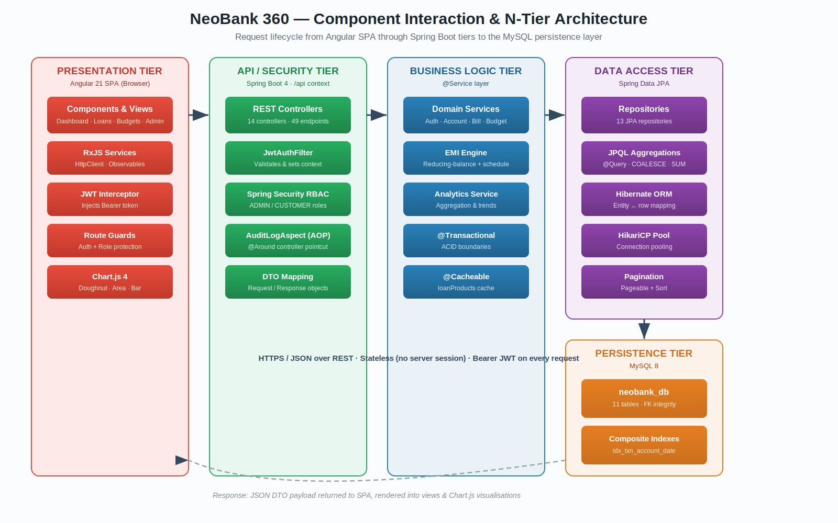
05
SYSTEM ARCHITECTURE
Layered N-Tier Request Lifecycle
Angular SPA → JWT-secured Spring Boot API → Business services → Spring Data JPA → MySQL · stateless JSON over REST
Notes:
This is our architecture in one picture — a layered N-Tier design. A user action passes through an RxJS service, the JWT interceptor attaches the token, the API authenticates and authorises, a service runs the logic in a transaction, JPA reaches MySQL, and a JSON DTO flows back. Five clean tiers, each independently testable, without the operational cost of microservices.

Slide 6




06
KEY FEATURES · 1 OF 3
Core Banking & Transactions
Secure Onboarding
KYC capture (Aadhaar, PAN) with BCrypt-hashed credentials and password-strength rules.
TRANSACTION TYPES
CREDIT
Funds in
Account Approval Lifecycle
DEBIT
Funds out
New accounts start PENDING_APPROVAL; admins activate before any money moves.
TRANSFER
Between accounts
Atomic Transfers
Debit and credit legs commit or roll back together — never partially.
DECIMAL(15,2)
Auditable Ledger
Exact money type — no floating-point error in any balance or amount.
Every transaction records balance_after for a verifiable running total.
Notes:
First feature area: core banking. Onboarding captures KYC and hashes passwords with BCrypt. Accounts follow an approval lifecycle. Transfers are atomic — both legs commit or neither does. And every value uses an exact decimal type, so there's no floating-point error in any balance.

Slide 7



07
KEY FEATURES · 2 OF 3
Budgeting & Bill Management
MONTHLY SPEND BY CATEGORY
Category Budgets
Per-user, per-category, per-month limits with a DB-level uniqueness guard.
Adherence Tracking
Live comparison of budgeted limit against categorised actual spend.
Bill Scheduling
Bills move through PENDING → PAID → OVERDUE, flagged by due date.
Rewards Accrual
A 1:1 loyalty-points balance accrues on qualifying activity.
Notes:
Second feature area: budgeting and bills, brought inside the bank. Budgets are per category per month, with a uniqueness constraint. Adherence is computed live against categorised spend — the doughnut is exactly that view. Bills transition through pending, paid and overdue automatically, and rewards accrue on activity. Because it's wired to live transactions, nothing is stale.

Slide 8




08
KEY FEATURES · 3 OF 3
Loan Application & EMI Engine
1. Apply
›
2. Admin Review
›
3. Approve
›
4. Disburse
›
5. Schedule
PRINCIPAL vs INTEREST OVER TENURE
REDUCING-BALANCE EMI
EMI = P · r · (1+r)^{ⁿ} / [ (1+r)^{ⁿ} − 1 ]
P principal r monthly rate n tenure (months)
Final-instalment residual: interest is computed on the live reducing balance, and the last payment absorbs the rounding residual so the loan amortises to exactly zero — to the paise.
Notes:
The most logic-rich module: lending. The workflow runs apply, review, approve, disburse, schedule. The EMI uses the standard reducing-balance formula, but the detail that matters is rounding — interest is computed on the live balance, so early payments are interest-heavy and later ones principal-heavy, as the chart shows. The final instalment absorbs the rounding residual, so the loan amortises to exactly zero.

Slide 9
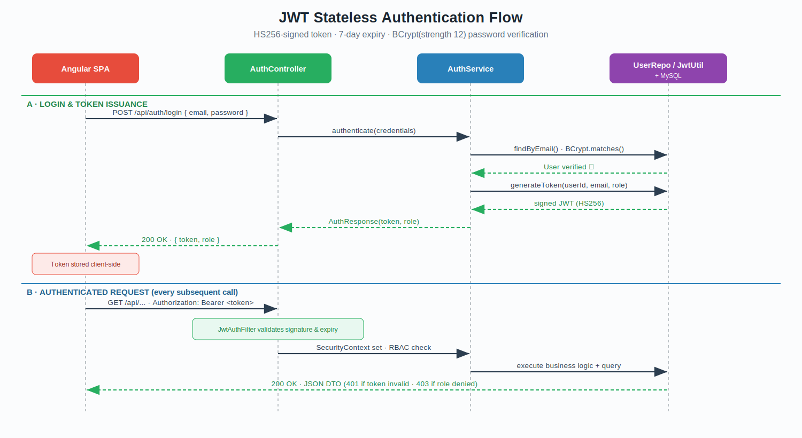



09
SECURITY POSTURE
Stateless JWT, BCrypt & RBAC
HS256 Signed Tokens
7-day expiry; subject + userId + role claims.
BCrypt · strength 12
Adaptive, salted password hashing.
Spring Security RBAC
ADMIN-only /admin/**; ownership checks → 403.
JWT authentication flow — login & token issuance, then per-request validation
Stateless Sessions
No server session; CSRF safely disabled.
Notes:
Security is a foundational pillar. The diagram shows our JWT flow: on login we verify the BCrypt hash and issue an HS256-signed token; every later request is validated by a custom filter that sets the security context. On the right are the controls — strength-12 BCrypt, role-based access with ADMIN-only admin routes plus ownership checks returning 403, and a fully stateless design which is why CSRF is safely disabled. For production we'd externalise the secret and add refresh-token rotation.

Slide 10
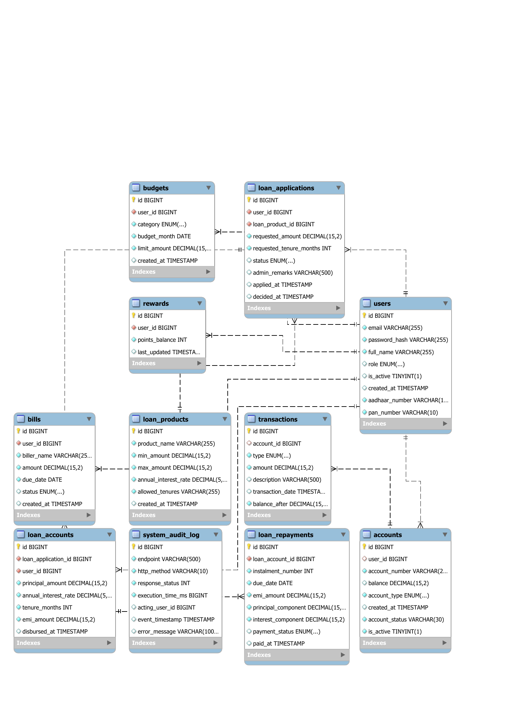

10
DATA MODEL
Normalised Schema — 11 Tables
Identity & Core
users · accounts · transactions
Money Management
budgets · bills · rewards
Lending Chain
loan_products · loan_applications · loan_accounts · loan_repayments
Observability
system_audit_log
Entity-Relationship diagram — all tables, keys & the system_audit_log
Integrity: foreign keys with intent-driven CASCADE / RESTRICT · DECIMAL(15,2) money · unique constraints on budgets, bills & rewards.
Notes:
Our data model is eleven normalised tables. Users is the identity anchor; accounts and transactions form the core banking chain; budgets, bills and rewards hang off users. The loan domain is a four-table chain from products to applications to accounts to the repayment schedule. And the system audit log records every call independently. Foreign keys enforce integrity with deliberate cascade-versus-restrict choices, and all money uses exact decimals.

Slide 11




11
ADVANCED ANALYTICS · ADMIN
Operational Dashboards & Audit Log
2,480
₹14.2 Cr
37
99.6%
Total Users
Txn Volume
Pending Approvals
2xx Responses
LOAN APPLICATIONS BY STATUS
SYSTEM AUDIT LOG · AOP-DRIVEN
GET
/api/admin/dashboard
200
42ms
POST
/api/loans/apply
201
88ms
PATCH
/api/admin/loans/12
200
51ms
GET
/api/analytics/spending
200
63ms
POST
/api/auth/login
401
12ms
One @Around aspect logs all 49 endpoints — endpoint, status, latency & acting user — without blocking the response.
Notes:
Sprint 5 added advanced analytics, first for administrators. Live KPIs across the top, loan status in the bar chart. The highlight is the audit log on the right — one AOP interceptor logs every endpoint with status, latency and acting user, without blocking the response and without touching any controller. Seed the demo DB heavily so these look enterprise-ready.

Slide 12

12
ADVANCED ANALYTICS · CUSTOMER
Personal Wealth Visualisations
NET-WORTH TREND (6 MONTHS)
Spending Doughnut
Category breakdown of every rupee, from real transactions.
Balance Area Chart
Smooth net-worth trajectory shows momentum at a glance.
INCOME vs EXPENSE
Budget Adherence
Limit-vs-spend tracking flags overspend before month-end.
Reward Insights
Loyalty-point accrual surfaced alongside activity.
Notes:
The same engine serves customers their own wealth view — net-worth area chart, income versus expense, a spending doughnut, budget adherence and reward insights. Crucially, none of this needed a separate warehouse: every visual derives from the existing schema, so what the customer sees is always consistent with their real transactions.

Slide 13


13
PERFORMANCE ENGINEERING
Faster Under Load — by Design
ADMIN DASHBOARD LATENCY (ILLUSTRATIVE)
Eliminated N+1 Queries
Single JPQL aggregates (COUNT · SUM · COALESCE) instead of a query per row.
Composite Indexes
idx_txn_account_date (account_id, transaction_date) serves history & analytics.
@Cacheable Catalogue
Loan products cached; @CacheEvict on write keeps it never-stale.
Composite indexing + DB-side aggregation + caching reduced dashboard load time dramatically.
AOP Audit (Non-Blocking)
One @Around aspect; writes in a finally block, never delays the response.
Notes:
Performance was engineered, not hoped for. We eliminated N+1 queries by pushing aggregation into single JPQL queries; added a composite index on account-and-date for history and analytics; cached the read-heavy, write-rare loan catalogue with cache eviction on writes; and kept the audit log non-blocking via AOP. The chart illustrates the kind of dashboard latency improvement these produced. Exact figures depend on hardware and dataset size.

Slide 14
14
QUALITY ASSURANCE
Tested Across Every Layer
AUTOMATED SUITE BREAKDOWN
23
Authentication & RBAC
11 tests
PASS
Admin Dashboard Aggregations
7 tests
PASS
AUTOMATED TESTS
Insights / Analytics Logic
4 tests
PASS
0 failures · 0 errors
Application Context Bootstrap
1 test
PASS
Maven build · Postman · E2E · Load test
E2E journeys validated against the running stack: register → approve → transfer → loan apply → admin decision → schedule → analytics. Authorization verified (customer → /admin = 403).
Notes:
We tested across every layer. The automated suite runs with the Maven build — twenty-three tests, zero failures, zero errors — covering auth and RBAC, admin aggregations, insights logic, and context bootstrap. Beyond that, Postman collections for the API, manual end-to-end walkthroughs of the critical journeys, and load testing on the heaviest dashboard queries. We specifically verify a customer token is rejected from admin endpoints with a 403.

Slide 15



15
DEPLOYMENT & INFRASTRUCTURE
Containerised, Profile-Driven Delivery
Source + Maven
›
Slim Runtime Image
›
Run Anywhere
Build stage compiles to a JAR with the full JDK
Only the JAR copied into a lightweight JRE
Same image across dev / staging / prod
CONFIGURATION VIA ENVIRONMENT
Deterministic Rollback
DB_HOST · DB_NAME · DB_USER · DB_PASSWORD
JWT_SECRET · JWT_EXPIRY
Versioned image tags revert instantly to the last known-good build; additive forward-only migrations make DB recovery predictable via backup restore.
SERVER_PORT · SPRING_PROFILES_ACTIVE
Secrets injected at runtime — never committed to source control.
Notes:
Deployment is containerised with a multi-stage Docker build — compile with the full JDK, then ship only the JAR in a slim runtime image. All configuration comes from environment variables, so the same image runs unchanged across environments and secrets are never committed. Rollback is deterministic via versioned image tags, and additive migrations keep database recovery predictable.

Slide 16
16
API SURFACE
49 RESTful Endpoints · 14 Controllers
BY HTTP METHOD
Auth
login · register · profile
Accounts & Txns
accounts · transactions · transfers
Budgets & Bills
budgets · bills · rewards
Loans
products · applications · accounts · repayments
Analytics
insights · admin · wealth dashboards
Documented & explorable via Swagger UI (springdoc OpenAPI) — /api/swagger-ui/index.html
Notes:
The API is forty-nine RESTful endpoints across fourteen controllers, the majority reads as you'd expect. They group cleanly by resource — auth, accounts and transactions, budgets and bills, the loan chain, and analytics. Everything is documented and explorable through Swagger UI generated by springdoc, so reviewers can try the live contract rather than read a static list.

Slide 17
17
EXECUTION
60-Day · 5-Sprint Delivery Roadmap
S1
S2
S3
S4
S5
DAYS 1–10
DAYS 11–20
DAYS 21–30
DAYS 31–40
DAYS 41–60
Foundation & Core Banking
Budgets, Bills & Rewards
Loan Management
Insights & Admin Controls
Analytics, Deploy & Handover
Auth, JWT, accounts, transactions, transfers
Category budgets, bill lifecycle, loyalty points
Products, applications, EMI engine, schedules
Net-worth, admin dashboards, approvals
Charts, audit log, caching, Docker, docs
Integration was continuous — each feature wired end-to-end within the sprint it was built.
Notes:
A sixty-day lifecycle across five sprints: foundation, then budgets and bills, then the loan engine, then insights and admin controls, and finally analytics, deployment and handover. Integration was continuous — we wired each feature end-to-end within its sprint rather than leaving a painful integration phase to the end.

Slide 18


18
SOLO DELIVERY
Contributions & Module Ownership
Phase 1
Phase 2
Phase 3
AUTHENTICATION & ACCOUNTS
TRANSACTIONS & TRANSFERS
BUDGETS, BILLS & REWARDS
JWT security chain, BCrypt, account lifecycle & approval
Atomic transfers, debit/credit ledger, balance tracking
Budget limits, bill states, loyalty-points accrual
Phase 4
Phase 5
Built Individually
LOANS & EMI ENGINE
ANALYTICS & AUDIT LOG
All modules were independently designed, implemented, and integrated by Ritik Shekhar Parida (Intern ID: 584355).
Loan workflow, EMI math, amortisation scheduling
Admin & user dashboards, AOP audit, Chart.js views
Notes:
This matrix records who owned what — authentication and accounts, transactions, budgets and bills, the loan engine, and the analytics layer. Ownership reflects primary accountability, but every module was peer-reviewed and integrated collaboratively. If a question goes deep into a module that isn't mine, I'll hand it to the person who built it.

Slide 19

19
REFLECTION
Technical Challenges & Learnings
EMI Decimal Drift
N+1 Query Slowdown
Challenge: Rounding each instalment left a residual.
Challenge: Dashboards issued a query per row.
Solution: Compute interest on the live balance; absorb the residual in the final instalment → clean zero payoff.
Solution: Rewrote as single JPQL aggregates (COUNT / SUM / COALESCE) + composite indexes on transactions.
Audit Without Clutter
Stateless Multi-Tenant Auth
Challenge: Logging risked touching all 14 controllers.
Challenge: Cross-user data exposure risk.
Solution: One AOP @Around aspect logs every endpoint in a finally block — zero controller changes.
Solution: Self-contained JWTs + service-level ownership checks returning 403 on mismatch.
Notes:
Four hurdles stand out. EMI decimal drift — solved by computing interest on the live balance and absorbing the residual in the final instalment. N+1 queries — solved by pushing aggregation into the database with composite indexes. Audit clutter — solved with one AOP aspect. And stateless multi-tenant auth — solved with self-contained tokens plus ownership checks. The meta-lesson: cross-cutting concerns belong in declarative infrastructure, and financial correctness is as much about rounding as formula.

Slide 20

LIVE DEMO
Let's see NeoBank 360 in action
1
Register & Login
2
Approve Account
3
Transfer Funds
4
Apply for Loan
5
Admin Decision
6
View Analytics
Thank you · NeoBank 360 · Infosys PMIS · Questions welcome after the walkthrough
Notes:
That brings us to the live demo. We'll walk the full journey end to end: register and log in, approve the account as admin, make a transfer, apply for a loan, approve it and watch the EMI schedule generate, then open the analytics dashboards. The database is seeded heavily so the charts look enterprise-ready, and we have fallback screenshots for every step. Let's switch to the application.

