Slide 1





NEOBANK 360
PROJECT TEAM
DIGITAL BANKING SUITE
RP
Ritik Shekhar Parida
Unified Digital
Team Lead
GS
Gyana Ranjan Sahoo
Developer
Banking Platform
Laxmipriya Nayak
LN
Developer
MS
Manoj Kumar Sahoo
Developer
A premium, end-to-end banking experience — accounts, transfers, lending, budgeting, bills and rewards — engineered on a secure Spring Boot core with an Angular single-page front end.
AS
Ashutosh Sahoo
Developer
BM
Biswa Prakash Mandal
Developer
Secure by Design
Fully Audited
Customer 360°
SM
Suvajit Majhi
Developer
Infosys • Capstone Project
Notes:
Good morning. We're presenting NeoBank 360 — a unified, premium digital banking platform. It brings accounts, transfers, lending, budgeting, bill payments and rewards into one secure experience, built on a Spring Boot core with an Angular single-page front end. Our team is led by Ritik Shekhar Parida, alongside Gyana, Laxmipriya, Manoj, Ashutosh, Biswa and Suvajit. Over the next few minutes we'll cover the problem we solve, our technology, a detailed look at the architecture, and the core banking engines.

Slide 2









WHAT WE'LL COVER
Agenda
01
02
03
Problem & Solution
Technology Stack
System Architecture
The gap we close
Tools & frameworks
Detailed layered design
04
05
06
Data Model
Core Banking
Budgeting & Bills
Relational schema
Accounts & transfers
Spend control
07
08
09
Loan & EMI Engine
Admin Analytics
Achievements & Future
Reducing-balance
Insights & audit
What's next
Notes:
Here's our roadmap. We open with the problem and our solution, then the technology stack. The centrepiece is a detailed look at the system architecture and the data model. From there we walk through the core banking engines — accounts and transfers, budgeting and bills, the loan and EMI engine, and admin analytics — before closing on achievements and future scope.

Slide 3


WHY NEOBANK 360
The Problem & Our Solution
THE PROBLEM
OUR SOLUTION
Banking lives in disconnected silos — accounts, transfers, loans and budgeting rarely share one source of truth.
One unified platform
Every banking primitive on a single secure core with shared transactional integrity.
Manual EMI tracking and bill reminders are error-prone and easy to miss.
Money that runs itself
Atomic transfers, computed EMI schedules and live bill status — minimal manual effort.
Customers lack a single, real-time view of spending, savings and obligations.
A true 360° view
Live dashboards for balances, budgets, rewards and obligations in one place.
Admins have no unified console for loan decisions, analytics and audit trails.
Full admin control
Loan decisions, analytics and an AOP-driven audit trail in one console.
Notes:
The problem: banking capability is fragmented, manual EMI and bill tracking is error-prone, and neither customers nor admins get one source of truth. NeoBank 360 answers with a single secure platform — atomic money operations, a genuine 360-degree customer view, and a full admin console with an AOP-driven audit trail.

Slide 4



ENGINEERING FOUNDATION
Technology Stack
FRONTEND
BACKEND
DATA & SECURITY
Angular 21
Spring Boot 4
MySQL 8
Standalone SPA
Modular monolith
Relational store
TypeScript
Java 21
Spring Data JPA
Type-safe UI
Modern LTS runtime
Hibernate ORM
Chart.js
Spring Security + JWT
JJWT + BCrypt
Live analytics
Stateless HS256 auth
Signing & hashing
RxJS + Guards
Spring AOP
DTO + Validation
Reactive, secured routes
Audit-log aspect
Clean API contracts
Notes:
Our stack pairs an Angular 21 standalone single-page app with a Spring Boot 4 modular monolith on Java 21. Security is stateless JWT with HS256 signing and BCrypt password hashing, and Spring AOP gives us an audit-log aspect over every controller call. Persistence is MySQL 8 through Spring Data JPA, with DTOs and validation keeping our API contracts clean. Chart.js drives the live dashboards.

Slide 5



END TO END
System Architecture
CLIENT
›
SECURITY
›
APPLICATION
›
DATA
Angular 21 SPA
JwtAuthFilter
REST Controllers
JPA Repositories
Standalone components
Reads & validates token
Accounts · Transfers · Loans…
Spring Data + Hibernate
JWT Interceptor
Security Filter Chain
Service Layer
MySQL 8
Attaches Bearer token
Stateless · CSRF-off · CORS
Business rules & @Transactional
Relational source of truth
Route Guards
UserDetailsService
AuditLogAspect (AOP)
EmiCalculatorUtil
Auth · Admin · Guest
Loads principal + role
Wraps every controller call
Reducing-balance schedule
Chart.js Dashboards
Authorization
DTO + Enum Domain
system_audit_log
Customer & Admin
/admin/** → ADMIN role
Validated request/response
Endpoint · status · latency
Request flow: SPA › JWT Interceptor › JwtAuthFilter › Security Chain › Controller › Service › Repository › MySQL — every call captured by the audit aspect.
Notes:
Here's the detailed architecture, read left to right across four layers. On the client, the Angular SPA attaches a Bearer token through a JWT interceptor, and route guards — auth, admin and guest — gate navigation. At the security layer, every request passes the JwtAuthFilter, which validates the token and loads the principal through UserDetailsService; the filter chain is stateless with CSRF disabled and CORS configured, and admin routes require the ADMIN role. In the application layer, REST controllers delegate to a transactional service layer, while an AOP audit aspect transparently wraps every controller call, and DTOs with enums keep contracts validated. Finally the data layer: JPA repositories over MySQL 8 as the source of truth, the EmiCalculatorUtil that builds reducing-balance schedules, and the system_audit_log capturing endpoint, status and latency. The gold chevrons trace a single request end to end.

Slide 6
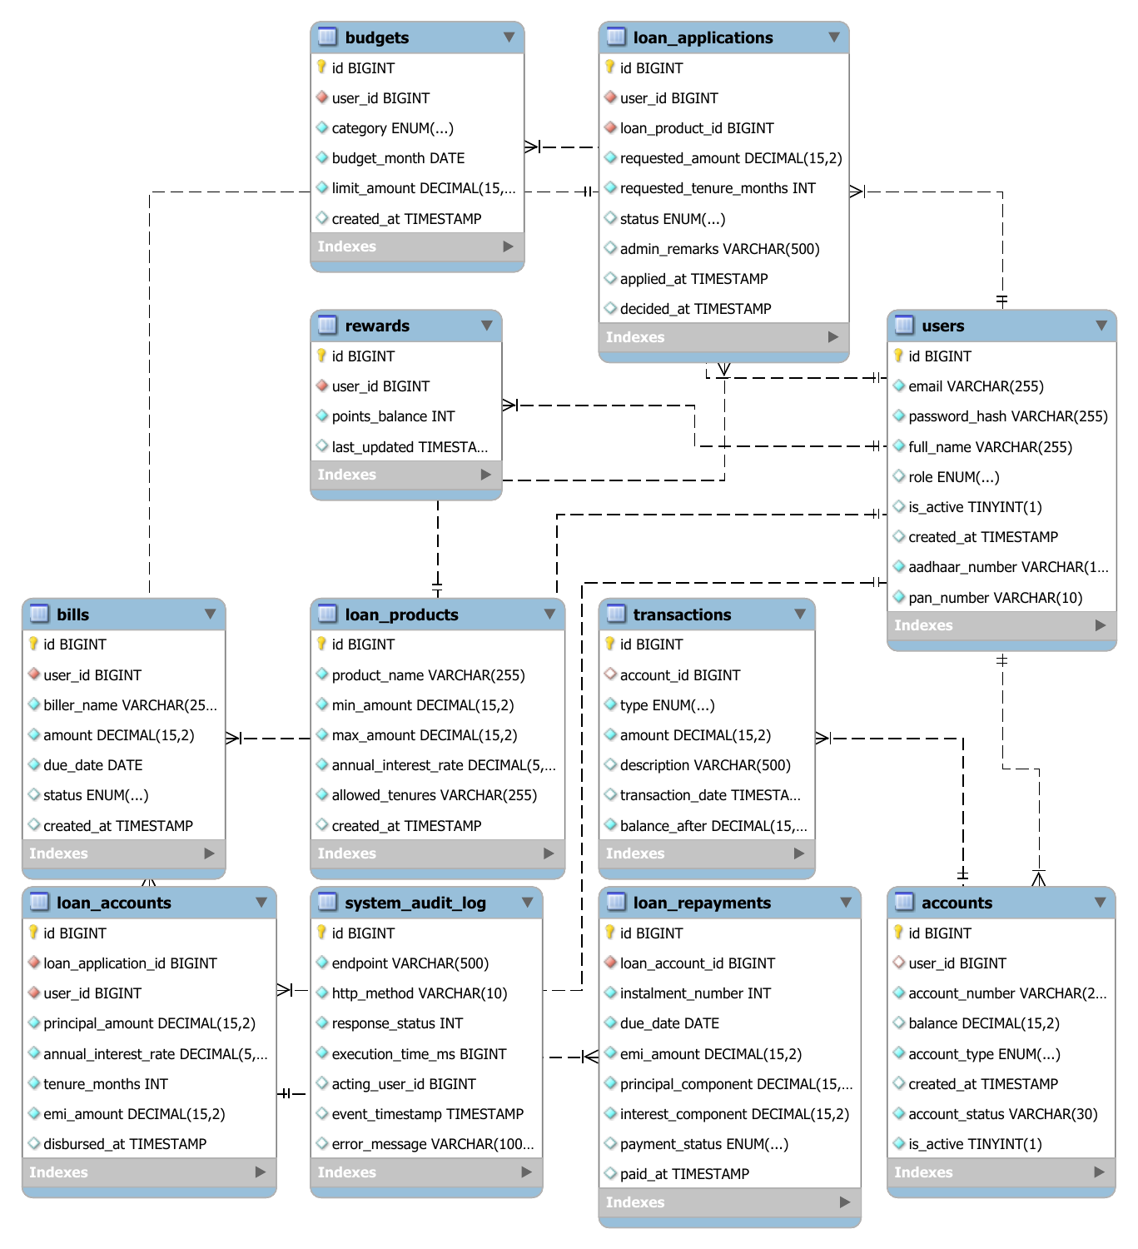





RELATIONAL CORE
Data Model
Identity & Access
Users, roles & JWT-secured access
Accounts & Money Flow
Accounts and the transaction ledger
Lending
Products → applications → accounts → repayments
Personal Finance
Budgets, bills & reward points
Operations & Audit
Full relational schema
System-wide audit logging
Notes:
This is the relational core. We organise it into five domains: identity and access centred on users and roles; accounts and the money flow through the transaction ledger; a lending chain that runs from products to applications to accounts to repayments; personal finance covering budgets, bills and rewards; and operations, with system-wide audit logging. Every loan account fans out into a full repayment schedule, and every API call is traceable through the audit log.

Slide 7




ENGINE 01
Core Banking & Transactions
Account Lifecycle
Atomic Transfers
Each customer holds an account with type, status and live balance — their banking home base.
TransferService validates ownership & balance, then moves debit and credit legs in one transaction.
Transaction Ledger
Secure & Audited
Every movement recorded with type, amount, running balance and description for a complete history.
JWT-guarded endpoints; the AOP aspect records each controller call into the audit log.
Notes:
Engine one is core banking. Each customer holds an account with a type, status and live balance. The TransferService is the heart of it: it validates ownership and sufficient balance, then moves the debit and credit legs inside a single transaction, so the books always balance. Every movement is written to the transaction ledger with type, amount, running balance and description. All endpoints are JWT-guarded, and the audit aspect records each call.

Slide 8




ENGINE 02
Budgeting & Bill Management
Category Budgets
BILL STATUS DISTRIBUTION
Monthly limits per category give customers proactive control of their spending.
Illustrative cycle snapshot
Bill Tracking
Billers, due dates and amounts carry a clear paid / pending / overdue status.
Overdue Detection
Bills are evaluated against their due date, so overdue items surface automatically.
Spend Insights
The insights engine aggregates outflow against budgets to show where money goes.
Notes:
Engine two is personal finance. Customers set monthly category budgets for proactive control, and bills are tracked with biller, due date and amount, carrying a clear paid, pending or overdue status. Overdue items are detected by evaluating each bill against its due date, so they surface on their own. The insights engine aggregates outflow against budgets to show exactly where money goes. The donut is an illustrative snapshot of a billing cycle.

Slide 9

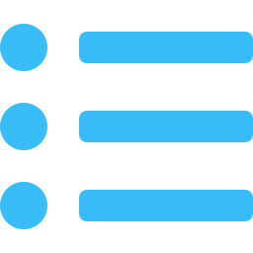


ENGINE 03
Loan & EMI Engine
Loan Products
STEP 1
EMI FORMULA
Admin-defined products with min/max amount, annual rate and allowed tenures.
E = P · r · (1+r)ⁿ / (1+r)ⁿ − 1
Apply & Decide
STEP 2
Customer applies; admin approves or rejects with remarks.
Account & Schedule
STEP 3
P
Principal amount
On approval, the EMI is computed and a full repayment schedule is generated.
r
Monthly rate = annual ÷ 12 ÷ 100
Track Repayments
STEP 4
n
Tenure in months (per product)
Per-instalment principal & interest split with paid / pending / overdue status.
Reducing-balance · per-instalment split · HALF_UP rounding
Notes:
Engine three is lending, the most computationally interesting part. Admins define loan products with minimum and maximum amounts, an annual rate and a set of allowed tenures. Customers apply, and an admin approves or rejects with remarks. On approval, the EMI is computed with the standard reducing-balance formula — E equals P r times one-plus-r to the n, over one-plus-r to the n minus one — and a full repayment schedule is generated. Each instalment is split into principal and interest with its own status, and the final instalment absorbs any rounding residual so the schedule closes to the cent.

Slide 10



ENGINE 04
Advanced Admin Analytics
PLATFORM ACTIVITY — TRANSACTIONS vs. LOANS
Live Dashboards
Illustrative growth trend
Real-time transaction, loan & user analytics.
AOP Audit Logging
Every controller call captured to the audit log.
Loan Decisions
Approve or reject applications with remarks.
User & Role Control
Admin-scoped management across roles.
Notes:
Engine four is the admin side. Admins get live dashboards for transactions, loans and users — the line chart shows an illustrative growth trend. Critically, every controller call is intercepted by the AOP audit aspect and written to the audit log, capturing endpoint, HTTP method, response status and execution time — a complete, tamper-evident trail. Admins also drive loan decisions, approving or rejecting with remarks, and manage users across roles.

Slide 11




OUTCOMES
Key Achievements
Accurate loan engine
Secure by design
Fully auditable
Reducing-balance EMI with a clean principal/interest split and exact rounding closure.
Stateless JWT (HS256), BCrypt hashing and layered route guards across roles.
An AOP aspect records every controller action into a queryable audit log.
Transactional integrity
Unified domain
Clean architecture
Atomic transfers keep debit and credit legs perfectly consistent.
One coherent schema spanning every banking domain end to end.
Disciplined controller-service-repository layering with DTOs at the edges.
Notes:
To summarise outcomes: we built an accurate reducing-balance loan engine with proper principal-interest splitting and exact rounding; a secure-by-design stack with stateless JWT, BCrypt and layered guards; full auditability through the AOP aspect; transactional integrity in transfers; a unified domain model spanning every banking area; and a clean, disciplined layered architecture.

Slide 12






WHAT'S NEXT
Future Scope
Scheduled Automation
Microservices
AI Spend Insights
Background jobs to auto-mark overdue EMIs & bills and send reminders.
Decompose the monolith into independently scalable services.
ML-driven categorisation, anomaly detection & savings nudges.
Native Mobile Apps
Biometric & 2FA
Open Banking APIs
Companion iOS / Android clients on the same API surface.
Device biometrics and TOTP for stronger authentication.
Secure third-party integrations via partner endpoints.
Notes:
Looking ahead: the most immediate win is scheduled automation — background jobs to auto-mark overdue EMIs and bills and push reminders. Beyond that, decomposing into microservices, ML-driven spend insights and anomaly detection, native mobile apps on the same API, biometric and TOTP two-factor auth, and open-banking APIs for partners.

Slide 13



REFLECTIONS
Challenges & Learnings
Financial precision
Atomic transfers
Careful rounding and a residual-absorbing final EMI so schedules close exactly.
Debit and credit legs must commit together for true consistency.
Securing the API
Clean layering
Mapping endpoints onto clean role-based access with stateless JWT.
Disciplined controller-service-repository boundaries with DTOs.
Cross-cutting concerns
Team collaboration
AOP added audit logging without polluting business logic.
Coordinated Git workflow across the whole team.
Notes:
Our biggest learnings: financial precision means careful rounding with a residual-absorbing final EMI. Transfers taught us atomicity — both legs commit together. Securing the API behind clean role-based access with stateless JWT took discipline, as did keeping the layering clean with DTOs. AOP was the unlock for cross-cutting audit logging without polluting business logic, and coordinating the team sharpened our Git workflow.

Slide 14
THANK YOU
NeoBank 360 — Unified Digital Banking Platform
We welcome your questions.
Presented by Ritik Shekhar Parida · Gyana Ranjan Sahoo · Laxmipriya Nayak · Manoj Kumar Sahoo · Ashutosh Sahoo · Biswa Prakash Mandal · Suvajit Majhi
Notes:
Thank you for your time and attention. That completes our walkthrough of NeoBank 360 — from the layered architecture and security model through the core banking, lending and analytics engines. We'd be glad to take any questions.

