Slide 1








Optimized Cloud Security with AI Automation
Presented By:-
Taufeeq Iqbal Khan:2241011049
Ashutosh Maharana:2241013027
Shubhrajit Malla:2241013065
Koushikee Mantry:2241013099

Slide 2



CONTENT OVERVIEW
Introduction
Problem Identification
Solution Development
Architectural Plan
Results
Dashboard
Conclusion
References

Slide 3
INTRODUCTION
Optimizing Incident Response in cloud environments using AI-driven automation ensures faster detection and reaction to threats.
Cloud computing has revolutionized enterprises with scalability and efficiency.
Traditional incident response is slow, manual, and reactive → delays mitigation.
AI-enabled automation solves this by:
Collecting logs in real time (CloudTrail, VPC Flow Logs).
Using anomaly detection to spot suspicious patterns.
Providing real-time incident response (blocking IPs, revoking access, isolating servers).
Ensures faster detection, automated response, and continuous learning.

Slide 4
PROBLEM IDENTIFICATION
Manual Inefficiency:-
Human-led response is too slow for dynamic, large-scale cloud environments.
Security teams cannot keep pace with the speed of cloud attacks.
Delays in reaction give attackers more time to exploit systems.
Overwhelming Data
Massive volumes of CloudTrail and VPC Flow Logs flood analysts daily.
Manual log analysis becomes slow, error-prone, and unsustainable.
Critical threats risk being lost in the noise.

Slide 5
PROBLEM IDENTIFICATION
Weak Detection
Traditional, signature-based tools only detect known threats.
Zero-day attacks and new anomalies easily bypass defenses.
Cloud-specific attack patterns often go undetected.
Delayed Mitigation
Even after detection, responses are manual and slow.
Results in downtime, data breach exposure, and compliance risks.
Lack of automation increases recovery time and damages trust.

Slide 6

SOLUTION DEVELOPMENT
Unsupervised Learning Model:-
“Detect the Unknown – Anomalies in Real Time”
Data Source: AWS CloudTrail logs stored securely in S3.
Methodology: Isolation Forest algorithm uncovers unusual activity without needing labels.
Process Flow: Logs → S3 bucket → Preprocessing → Feature Extraction → Train Model.
Outcome: Automated alerts with immediate responses — revoking risky access, notifying SOC teams.

Slide 7
SOLUTION DEVELOPMENT
Supervised Learning Model:-
“Recognize the Known – Classify Threats with Precision”
Data Source: NSL-KDD dataset with labeled attack patterns.
Methodology: Machine learning classifiers (Decision Tree, Random Forest, SVM).
Process Flow: Dataset → Preprocessing → Model Training → Confusion Matrix Evaluation.
Outcome: Accurately classifies traffic as normal or attack and suggests countermeasures.

Slide 8
SOLUTION DEVELOPMENT
Hybrid Approach:-
“Best of Both Worlds – Smarter, Faster, Stronger”
Unsupervised model identifies new & unknown anomalies.
Supervised model recognizes known attack signatures.
Together they form a complementary shield: broader coverage, reduced false positives, faster detection.

Slide 9
ARCHITECTURAL PLAN
Unsupervised Model:-
Data Collection
Processing
[Feature extraction on pass]
Detection
[Isolation Forest]
Response
[Invoke Automated IAM recovation]
Visualization
[Dashboards, Anomalies]

Slide 10
ARCHITECTURAL PLAN
Supervised Model:-
Data Collection
Processing
[Preprocessing and Training]
Detection
[Supervised Classifiers]
Response
[Suggested Countermeasures]
Visualization
[Dashboards, Confusion Matrix]

Slide 11
RESULT
MODEL OUTPUT:-
MODEL | DATASET | TYPE | OUTPUT METRIC
RandomForest/ XGBoost | NSL-KDD | Supervised
Isolation Forest (Cloud) | CloudTrail | Unsupervised | Number of Anomalies detected(per logs)
MODEL
ACCURACY
PRECISION
RECALL
F1-SCORE
Accuracy | 0.998
Precision | 0.997
Recall | 1.000
F1-Score | 0.998

Slide 12
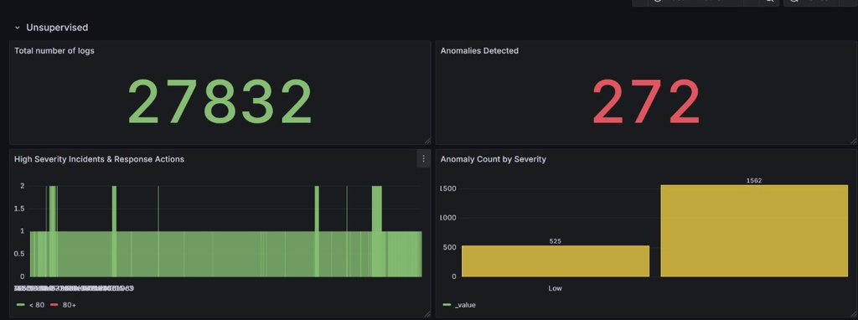
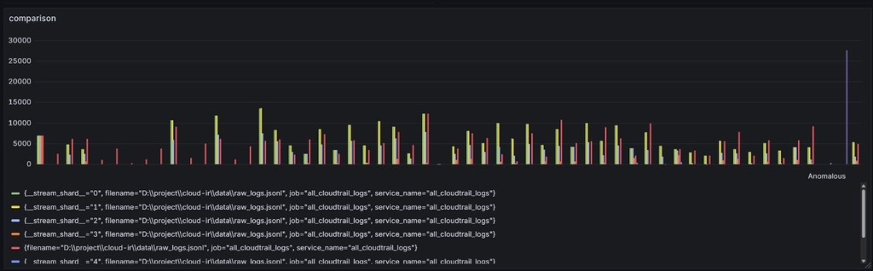
Dashboard
UNSUPERVISED VISUALIZATION

Slide 13
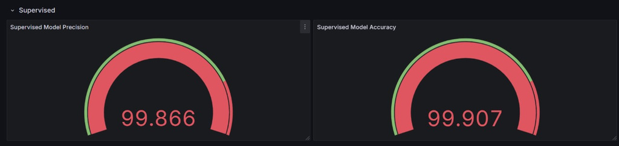
Dashboard
SUPERVISED VISUALIZATION:-

Slide 14
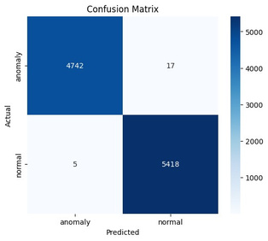
RESPONSE
SUPERVISED MODEL:
Fig-1: Supervised Confusion Matrix

Slide 15
RESPONSE
UNSUPERVISED MODEL:
Preparation
- Define IAM roles
- Logging enabled
Identification
- Collect CloudTrail
- Detect Anomalies
Containment
- Isolate EC2/S3
- Restrict IAM keys
Eradication
- Rotate keys/MFA
- Patch Configs
Recovery
- Restore Services
- Monitor Closely

Slide 16
CONCLUSION
AI-enabled automation revolutionizes cloud incident response by uniting unsupervised anomaly detection with supervised classification, creating a hybrid defense against both known and unknown threats.
Automated response reduces human effort, speeds up mitigation, and strengthens the security posture, making cloud networks more resilient and adaptive.

Slide 17
REFERENCES
1. Amazon Web Services (AWS) – CloudTrail Documentation.
2. Scikit-learn: Machine Learning in Python.
3. NSL-KDD Dataset – Canadian Institute for Cybersecurity.
4. Isolation Forest: Anomaly Detection Algorithm (Liu et al., 2008).
5. NIST Cybersecurity Framework for Incident Response.

