Slide 1

Exploratory Data Analysis of Top 1000 movies
By: Ashutosh Kumar
COHORT BATCH 2nd MARCH 2019

Slide 2

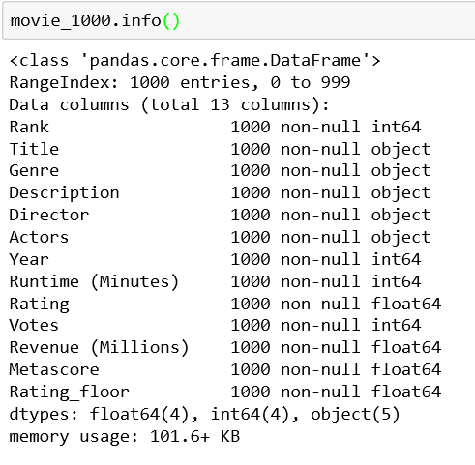
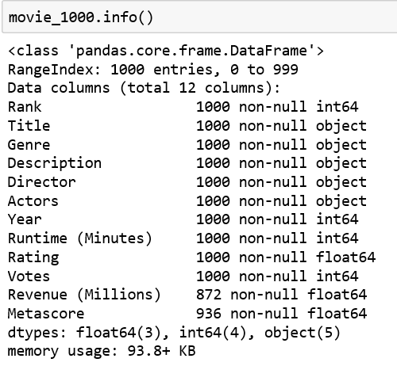
Pre- Profilling
Post- Profilling
In the Dataset info, Total Missing(%) = 1.6%
Number of variables = 12
Observe the newly created variable Rating_Floor.
In the Dataset info, Total Missing(%) = 0.0%
Number of variables = 13
Observe the newly created variable Rating_Floor.

Slide 3
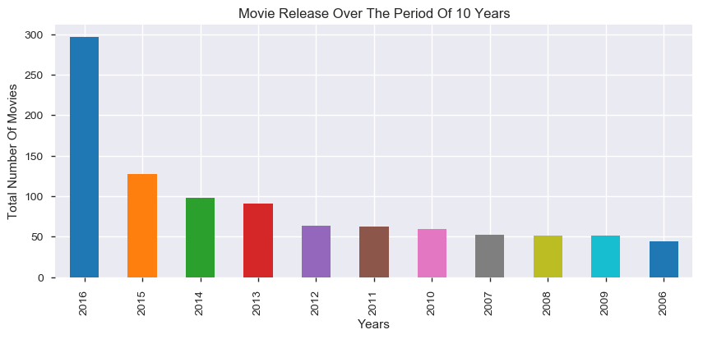
Which year has highest number of movies released that made it to top 1000?
Most of the movie,which made it Top 1000, were released in 2016.

Slide 4
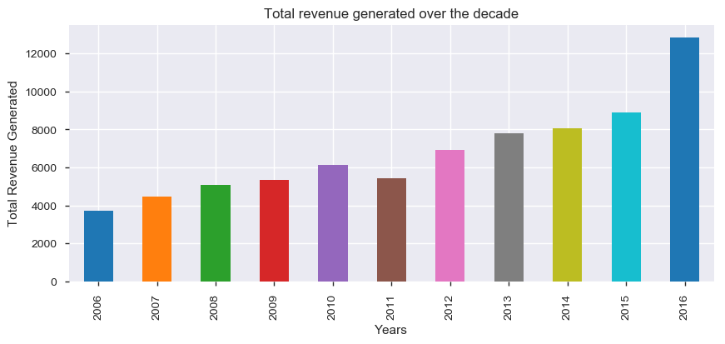
How has been the trend of revenues generated from movies over the past decade?
Overall movie revenue have been improved over the years, which coorelates with increasing number of movies getting released every year.

Slide 5
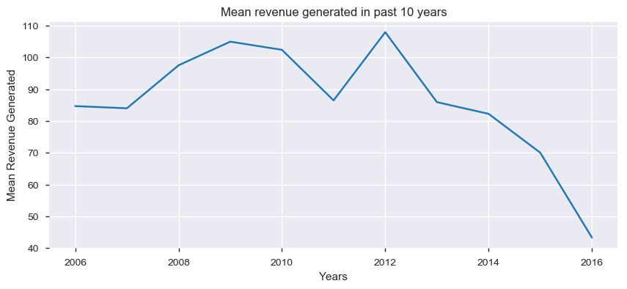
Visulaizing, average revenue generated by movies releasesd in past 10 years
Total revenue generated coorelates with total movies released, which reached Top 1000, in particular year. But annual average revenue of movies has reduced over the period , from 85 Million in 2006 to 43 MIllion in 2016.

Slide 6
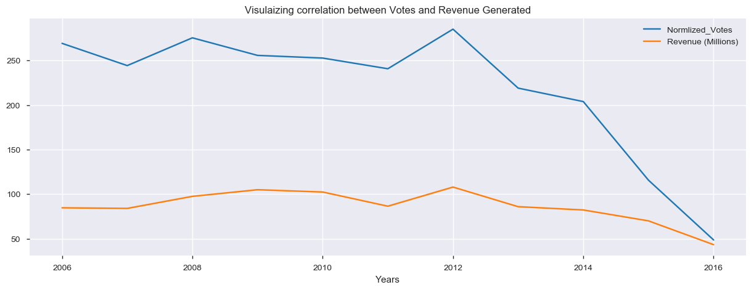
How has been the trend of voters, who actually voted, over the period?
From above graph it is clear that , due to less footfall in theaters, mean revenue has reduced over the period

Slide 7
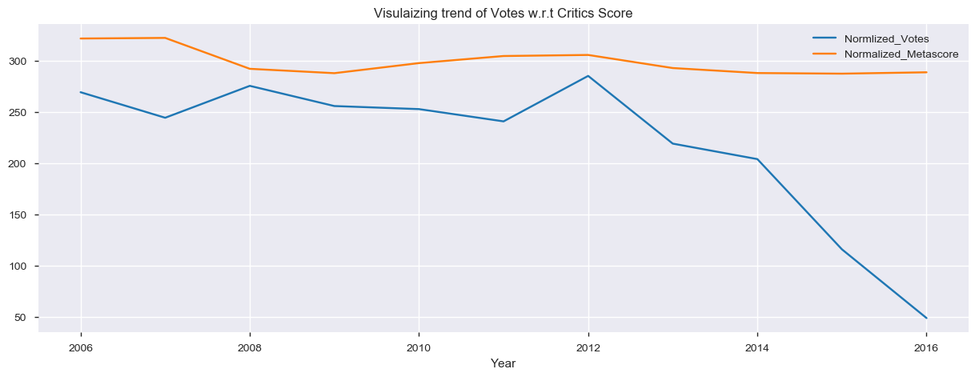
How has been the response of Critics on movies released over the period?
Though there has been some negative response from critics side , but score are not damaging enough for the voters/public to stop going to theaters.
Some intresting observation:
From 2006 To 2008 : Crtics didn't play an influencial role in swaying movie goers.
From 2008 Onwards : Movie goers seems to follow critics and their reviews,as a second opinion before selecting a movie. .

Slide 8
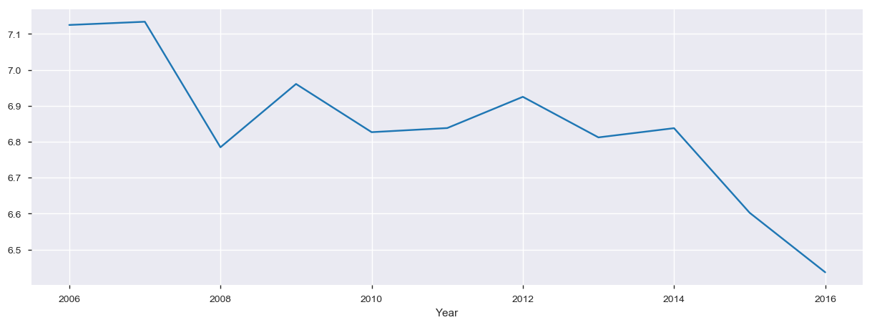
How people who actually watched the movie reacted to the movies?
There has been substantial depreciation in mean of rating provided by the voters , specifically from 2012 to 2016.

Slide 9
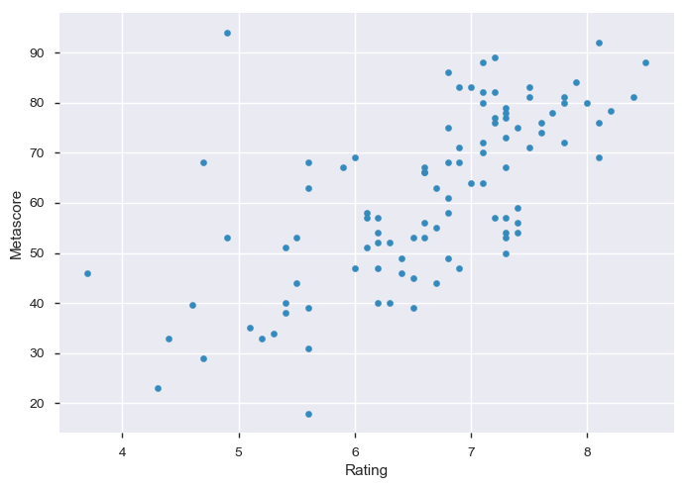
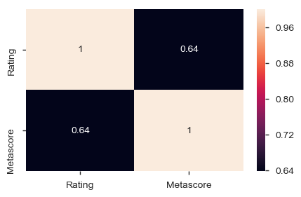
How alligned their reviews were with the critics' ones ?
From the above trend it is clear that, people are quite alligned with critics' opinion on whole.

Slide 10
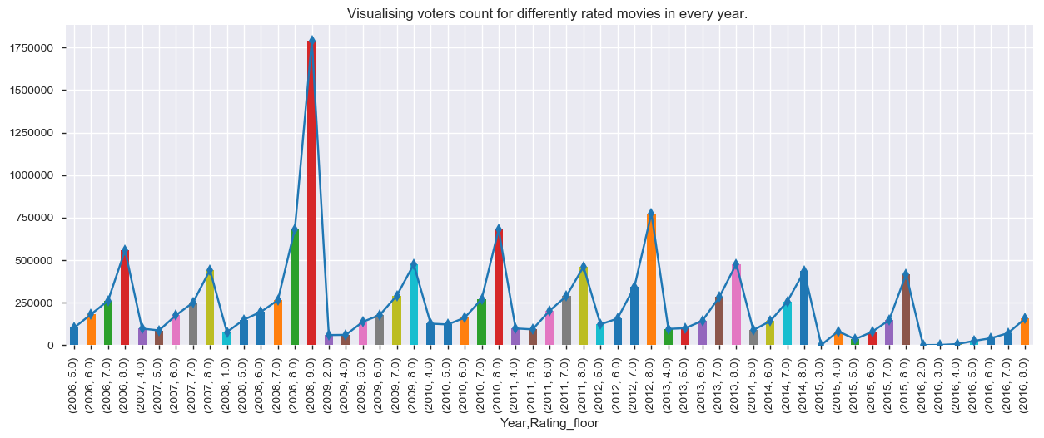
How has been trend of people, towards differently rated movies over the years ?
More and more people have rushed to theaters when a good movie has been released, irrespective of year of release. But the number has drastically reduced in 2016.

Slide 11
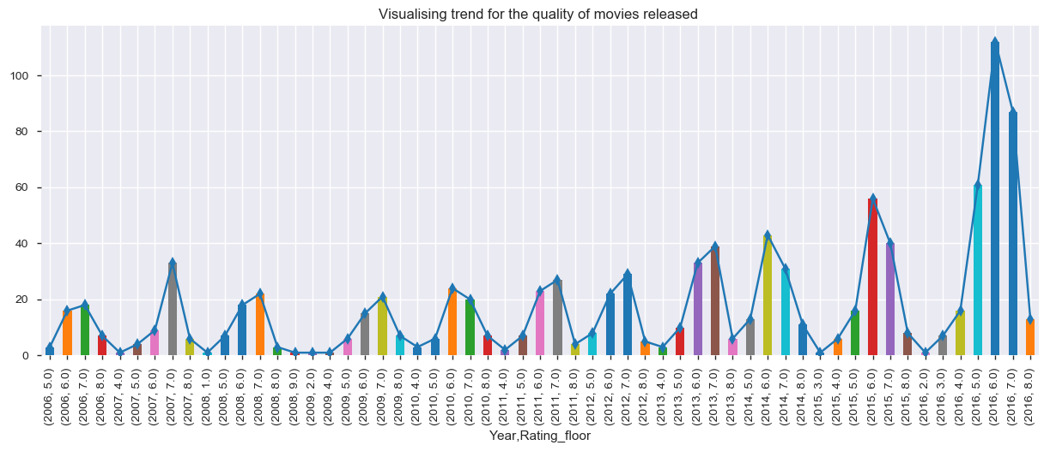
Ananlysing trend of quality of movies released in every year of decade?
There has been slight shift in the quality of movie realesed between 2006 to 2016. From 2006 -2008 , most of the movie relased were rated 7 and above , while as me move ahead in years , no of medicore movies starts to take substanstial share.

Slide 12
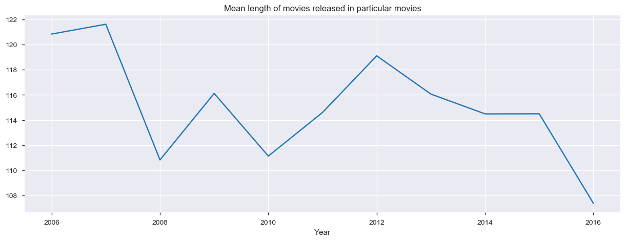
Is there any other reason , which may affect, overall public count in theaters ?
The graph also shows that movies' runtime has actually reduced from 121 minutes in 2006 to 107 minutes in 2016. Which poofs movies are catering with growing busy schedule and reducing attention span of people

Slide 13
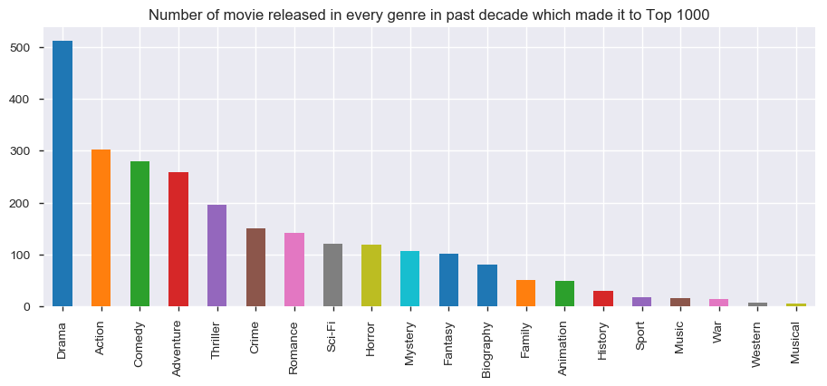
Which genere movie has a major share in Top 1000 movies made from 2006 to 2016 ?

Slide 14
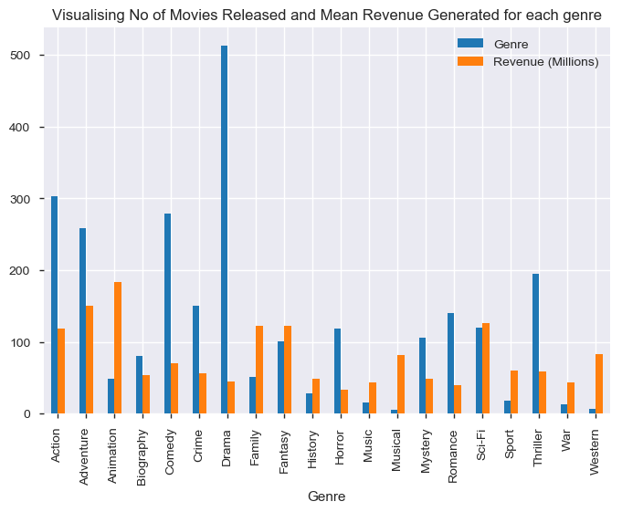
Showing relation between No of Movies Released and Mean Revenue Generated by movies when grouped based on Genre.?
Animation,Family, Fantasy and Sci-Fi movies have been crowd favourite while Drama, Comedy and Thriller has been least attractive for the movigoers to rush them to theaters

Slide 15
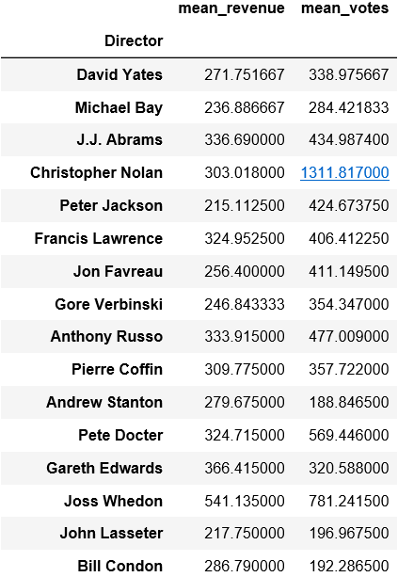
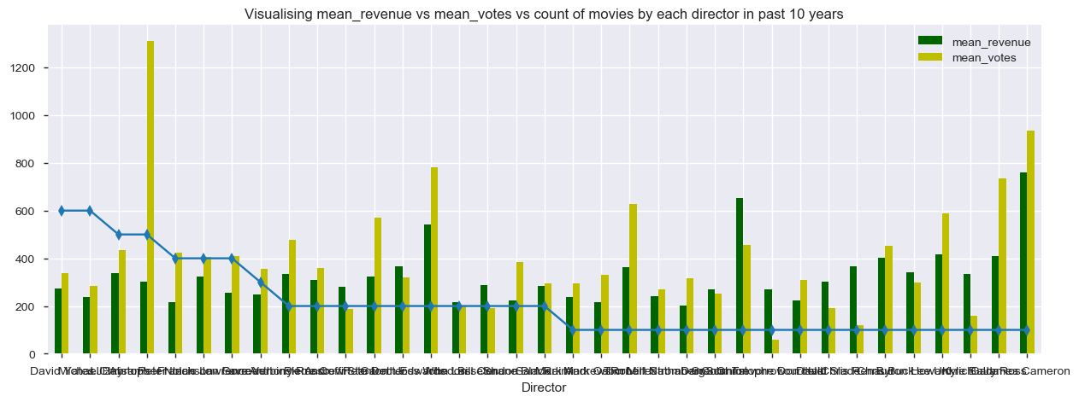
Which Director performance has been exemplary based on revenue generated and votes recieved for their movies?

Slide 16
Inferences
Eventhough number of movies getting to top 1000 has increased with years but their mean box-office collection has detoriated at the same time.
There is strong coorelation between Votes and Revenue, which suggests: the more the people visited theater, the more the people voted and the better the revenue that particular movie earned.
There is another strong corelation between Rating and Metascore, which suggest: People are quite alligned with critics review and consider critics' opinions before watching the movie, specifically after 2014.
Decreasing average meatscore and rating indicates detoriation in quality of movie, which as led lesser auidence, votes and revenue.
Release of mediocre movie (Rating < 7.0), has increased with the time.
With time, average length of movie has reduced with every increasing year, which indicates towards busy lifestyle among the common masses.
Movies belonging to Animation and Fantasy genre has attracted grossed extraordinary mean revenue, because of their extravagant theme, which compeles audience to watch them in big screen.
Joss Whedon, has turned out be the most sucessful director with top 5 mean audience count and mean revenue earned in just 2 movies

Slide 17
Conclusion
With the help of this notebook we learnt how exploratory data analysis can be carried out using Pandas plotting.
Also we have seen making use of packages like matplotlib and seaborn to develop better insights about the data.
We have also seen how preproceesing helps in dealing with missing values and irregualities present in the data. We also learnt how to create new features which will in turn help us to better predict the survival.
We also make use of pandas profiling feature to generate an html report containing all the information of the various features present in the dataset.
We have seen the impact of columns like Votes, Revenue, Rating and Metascore to determine current movie-goers trend.
There could be other factors which are affecting footfall in theaters, beacuse:
1. Detroriation in slope of Votes count is quite steeper that falling mean rating , in past 10 years.
2. People have responded positively whenever a good movie has been released irrespective of their movie_data
other factors could be :
1. Emergence of online streaming network like Netflix and Amazon Prime.
2. Easy availablity of movies online, with few days of their release.
3. Expensive ticket prices and huge rush for movies, demotivates normal movie goers.

Slide 18
THE END

