Slide 1

ASSIGNMENT GUIDELINES
Make the changes in the PPT as you solve the parts
This file contains the template for all the parts of the project.
Check the instructions added in the note section of every slide for clarity.
Don’t move around any image or text box
If you require more/lesser elements, be careful when you copy/delete the existing ones.

Slide 2
ASSIGNMENT Name: Ashutosh Kasaudhan
Problem Statement The sales pipeline conversion percentage at TechnoServe (a tech SaaS startup) has dropped from 35% at the end of last fiscal (FY 2017-18) to 25% at present.
Assignment Objective
Understand the problem, come up with a hypothesis for low conversions faced by TechnoServe, and analyse the dataset provided to arrive at possible solutions to increase it.
Notes:
Problem Statement

Slide 3
PART I : 1. Understanding the Problem Sales Pipeline Conversion at a SaaS Startup
Who?
A Tech SaaS Startup Company name Techno Serve Located in Pune
What?
They are facing issues with their Leads, having a Low Conversion rate
When?
They are facing this issue at the end of the last Fiscal FY(2017-18) to present
Where?
Among the possible customers or leads generated by the Company
How?
They are facing this issue because of inefficiency in their Sales teams or maybe the Quality of the product they provide is not up to the mark, or maybe the price they offer is too high

Slide 4
PART I : 2. Understanding the Problem Sales Pipeline Conversion at a SaaS Startup
Situation
How much Revenue does TechnoServe generate?
How many Clients does TechnoServe have?
What type of products do you offer?
How many Branches do you have?
Can you describe the current state of your sales process?
Problem
How does TechnoServe find leads from the market
On an average how many days does it take for TechnoServe to convert their leads into clients
Is it your Sales team having enough experience to convert these leads
What specific obstacles do potential customers face when considering your products?
Implication
What impact does the declining conversion rate have on your revenue and growth?
How does the pipeline conversion rate is going to affect on your profit
How does the low pipeline conversion rate restrict your market growth
Is it going to impact your future sales target or future projection
How does your sales teams handle objection and challenges?
Need-Payoff
How much increase in the revenue if the problem is solved?
How will your employee get benefits from this like(an increment in their salary)
Having an increase in TechnoServe Clients
What is TechnoServe Goodwill after this or Having a strong position in the market
What would it mean to your business if you could effectively address this issue?
Notes:
Provide at least three questions under each branch.

Slide 5
PART II : Formulating Hypotheses Sales Pipeline Conversion at a SaaS Startup
Framework Used
Issue tree framework with 5C’
Reason for using the selected framework
1- Structured Analysis: It provides a structured and organized way to break down complex business problems into smaller, more manageable components. This makes it easier to identify the root cause and interdependencies of the issues.
How you have used the framework here
1- Core Issue: Declining Sales Pipeline Conversion Rate
Notes:
All the frameworks that are used should be mentioned.
A suitable reason is a must to provide here

Slide 6
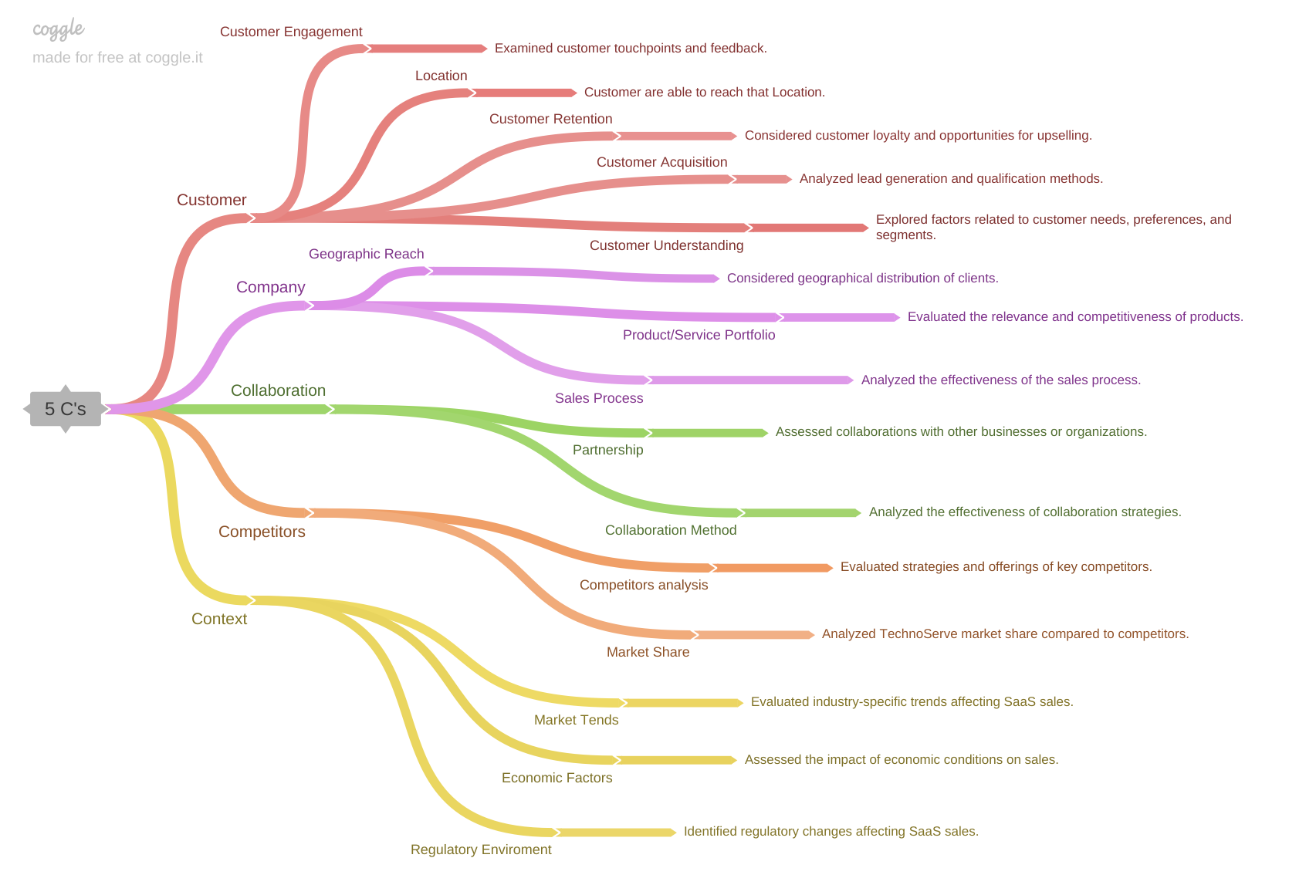
PART II : Formulating Hypotheses Sales Pipeline Conversion at a SaaS Startup
Notes:
Use the “download as” feature of Coggle if you are using the tool.
Provide one image with complete tree along with separate elements where the text is readable.
Copy the slide if you require more space

Slide 7
PART II : Formulating Hypotheses Sales Pipeline Conversion at a SaaS Startup
Branch 1 Customer- Customer Engagement
Examined customer touchpoints and feedback.
Branch 2 Customer- Location
Customers are able to reach that Location.
Notes:
Each branch must follow this naming pattern: Problem – Branch 1 – Sub-branch 1 – Sub-branch 2 – …… – Hypotheses
There must be minimum 10 hypotheses in total and at least 1 in each branch.

Slide 8
PART II : Formulating Hypotheses Sales Pipeline Conversion at a SaaS Startup
Branch 3 Customer- Customer Retention
Considered customer loyalty and opportunities for upselling
Branch 4 Customer- Customer Acquisition
Analyzed lead generation and qualification methods.
Notes:
Each branch must follow this naming pattern: Problem – Branch 1 – Sub-branch 1 – Sub-branch 2 – …… – Hypotheses
There must be minimum 10 hypotheses in total and at least 1 in each branch.

Slide 9
PART II : Formulating Hypotheses Sales Pipeline Conversion at a SaaS Startup
Branch 5 Customer- Customer Understanding
Explored factors related to customer needs, preferences, and segments.
Branch 6 Company- Geographic Reach
Considered geographical distribution of clients.
Notes:
Each branch must follow this naming pattern: Problem – Branch 1 – Sub-branch 1 – Sub-branch 2 – …… – Hypotheses
There must be minimum 10 hypotheses in total and at least 1 in each branch.

Slide 10
PART II : Formulating Hypotheses Sales Pipeline Conversion at a SaaS Startup
Branch 7 Company- Product/Service Portfolio
Evaluated the relevance and competitiveness of products.
Branch 8 Company- Sales Process
Analyzed the effectiveness of the sales process.
Notes:
Each branch must follow this naming pattern: Problem – Branch 1 – Sub-branch 1 – Sub-branch 2 – …… – Hypotheses
There must be minimum 10 hypotheses in total and at least 1 in each branch.

Slide 11
PART II : Formulating Hypotheses Sales Pipeline Conversion at a SaaS Startup
Branch 9 Collaboration- Partnership
Assessed collaborations with other businesses or organizations.
Branch 10 Collaboration- Collaboration Method
Analyzed the effectiveness of collaboration strategies.
Notes:
Each branch must follow this naming pattern: Problem – Branch 1 – Sub-branch 1 – Sub-branch 2 – …… – Hypotheses
There must be minimum 10 hypotheses in total and at least 1 in each branch.

Slide 12
PART II : Formulating Hypotheses Sales Pipeline Conversion at a SaaS Startup
Branch 10 Competitors- Competitors Analysis
Evaluated strategies and offerings of key competitors.
Branch 11 Competitors- Market Share
Analyzed TechnoServe market share compared to competitors.
Notes:
Each branch must follow this naming pattern: Problem – Branch 1 – Sub-branch 1 – Sub-branch 2 – …… – Hypotheses
There must be minimum 10 hypotheses in total and at least 1 in each branch.

Slide 13
PART II : Formulating Hypotheses Sales Pipeline Conversion at a SaaS Startup
Branch 12 Context- Market Trends
Evaluated industry-specific trends affecting SaaS sales.
Branch 13 Context- Economic Factors
Assessed the impact of economic conditions on sales.
Notes:
Each branch must follow this naming pattern: Problem – Branch 1 – Sub-branch 1 – Sub-branch 2 – …… – Hypotheses
There must be minimum 10 hypotheses in total and at least 1 in each branch.

Slide 14
PART II : Formulating Hypotheses Sales Pipeline Conversion at a SaaS Startup
Branch 14 Context- Regulatory Environment
Identified regulatory changes affecting SaaS sales.
Notes:
Each branch must follow this naming pattern: Problem – Branch 1 – Sub-branch 1 – Sub-branch 2 – …… – Hypotheses
There must be minimum 10 hypotheses in total and at least 1 in each branch.

Slide 15
PART III A : Generating Insights Sales Pipeline Conversion at a SaaS Startup
Variable
City
Technology Primary
B2B Sales Medium
Sales Velocity
Opportunity Status
Insights if any
We see that we have a maximum number of customers from Mumbai in comparison to other
In these 3 Technology Solutions (ERP tech., Analytics, Legacy Modern.) we have the best city to recognize is Mumbai and for Tech. Business Solution we have 2 cities to be recognized Delhi and Mumbai
In Mumbai, we are maximum in Enterprises Seller, and Marketing but in Delhi we are leading with maximum in Online leads, Partners, and Tele Sales
We have a maximum percentage of Sales Velocity in Mumbai 27% and an average of 44.58 days and in Delhi we have 19% Sales Velocity and an average is 45.47 days
We have maximum Losses in Mumbai with a count of 15687 and Maximum wins in Mumbai with a count of 5333
Pattern of Insight
Surprising Comparison
Surprising Comparison
Surprising Extreme
Significant Outliers
Abnormal Distribution
Notes:
Analyse the variables in the dataset, find the insights and mention the pattern of insights in the data. Make more copies of this slide if needed.

Slide 16
PART III A : Generating Insights Sales Pipeline Conversion at a SaaS Startup
Variable under consideration: By City
We see that we have a maximum number of customers from Mumbai in comparison to other
Notes:
For each variable that produced an interesting insight, explain you analysis bit here – the results you got from excel and the necessary visualisations. Note: it is compulsory for you to mention the results of the analysis on these variables - 'Technology Primary', 'B2B Sales Medium', 'Client Revenue Sizing', 'Opportunity Sizing' and 'Business from Client last year’.

Slide 17
PART III A : Generating Insights Sales Pipeline Conversion at a SaaS Startup
Variable under consideration: By Technology Primary
In these 3 Technology Solutions (ERP tech., Analytics, Legacy Modern.) we have the best city to recognize is Mumbai and for Tech. Business Solution we have 2 cities to be recognized Delhi and Mumbai
Notes:
For each variable that produced an interesting insight, explain you analysis bit here – the results you got from excel and the necessary visualisations. Note: it is compulsory for you to mention the results of the analysis on these variables - 'Technology Primary', 'B2B Sales Medium', 'Client Revenue Sizing', 'Opportunity Sizing' and 'Business from Client last year’.

Slide 18
PART III A : Generating Insights Sales Pipeline Conversion at a SaaS Startup
Variable under consideration: By B2B Sales Medium
In Mumbai, we are maximum in Enterprises Seller, and Marketing but in Delhi we are leading with maximum in Online leads, Partners, and Tele Sales
Notes:
For each variable that produced an interesting insight, explain you analysis bit here – the results you got from excel and the necessary visualisations. Note: it is compulsory for you to mention the results of the analysis on these variables - 'Technology Primary', 'B2B Sales Medium', 'Client Revenue Sizing', 'Opportunity Sizing' and 'Business from Client last year’.

Slide 19
PART III A : Generating Insights Sales Pipeline Conversion at a SaaS Startup
Variable under consideration: Sales Velocity
We have a maximum percentage of Sales Velocity in Mumbai 27% and an average of 44.58 days and in Delhi we have 19% Sales Velocity and an average is 45.47 days
Notes:
For each variable that produced an interesting insight, explain you analysis bit here – the results you got from excel and the necessary visualisations. Note: it is compulsory for you to mention the results of the analysis on these variables - 'Technology Primary', 'B2B Sales Medium', 'Client Revenue Sizing', 'Opportunity Sizing' and 'Business from Client last year’.

Slide 20
PART III A : Generating Insights Sales Pipeline Conversion at a SaaS Startup
Variable under consideration: Opportunity Status
We have maximum Losses in Mumbai with a count of 15687 and Maximum wins in Mumbai with a count of 5333
Notes:
For each variable that produced an interesting insight, explain you analysis bit here – the results you got from excel and the necessary visualisations. Note: it is compulsory for you to mention the results of the analysis on these variables - 'Technology Primary', 'B2B Sales Medium', 'Client Revenue Sizing', 'Opportunity Sizing' and 'Business from Client last year’. Make more copies of this slide if needed.

Slide 21
PART III A : Generating Insights Sales Pipeline Conversion at a SaaS Startup
Recommendations
Streamline Onboarding and Accelerate Value Delivery
Deepen Industry-Specific Partnerships
Implement Flexible Pricing Strategies
Corresponding Insights
To address customer concerns about onboarding and time-to-value, TechnoServe should streamline the onboarding process. This includes simplifying setup procedures and providing clear, step-by-step guidance. Additionally, the company should work on delivering quicker time-to-value by emphasizing the immediate benefits of its products to new customers.
TechnoServe should actively seek opportunities to deepen collaborations and partnerships within specific industries. This includes identifying key industry players and jointly developing solutions that cater to the unique needs of these sectors. Such collaborations can lead to increased leads and conversions.
To address economic sensitivity, TechnoServe should implement flexible pricing strategies. This may involve offering special pricing or payment plans during economic downturns to attract and retain customers. Transparent communication about these measures is essential to maintain trust.
Notes:
For each recommendation explain the insights that form the reasoning for giving that recommendation. Make more copies of this slide if necessary.

Slide 22
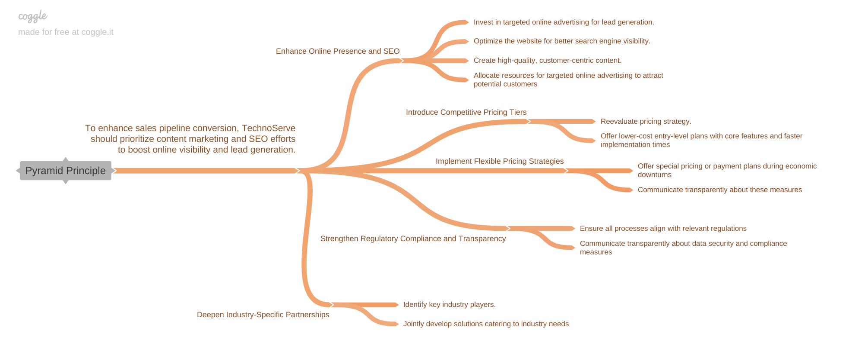
PART III B : Presenting Findings Sales Pipeline Conversion at a SaaS Startup
Notes:
You are free to use the elements and boxes mentioned previously. Make sure you’re using the pyramid principle, data visualization, visual design principle and storyboarding concepts to design these slides.

